Slide 1
Dream life collage
By Zac

Slide 2
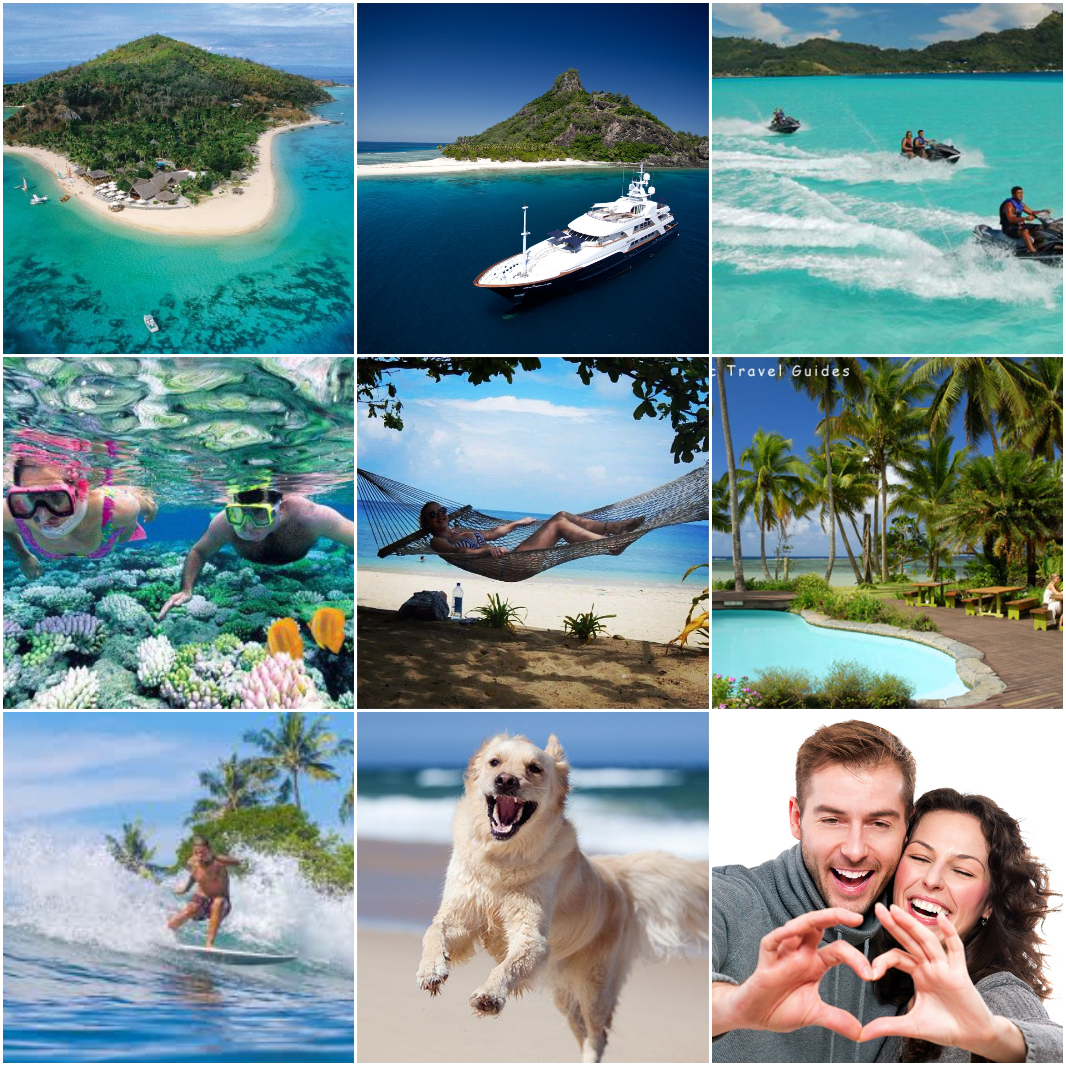
A typical day would be relaxing on the beach. Doing beach activities. Surfing, snorkeling. I will go out to nice restaurants. Long walks on the beach. Go fishing. Overall I want a luxurious lifestyle with waking up to something new to do everyday day.

Slide 3
Income/Cost of Living
Income
The annual income of my career is $75,000
Cost of living
The average cost for a wedding is $2000
Cost of a yacht and Jet skis
Yacht=$125K-$200K
Jet skis= $16,000 for 2
Surf board $100
Cost of house is $5000 per month

