Slide 1
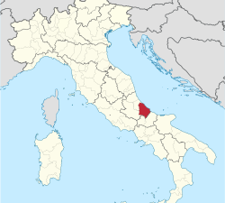
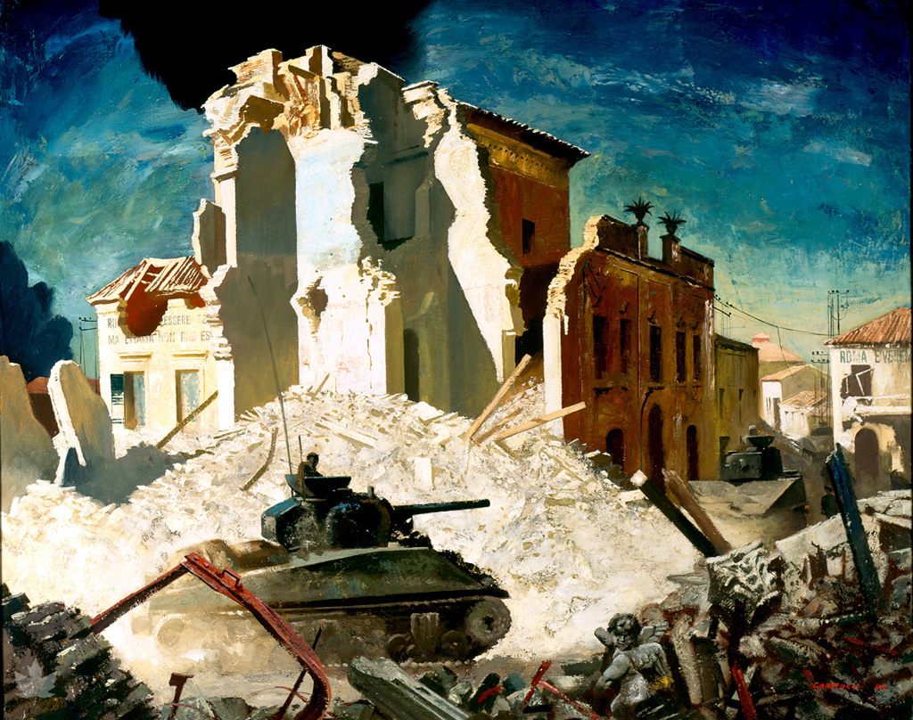
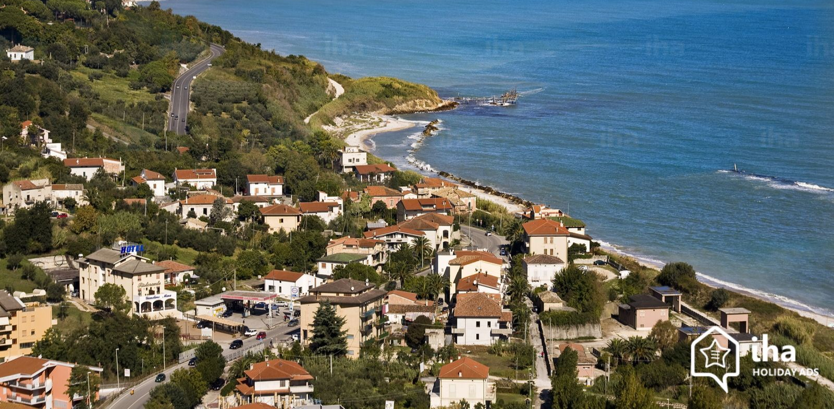
Ortona
Zach Letnes

Slide 2
Ortona
Unlike many other Italian cities and towns, Ortona has some Canadian-centric tourist attractions, that many people, not just Canadians would enjoy.
In Ortona, ci sono 23,064 persone.
Ortona si trova al est dell’Italia in la provincia Chieti.
Se potessi andare in Ortona, la prima cosa che vorrei fare sarrebe visita la Museo della Battaglia di Ortona.

Slide 3
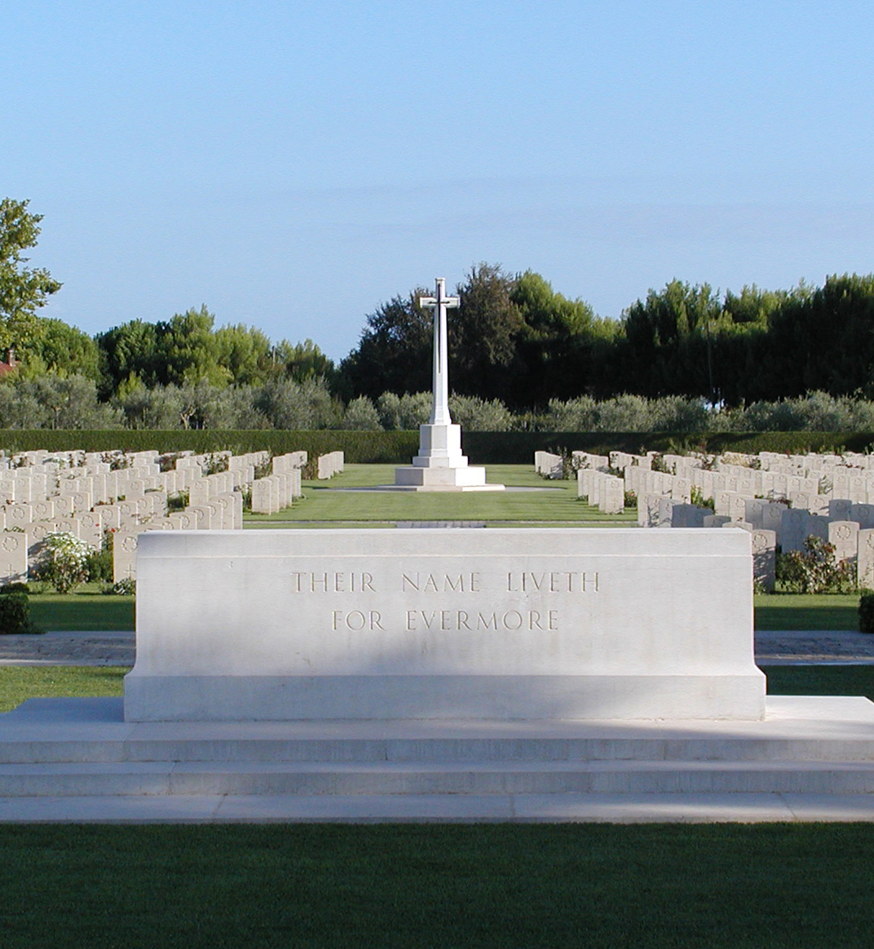
Moro River Canadian War Cemetary
This cemetery honours fallen Canadian soldiers who fought in Ortona during the Christmas of 1943. Many of these soldiers belonged to the Loyal Edmonton Regiment and Vancouver’s own Seaforth Highlanders of Canada.
This is a beautiful location that is a must-see for Canadians visiting Ortona.
Though there isn’t much to do here because it’s a war cemetery, Canadians can still come here and pay respects to fallen Canadians who fought and died there trying to remove a German Parachute Division,
This Photo by Unknown Author is licensed under CC BY-SA

Slide 4
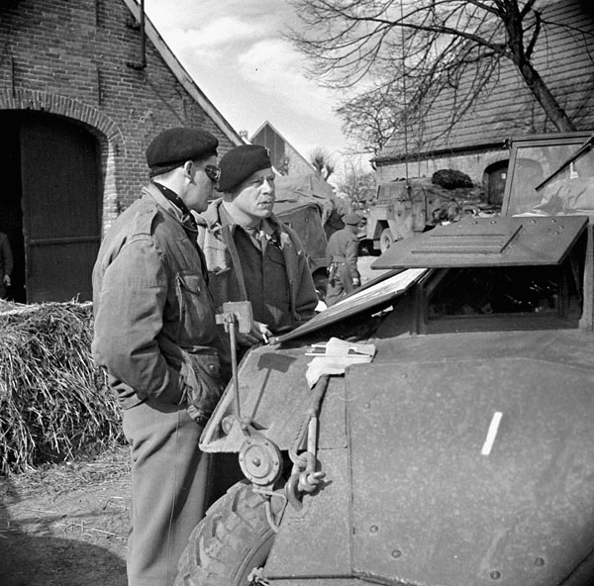
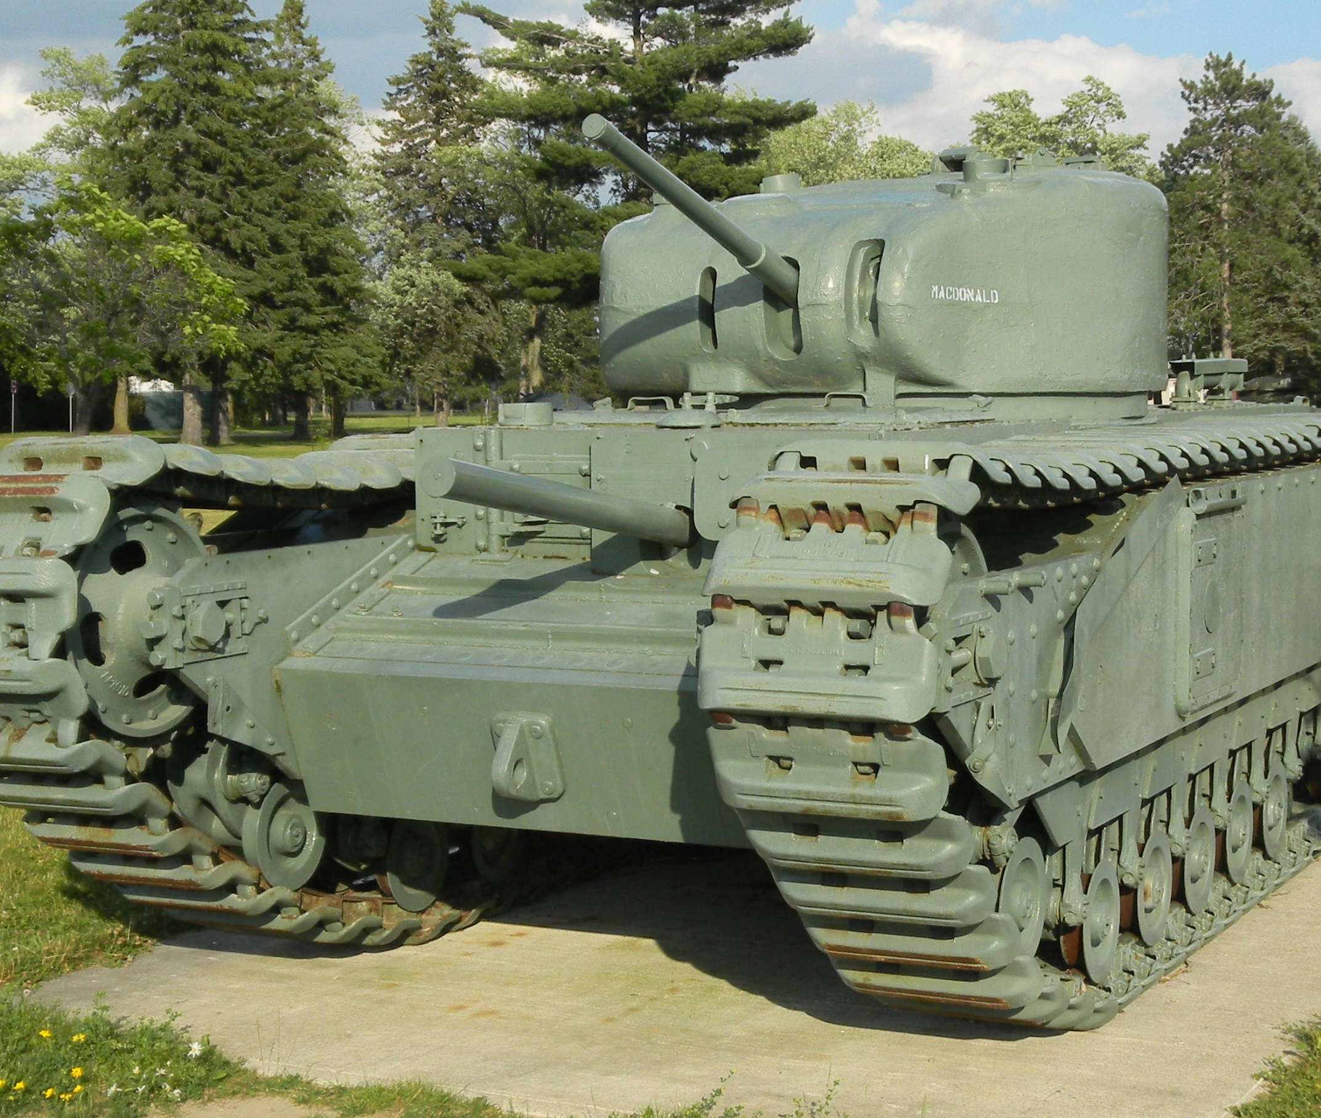
Battle of Ortona Museum
This is a war museum focusing on the Battle of Ortona, a major part in recent Italian history in the town.
Tourists can come here and learn about the war in Ortona, the strategic importance of the town, the units involved, and a military tradition that was born here.
Tourists can come and purchase souvenirs relating to the battle.

Slide 5
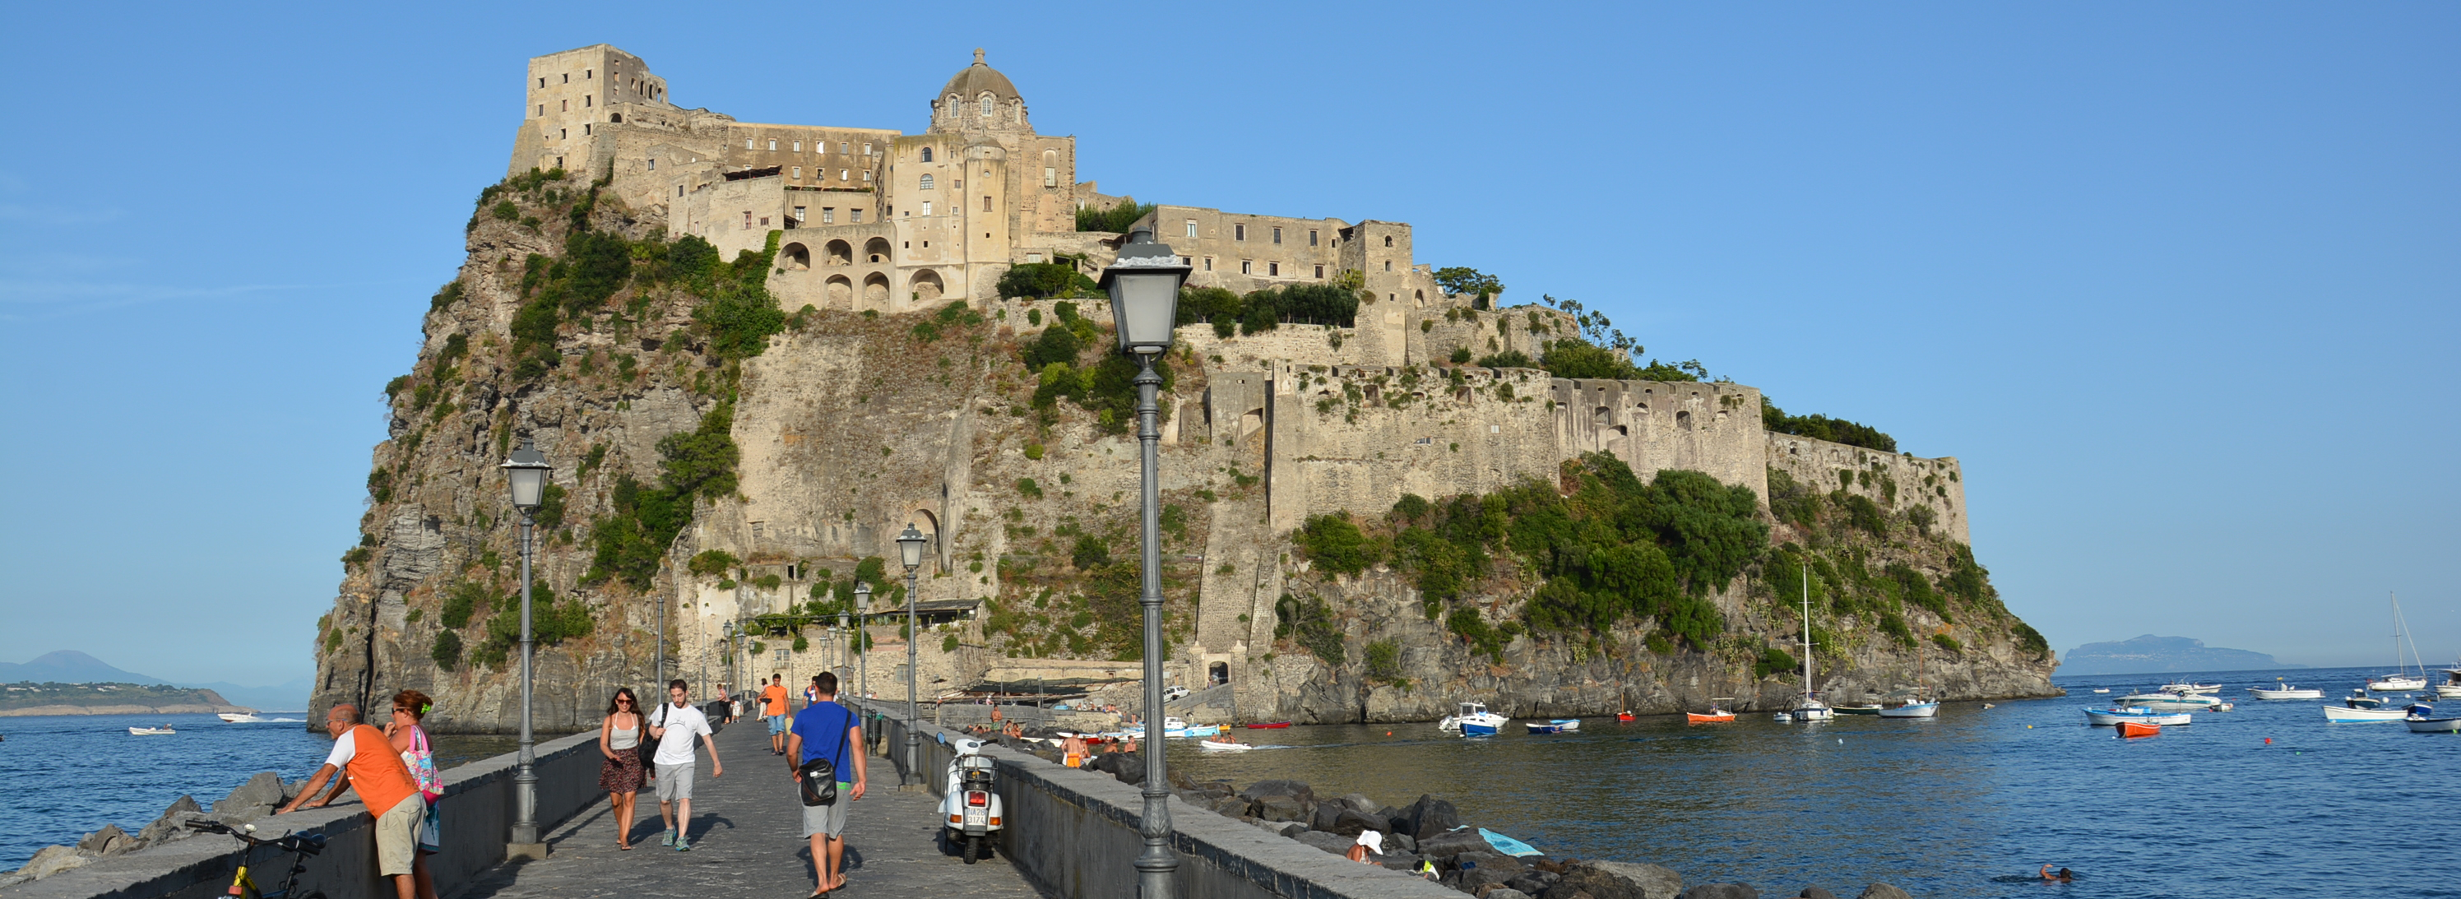
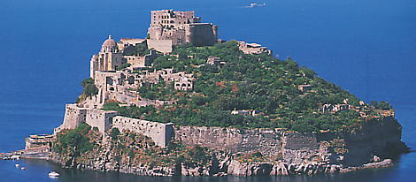
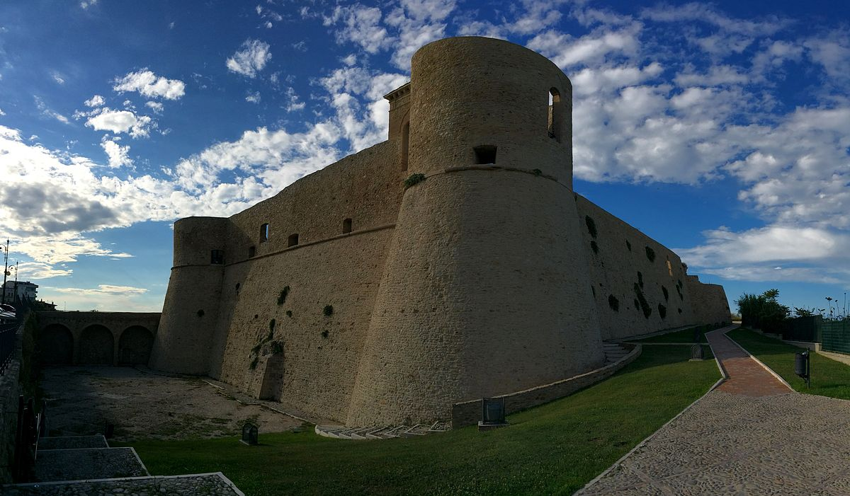
Castello Aragonese
Castello Aragonese is an ancient Italian castle built on an island just off the coast of Ortona.
It was built 474 BC by Hiero I of Syracuse to control enemy fleet movements in the water nearby.
Due to Ortona being the site of fierce combat in WWII, not many original structures remained, this is one of the few that survived the war relatively intact and is considered a must-see.
The castle also hosts a variety of different events at different times throughout the year.
After tourists have finished touring the island, the castle offers a great lookout of the coastline of Ortona.

Slide 7
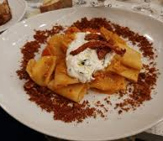
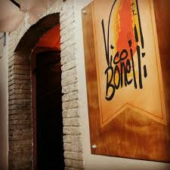
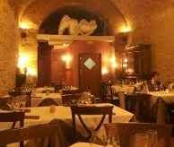
Food in Ortona
Ortona doesn’t have any foods that stand out from the rest of the country, but a very popular restaurant is Vico Bonelli, though they are quite expensive, they have excellent pasta and an impressive wine selection.
Seafood is considered to be popular here, attributed to the town’s coastal nature.

Slide 8
Sources
http://www.veterans.gc.ca/eng/remembrance/memorials/overseas/second-world-war/italy/moro
https://www.thecanadianencyclopedia.ca/en/article/battle-of-ortona
http://www.castelloaragoneseischia.com/en/homepage
https://www.seaforthhighlanders.ca/events/100
https://www.tripadvisor.ca/ShowUserReviews-g194842-d8621700-r475882709-Museo_della_Battaglia_di_Ortona-Ortona_Province_of_Chieti_Abruzzo.html

