Slide 1
Setting and story

Slide 2
Questions We will tackle
How does setting draw a reader’s attention?
How does a setting build a story?
How does the Indigenous lens assist with each?
Challenge:
How can setting go beyond being just a backdrop for a story?

Slide 3
The Revenant (2015)
How does the setting draw you in as a viewer?
How are movies different than books when it comes to setting and its presentation?

Slide 4
The Revenant (2015)

Slide 5
The Revenant (2015)
What do you notice about Revenant’s opening scene and the first chapter of Indian Horse?
Similarities?
Differences?

Slide 6
Place vs. space

Slide 7
Where do these ideas come from?
Humanistic geography
“concerned with human experience and how the world comes to mean something to those who live within specific places within it” (Simpson & Ash)

Slide 8
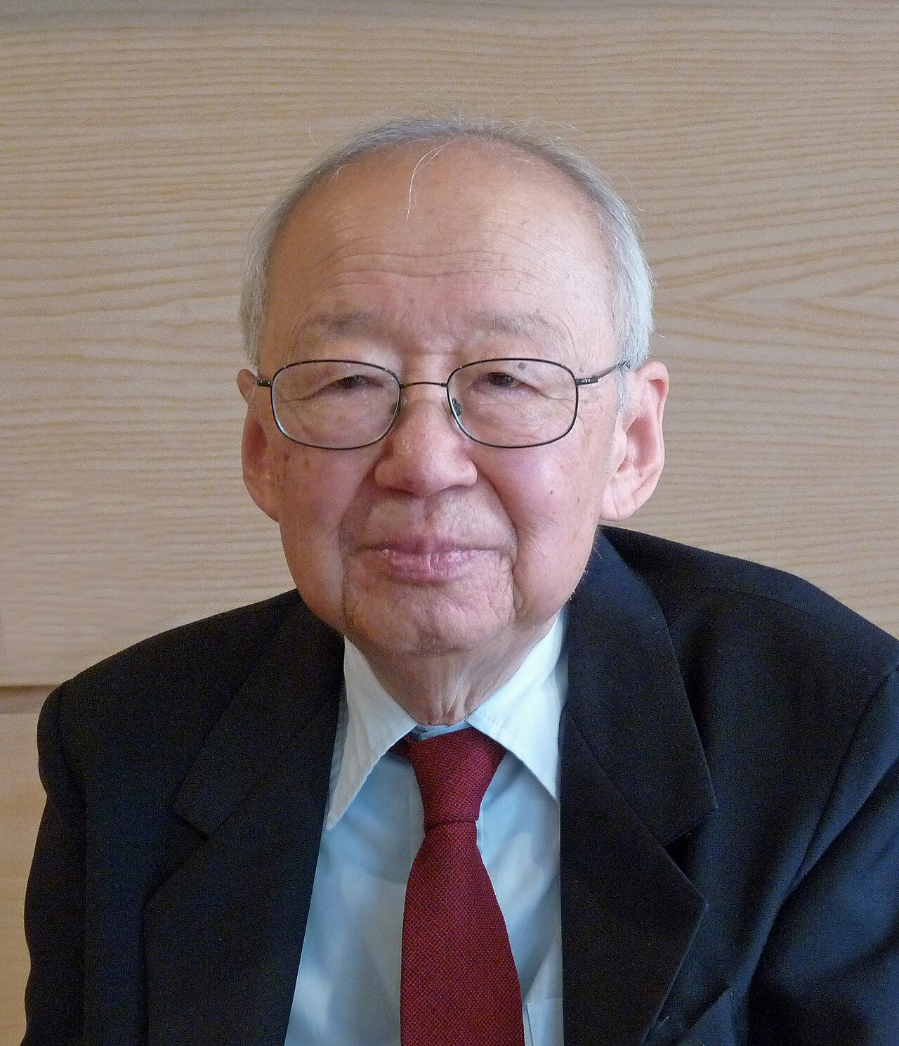
Yi-Fu Tuan
Was a geographer and a writer
Key figure in humanistic geography

Slide 9
Space
“‘Space’ can be described as a location which has no social connections for a human being. No value has been added to this space. According to Tuan (1977, p.164-165) it is an open space…It does not invite or encourage people to fill the space by being creative. No meaning has been described to it. It is more or less abstract” (Tuan, 1977, p. 6).

Slide 10
Place
“‘Place’ is in contrary more than just a location and can be described as a location created by human experiences. The size of this location does not matter and is unlimited. It can be a city, neighborhood, a region or even a classroom et cetera. In fact ‘place’ exists of ‘space’ that is filled with meanings and objectives by human experiences in this particular space. Places are centers where people can satisfy their biological needs such as food [and] water (Tuan, 1977, p. 4)."

Slide 11
Our main questions!!!
How does setting draw a reader’s attention?
How does a setting build a story?
How does the Indigenous lens assist with each?
Challenge:
How can setting go beyond being just a backdrop for a story?

Slide 12
The Marrow thieves (first 4 pages)
Treehouse used as a hideout
The weather (damp spring) prevents the characters from constantly moving around
The setting (rain) causes them to stay in the treehouse
Climbing the trees to evade the truancy officers (Recruiters)
Interacting with the trees to get away
A branch being used in a simile: “I heard a bone snap like a young branch” (Dimaline 4)

Slide 13
Son of a trickster
Never letting him come closer than an arm’s length of her
The house is small—emphasizing proximity but the grandmother still wants to maintain distance
You still smell like lightning
Indigenous mysticism
Will weather play a role?
“His Grandma was a shrinking figure in the side mirror”
Side mirror? Objects are closer than they appear
Will she be closer than they think?
Driving inside the ferry was like being swallowed by a whale
The ferry (unnatural) and the whale (natural)
Both exists in the same setting/location

Slide 14
Firekeeper’s Daughter
“All journeys begin in the Eastern Direction”
Setting her offering on the eastern base of the tree
Talking about the zone (when running): her mind wanders elsewhere as her legs and arms enter autopilot
Can the zone be a setting? Her body is in one place but her mind is in another
The dorm is named after her maternal grandfather (place)
The wind propels her forward
The New Normal?

Slide 15
Group discussion Time!
Group 1 – Josh, Jaime G., Xander S., David, Madison
Group 2 – Hashraj, Amaris, James, Arman, Audrey
Group 3 – Ava, Miranda, Mehrun, Olivia
Group 4 – Xander C., Shyla, Emily, Nele, Evan
Group 5 – Ronica, Mattias, Snyra, Cooper, Jamie O.
Make connections between your books!

Slide 16
Group discussion
How does setting draw a reader’s attention?
How does a setting build a story?
How does the Indigenous lens assist with each?
Challenge:
How can setting go beyond being just a backdrop for a story?
Also discuss the questions you looked at yesterday in your lit circles

Slide 17
Exit slip
Pick one of the questions you discussed and respond to it on an exit slip
Hand it to me before you leave!!!

