Slide 1
Oral Traditions and Modern Storytelling with the First People of Canada
From Traditional to Contemporary

Slide 2
“Through my language I understand- I am being spoken to, I’m not the one speaking. The words are coming from any tongues and mouths of Okanagan people and the land around them. I am a listener to the language’s stories, and when my words form, I am merely retelling the same stories in different patterns.” Jeannette Armstrong, pg. 208.
Both educator and protector, Jeannette Armstrong is a professor of Indigenous Studies and a Canada Research Chair in Indigenous Philosophy

Slide 3
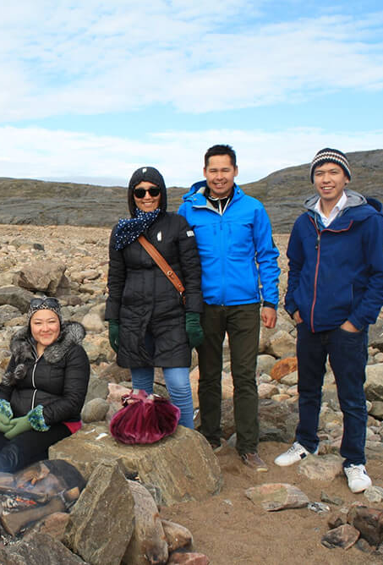
First Nations, Inuit, and Metis cultures have long passed on knowledge from generation to generation through oral traditions, including storytelling. Storytelling is a traditional method used to teach about cultural beliefs, values, customs, rituals, history, practices, relationships, and ways of life. First Nations storytelling is a foundation for holistic learning, relationship building, and experiential learning.

Slide 4
Stories
☉ Stories can vary from the sacred to the historical. ☉ Some focus on social, political, and cultural ways. ☉ Some are entertaining, even humorous. ☉ Some tell of personal, family, community or an entire nation’s experiences.

Slide 5
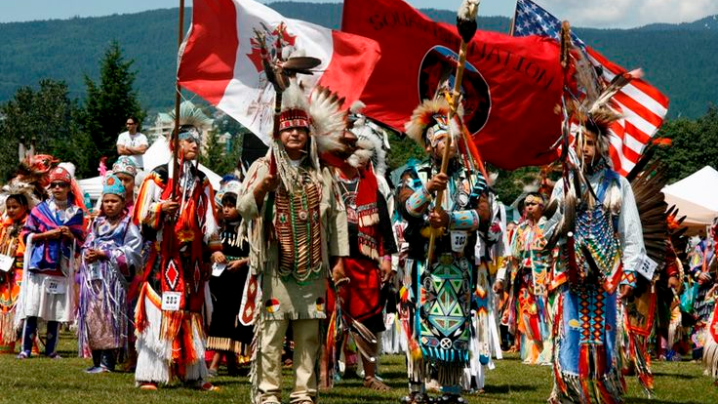
Some are “owned” by certain clans or families and can only be told by a member of that group. ☉ Others can be told by anyone who knows them and cares for them. ☉ Stories reflect the perceptions, relationships, beliefs and attitudes of a particular people.

Slide 6
Expand your concept of “story”
Move away from concept of story as fiction
Move away from the concept that a written story is inherently superior to or more valid than an oral one

Slide 7
Oral Traditions Are:
A cultures collection of spoken words passed down for generations
Poems, prayers, speeches, spirited teachings, songs, stories, and histories
Practical skills
Housebuilding skills
Hunting
Collection and prep of medicinal plants
Fishing spots, migratory routes

Slide 8
Cultural Transmission
When a society’s culture is passed on to individuals who adopt the values and perspectives of the culture as their own
Repetition was a key element of the oral tradition, the stories would be repeated by different individuals and at different times so they would become a part of one’s identity and integral to everyday life
Storytelling would bind families together and connect young and old

Slide 9
First People’s Stories can be unique because of
Role of the narrator
Recursive, circular structures
Symbols and motifs
The importance of humour

Slide 10
Traditional Stories

Slide 11
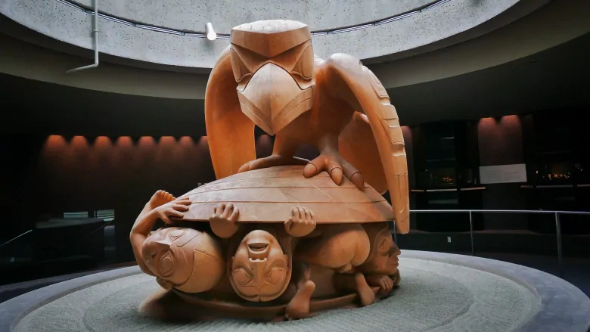
Creation Story- The Raven and the First Men
Haida Creation Story

Slide 12
Beau Dick: The Raven and the Rock

Slide 13
The Hummingbird and the Great Fire- Haida
the Hummingbird and the Great Fire- Haida

Slide 14
What are some common elements in these stories?

Slide 15
How are these stories unique in terms of voice, narrative structure, subject matter, symbolism, use of language?

Slide 16
Contemporary Stories

Slide 17
Contemporary Story Telling
Storytelling and First Nation’s culture is not frozen in time…
http://momus.ca/first-nations-art-and-the-matter-of-its-politics/

Slide 18
Tribe Called Red
Stadium PowWow
What stereotypes are confirmed OR denied based on this video?
What is the setting(s) of this video?

Slide 19
“I am graffiti”
By Leanne Simpson
Poetry in Voice

Slide 20
Nobody Knows by iskwe

Slide 21
Beat Nation: Hip Hop Indigeous Culture

