Slide 1
PhotoVoice
Photography can be a powerful tool for social justice and advocacy

Slide 2
Look at the Following Photographs
What do you see here? What is really happening here?
What is the photographers intent?
As the viewer, how can this image be perceived?
How is the composition relevant to the message?
Whose perspective is this? How can it be manipulated by the media to suit someone’s political agenda or special interest? What can we do to improve this situation, or to enhance these strengths?

Slide 3
What do you see here? What is really happening here?
What is the photographers intent?
As the viewer, how can this image be perceived?
How is the composition relevant to the message?
Whose perspective is this? How can it be manipulated by the media to suit someone’s political agenda or special interest? What can we do to improve this situation, or to enhance these strengths?

Slide 4
What do you see here? What is really happening here?
What is the photographers intent?
As the viewer, how can this image be perceived?
How is the composition relevant to the message?
Whose perspective is this? How can it be manipulated by the media to suit someone’s political agenda or special interest? What can we do to improve this situation, or to enhance these strengths?

Slide 5
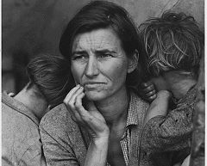
What do you see here? What is really happening here?
What is the photographers intent?
As the viewer, how can this image be perceived?
How is the composition relevant to the message?
Whose perspective is this? How can it be manipulated by the media to suit someone’s political agenda or special interest? What can we do to improve this situation, or to enhance these strengths?

Slide 6
Your turn
You will take 1-3 photos of something that concerns you about your community. It can be anything such as….
-traffic, pollution, environmental degradation
-poverty, homelessness, the cost of living
-child care spaces, educational concerns
-our economy, the closures of small businesses
-cost of housing

Slide 7
On Monday, you will be grouped with the other class to discuss your photograph.
Be ready to answer questions regarding your thinking of the content of the photo as well as the image itself

Slide 8
Composition as an aesthetic
Which image do you like best and why?

Slide 9
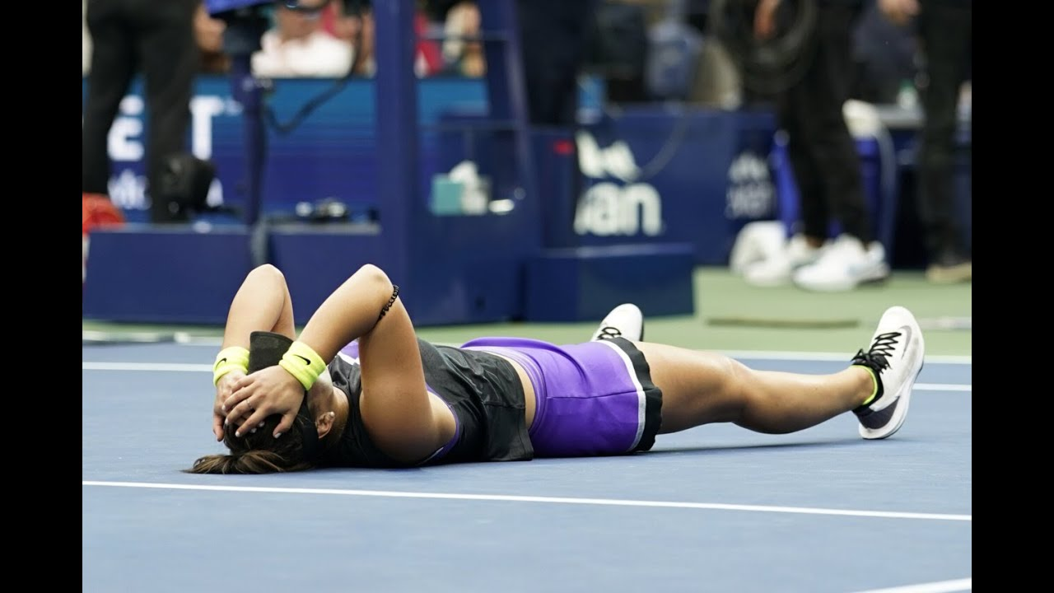

Slide 11
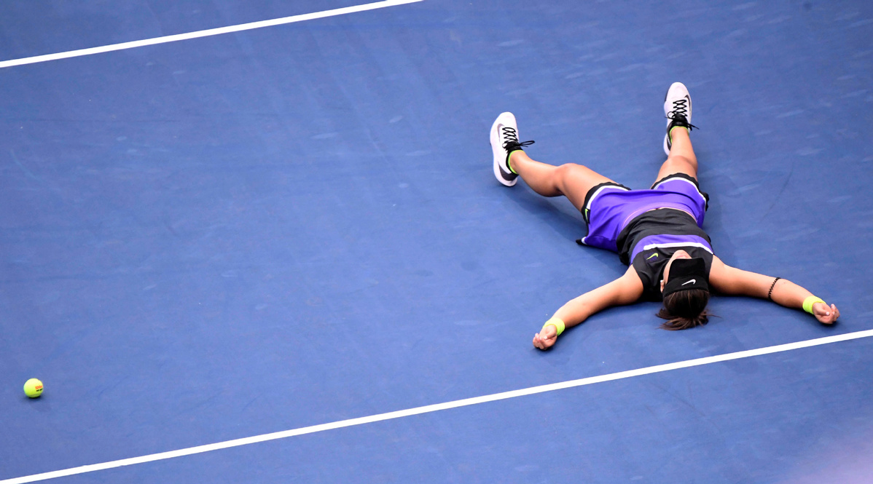

Slide 12
Composition
How can the composition define or manipulate the message?

Slide 13
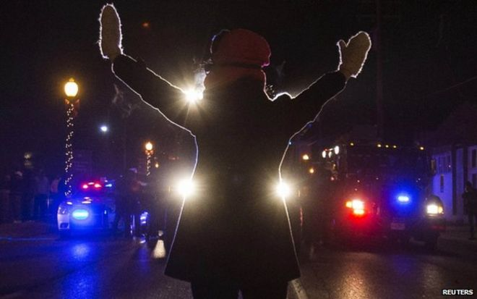

Slide 14
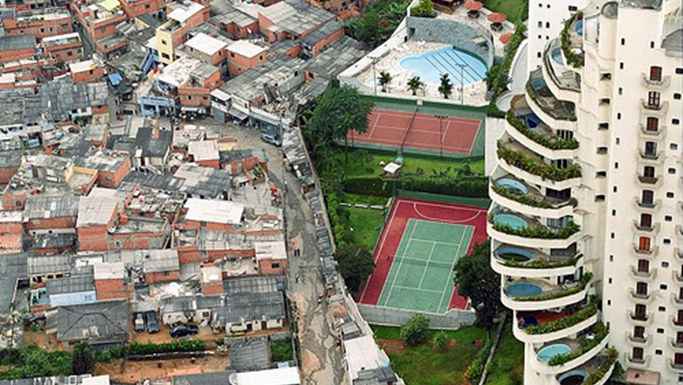

Slide 15
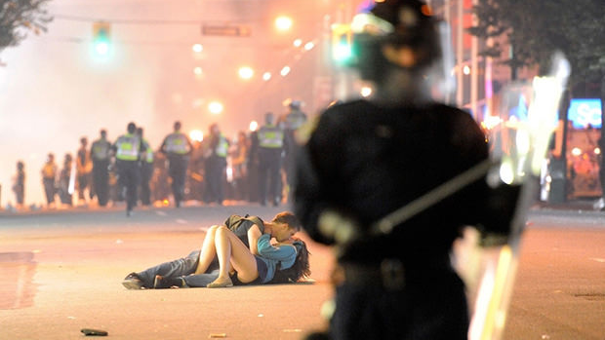

Slide 16
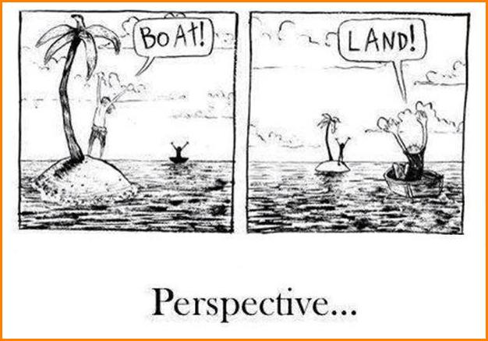

Slide 17
Perspective: Everyone has a different perspective of an image based on….
-

Slide 18
Be careful when analyzing the purpose or intent or meaning of an image

Slide 19
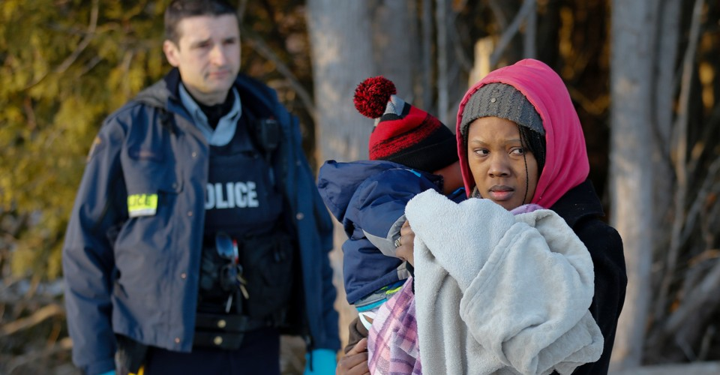

Slide 20
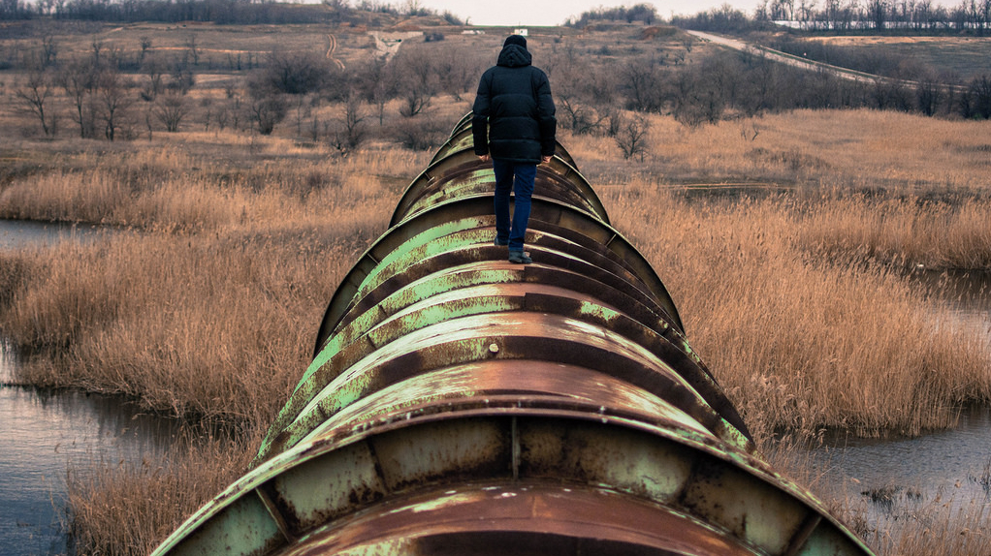

Slide 21
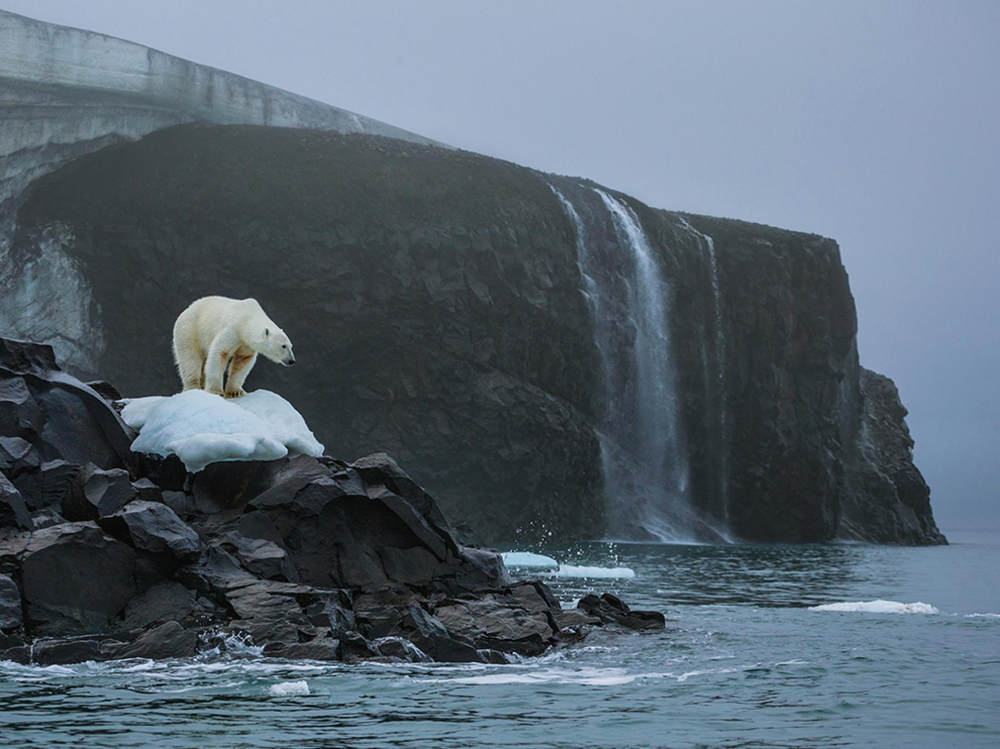

Slide 22
Viewer/photographer discussion
1. Show the group your image- photographer- do not talk about it!!!
2. The other people in your group tell you what they “see”. Viewer: What is the photographers purpose? What is the issue they are portraying? What is their stance on this issue based on the photo?
3. Photographer- what was your intent? Your purpose? What was your thinking in composing this photo?

Slide 23
How can media manipulate opinion?

Slide 24
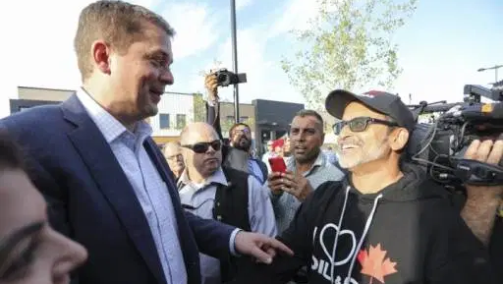

Slide 25
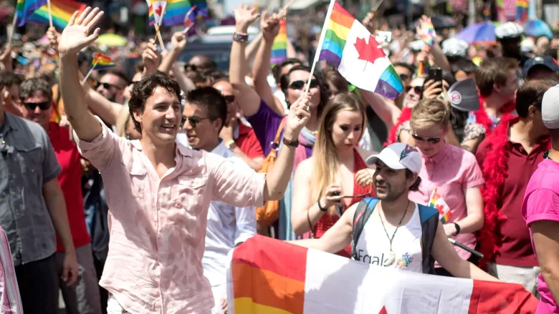

Slide 26
To Do
Post your image to your blog
In two paragraphs,, answer the following questions:
P#1 -The issue you are addressing
How this image is your “photovoice”
Your thinking behind the composition
How others may perceive your image
What we (society) can do to improve this issue or strengthen our lives
P #2-How the media could manipulate your image
What you can do as a viewer to be critical of images
TAG: PhotovoiceA or PhotovoiceB

Slide 27
To Do after you are done your paragraph:
In your group, find an image about an issue in Canada that can be perceived in numerous ways. Discuss how the media/and or a political party can manipulate this image to fit their agenda.

