Slide 1
Emailing your teacher 101

Slide 2
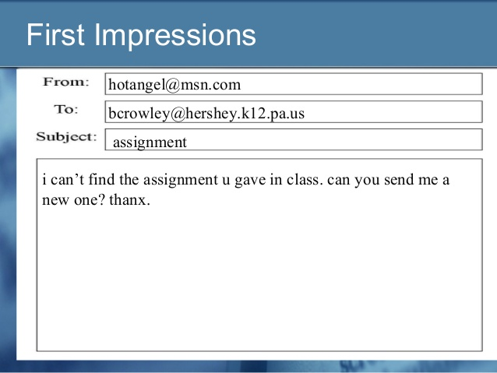

Slide 3
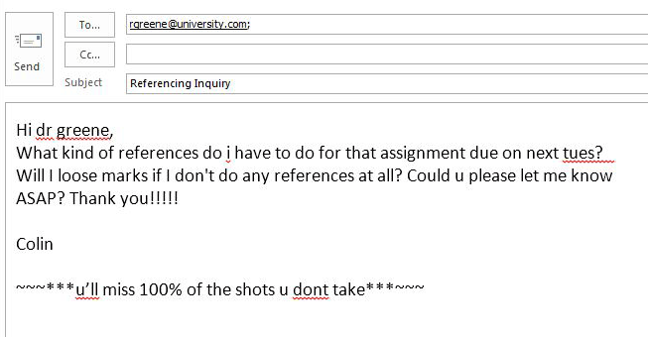

Slide 4
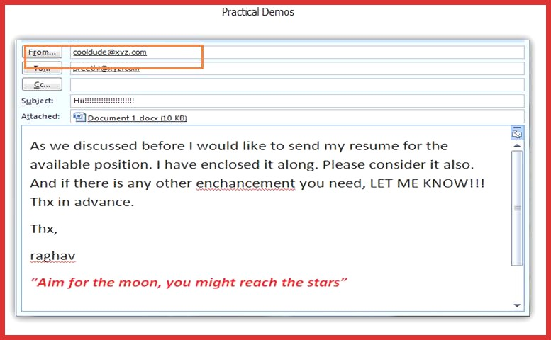

Slide 5
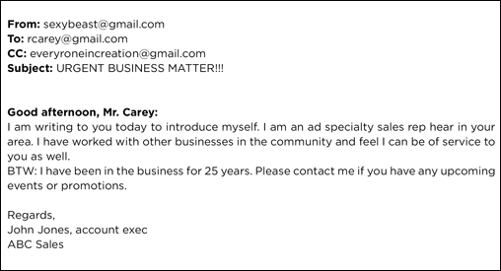
What is wrong with this email?

Slide 6
Audience- teacher. Therefore, you need to be professional.
Subject line: Name, Block, Subject (or assignment)
Eg. Jane Harris, BkC, About Me
Eg. John Doe, BkA, Extension for About Me
(note: if your email address is not English or does not contain your proper name, please be SURE to put your name in the subject line)
Salutation: Dear Mrs. Thomasen

Slide 7
Now send me an Email……
STHOMASEN@SD43.BC.CA

Slide 8
Keep the email short and to the point
  Eg. May I have an extension on the project? OR Here is my narrative essay. I hope you enjoy it.
No text speak:
  Eg. LOL, Mrs. T, whatcha gonna do 2morrow in class????
Proofread for spelling and punctuation. I am not expecting perfection but pay attention best you can.
End it politely:
  Eg. Thank you for considering my request, Mrs. Thomasen. Sincerely, Jane Harris

