Slide 1
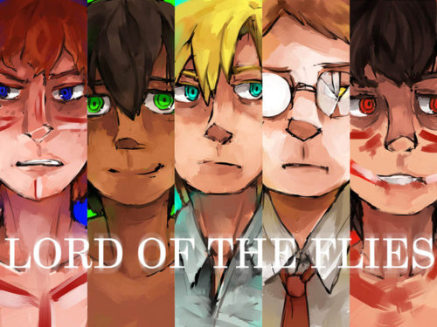
Literary Terms in Lord of the Flies
Allegory
Symbolism
Characterization

Slide 2
Allegory
Masque of the Red Death and Lord of the Flies may be seen as an ALLEGORY : A story or poem or picture that can be interpreted to reveal a hidden meaning, typically a moral or political one.
A story in which combinations of characters, objects, and actions represent ideas or qualities. A complex allegory like in Lord of the Flies contains a variety of symbols which have several levels of meaning.
Notes:
A story, poem or picture that can be interpreted to reveal a hidden meaning, typically a moral or political one

Slide 3
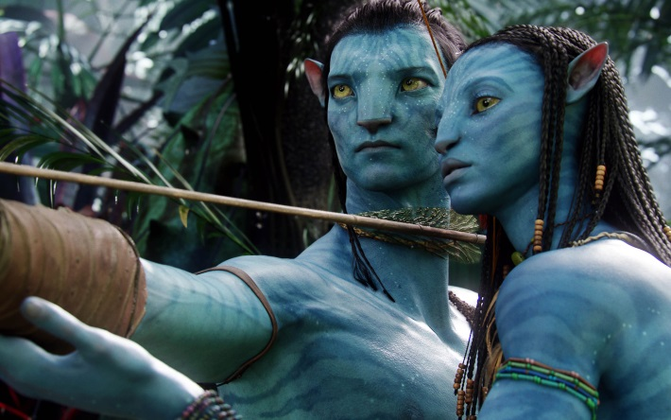
Avatar
The attack on the Na'vi people in Avatar makes a perfect allegory to the real history of the oppression on Native Americans or colonial Africans or the Indochinese or the entirety of the World at the hands of the English , Spanish, and Portuguese, in the name of the resources.

Slide 4
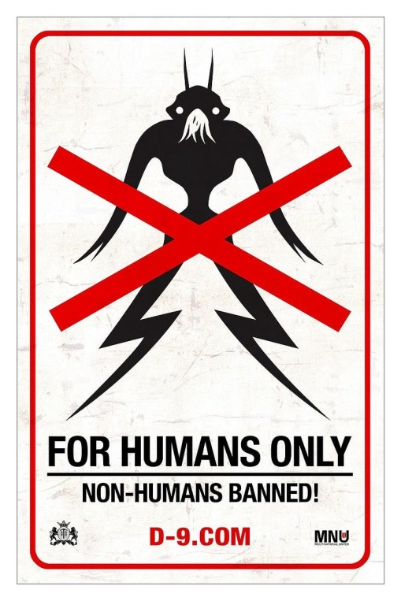
District 9
An allegory to apartheid in South Africa where the minority was repressed by the dominant government

Slide 5
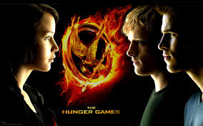
Hunger Games
A political allegory- the multitudes are brutally oppressed to support a grossly indulgent few, where the life and death horror of (ritualised) war is treated like a spectator sport, where the ruling class is distracted by the superficialities of celebrity culture, media sensationalism, fashion and food. This is the Western “civilization”.

Slide 6
Fables are allegories using animals
The Tortoise and the Hare
This classic fable from Aesop tells the story of a plucky hare who acts the bully and teases Tortoise for being so slow. Tortoise challenges Hare to a race and, because of Hare's overconfidence and laziness, wins. While this story can be enjoyed as just a fun story where a turtle beats a rabbit in a footrace, it is obviously meant, like all other fables from Aesop, to teach a lesson, and therefore this story is considered an allegory. The hidden meaning, or moral, here is that some people are born with natural talents but waste them to idleness or laziness. The tortoise's character is meant to show how despite natural talents, perseverance, hard work, and focus can win the day. Adults read this fable and see both the tortoise and hare as people they know in real life or have heard about. The race, read allegorically, is actually life itself. See the story for yourself below and try to read it allegorically.

Slide 7
Symbolism in Tortoise and Hare
What are the symbols in this fable?
They are used to reinforce meaning and the message.

Slide 8
Yertle the Turtle

Slide 9
Allegory –Garden of Eden
In the Biblical Garden Of Eden Story, God creates man from the dust of the earth, gives him a soul, by breathing life into him, and places him in a beautiful garden, made especially for him. In the garden are all sorts of trees with fruit that provides food for the man. God understands that the man should not be alone, and sets out to provide a companion for him. Out of the dust God creates animals, birds, and all living creatures, but none is found to be a suitable partner for the man. God then causes the man to fall into a deep sleep, takes one of his ribs and from it creates a woman. Adam and Eve, as the man and woman are called, are not ashamed, though naked, and appear to have no physical attraction for each other. Source: http://www.shvoong.com/books/254221-garden-eden-story/#ixzz2tKPC9jxt
Notes:
(the lush background of an untouched paradise. ).
(the Ralph vs. Jack conflict becomes a confrontation between parliamentarian democracy and totalitarian dictatorship. Remember, Golding fought in WW II. )

Slide 10
Among the trees of the garden, is one known as the tree of the knowledge of good and evil, and Adam and Eve are told not to eat of its fruit or they will die. The Serpent, however, convinces Eve that they will not die, but simply become as Gods. Eve eats of the fruit and gives of it to Adam, who does the same. Sudden they realize that they are naked and sew fig leaves together to cover themselves. They also try to hide from God, who when he discovers their disobedience, and newly attained knowledge expels them from the Garden Of Eden, and condemns them to a life of physical labor, pain, sorrow and finally death itself, when they will return to the dust from whence they came. The Garden Of Eden Story places Adam and Eve in a state of innocence, from which they apparently must escape, before they can grow in wisdom and knowledge, and begin the procreation of the human race.
Source: http://www.shvoong.com/books/254221-garden-eden-story/#ixzz2tKPC9jxt

Slide 11
It can also be considered a microcosm of adult society including government, social organization, leadership struggles, war and conflict
In order to understand the total allegory, its symbols must be understood.

Slide 12
Symbolism
Symbolism is a technique in which a person, place thing or idea represents not only itself, but also a deeper meaning more complex reality beyond itself.
Types of symbols (insert examples)
Universal symbols – numbers, dove= peace, white flag is surrender
Cultural symbols –shared by people of same ethnic background or faith – cross- Christianity, Buddha, ohm,

Slide 13
National symbols- understood by a particular society regardless of cultural group- beaver, moose, geese, syrup, poutine
Contextual symbols- meaning only applies to the context of the particular work- mockingbird
Notes:
Because Mockingbird is referred to in the title and throughout the book, it takes on a symbolic meaning.

Slide 14
Symbolism
You may ask “how do I know if it is symbol?”
If something is repeated enough times OR enhances the meaning, you can guess that it may be a symbol.
Sometimes it is obvious (a dove flies through the air, probably symbolizing peace is approaching)
Sometimes it takes a greater understanding of the theme to recognize the symbols (the rabid dog symbolized racism in “To Kill a Mockingbird”. Not a usual symbol. )

Slide 15
Objects as Symbols
The conch
Lord of the Flies
Huts
Fire
Piggy’s glasses
Face paint

Slide 16
Characters as Symbols
Ralph
Jack
Piggy
Simon
The dead parachutist
Fill in the worksheet as you read the novel.

Slide 17
Character- “the foundation of good fiction is character-creating and nothing else”
Plot and character are inseparable since an author uses character to advance the action of the story and they use plot to show the development of the character.
Character is the essence of the story and even the most simple escapist fiction makes some use of character development

Slide 18
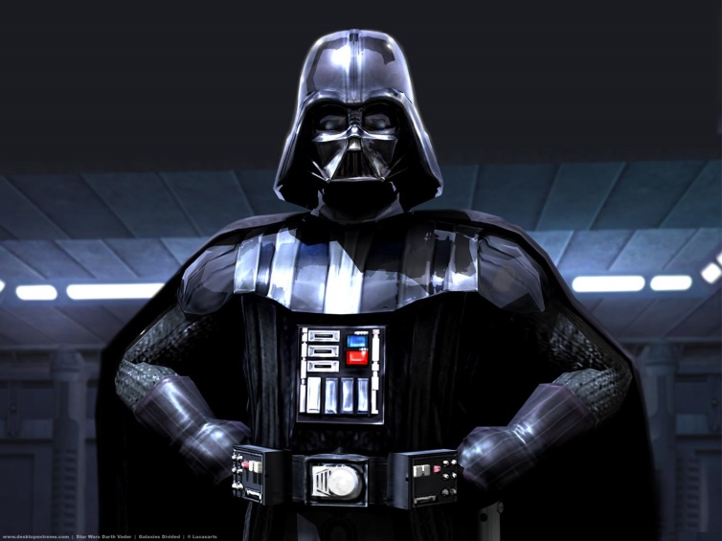
Characterization
A character in a story is someone or something whose actions, choices, thoughts , ideas, words and influence are important in developing the plot. Characters are often people but they can be non-living things. A force, such as good or evil, can operate as a character in a story.
Notes:
Actions, choices, thoughts, ideas, words and influence- non-living

Slide 19
Protagonist- main character(s)
Antagonist- opposes the protagonist
Characterization is the name for the techniques a writer uses to reveal the personality of characters to the reader.
Characterization is achieved in a number of ways:
Notes:
Who are the protagonists and antagonists?

Slide 20
Direct Presentation (of the character)
words and comments by the narrator, dialogue with others about the character, as well as the character’s own words. (Goldings
Thoughts- what is going on in the character’s head
Appearance- what they look like (compare Jack and Ralph’s colourings)
Notes:
Words, thoughts, appearance, actions, interactions, change/development

Slide 21
Indirect Presentation
Actions-what the character does
Interactions- how the character relates to others (How does Ralph treat Piggy? Compare him to Jack) (How does Miss Maudie treat Jem and Scout?)
Change and development- the occurrence of and direction of internal change or development a character undergoes

Slide 22
To be truly convincing a character must be consistent and clearly motivated and plausible.
Consistent- can’t behave one way on one occasion and then change in another (Darth Vader is not good one scene and then nice the next)
Motivated- so the reader can understand why the character acts like the do (why murder someone? Need a motive)
Plausible- character should be believable . They can’t be all good or all bad and even if you can’t connect to this character, you can at least be convinced the character can exist.

Slide 23
Discuss with your group:
Jack repeatedly strikes his knife into a tree trunk. What technique is Golding using to characterize Jack? What other techniques are used to build on Jack’s character? Give examples.
How would you describe Simon? What techniques does Golding use to build his character?

Slide 24
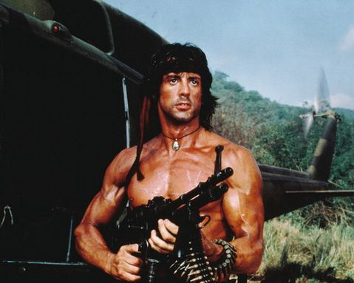
Flat character- one or two traits only
Round character- complex and many sided
Static- same person at the end of the story as the beginning- no development
Dynamic- undergoes a permanent change in condition or a minor change in opinion

