Slide 1
The Bullet
Sophia Wong
Found Poem from The Sniper

Slide 2
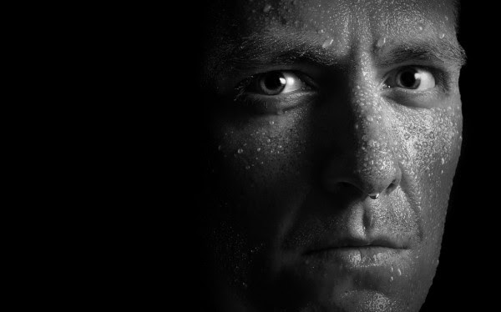
The sweat stood out in beads on his forehead,
A paroxysm of pain swept through him

Slide 3
Everywhere around was
quiet

Slide 4
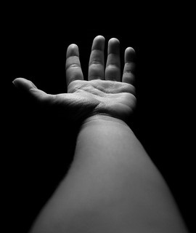
His right arm was paining him like a thousand devils, The blood was oozing through the sleeve of his coat

Slide 5
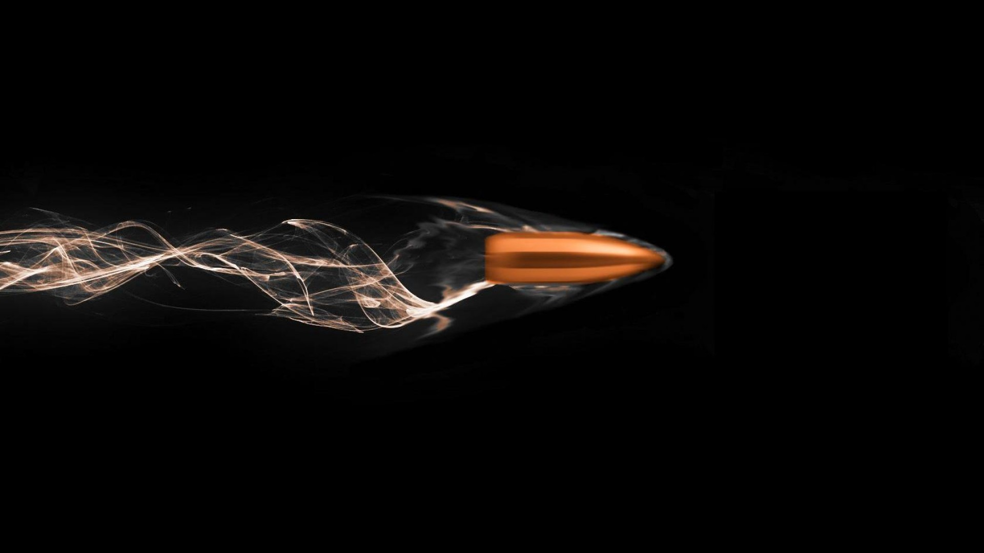
The bullet had lodged in the bone

Slide 6
He struggled to keep his feet

Slide 7
Closing his eyes, He made an effort to overcome the pain

Slide 8
But he was slowly falling over as if in a dream

