Slide 1
Cloud Project
Shelby Carpenter

Slide 2
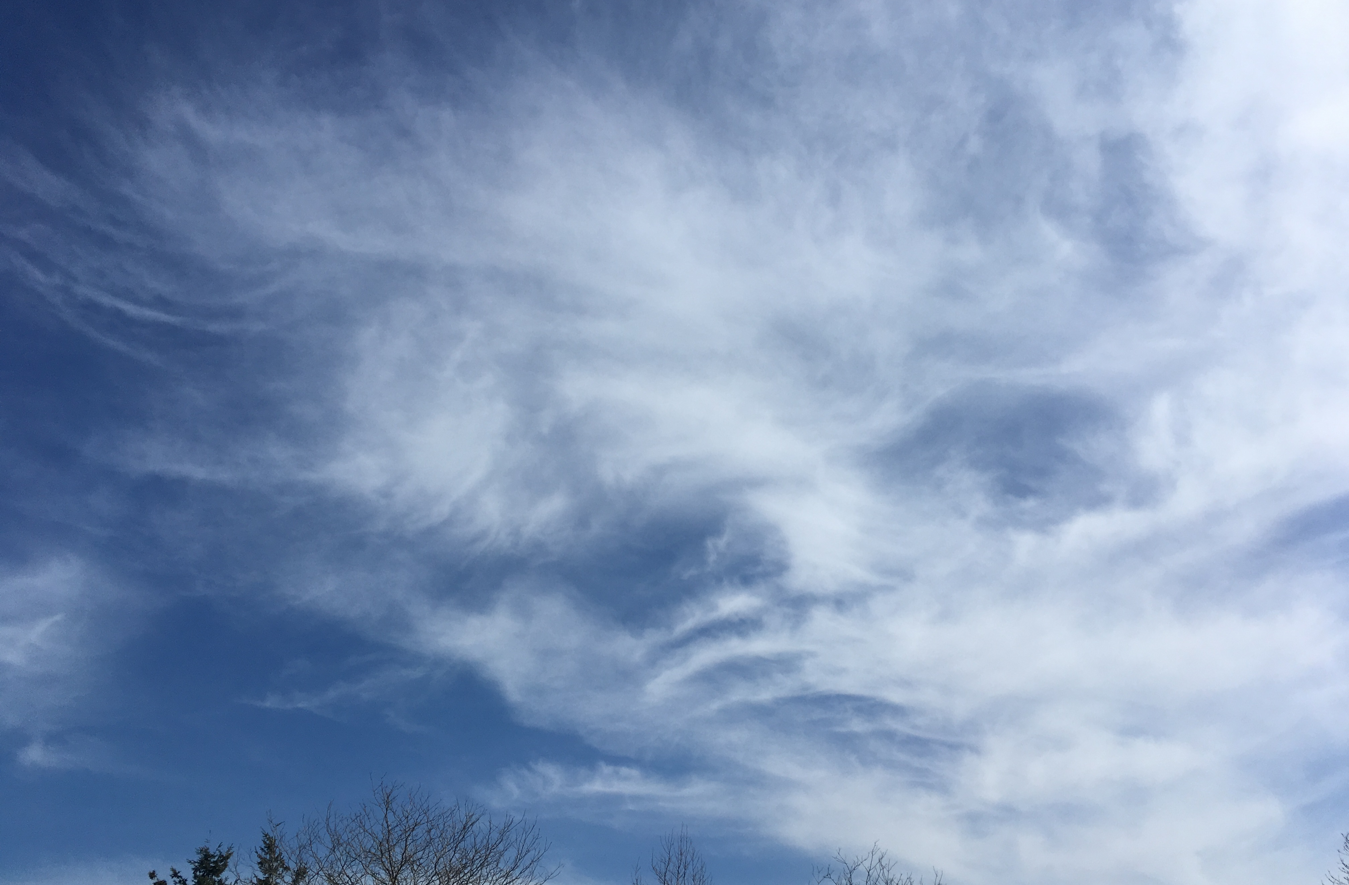
Cirrus
These clouds are Cirrus clouds because they are thin and feathery, and have all the traits a cirrus cloud would have. I think this is a great example to show what a cirrus cloud looks like. This photo was taken on March 21st at 1:24 pm at settlers park.

Slide 3
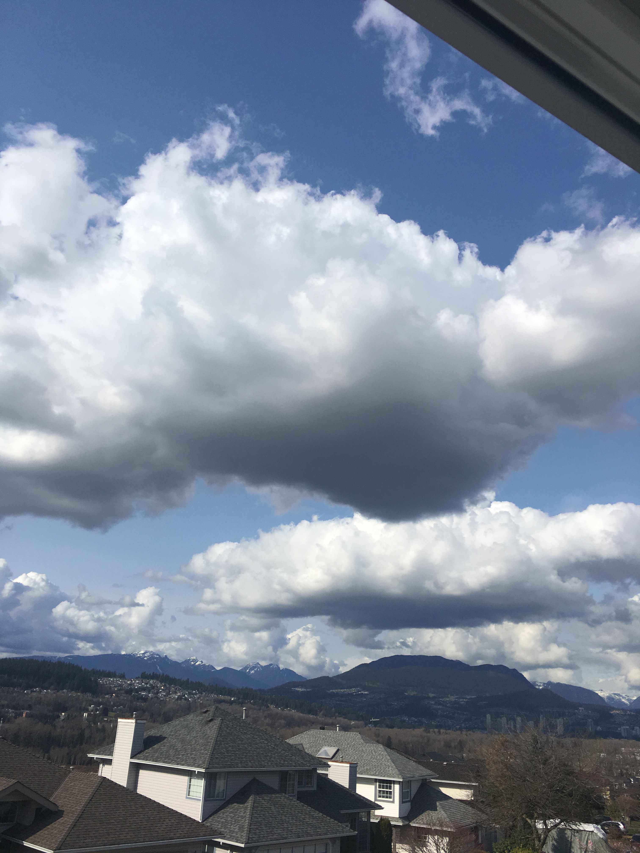
Cumulus
These are a great example of cumulus clouds because of their flat bottoms and fluffy white tops. This photo was taken on March 23rd at 3:33 pm looking out from my bedroom window.

Slide 4
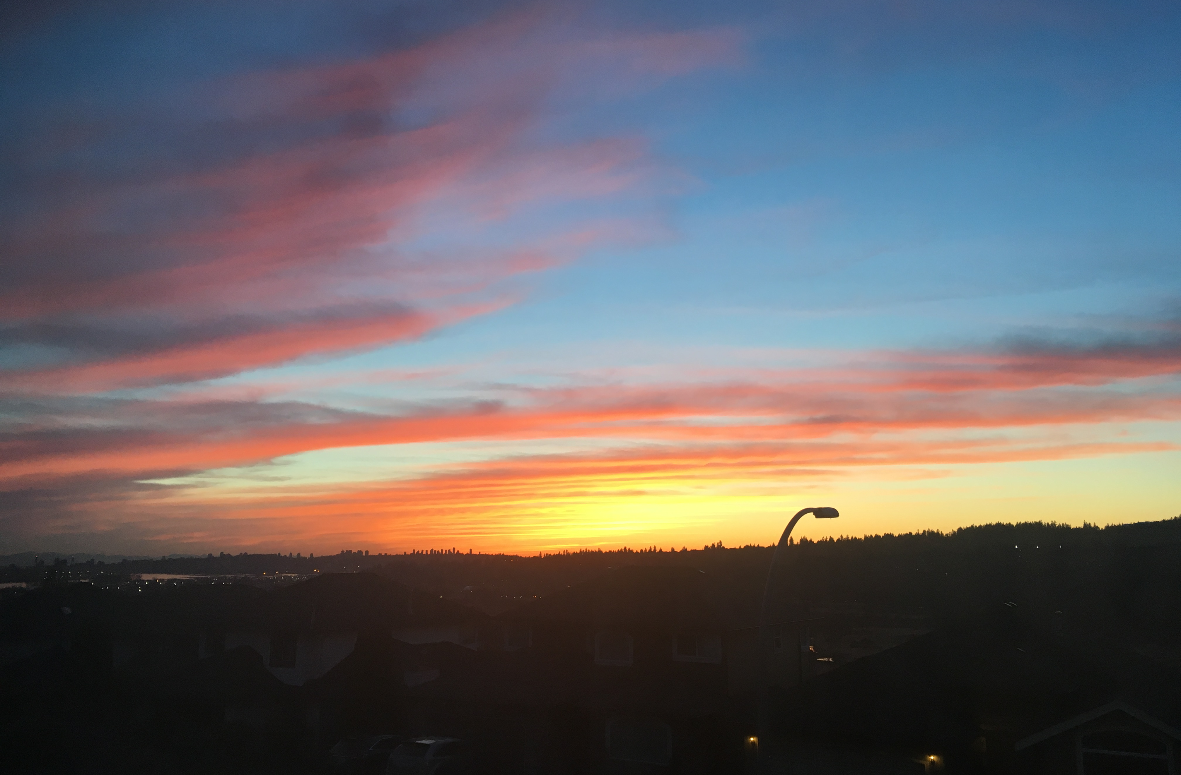
Cirrus/Stratus
These clouds are a good mix of cirrus and stratus clouds because while they are thin and wispy, they still cover a large amount of the sky in a blanket like form. This was taken on March 27th at 7:46 pm from my front deck.

Slide 5
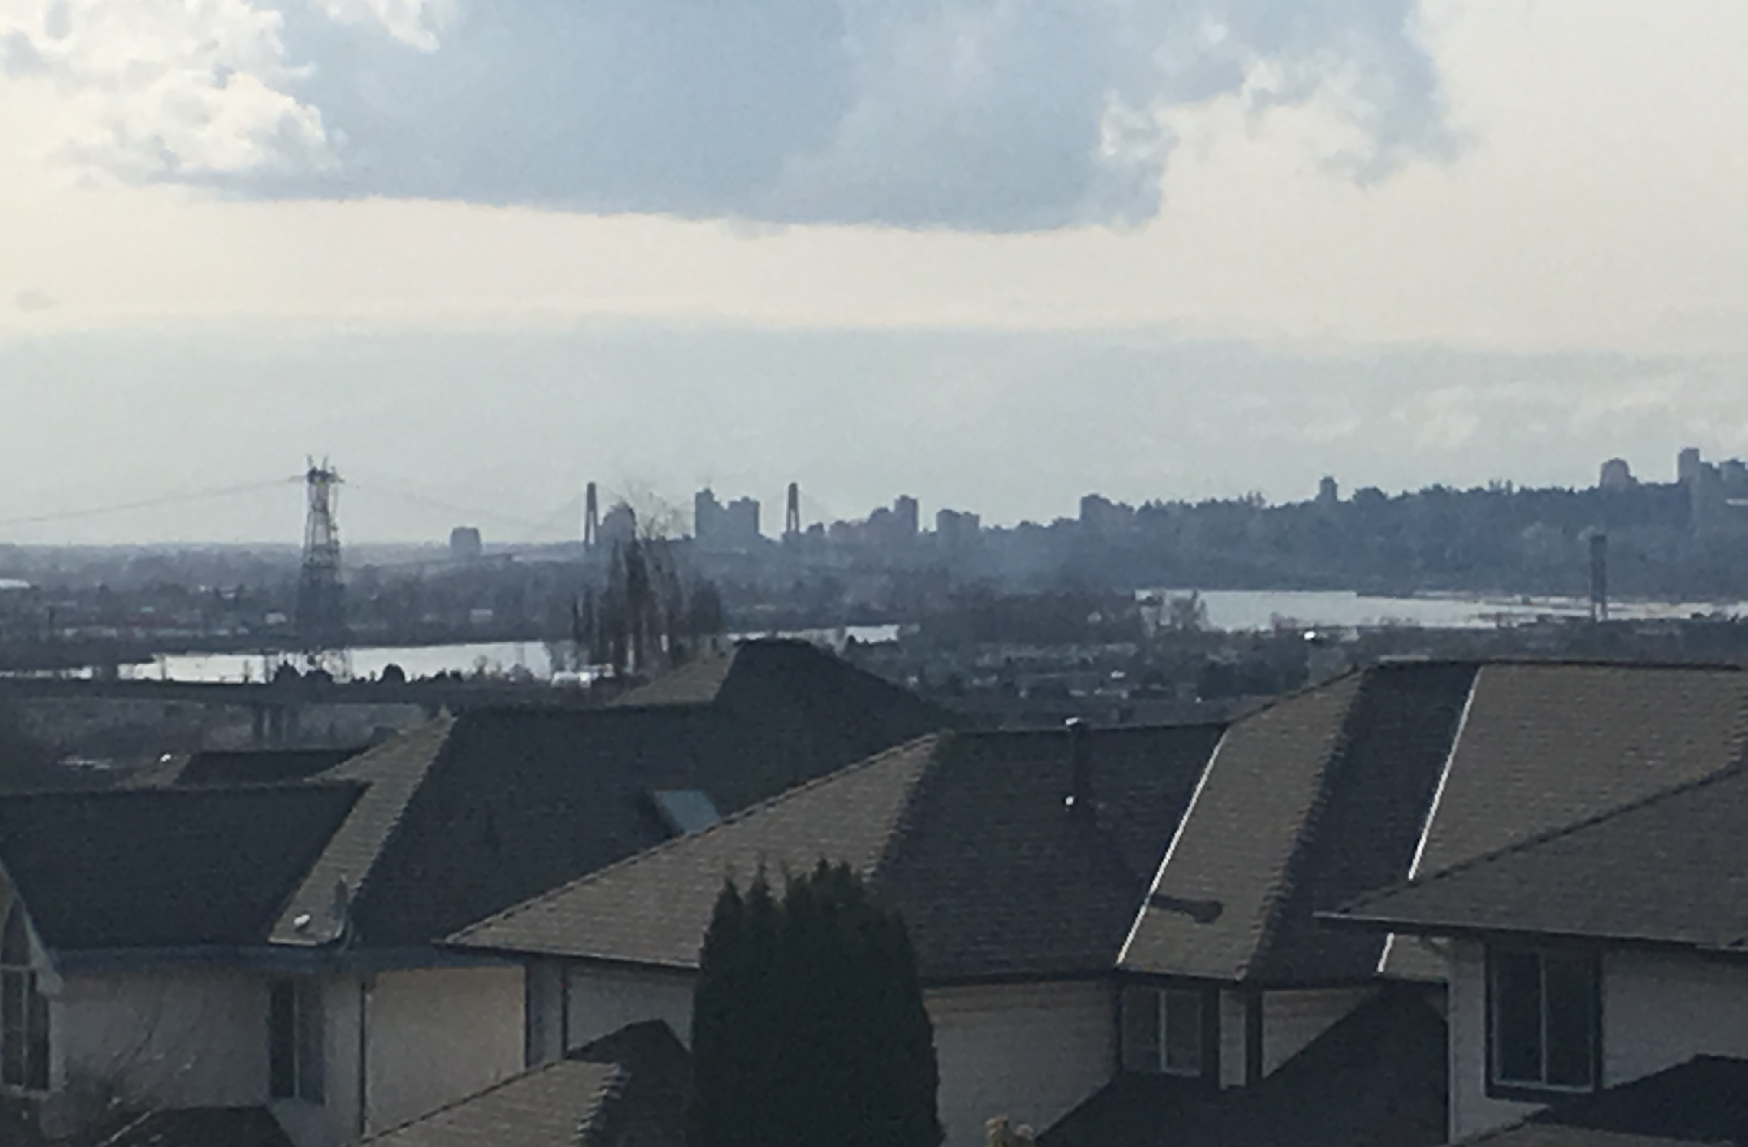
Stratus
This cloud is a stratus cloud because it is more of a grey colour and it covers the sky in a big sheet. It was also taken on March 27th at 3:34 pm

