Slide 1
Chef’s Career Path
How to become a (Chef)

Slide 2
My Career Goals
I want to become a/an (Chef) by (2026).
To get there, I will need to:
Graduate high school by (June 2020)
Graduate a 4 year culinary program at BCIT

Slide 3
What is a (Chef)?
A Professional cook, typically the chief cook of a restaurant or hotel.
Things you would be doing as a Chef:
Chefs lift heavy pots on a regular basis
Chefs cook food for around a 8 hour shift with only a 30 min break.
Chefs also have to deal with food being sent back
Chefs cannot be tired and they have to be organized because there around sharp tools such as knives for there whole shift.

Slide 4
About my future career
Chefs work in a restaurant
They make around $26,000 to $84,000
Chefs work 8 hours a day, which is around 50 hours in a week. For a Chef the start and finish time for a chef range but a typical night shift for a shift would be from 3pm-1pm

Slide 5
My job has a 10.1% chance of becoming automated
- A Chef is most likely to not become automated because it requires quick thinking. For example if you run out of some ingredient then they have to think of what to do.
- A chef could also not become automated because they have to adapt o different situations. For example if say you were cooking steak or cooking something that could very in size they have to make changes to how long they put the food in the oven for.

Slide 6
My compatibility
I am 78% compatible with this job.
The skills this job requires are:
Ability to Handle Criticism
Passion for the Culinary Arts
Creativity
Being a Team Player

Slide 7
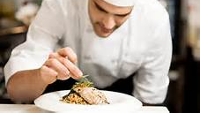
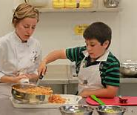
Being a Chef would be great for me because…
I already have these skills for this career:
I am a team player
I am also a people person
I am very creative
I am very passionate about making food

Slide 8
I am not quite ready for this career, but I will get there!
These are skills for the job I still need to learn:
To be a quick thinker
To be able to take criticism
To be able to be consistent.
This is how I will get those necessary skills:
To be a quick thinker I will have to be ready for anything and if something goes wrong I will know what to replace or to do. To be able to take criticism I will have to learn that I make mistakes and if I don’t I just have to accept the fact that they my have not have liked the way I have done something. I am not very consistent at the moment but to fix this I just simply have to work the job and get used to what I have to do.

Slide 9
Job Outlook
In BC, the job outlook is 2 of 3 stars.
Here are 2 reasons why:
Employment growth is expected to be weak.
A large number of people are expected to retire.

Slide 10
This is what appeals to me with this career…
You get to be around food all day, it may not seem fun for some of you guys but for me this is like a dream.
Another reason is that you get to be around other people and help them out and teach them how to cook.
My last reason is that you have lots of freedom at this job you get to do what you want to the food since you’re the head chef and you get to make it basically your own design.

Slide 11
These are some things I find less appealing about this career…
The hours kind of suck being a chef you work into the night and will not get home till late
Being a Chef is a dream of mine but I imagine it could be pretty repetitive at times

Slide 12
Potential obstacles to getting this career
The possible obstacles:
Takes lots of time
Hard to get into this business.
My plan to overcome them:
I will show my skills and hopefully it will be enough to impress them.
I will show my hard work and also show what I am willing to give to be able to work.

Slide 13
Potential obstacles to being successful within this career
The possible obstacles:
Being able to think on the spot.
Hard to stay focused
Being a chef you have to also be a butcher and take the raw animals in.
My plan to overcome them:
As a chef I will get used to the menu and problems will hopefully not be a problem.
To stay focused I will just have to focus on my cooking.
Basically being a butcher is a little bit of a deal breaker but I will have to deal with it.

Slide 14
The training/education required for my career is:
Chefs Will pursue formal training through culinary programs offered by community colleges, universities and culinary institutes. Some chefs complete certificate programs that typically last a few months, while others earn 2-year associate's or 4-year bachelor's degrees.

Slide 15
I intend to go to BCIT for that career
Burnaby, BC, Canada
bachelor of culinary arts
2 Years
Diploma

Slide 16
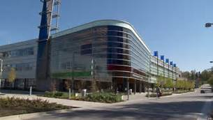
BCIT

Slide 17
High school courses required
Grade 11 courses:
Culinary programs
Cooking and Food Preparation.
Grade 12 courses:
Biology

Slide 18
Additional admission requirements
BCIT is known for its excellent practical applications and above average job placement.
I chose BCIT because they have a great Culinary program.

Slide 19
Financial Plan
$12,500 for this 2 year program
How I am going to pay for my program:
I will get a part time job and I will also get help from my family if I need it.

Slide 20
Some related occupations:
Nutritionist – Focussing on health and wellness, speciality diets, nutrient needs in hospitals for patients, or helping athletes achieve fitness goals.
Food Photographer – Kind of like Instagram but for real…and better.

Slide 21
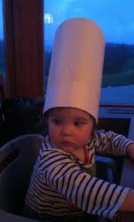
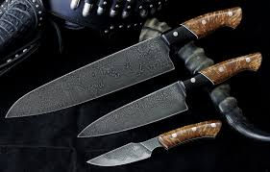
Chefs are awesome!!!
I Am Exited To Making People Happy Every Single Day.
I am also exited to be able to put my style on foods.
Apparently if you are a chef you Have A high Chance of Meeting Celebrities
When you’re a chef you will eat out more and you will respect the food that you make since you know how hard it is to do this.
Another fun fact is that all Chefs do have a favorite knife.

