Slide 1
English civil war Timeline
Causes, components, consequences
Scott Helmhold

Slide 2
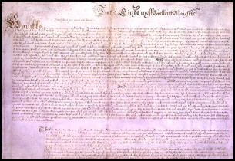
Causes
Charles did not rule according to law
Caption: The petition of right document.
Explanation: I believe Charles did not rule according to law is one of the Important causes because if Charles ruled according to law then parliament would not have been upset with him. Charles would also not have had any problems with his people also. The picture on the left is the petition of right, what the petition of right is is a document that was sent by parliament to Charles the first to say that they could not finance his polices, which simply means parliament denied the kings order, and Charles the 1st was very unhappy that parliament had done this. I also believe that Charles did not rule according to law is the most important because he split England in half which was parliament and the Charles and the people of this time felt like neither were a good choice.
http://www.luminarium.org/encyclopedia/petitionofright.htm

Slide 3
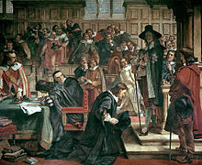
Causes
Charles invades the house of commons
Caption: Charles invades the house of common and Lenthall kneels before Charles.
Explanation: I chose Charles invades the house of commons because when parliament Apposed his polices it made Charles angry because he did not get what he wanted which was money. So since Charles could not get money through parliament he chose to get some money through taxes which parliament eventually figured out. Charles then invaded the house of commons but 5 members of parliament had already fled because they had had word that he was coming. Except for Cromwell which he stayed behind because he knew that Charles was no allowed to do what he was doing.
https://en.wikipedia.org/wiki/Long_Parliament

Slide 4
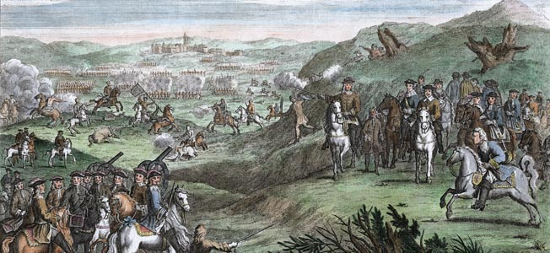
Components
Battle of Edgehill
Explanation: Both armies parliamentarians and royalists both had armies ready to fight and on Sunday, 23 October 1642 The first English civil war began. The battle of edge hill was the most important component because The Battle of Edgehil the first main battle of the English Civil War. The battle of edge hill had started on October 23rd 1642. this battle was important because if Charles had won this battle then there would be no parament, but since parliament won it lead to Cromwell being king which was no better than Charles.
Caption: Charles and his army in the middle of battle against the parliamentarians.
http://warfarehistorynetwork.com/daily/military-history/unbridled-fury/

Slide 5
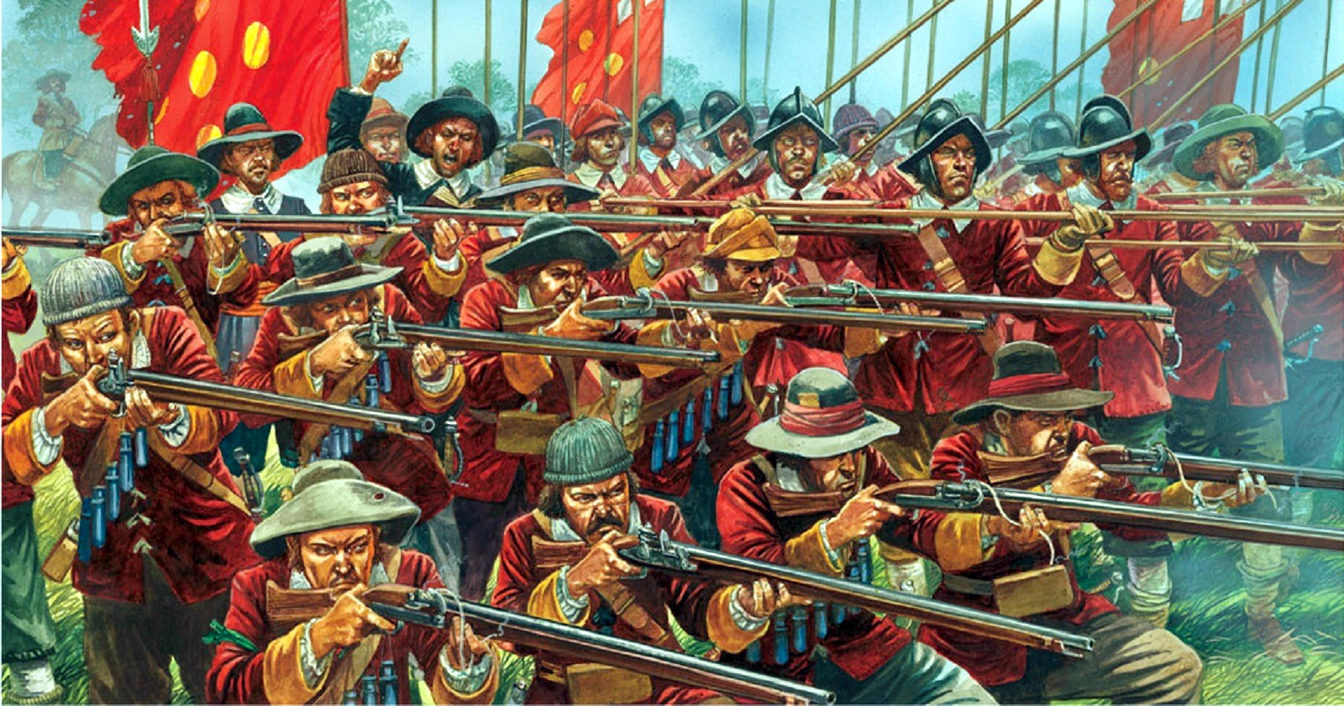
Components
New model army
The New Model Army of England was formed in 1645 by the parliamentarians, and was disbanded in 1660. The new model army was run my Oliver Cromwell. After the execution of Charles the 1st Cromwell proudly took over his duties as a king and created the new model army. The new model army solved the feud between the people on parliaments side and the people that were on Charles the 1st side. Cromwell lead the new model army but after comparing him to Charles the 1st I realized that Charles the 1st and Cromwell did many things that were a lot a like.
Caption: The new model army in action.
https://www.nationstates.net/page=dispatch/id=767851

Slide 6
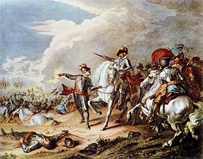
Components
Battle of Naseby
Caption: The royalists about to engage on parliament
Why I think the battle of Naseby is so important to the civil war, is simple because the royalists lost such a big part of there army, so what Charles did was seek out France to help fight. But even with France they were had no chance of winning against the parliamentarian army. The battle of Naseby was such a important component because this battle weekend the royalist army and after this defeat there was no coming back.
https://en.wikipedia.org/wiki/Battle_of_Naseby

Slide 7
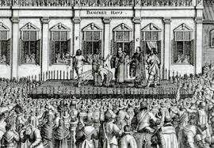
Consequences
Execution of Charles
Caption: Charles gets executed and the executioner is holding his head up.
Why I believe that the execution of Charles was the most significant consequence is because when Charles was ready for execution it seemed like he was ready for death and he didn’t put up that much fight to try and convince otherwise, what I don’t understand is why they had to kill him because many people in parliament did not want to and the people also did not want to as well. I think what pariament should have done is keep him in prison and tell him what he can and can not do.
http://www.emersonkent.com/speeches/execution_speech_charles_i.htm

Slide 8
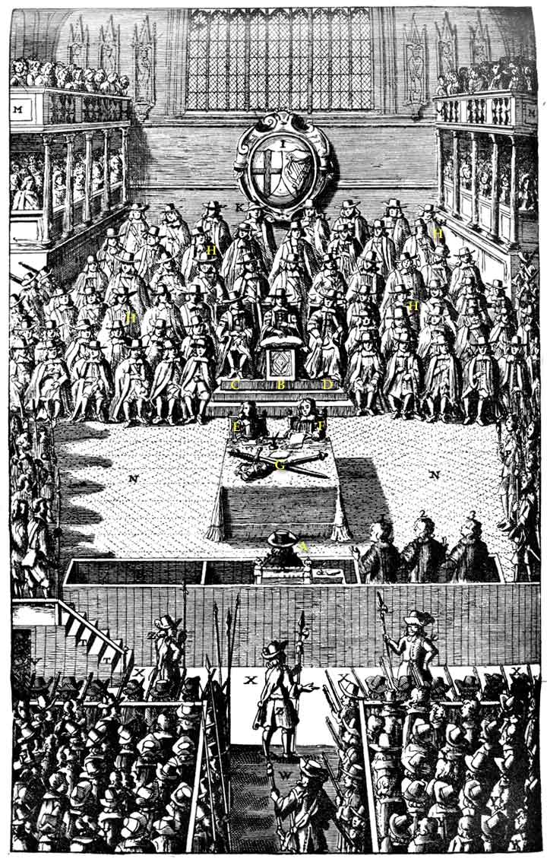
Consequences
Charles on trial
Caption: Charles gets put on trial And is sentenced to death.
Why I think that Charles on trial was the most important is because it was illegal. Parliament new what they were doing was illegal and so did Charles. Even in the short film we watched Charles refused to take the trial seriously and parliament sentenced him to death but Charles thought that this court was pointless because that he was the king and you cannot put the king on trial.
https://en.wikipedia.org/wiki/High_Court_of_Justice_for_the_trial_of_Charles_I

