Slide 1
When I was Fair and Young
By Queen Elizabeth I

Slide 2
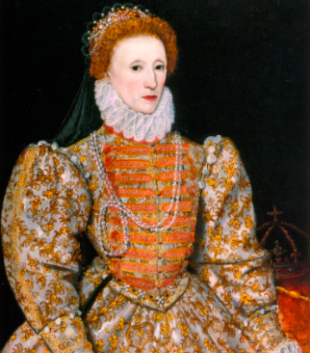
Bringing the Poem to life

Slide 3
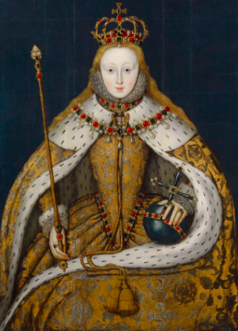
Imagery
1.)
IMAGE: “Of many was I sought their mistress for to be” (Queen Elizabeth I, Line 2).
MEANING: She was desired by men, and she had power over them.’
2.)
IMAGE: “But I did scorn then all, and said to them therefore” (Queen Elizabeth I, Line 3).
MEANING: She rejected the men who desired her.
3.)
IMAGE: “How many weeping eyes I made pine in woe;” (Queen Elizabeth I, Line 5).
MEANING: She was cruel and mean, and now has to suffer.

Slide 4
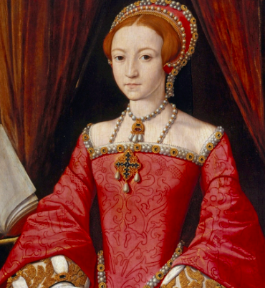
Lyric Qualities
1.)
LYRIC DEVICE: Repetition
MEANING: “Go, go, go, seek some other where, importune me no more” (Queen Elizabeth I, Line 4). She felt “too good” to be loved.
2.)
LYRIC DEVICE: Alliteration
MEANING: There’s alliteration in nearly all lines of this poem. It helps create the Some words are fair-favor, them-therefore, me-more and seek-some.

Slide 5
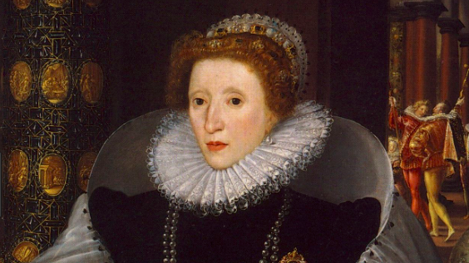
Figurative Meaning
1.
FIGURATIVE MEANING: Symbol
MEANING: Venus’s son Cupid, is a symbol for love.
2.
FIGURATIVE MEANING: Personification
MEANING: “How many sighing hearts I have not skill to show” (Queen Elizabeth I, Line 6). Hearts can not sigh.
3.
FIGURATIVE MEANING: Connotation
MEANING: “I shall so pluck your plumes so that you shall say no more”(Queen Elizabeth I, Line 11). This is saying she fell in love with someone but got rejected. Taking away plumaged makes you less proud. She is saying all this without actually saying it.

Slide 6
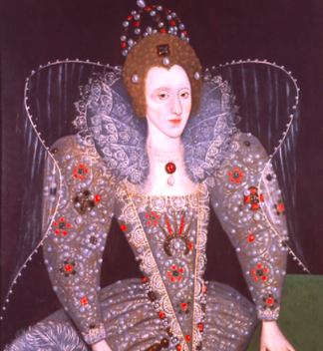
Theme and Tone and Type of poem
The theme of this poem is regret and love.
This poem has a tone of nostalgia and remorse.
This is a couplet poem.

Slide 7
Literal Meaning
When I was Fair and Young is about a woman (Queen Elizabeth I), looking back on her life and feeling great regret towards the decisions she made with love in the past. She regrets not allowing men into her life. She took the beauty that “graced” her for granted. Now, in her older years, she doesn't’t feel like she will be able to be loved like other women.

