Slide 1
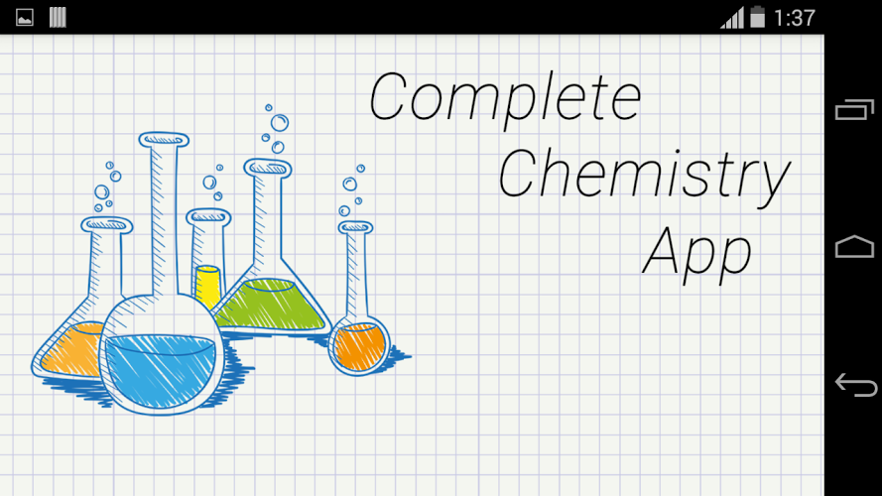
App Review
Sarah Lilley
ADL15

Slide 2
Questions being asked
How does this app teach students?
Who would this app be helpful for?
What is the main idea of the app?
What subject in science does the game address?
Does this app contribute to the subject it addresses?
Is the app easy to understand and figure out how it works?
Can the app be used for teaching in classrooms?
Could the app be used for studying?

Slide 3
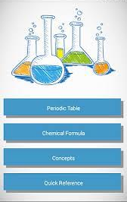
Complete Chemistry App
The Complete Chemistry App is a original and simple way of explaining and helping students to learn the elements of the periodic table and chemical properties.
As well as the elements, it covers chemical reactions and formula’s that can take place when combining specific elements together.
It explains the concepts and definitions of each scientific term you may come across while viewing and learning about the elements.

Slide 4
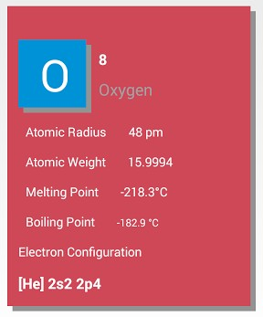
How it Works
when you choose a category that you would like to learn about, it’ll take you to a list of all the things you can view within that area of chemistry.
From there, you can click and view each items individual properties.
In detailed form, the app will give you a description and some facts about the item being viewed.

Slide 5
What I Learned
The app gives a more in depth look at the elements.
Good for studying, this app helps memorize and learn the chemical properties of the elements and their counterparts.
Giving a definition of terms that will be learned while studying chemistry makes it easier to understand what’s being learned.
If I had one wish for this app it would be that it’s partnered with a quiz option to practice the things you’ve learned.

Slide 6
Questions answered
This app taught students through memorizing the individual properties and causing the to drill the information into their brain.
This app would be useful to anyone looking to study for a chemistry test/quiz and needs a helpful guideline to the basics of chemistry.
The main idea of this app is to educate students on properties of elements and such.
This app specifically addresses the subject of chemistry in science.
This app contributes a good amount of information to the subject it addresses through the set up.
This app does not have a walk through of the basics but it’s so simple that it doesn’t really need instructions on how it works.
I would not recommend using this app in the classroom only for the reason that it doesn’t share much information on anything else except definitions.
I would highly recommend using this app for studying since it’s strongly influenced on learning the terms and definitions for chemistry by heart.

