Slide 1
Photo Poetry Analysis
By Rose Farkhondeh

Slide 2
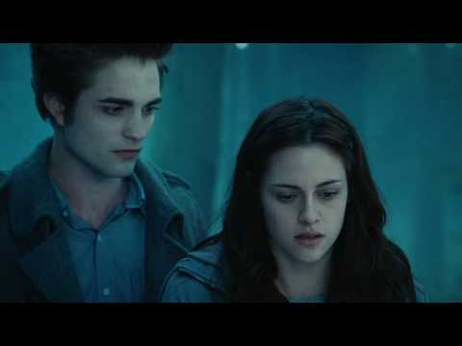
Iconic Image
Twilight (2008)

Slide 3
Why This Photo?
When looking at this image, one is most certainly reminded of simpler times where the only question you had to answer was if you were team Edward or team Jacob? The moodiness of the blue and black hues reflect on the pre preteen angst we all felt together. The tension between the two characters in this moment is hard to put into words and the mystery of that is what draws you in.
The aura around them is so enticing, daring you to tap into the adventurous side of you and to try new things, like falling in love with a vampire.

Slide 4
Why This Photo?
This iconic photo is so important because it portrays one of the greatest love stories of our time. If your significant other doesn’t look at you the way Edward looks at Bella in this photo then there really is a problem. This picture set the bar for all men, vampires and humans alike. It’s important that men recognize that they should reach the level that Edward was on. From this scene forward, he did everything he could to be near Bella, even breaking into her house to watch her while she slept, and one could argue that that is the height of romance. Without this scene, without Bella becoming confident enough to tell Edward that she knew his secret, their love wouldn’t have blossomed, and that is a beautiful thing.

Slide 5
Where did this photo come from?
The cinematographer behind the movie Twilight was Elliot Davis. The shot was for the film, so that was the reason behind the photo. The angle it was taken in was to create tension and to have a clear view of each character’s face to get a full comprehension of what feelings they were going through at that moment. The dark lighting in this photo adds to the tension and suspense. The photo was taken in a forest in Clackamas Oregon.

Slide 6
Poem
With every step she took
Branches crackling beneath her bones
Our curiosity grew stronger
She looked forward
And we looked backwards
We searched for his input, for his thoughts
But she was in charge of every twist in the plot
Guiding us to where she wanted us to be
She suddenly stopped
And they stood in front of a tree
Then with her mouth slightly ajar
She said slowly “I know what you are.”

Slide 7
Reflecting
I used alliteration (branches crackling beneath her bones), symbolism as the branches breaking was the growing tension leading up to the breaking point, rhyming, and I used allusion with the last line being the famous line said in the photo. The research was not much help because I already knew everything about this scene and the story behind it. I think I was able to capture the suspense leading up to the moment she tells him she knows his secret in the words I chose.

Slide 8
Works Cited
“Twilight Movie Filming Sites,” Fold3, 8/15/2009, modified 5/30/2018.
https://www.fold3.com/page/94159453-twilight-movie-filming-sites
“Elliot Davis (cinematographer), Wikipedia, 12/31/2018
https://en.wikipedia.org/wiki/Elliot_Davis_(cinematographer)

