Slide 1
PPT My Lemonade Stand
CS10

Slide 2
A week of Sales..

Slide 3
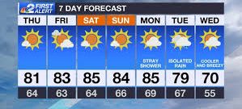
Weather Report
Notes:
This weeks weather report is looking good for selling lemonade

Slide 4
Net Profit

Slide 5
Cups of Lemonade Sold Per Day

Slide 6
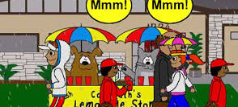
Summary and Looking Forward
Notes:
I enjoyed selling lemonade and I am looking forward to play again

