Slide 1
Ocean Quest
By: Paige & Ranya

Slide 2
Definitions
Ocean currents are the continuous, predictable, directional movement of seawater driven by gravity, wind the coriolis effect, and water density.
The simplest salinity definition is that it is a measure of dissolved salts in a concentration of water. Salts in seawater include not just sodium chloride (table salt) but other elements such as calcium, magnesium, and potassium.
Density, the density, of a substance is its mass per unit volume. The symbol most often used for density is ρ, although the Latin letter D can also be used. Mathematically, density is defined as mass divided by volume
A gyre is a large system of rotating ocean currents.
The greater the difference in pressure between the two locations, the greater the pressure gradient. A pressure gradient can be analyzed in the vertical dimension, with the prevailing trend being a downward gradient (toward the Earth's surface).
Thermohaline circulation (THC) is a part of the large-scale ocean circulation that is driven by global density gradients created by surface heat and freshwater fluxes.
Upwelling is a process in which currents bring deep, cold water to the surface of the ocean. Upwelling is a result of winds and the rotation of the earth

Slide 3
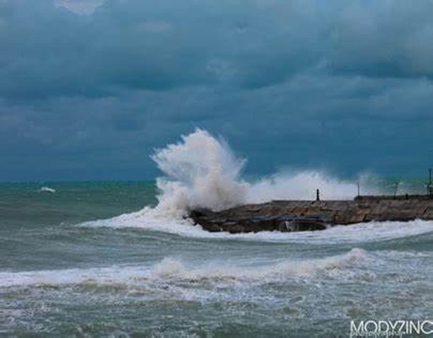
Ocean currents
Surface Currents
What drives them
1. Large-scale surface ocean currents are driven by global wind systems that are fueled by energy from the sun. These currents transfer heat from the tropics to the polar regions, influencing local and global climate. The warm Gulf Stream originating in the tropical Caribbean, for instance, carries about 150 times more water than the Amazon River. The current moves along the U.S. East Coast across the Atlantic Ocean towards Europe. The heat from the Gulf Stream keeps much of Northern Europe significantly warmer than other places equally as far north.

Slide 4
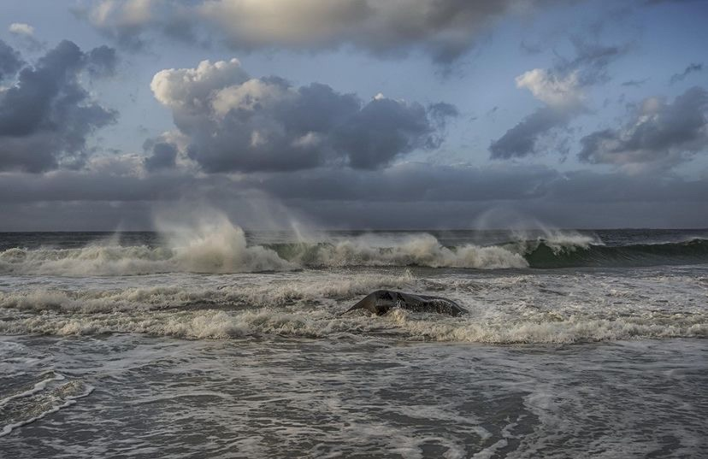
Ocean currents
2. Deep-ocean currents
What drives them
These deep-ocean currents are driven by differences in the water's density, which is controlled by temperature and salinity. This process is known as thermohaline circulation. In the Earth's polar regions ocean water gets very cold, forming sea ice.

Slide 5
Ocean Currents
What drives them
3. Measuring currents
Winds drive currents that are at or near the ocean's surface. These currents are generally measured in meters per second or in knots (1 knot = 1.15 miles per hour or 1.85 kilometers per hour). Winds drive currents near coastal areas on a localized scale, and in the open ocean on a global scale.

Slide 6
Factors that influence ocean currents
Heating by solar energy. Heating by solar energy causes the water to expand. Near the equator the water is about 8 centimeters high than in middle latitudes.
Winds. Winds blowing on the surface of the ocean push the water. Usually winds drive currents that are at or near the ocean’s surface.
Gravity. Gravity is one of the forces which established the direction of the ocean currents. Gravity pulls water down the slope created by solar heating.
Coriolis Force. The corialis force is defined as the apparent deflection of objects (airplanes,winds,missiles and ocean currents) moving un straight path relative to the earth’s surface.
Temperature difference. Temperature and density share an inverse relationship. As temperature increases, the space between water molecules increases also known as density, which therefore decreases.
Salinity Difference. Salinity and density share a positive relationship. As density increases, the amount of salts in the water also known as salinity increase.

Slide 7
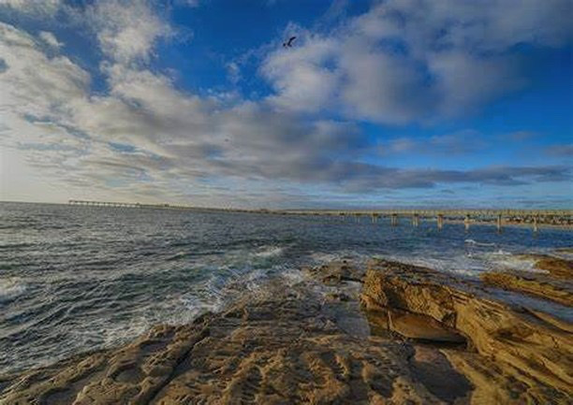
2 main causes of density differences
A density difference can exist between two fluids because of a difference in temperature, salinity, or concentration of suspended sediment.
Density currents in nature are exemplified by those currents that flow along the bottom of oceans or lakes.

Slide 8
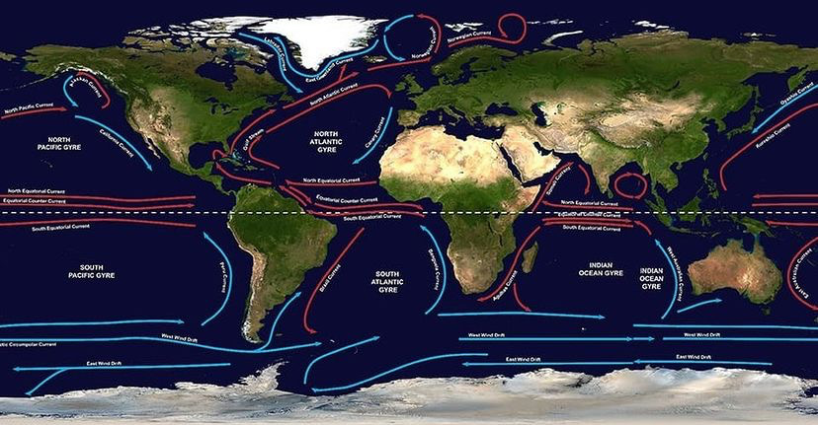
Gyres and what factors influence them
There are five major gyres: the North and South Pacific Subtropical Gyres, the North and South Atlantic Subtropical Gyres, and the Indian Ocean Subtropical Gyre.
An ocean gyre is a large system of circular ocean current s formed by global wind patterns and forces created by Earth’s rotation. The movement of the world’s major ocean gyres helps drive the “ocean conveyor belt.” The ocean conveyor belt circulates ocean water around the entire planet.

