Slide 1
5 Themes of Geography and ME
By Nicole Matonis

Slide 2
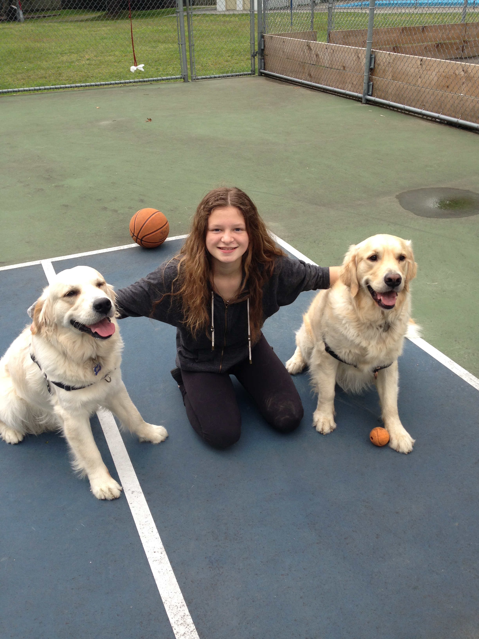
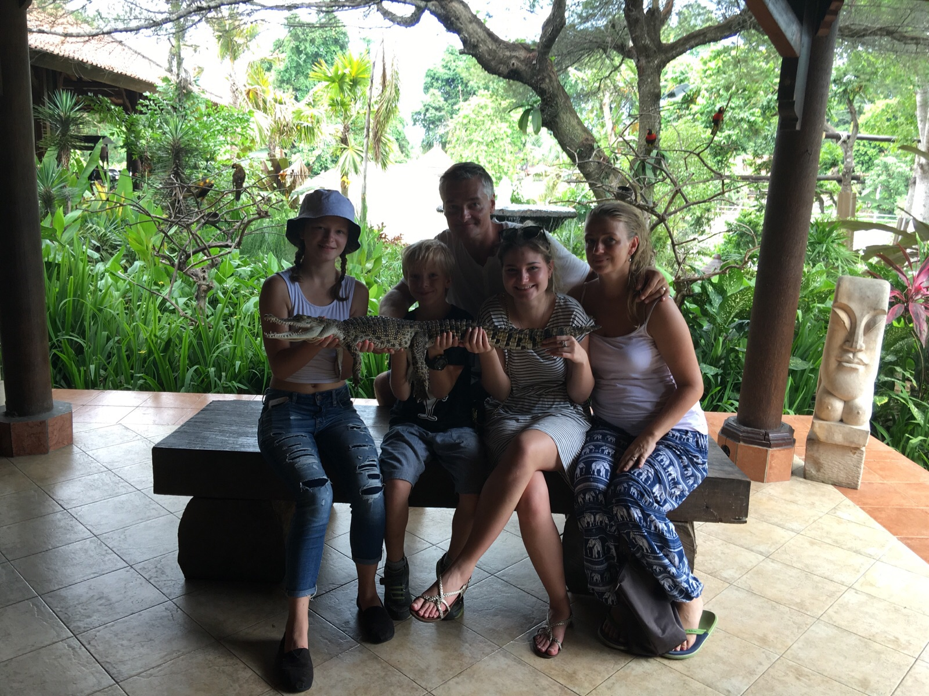
LOCATION
I live in Port Coquitlam, B.C, Canada. It is so different than when I used to live in Dubai. In Dubai, it was hot and attending the pool or the beach was a very normal every-day activity. Here in Poco it rains a lot so it isn’t very ideal beach weather, My location has affected the activities I do, the societal “norms”, transportation too. Ex: In Dubai it was normal to own exotic pets, but here in Canada if you come out with a monkey it would be weird. Another example is that my house is very close to my school so I walk evryday. Location make’s a big impact on thing’s in my everyday life.

Slide 3
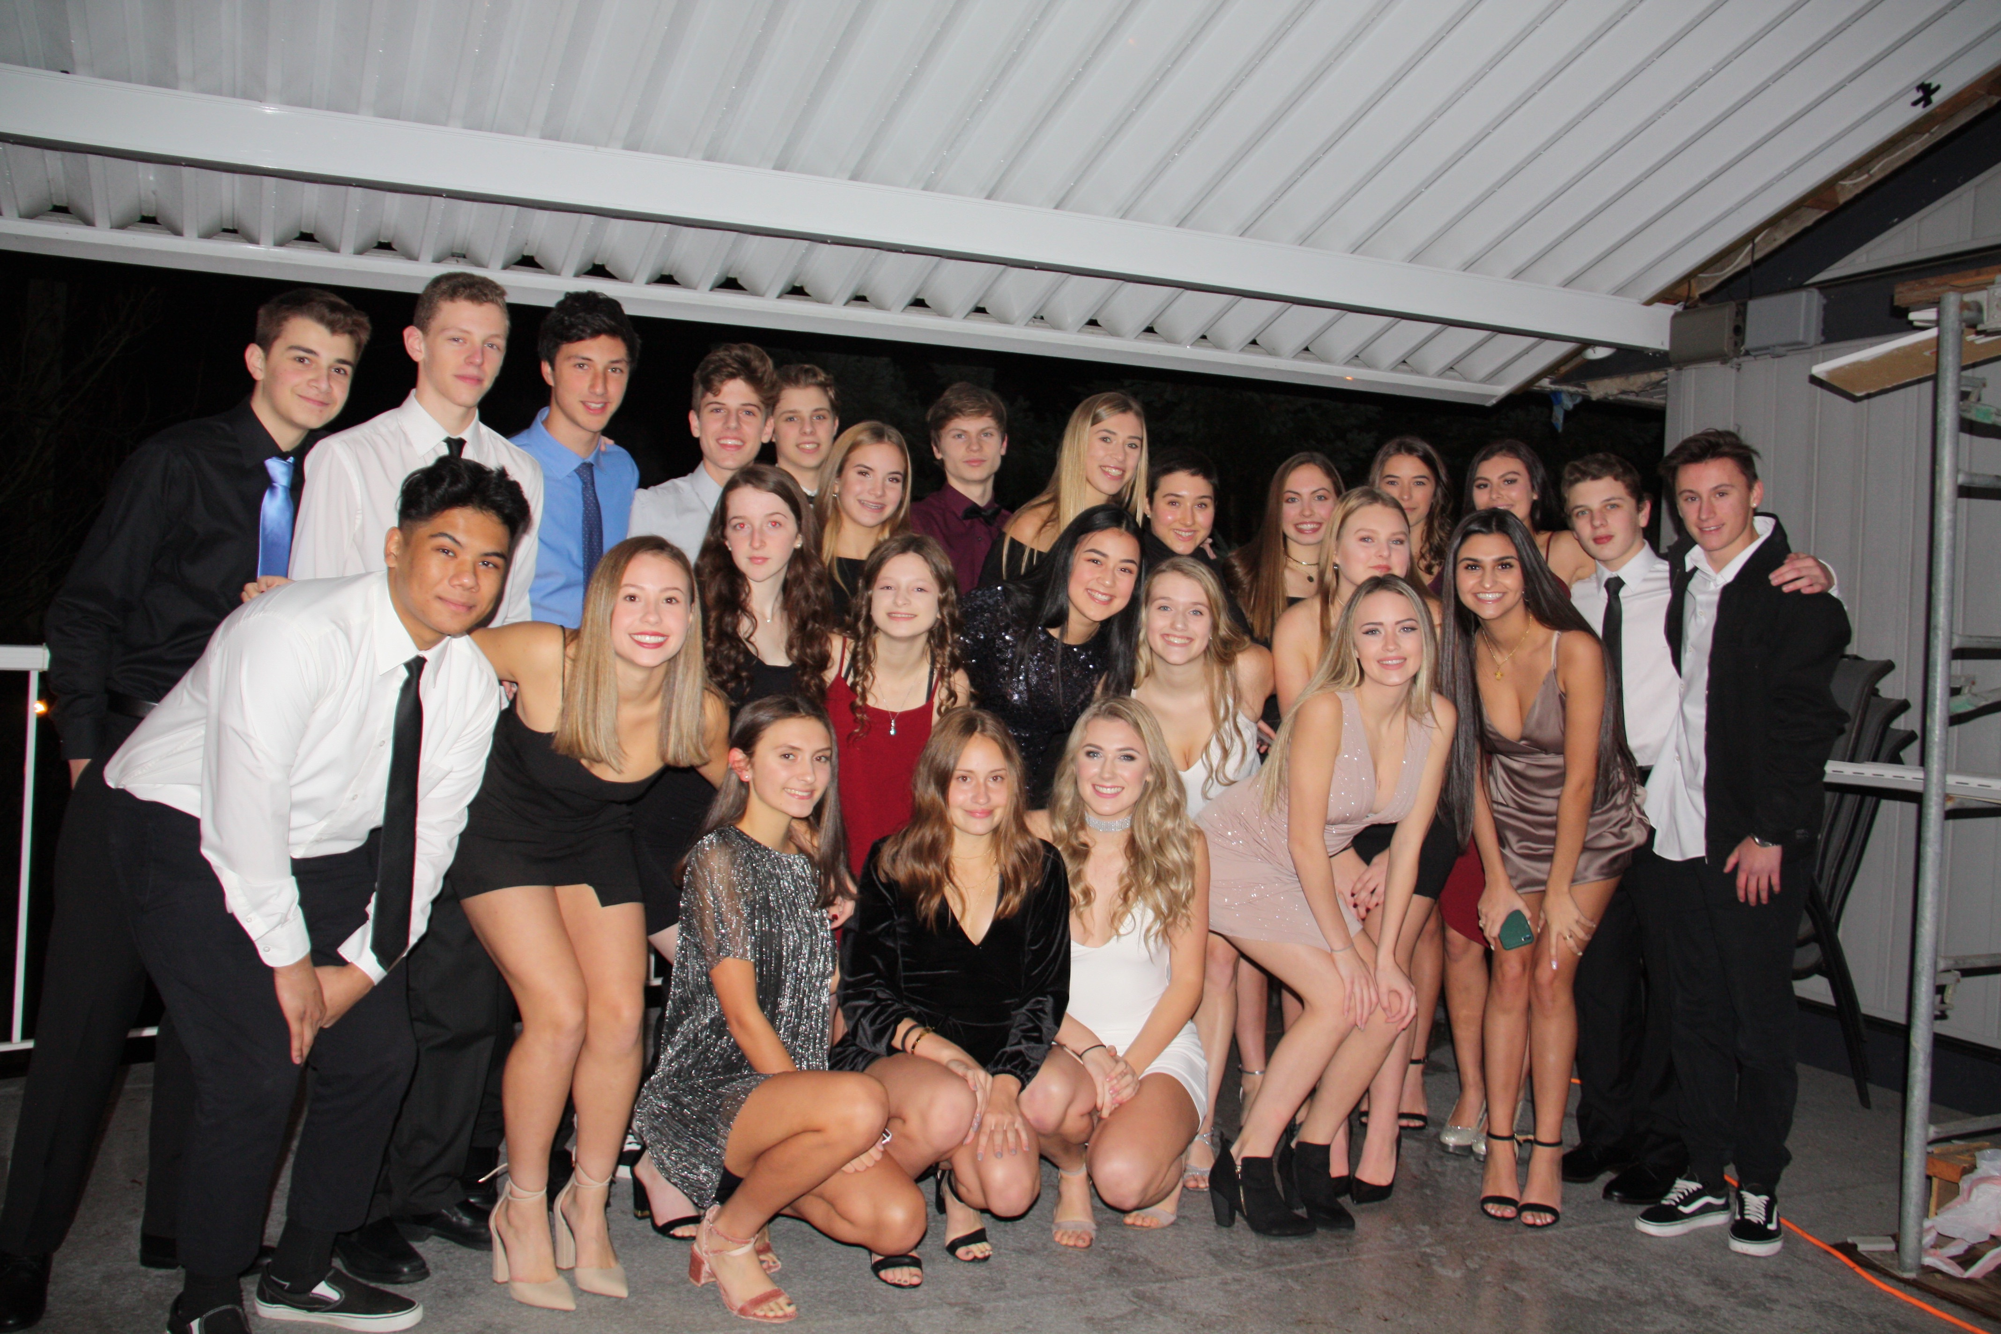
PLACE
In Canada specifically Port Coquitlam, there are many things that make this place what it is. Like the parks, the certain stores, and even the natural characteristics like the rivers and hikes! In my own personal interactions place has affected my transportation, the interests I have, and even the friends I have… My place can be recognized by things like Gates Park, or the rope swing at Gates and specifically to my life, the viewpoints and school. Me and my friends spend alot of time at viewpoints, which is connected to the physical landscape because most of these viewpoints are on top of hills, but also surrounded by houses which are cultural characteristics. School is where I spend most my time so it has affected me greatly .

Slide 4
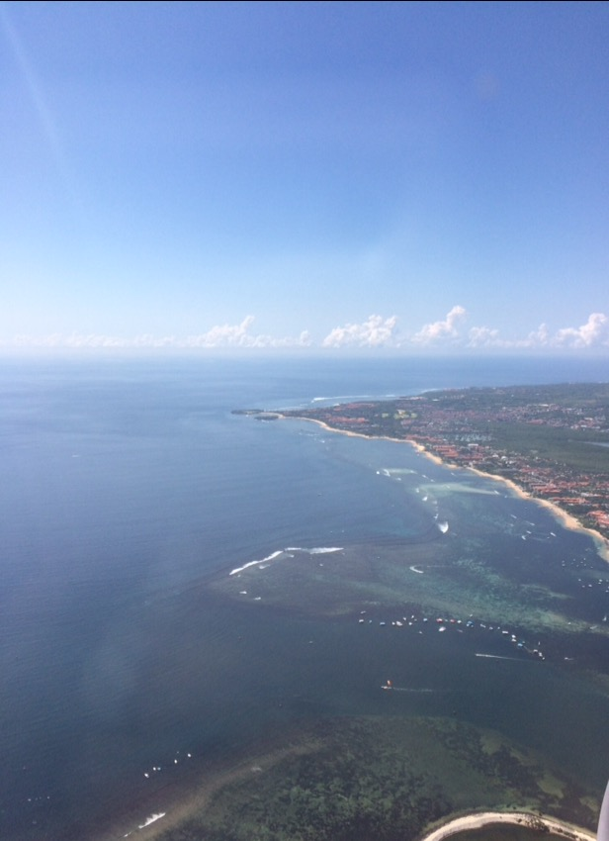
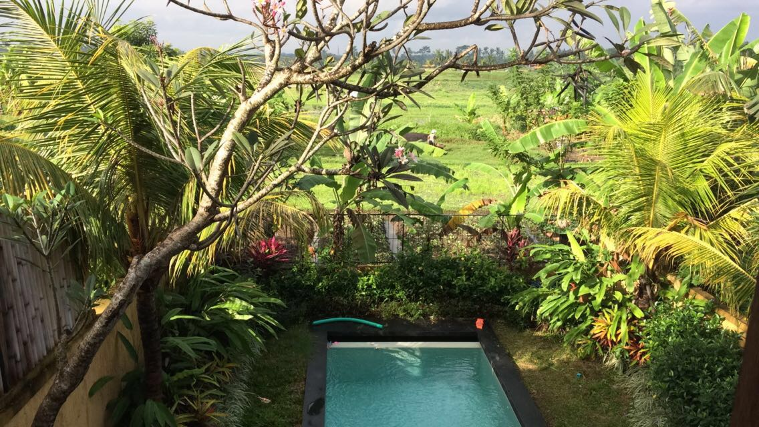
MOVEMENT
Movement has affected my life greatly. When I was younger me and my family moved a lot. So the first half of my life was basically movement of people. This is important because if I hadn’t moved around I might’ve never ended up in Port Coquitlam. A big part of my life now is movement of goods. Because pretty much everything I own is from another country. Like my laptop, clothes… If these thing’s weren’t sold in Canda that would affect my life because I wouldn’t have them.

Slide 5
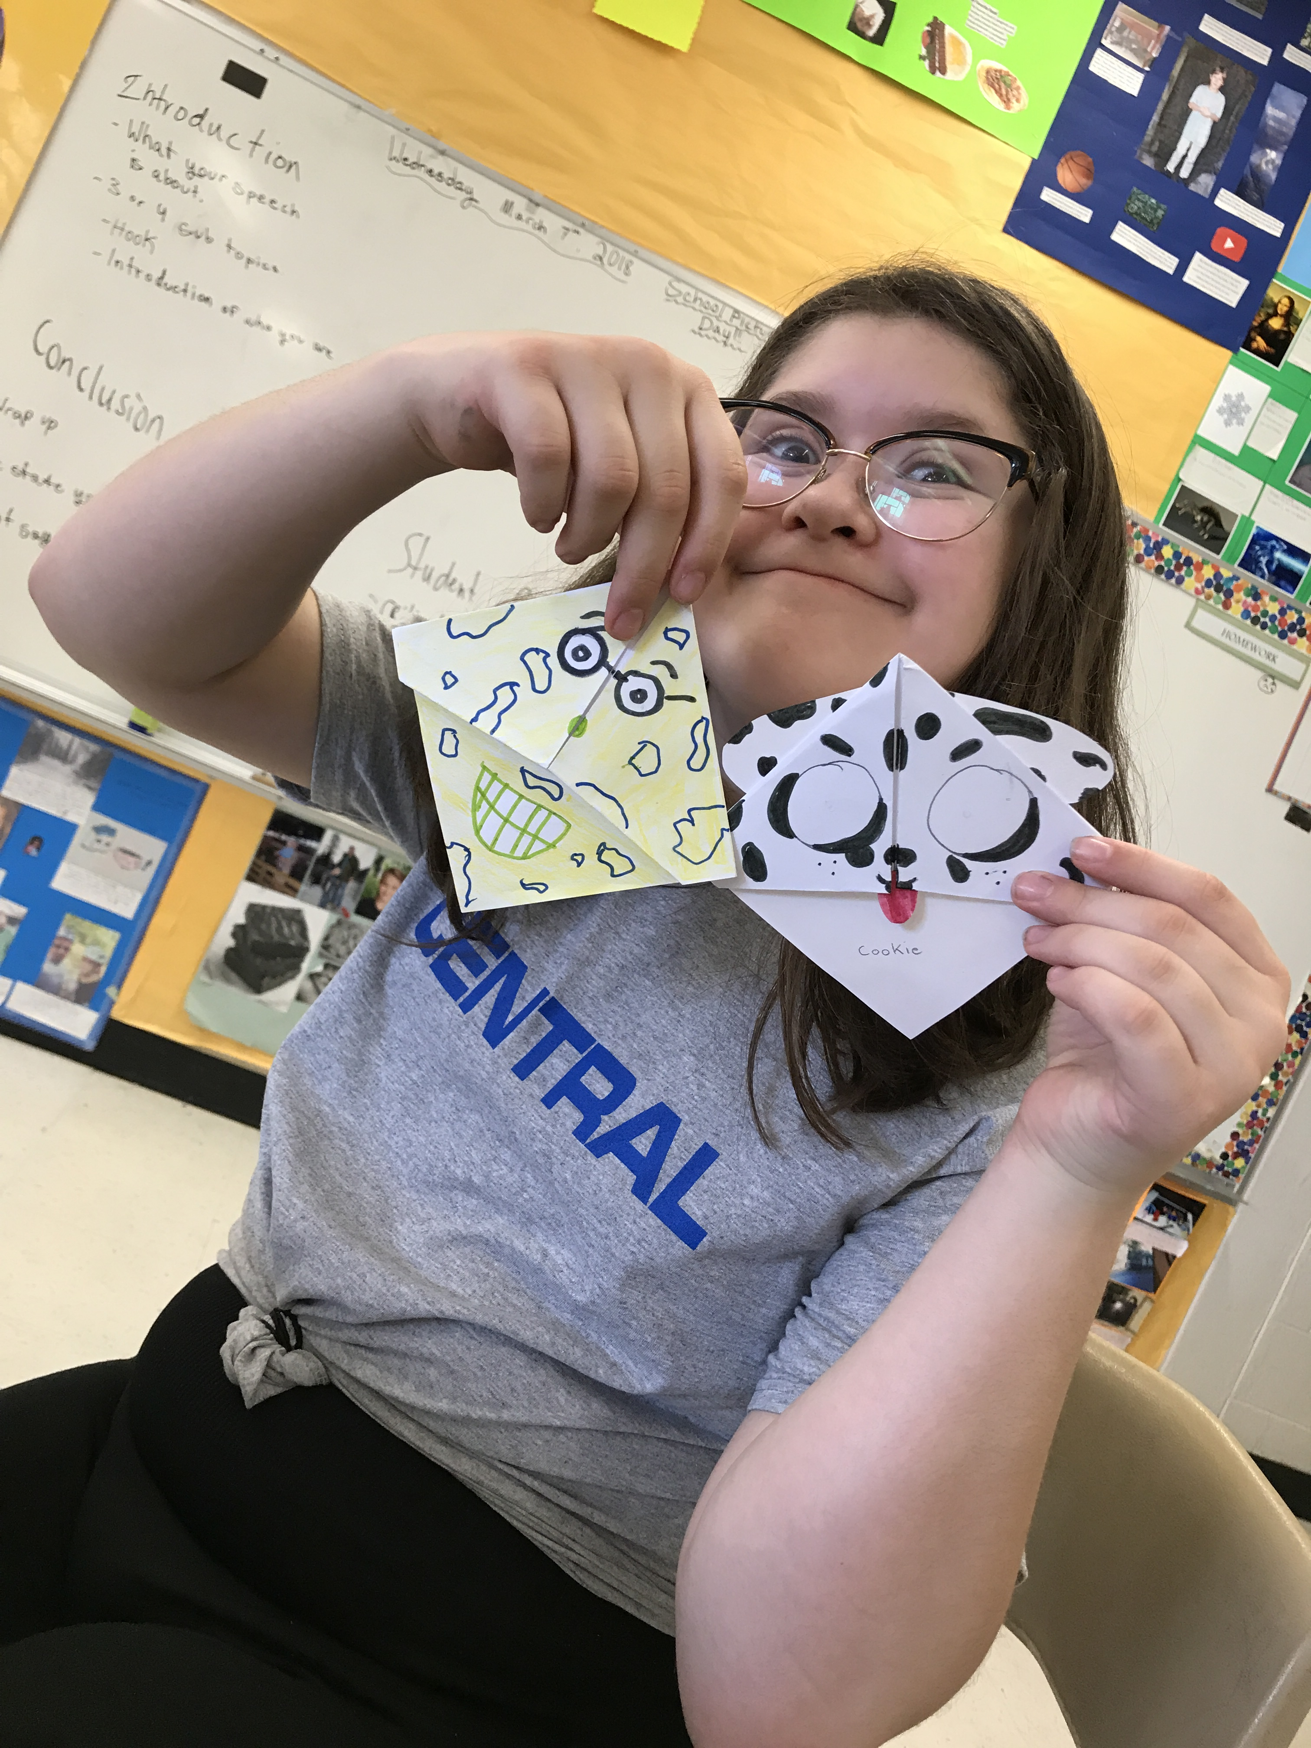
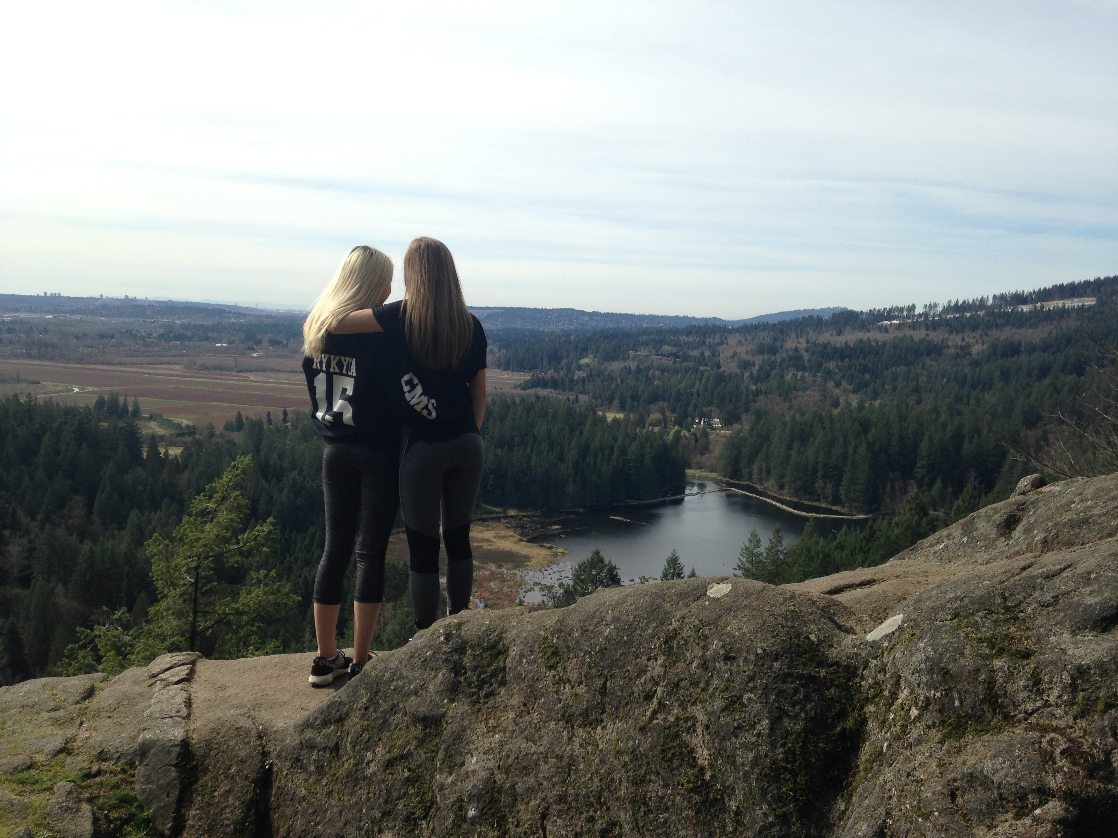
REGIONS
Vernacular: Port Coquitlam has many vernacular regions, some that only me and my friends understand and then some that all of Poco are used to. A big divide Poco has is “Northside” and “Southside”. In my opinion the divide is where the overpass is and the Tim Horton's. There are many stereotypes and differences about the two sides. This affects me because of who I hangout with and the types of activities me and my friends do.

Slide 6
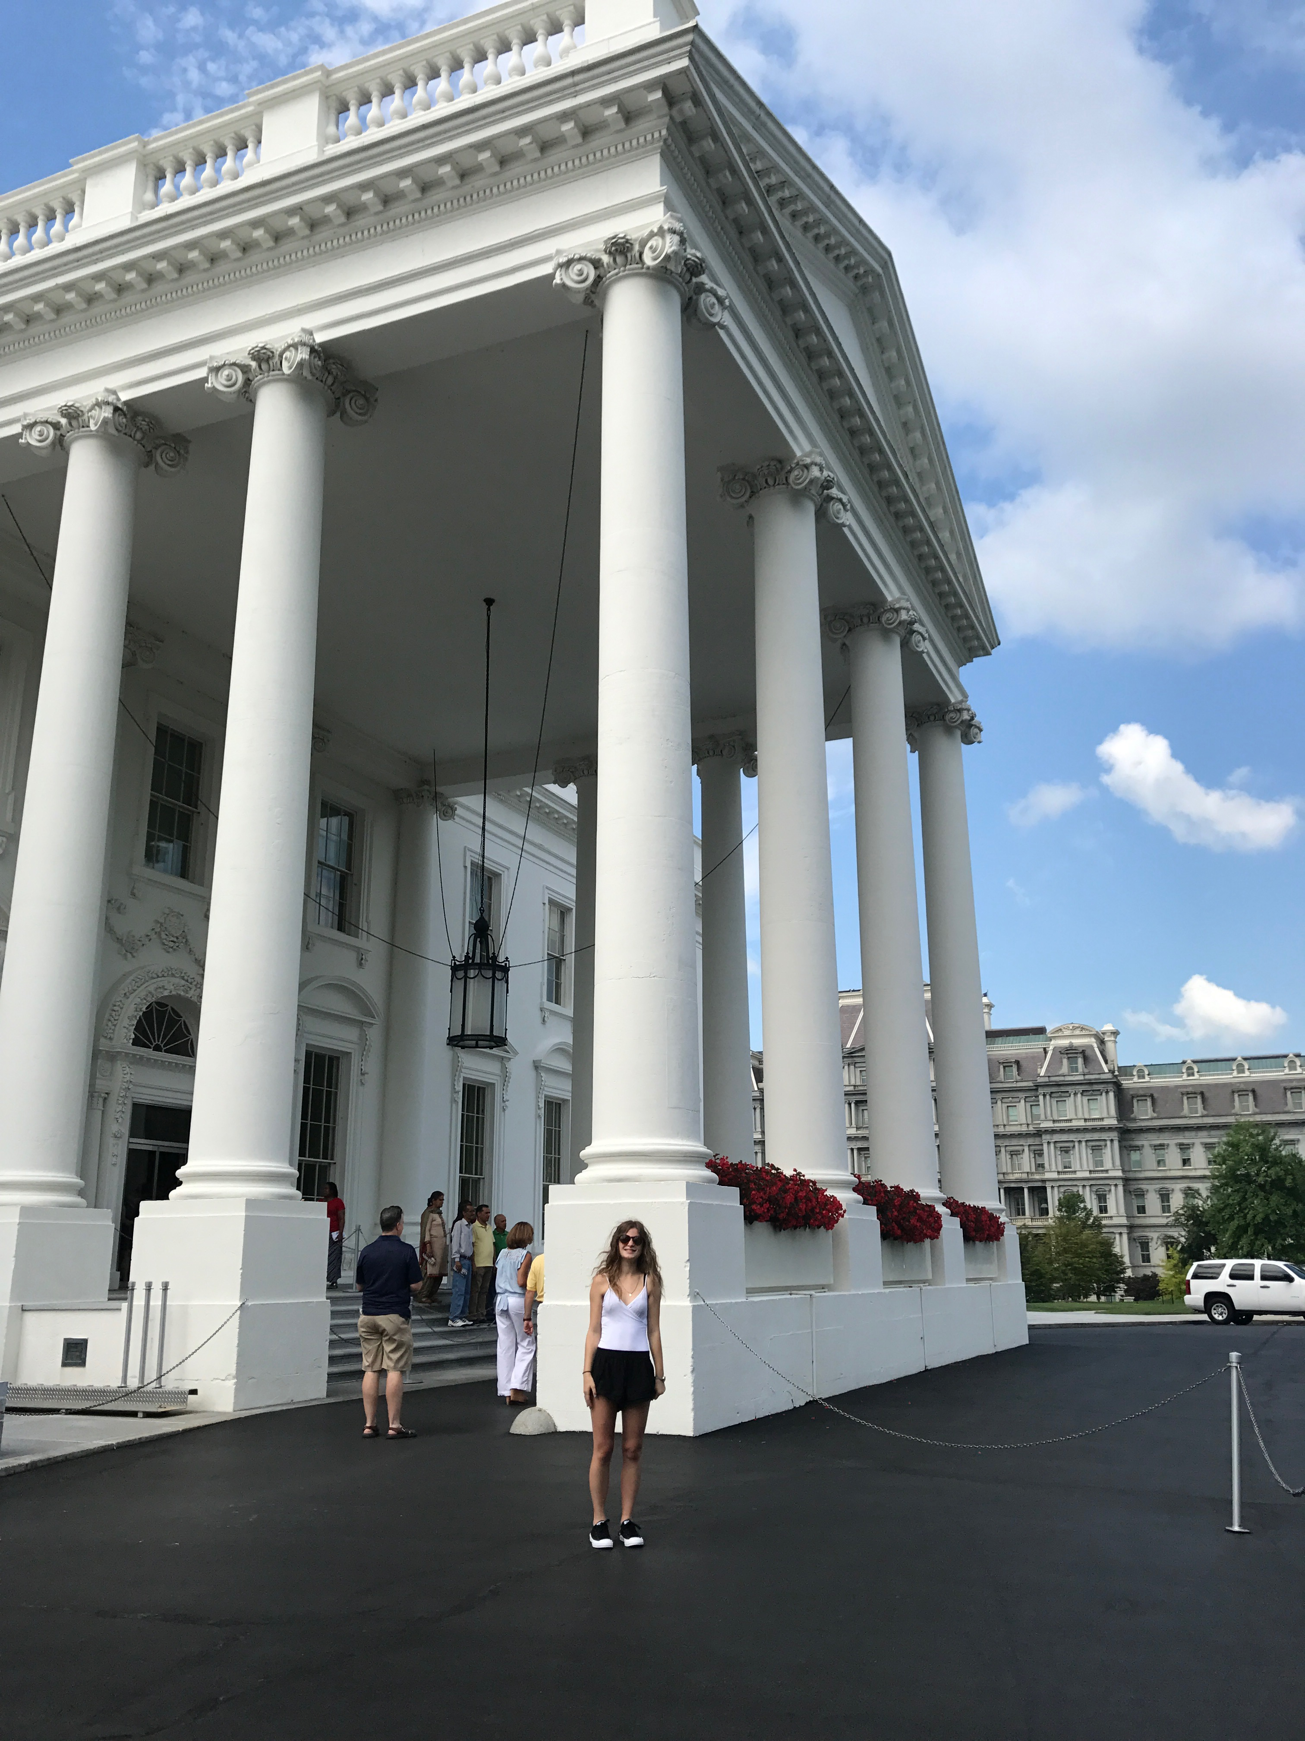
REGIONS
Formal: Formal regions are not a huge part of my life, because I don’t really vote or go around anywhere too far from Port Coquitlam. But when I am travelling and people ask where I am from I have to say Vancouver because people around the world don’t know what Port Coquitlam is. Except one time in Washington DC I said I was from Vancouver and they thought I meant the Vancouver there, because they have one too so it works both ways and that awkwardness really made me understand that.

Slide 7
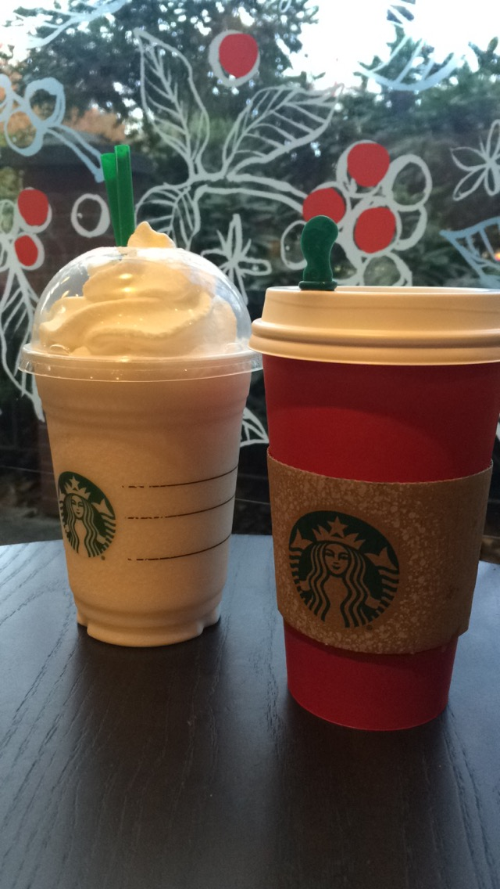
REGIONS
Functional: Functional regions haven’t really influenced my life much. I live in an apartment building and my mom takes out the garbage so I wouldn’t even know what days garbage pick up is or anything. Although the only thing I’d say has really influenced my life are the food places and stores and how late they’re open. Or even skip the dishes, depending on where I am they no longer deliver at certain hours which obviously affects my life.

Slide 8
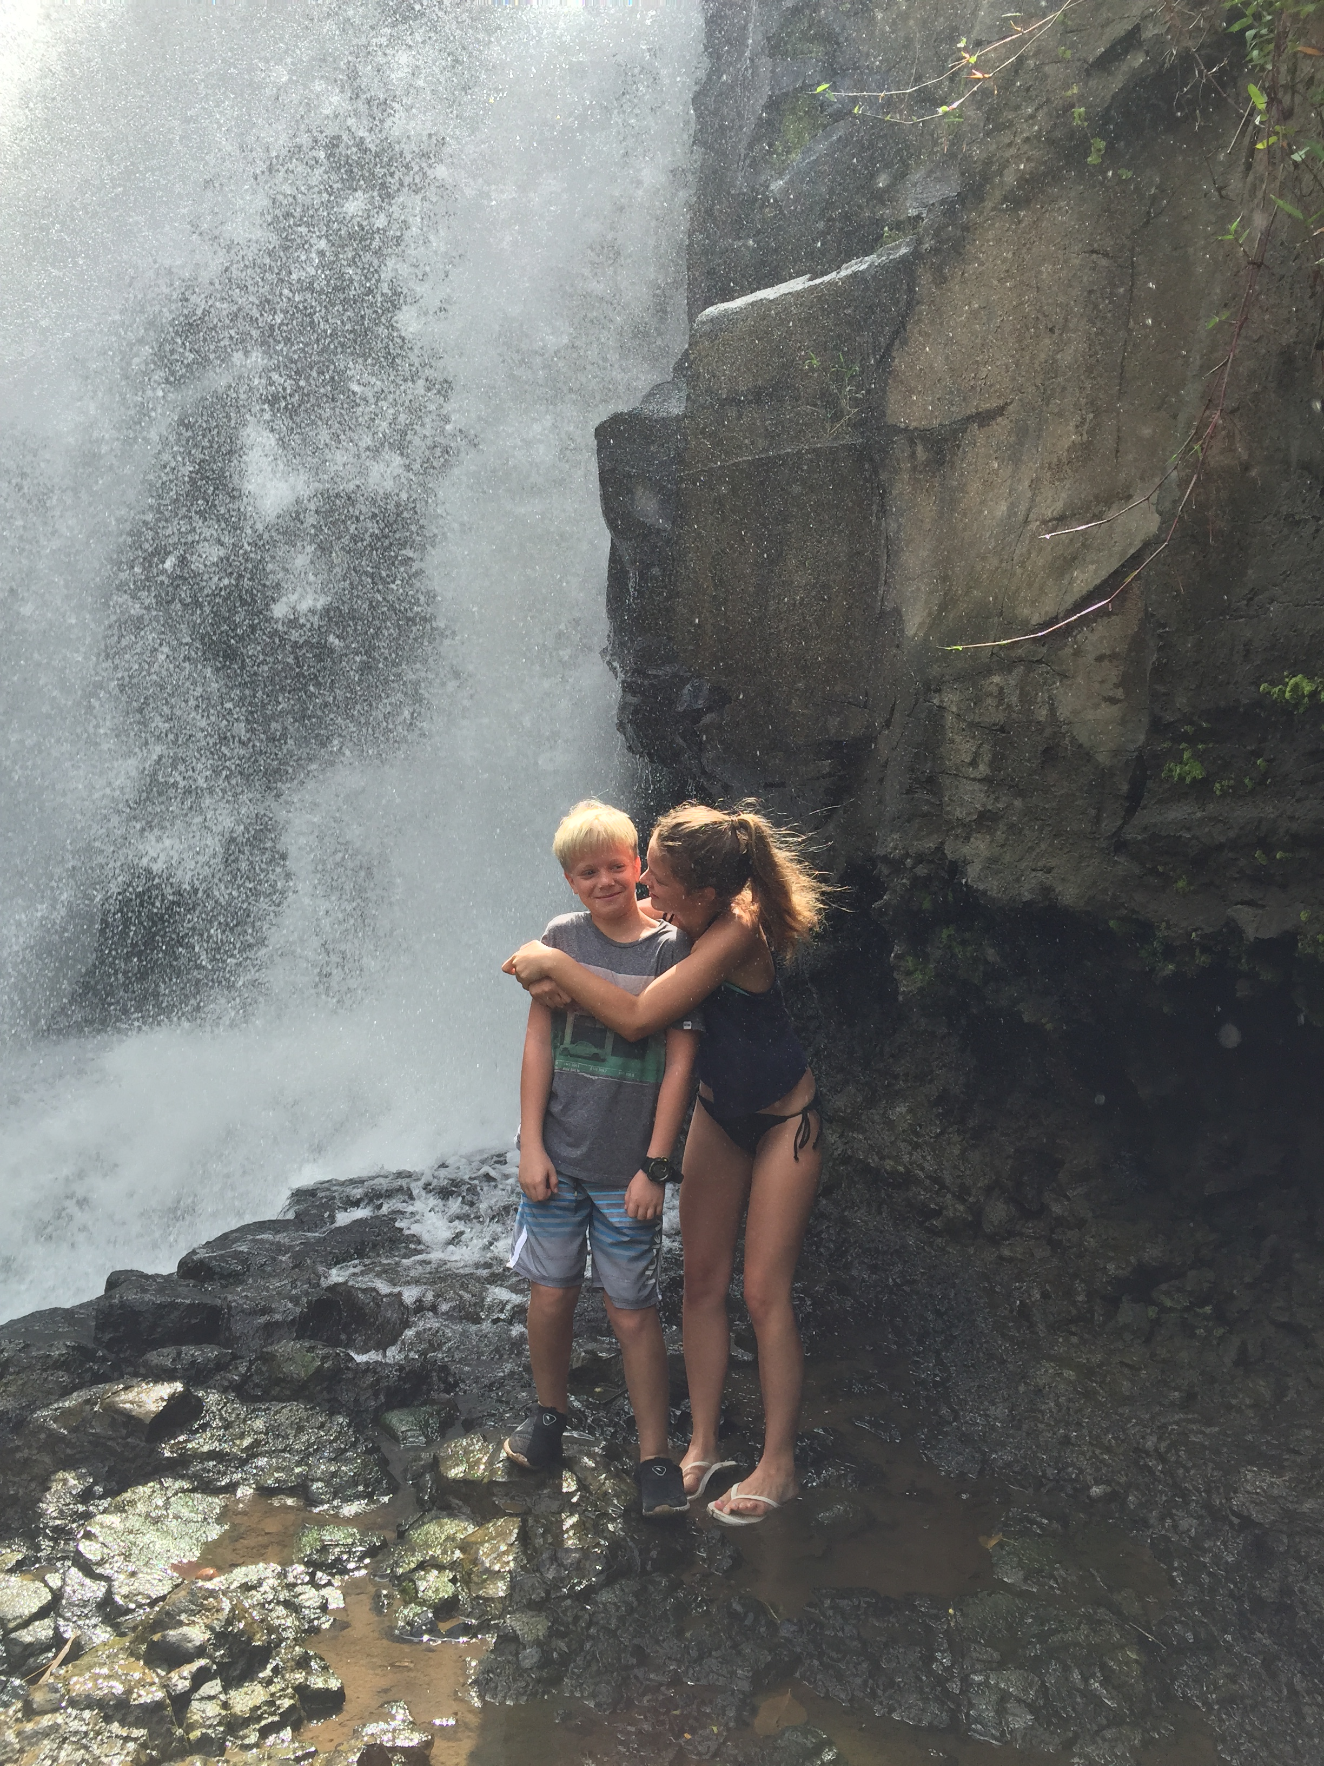
HUMAN INTERACTIONS
Lots of things in my life come from the environment. Like my food, water, what my clothes are made from, and my house/school are initially from the environment. Which is great, but it is also harming the Earth. Having a car is creating pollution and having such a high demand on food is creating animal cruelty and these are just some of the negative ways we have modified the Earth. I depend on the environment for all these necessities and materials to help my life continue. Although, I have adapted to the environment as well. I have adapted to the weather and know to wear a jacket when it is raining. Things like the weather impact my life every day, because due to the weather changes I have to pick out new clothes to wear, or in gym class we might not go for runs or do activities outside if the weather isn’t ideal.

Slide 9
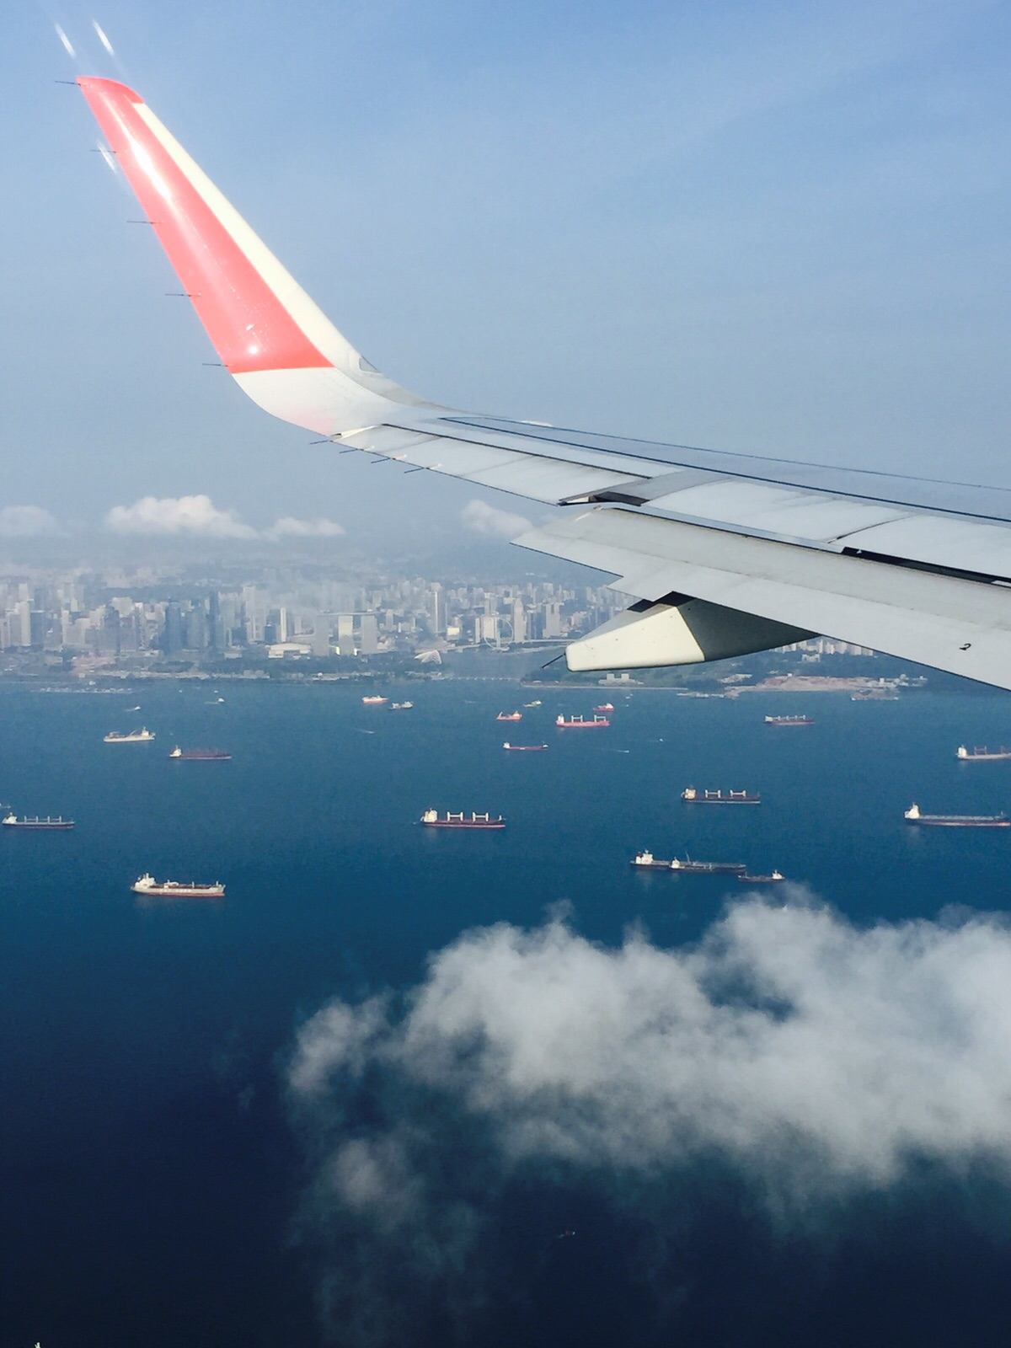
INTERACTIONS WITH THE 4 SPHERES
Lithosphere: When you’re flying in a plane the air pressure becomes different rather than on the ground. Planes are made from materials in the lithosphere, so this is one way lithosphere and the atmosphere interact. This affects me because we need safe plane’s so that people can travel from one place to another. Without humans knowing about how each sphere works we wouldn’t be able to fly planes or other things so this affects me greatly because I do travel a lot.

Slide 10
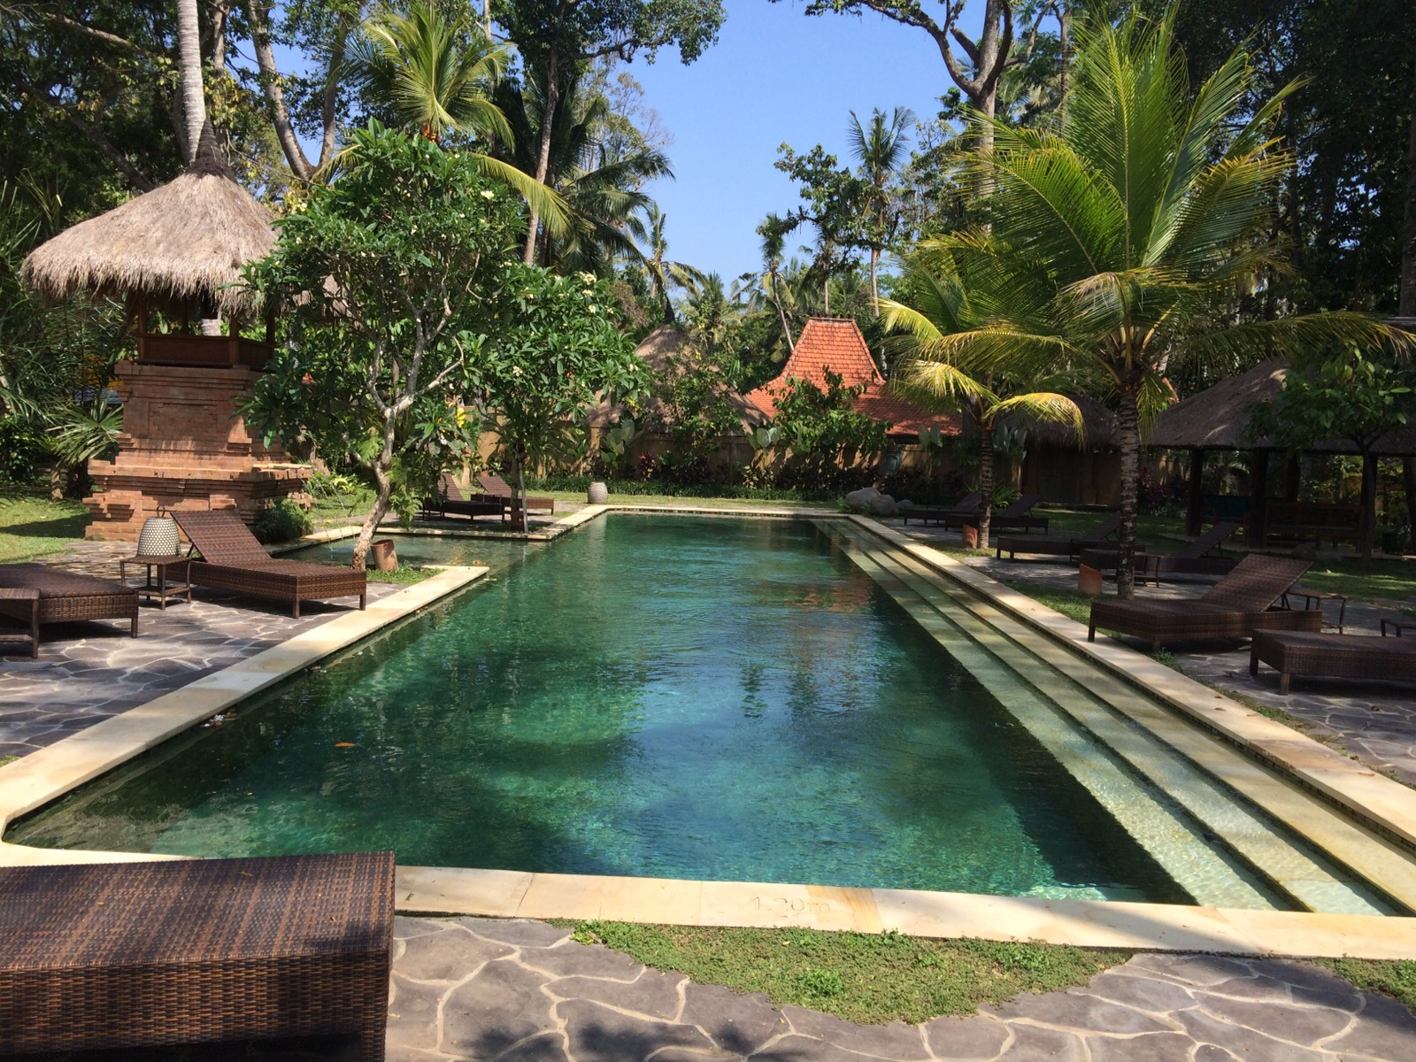
INTERACTIONS WITH THE 4 SPHERES
Hydrosphere: Hydrosphere affects me and where I live because here in Canada we are very fortunate to have lots of clean water. We an drink water from the tap, and you never know what you have until you visit another country where you cant drink water out of the tap. Like when I went to Indonesia we weren’t allowed to drink tap water and I just thought this was so crazy.

Slide 11
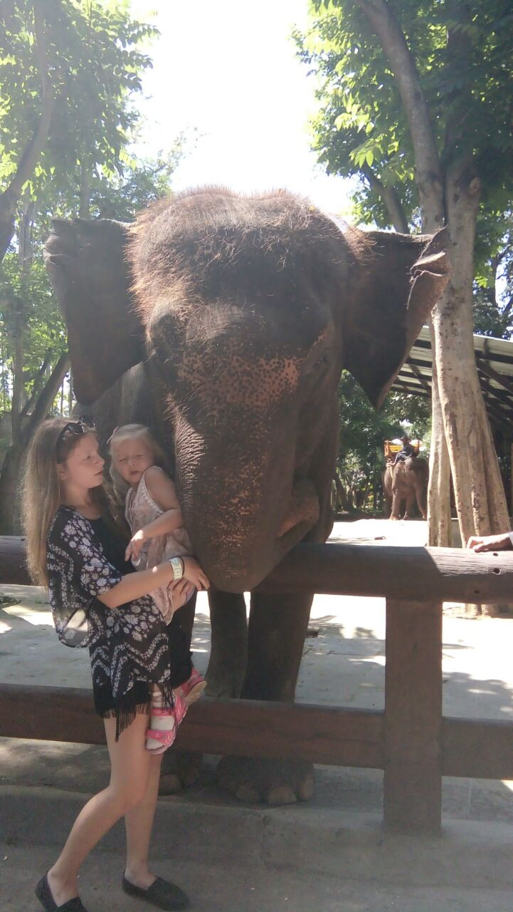
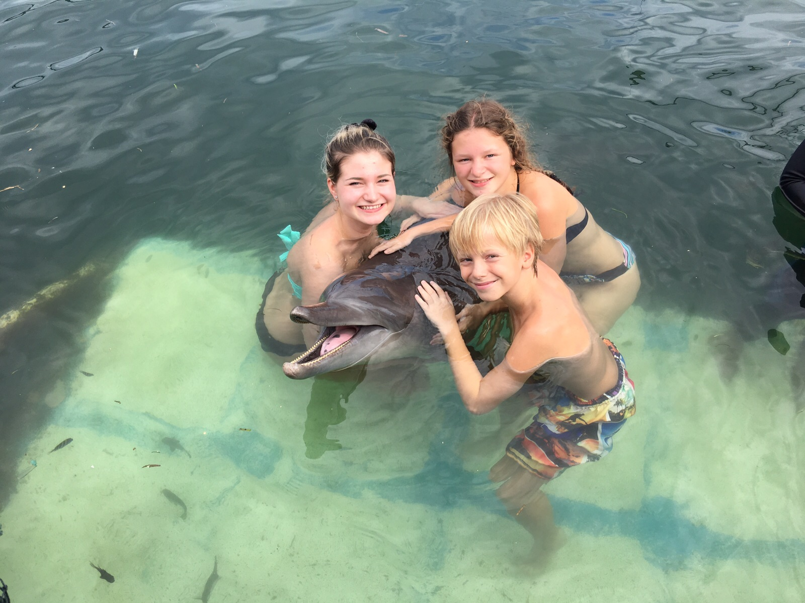
INTERACTIONS WITH THE 4 SPHERES
Biosphere: The biosphere can affect us in many ways. Animals and plants is something human’s greatly rely on. So it really all depends on the biosphere. The biosphere allows us to eat and survive without it there would be no life. The biosphere also interacts with the atmosphere which affect us and our way of living, for example green house gases. This is going to affect us in the long run, which is honestly something that scares me everyday. That is why I chose this example.

Slide 12
INTERACTIONS WITH THE 4 SPEHRES
Atmosphere: The atmosphere can affect many thing’s in my life like my health, which then affects my money and well being and so on. Human interaction is slowly killing this planet and the atmosphere is putting out a lot of warnings. Some countries already feel the effects of pollution. And even though it isn’t really impacting my day to day life, maybe down the road I’ll live in a country with bad air quality and develop asthma. This is just one way the atmosphere affects us.

Slide 13
THE END
THANK YOU

