Slide 1

My digital autobiography

Slide 2
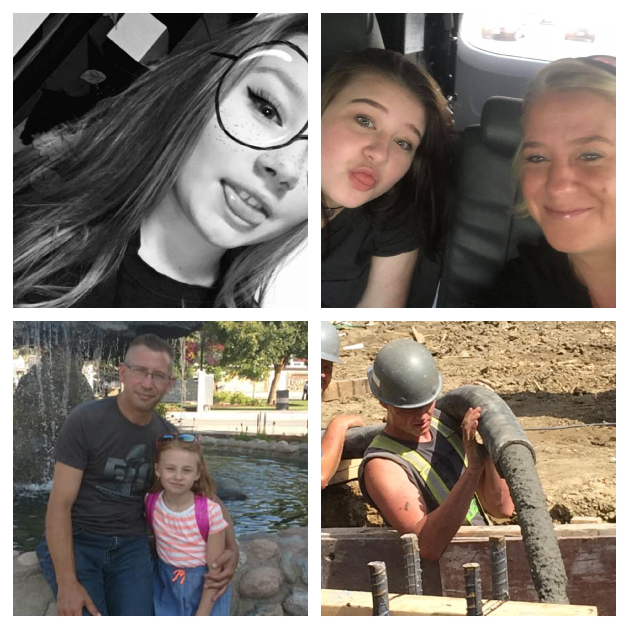
Family & Orgins

Slide 3

Personal interests

Slide 4
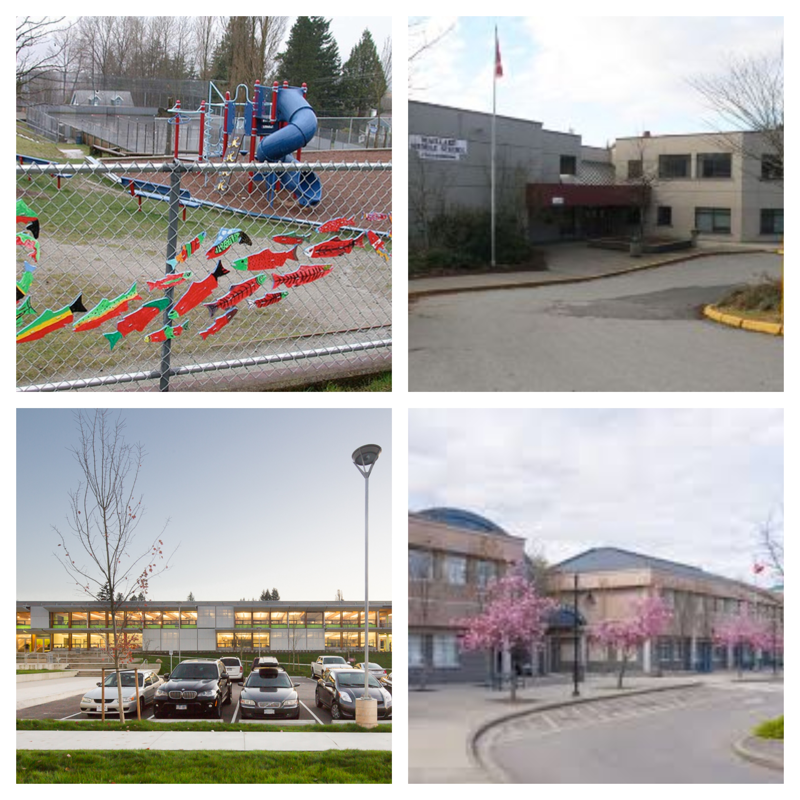
My school experience

Slide 5

Personal & Academic goals

