Slide 1
Families Around the World: EGYPT
Melissa & Emma

Slide 2
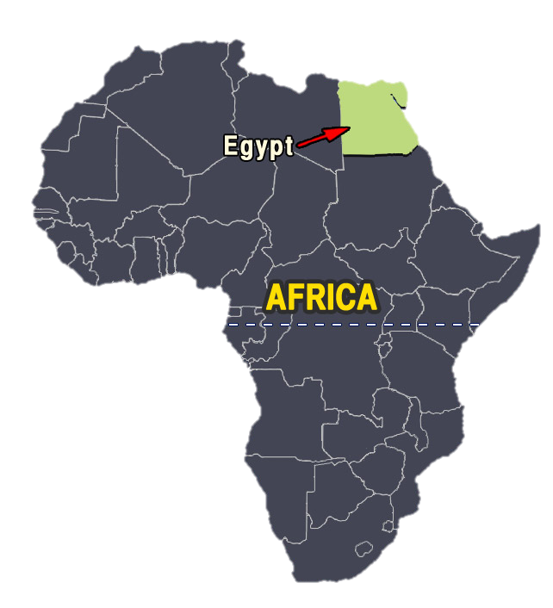
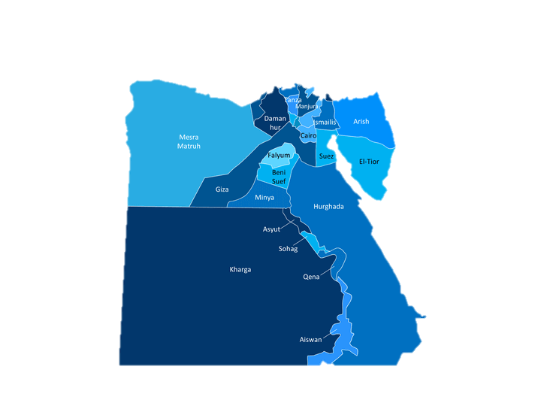
Location

Slide 3
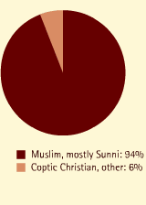
Language & Religion/Ethnicity

Slide 4
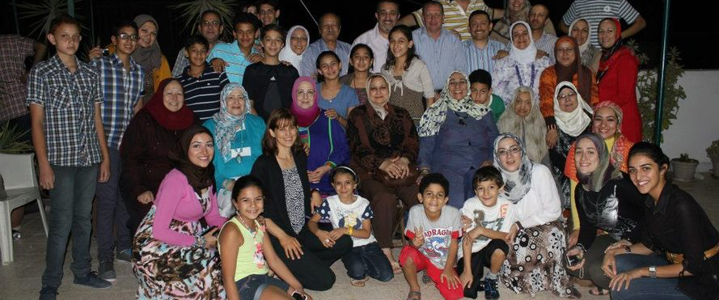
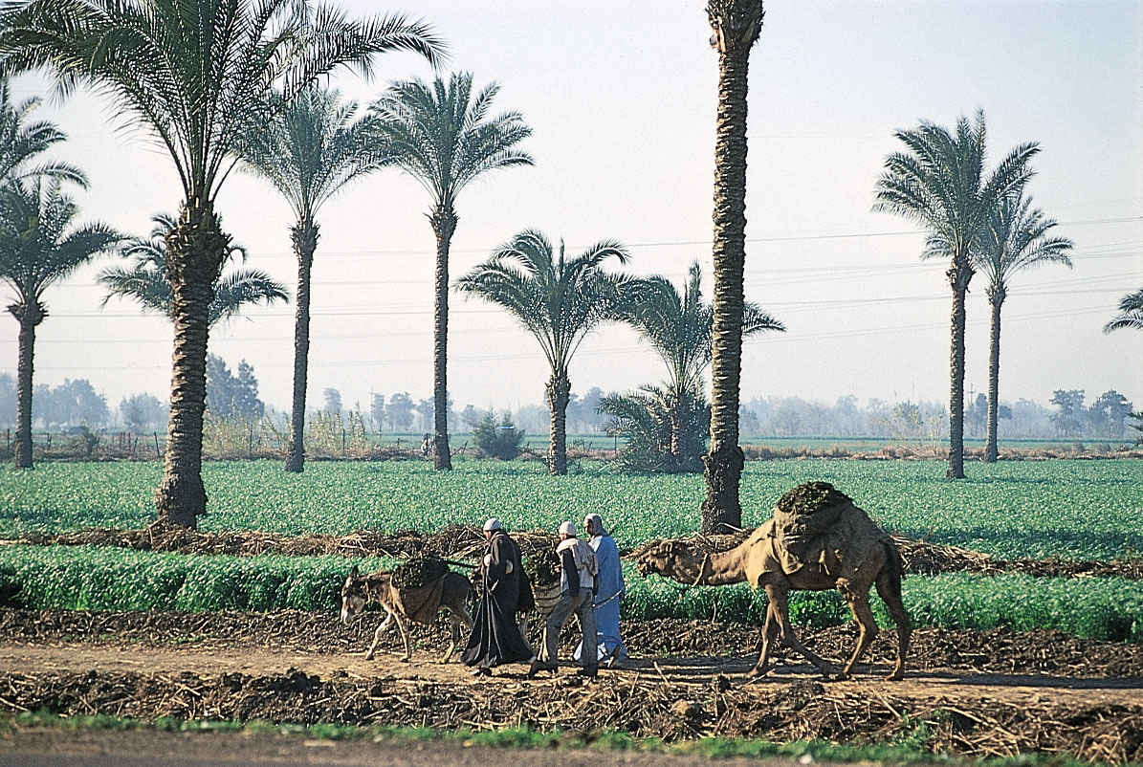
Household Structure

Slide 5
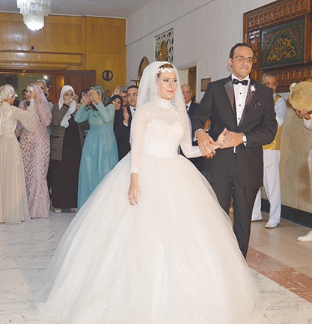
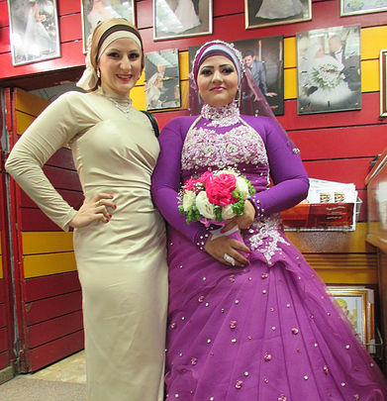
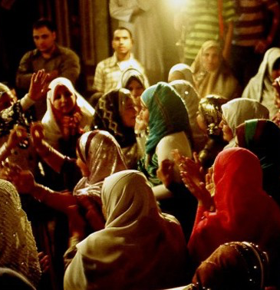
Marriage

Slide 6
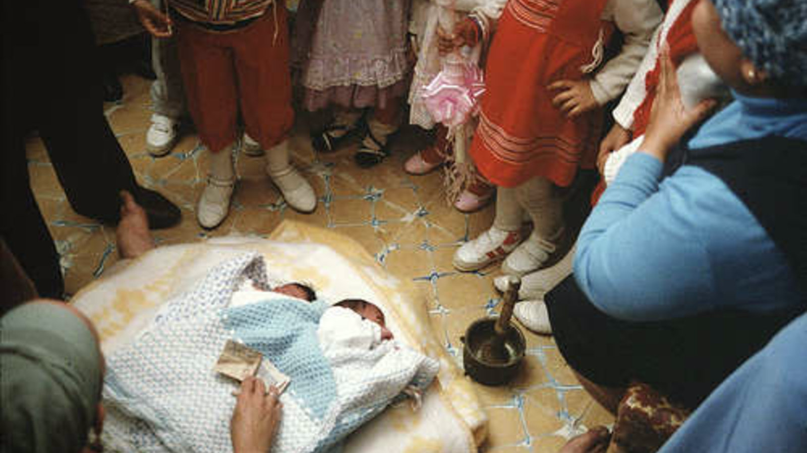
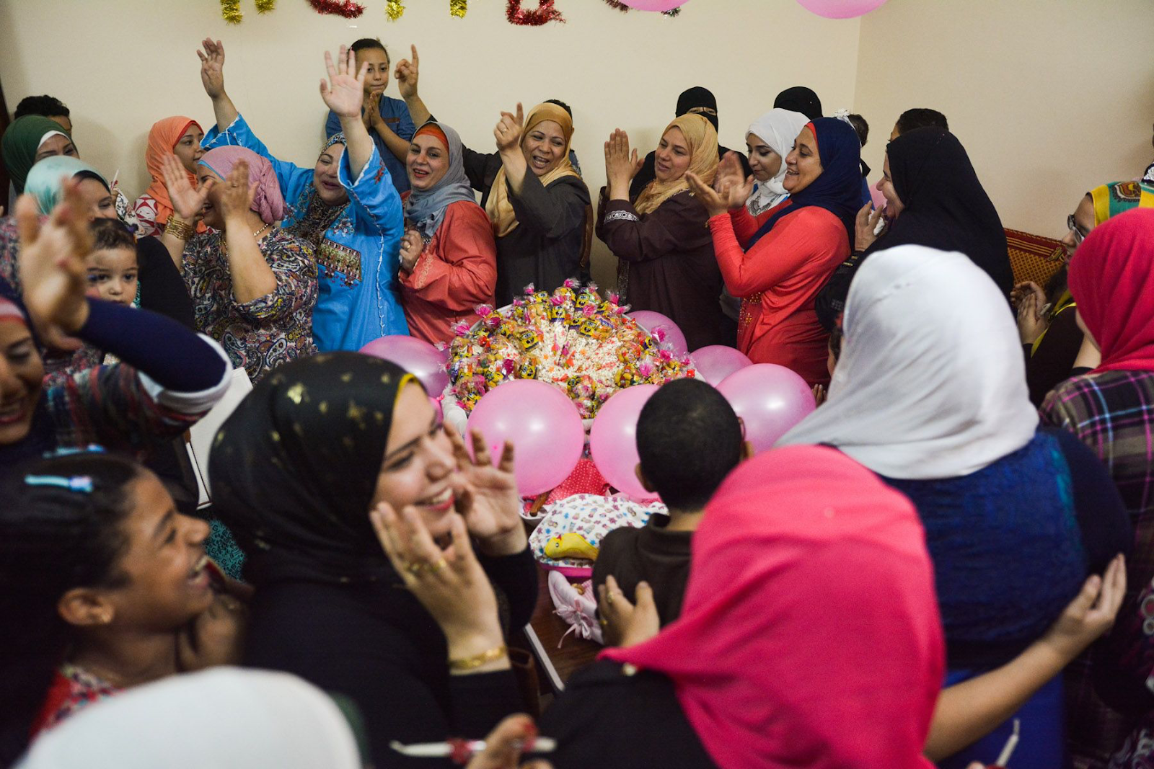
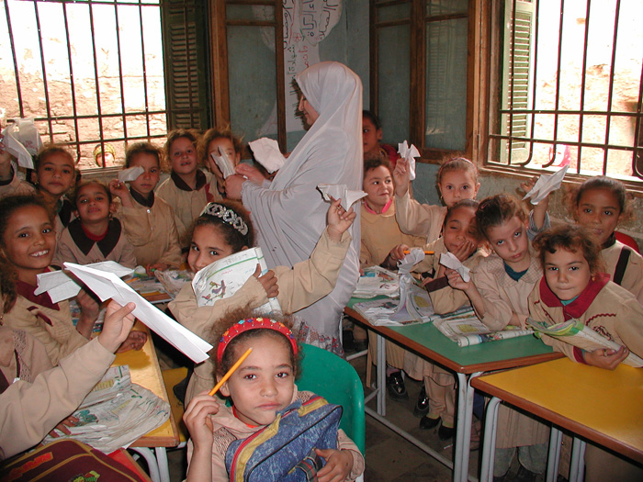
Children

Slide 7
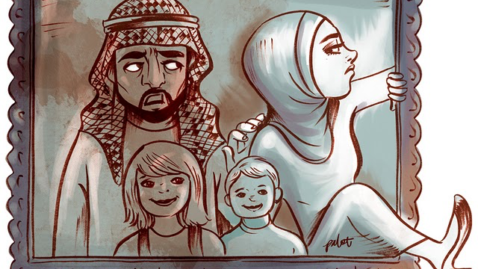
Divorce

Slide 8
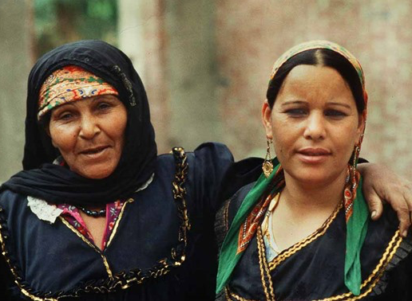
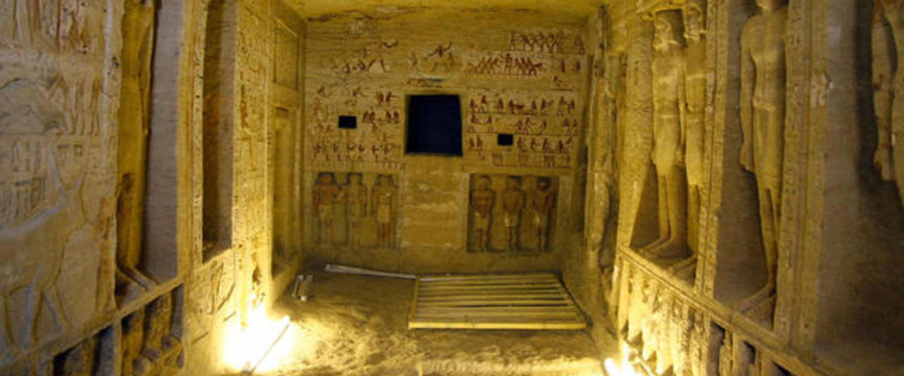
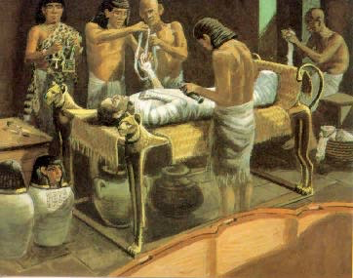
Care of Elderly & Death Rituals

Slide 9
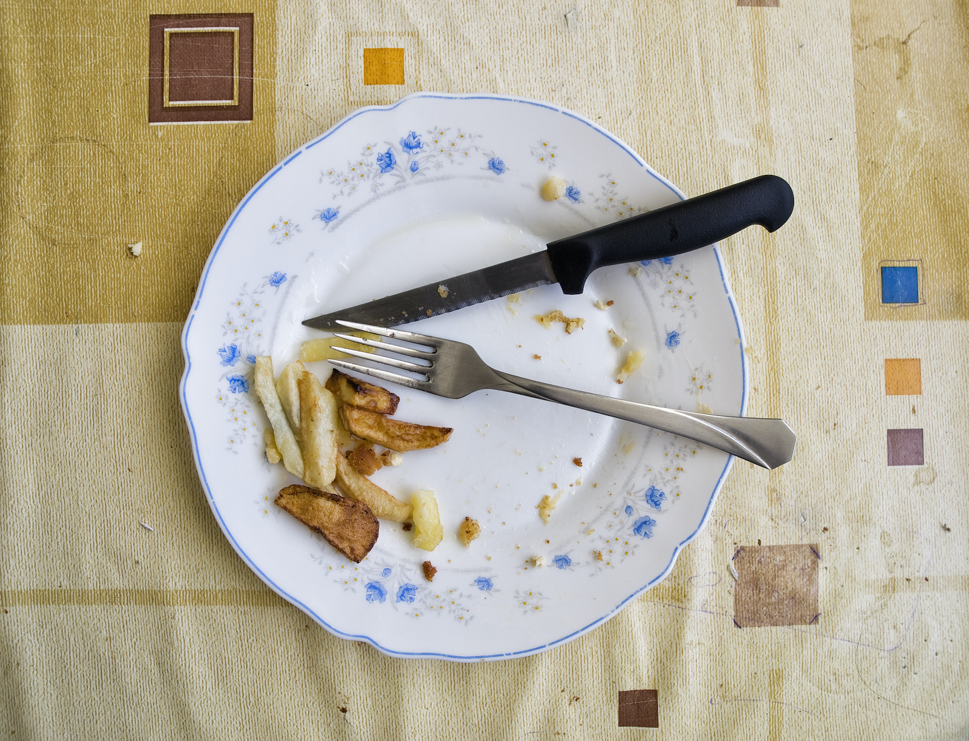
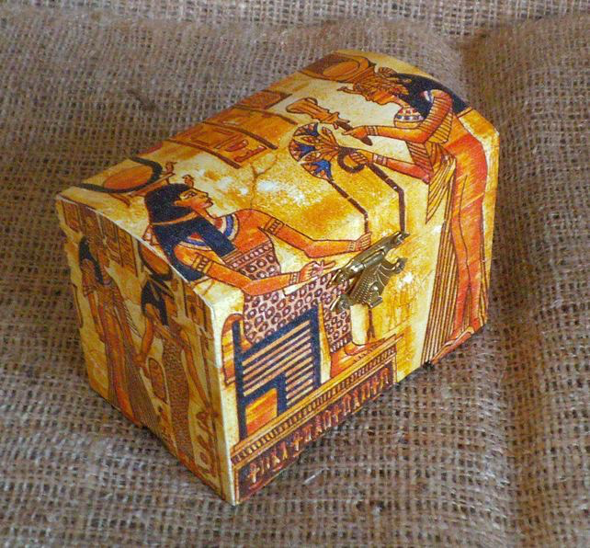
Other Interesting Facts

Slide 10
Sources
https://culturalatlas.sbs.com.au/egyptian-culture
https://www.sharmwomen.com/wb/pages/egyptian-marriage-tradition.php
https://www.ancient.eu/article/934/love-sex-and-marriage-in-ancient-egypt/
https://www.egypttoday.com/Article/6/66379/On-Marriage-and-Divorce-in-Egypt
https://www.zaradance.com/single-post/2014/08/07/An-Egyptian-Engagement
https://www.egypttoday.com/Article/1/14488/Egypt-targets-2-5-children-per-woman-Health-Ministry

