Slide 1
What Emotional Conflicts do Soldiers fighting in a war have on the battlefield?
Mark Iversen

Slide 2
Emotional Conflicts

Slide 3
Emotional conflicts felt in combat
Soldiers face a variety of emotions in combat
Ranging from complete overwhelmed thought, thinking of loved ones, to the thought of what they are doing
These emotions can start as just thoughts to the inability for the soldier to conduct there job, sometimes leading to death

Slide 4
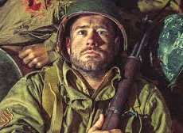
Emotional conflict of facing self
Soldiers often faced conflicts with their own thoughts
These thoughts can be as simple to the fear of battle
To the need to do something contradicting your own beliefs to safe your own life
These thoughts often led to immense fear and sadness leading to a blank stare of there thoughts

Slide 5
Emotional conflict of facing orders
Many orders in war can be considered mistakes by the lower ranks conducting the tasks
Although they may not believe in the order they are forced to follow it
If not they face being labeled a traitor or even killed

Slide 6
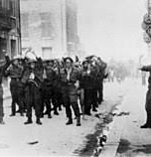
Conflict of facing orders through Prisoner of Dieppe
Many of the soldiers believed that the surprise of the raid was lost
They believed it was already a failure due to having losses before even departing
The fear of being imprisoned as a deserter was more worrying than the mental conflict

Slide 7
Emotional conflict of facing sights
During war many harsh battles were fought
Many horrors were seen
Many soldiers can not describe what they have seen and often leave with PTSD
These conflicts arise at many of the sites in war

Slide 8
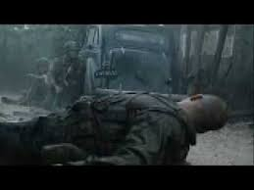
Conflicts of facing sights shown in saving private ryan
These sights also including watching your allies die with no way of helping
This is shown well were the entire squad must sit and wait while they are held down with an enemy sniper
During this one member is wounded in the center of a courtyard
They have no ways to help, but must sit and watch as there friend bleeds to death and begs for them to send a letter to his family

Slide 9
Emotional Conflict of actions
Soldiers in the war often had to make harsh decisions that could lead to very difficult consequences
Many would worry of the thought of taking life, and being able to do many of the tasks that are conducted during war

Slide 10
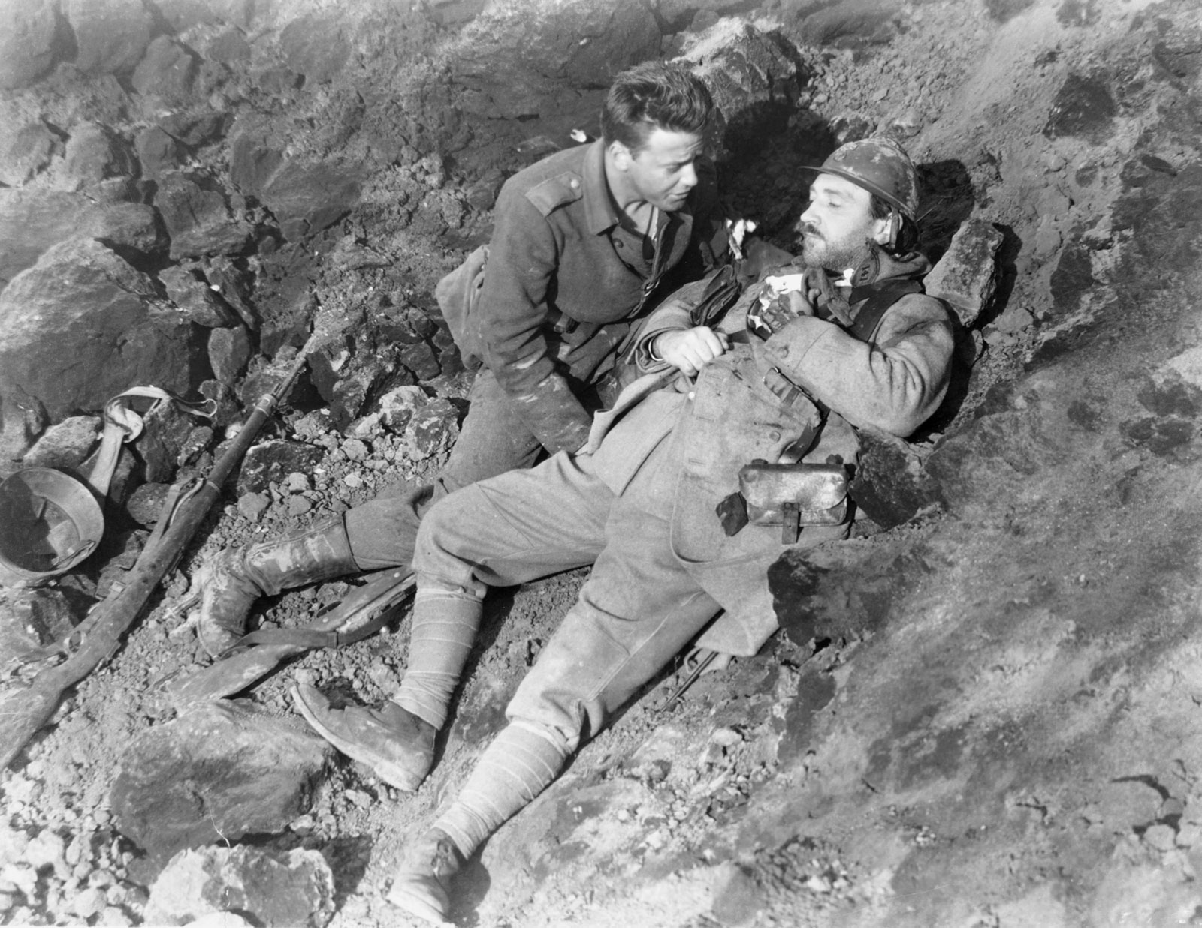
Conflict of actions shown in All Quiet on the Western Front
Shown when Paul is faced with needing to kill a French soldier while they both dive into a shell hole for cover
He faces the emotions of the realisation that he has just taken someone's life, in shock he watched the man die
He began to feel a need to compensate the dead soldiers family
He is unable to move with these thoughts on his mind

Slide 11
Emotional conflict of separation of family
Many soldiers would feel immense sorrow for not being with loved ones
Many soldiers managed this with letters being written home, these letters were sometimes never sent and left on the dead soldier

Slide 12
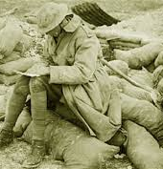
Conflict of separation of family shown in All Quiet on the Western Front
When Paul was in shock of his actions of taking a French life in a shell hole he felt he must reach out to the family of the soldier
He felt he needed to, so he found a letter to the soldiers home
Although Paul could not understand most words it was clear that that soldier faced the same conflict that he felt with being away from his family

Slide 13
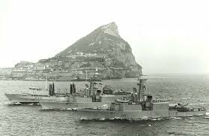
Family connection to conflict of separation of family
While I grew up I heard of the stress that my grandfather went through while he served in the navy
Being away for most of the year missing your children's childhood
This conflict continued to build until he left the navy

Slide 14
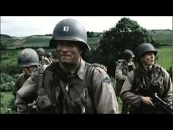
Conflict of separation of family in Saving Private Ryan
During one scene after the team loses one of there men a conflict arise leading to Captain Miller sharing his emotions with leaving and being away from his family
He also shows how everything he does is for a chance to return to his family

Slide 15
Overwhelmed emotions

Slide 16
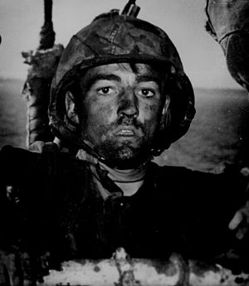
thousand yard stare
Unfocused
shocked,
Weary gaze
Frequently referred to as shell shock

Slide 17
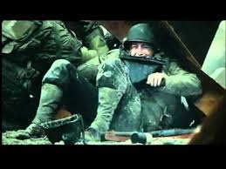
Overwhelming Fear
Instead of shock
Fear fills the body giving little to no ability to operate

Slide 18
Commitment to overcome
Often felt by many of the soldiers
Often emotion is centered towards a loved one
They are often the sole reason a soldier is able to hold together
For the thought of a loved one and to see them again

Slide 19
Solution

Slide 20
There is no simple resolution
Emotional conflict will always be in harsh conflict
There is no way to avoid it
There are only ways to manage it after the battles are fought
Many countries have become very good at assisting and managing past serving members mental stresses

Slide 21
Existing methods to assist
Counselling through someone who is knowledgeable on the topic and who the person affected trusts
Often treatment consists of multiple stages leading into confronting the trauma
The treatment continues with ongoing support and many people affected will be issued a service dog to hope them perfect it

Slide 22
The Perfect Solution
The only solution that would solve the solution of war time stress would be to eliminate war
But in our worlds past that would be very difficult
But the only way to eliminate war time emotional conflicts is to eliminate war

