Slide 1
Dave Cooks A Turkey
By: Leah Nathorst

Slide 2
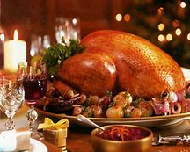
Significance of the title
From reading the title we are able to decipher that there is a main character named Dave, who is going to cook a turkey.
This gives the reader insight towards what time of year the story could be taking place like Christmas time or thanksgiving.

Slide 3
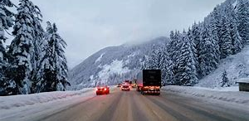
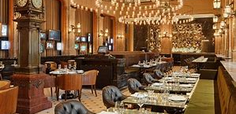
Setting
House – the majority of the story takes place in Dave and Morley's home. A small but modest home located in a small snowy neighbourhood.
Grocery store – the grocery store where Dave buys the turkey.
Hotel – The hotel Dave asked to cook the turkey was a 5 star luxury hotel.

Slide 4
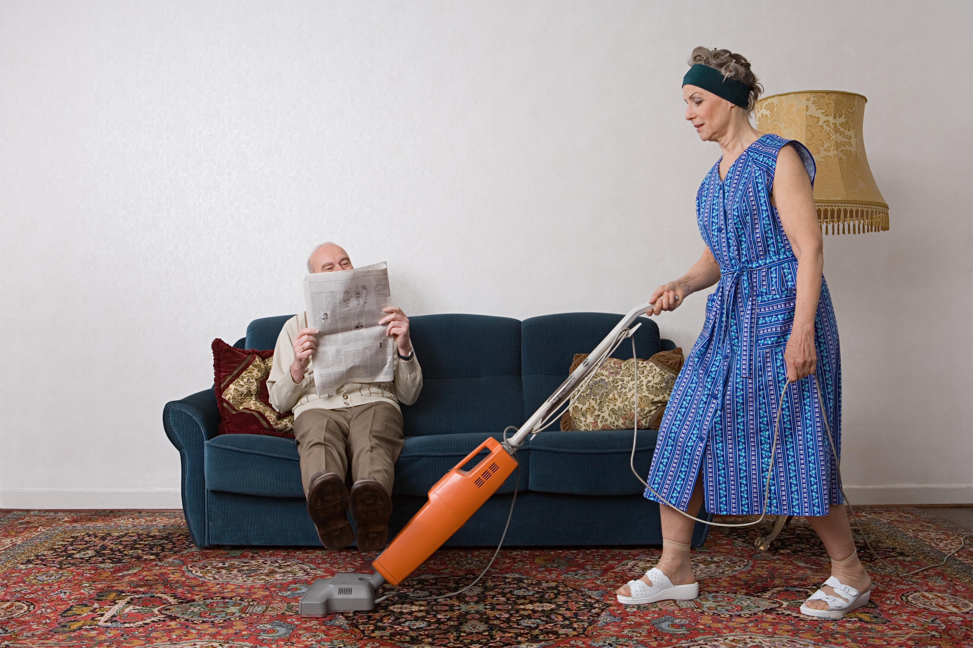
Introduction (plot)
Dave needed to help his wife Morley with dinner, Morley had felt overwhelmed with the amount of work she has to do around the house and decided to put Dave in charge of cooking the turkey

Slide 5
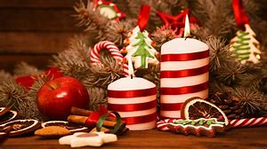
Initiating Incident (plot)
Morley joins the neighbourhood Christmas club and finds a new found love for Christmas.

Slide 6
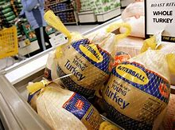
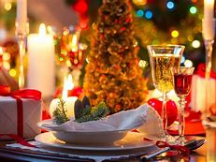
Rising action (plot)
Dave and Morley get into an argument and about Dave is lazy and never helps Morley out with the housework like cooking and cleaning and taking care of the kids.
On Christmas eve Dave had forgotten to go buy the Christmas turkey, so in the morning he quickly went to the store and bought one.
When Dave got home to cook the turkey he found out he did not know how to use the oven.
Dave ended up having to drive to a 5 star hotel and convince them to cook his turkey for him.

Slide 7
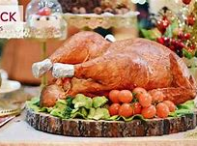
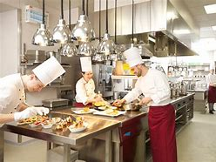
Rising action (plot)
The hotel finally cooked Dave’s turkey and he headed home, and began to panic because the house did not appear like he had been cooking at all, and Morley and the family where to be coming home any minute.

Slide 8
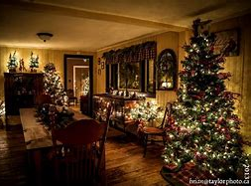
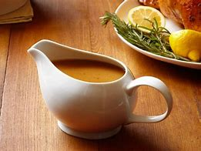
Climax (plot)
When Dave got home he took the bowl of gravy the hotel made and smeared it around the light bulbs around the house to make it smell like he had been cooking.
Morley came home with their family in tow and some friends and was delighted to see Dave cooked the turkey.

Slide 9
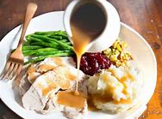
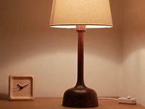
Falling action
Jim one of the neighbours sat down under one of the lamps and gravy began to drip on his forehead.

Slide 10
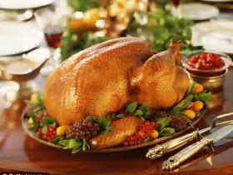
Conclusion (plot)
The story ended with Dave having to confess to Morley what really happened.

Slide 11
Characters
Dave – protagonist, dynamic
Morley – static
Carl (Neighbourhood club) – flat
Greta (Neighbourhood club) – flat
Jim - Flat

Slide 12
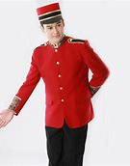
Irony
Situational irony – we expected Dave to cook a turkey from the reading the title, but Dave did not end up cooking the turkey.
Verbal irony – The story includes a lot of verbal irony in Dave's character like when he went to the hotel and said to the bell boy “I'm just checking in with my chick” he uses a lot of sarcasm.

Slide 13
Foreshadowing
Morley had warned Dave that he would mess up cooking the turkey, but Dave denied all claims saying that he could handle it fine.
This leaves the viewer to easily predict what would eventually happen to Dave.

Slide 14
Genre
The story was a very easy to read lighthearted and humorous short story.
Humor
Light hearted
Short story

Slide 15
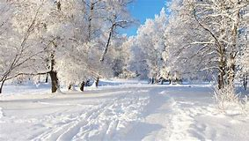
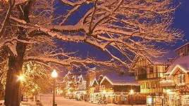
Setting (physical and emotional)
physical – Very snowy, cold, festive, Christmas time, people busy and in a rush.
Emotional – panicked, light hearted, humorous, angry.
Atmosphere – the atmosphere of the story was very lighthearted and funny.

Slide 16
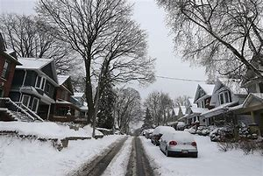
Symbol
Turkey – The turkey resembles Dave and Morley's relationship and the lack of trust they have in each other.
Neighbourhood club – the neighbourhood club Morley joins represents how she never seems to have time to herself and needs a club to find an escape.
Scotch – the scotch resembles how when Dave gets stressed he drinks.

Slide 17
Moral
Dave starts off not understanding why Morley feels like she is a “train” and has no life of her own other then caring for her family. Dave begins to feel bad and accepts Morley’s request of cooking the Christmas turkey. During and towards the end of the story Dave begins to feel how Morley feels all the time and starts to understand how little he does to help her out.

Slide 18
Theme
Dave faces a lot of obstacles throughout the story but doesn’t seem to give up for the sake of Morley.
The theme is that no matter how many obstacles you face there's always a way to overcome them.
Another theme is that you should always be honest with people and tell the truth because if you don’t it can sometimes have consequences. For example when Dave did not come clean to Morley about not cooking the turkey.

