Slide 1
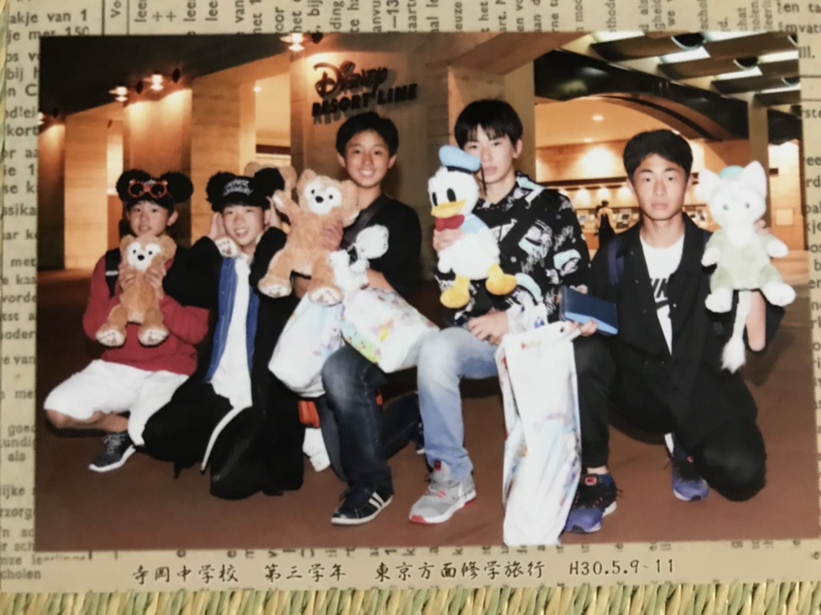
All about me
Kosuke Ueno
上野 倖奨

Slide 2
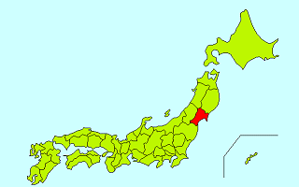
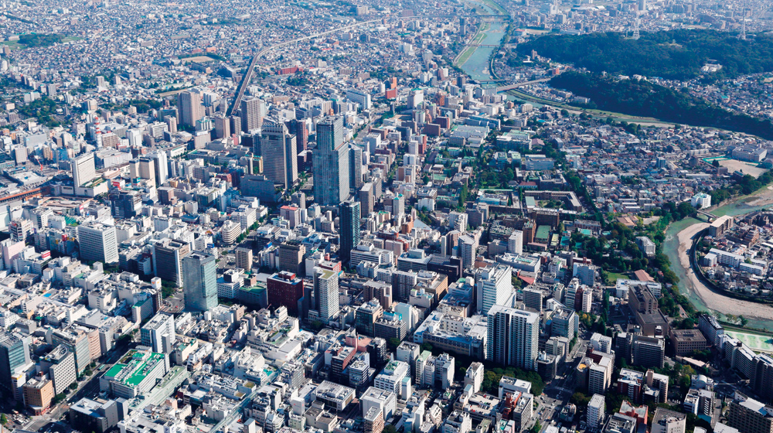
My Hometown
Sendai Japan

Slide 3
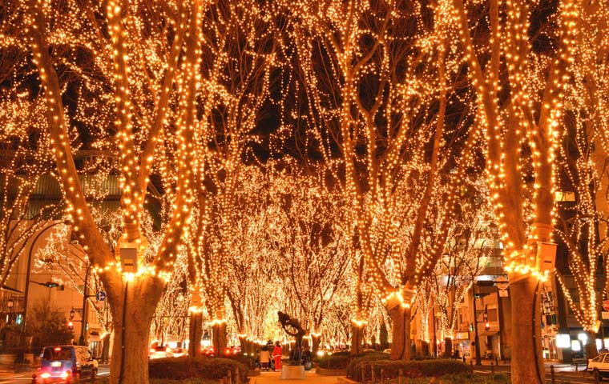
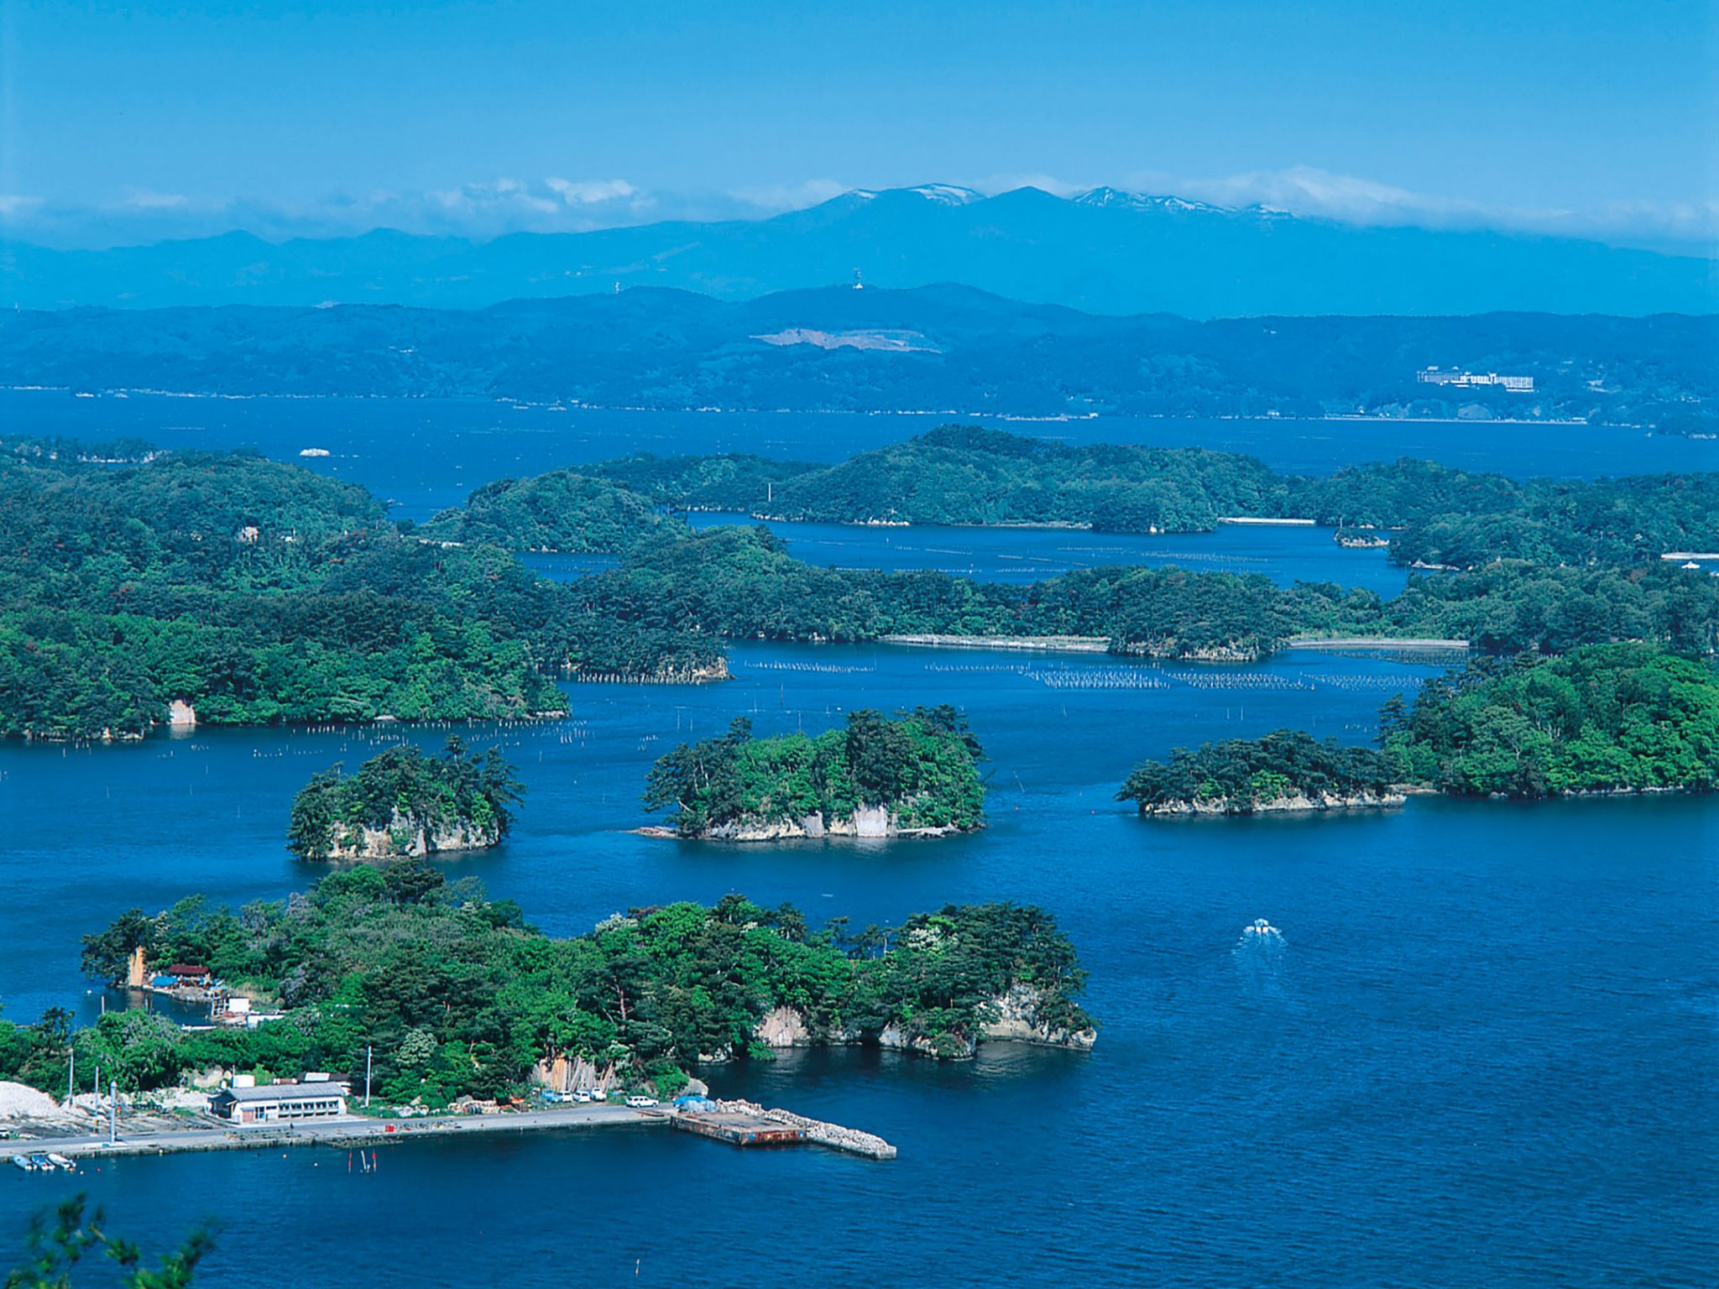
About Sendai
Sendai Light Pageant
Matsushima

Slide 4
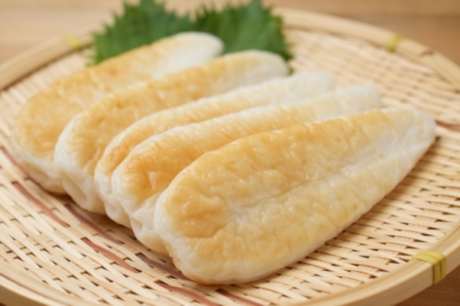
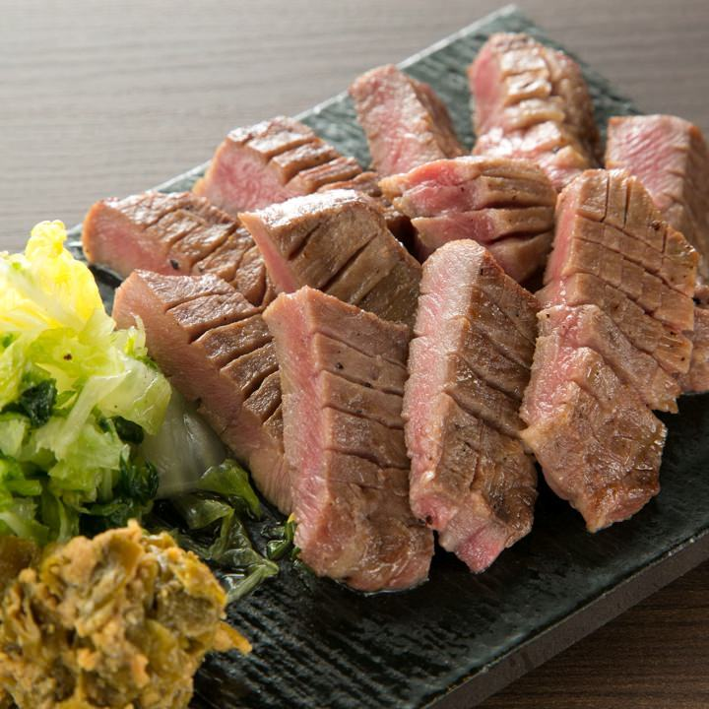
Food in Sendai
Sasakama Gyu-tongue

Slide 5
Favorite Singer
Shawn Mendes

Slide 6
My family
Father Mother Me

Slide 7
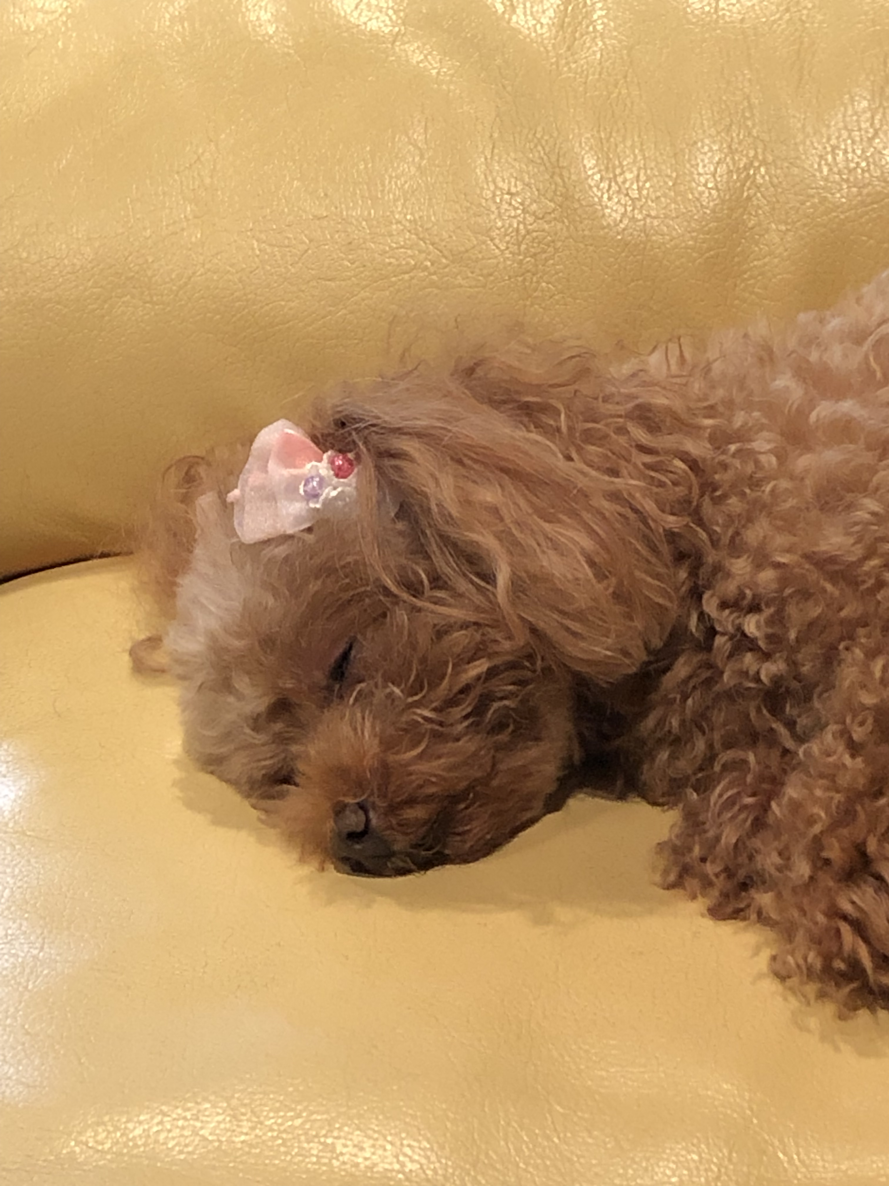
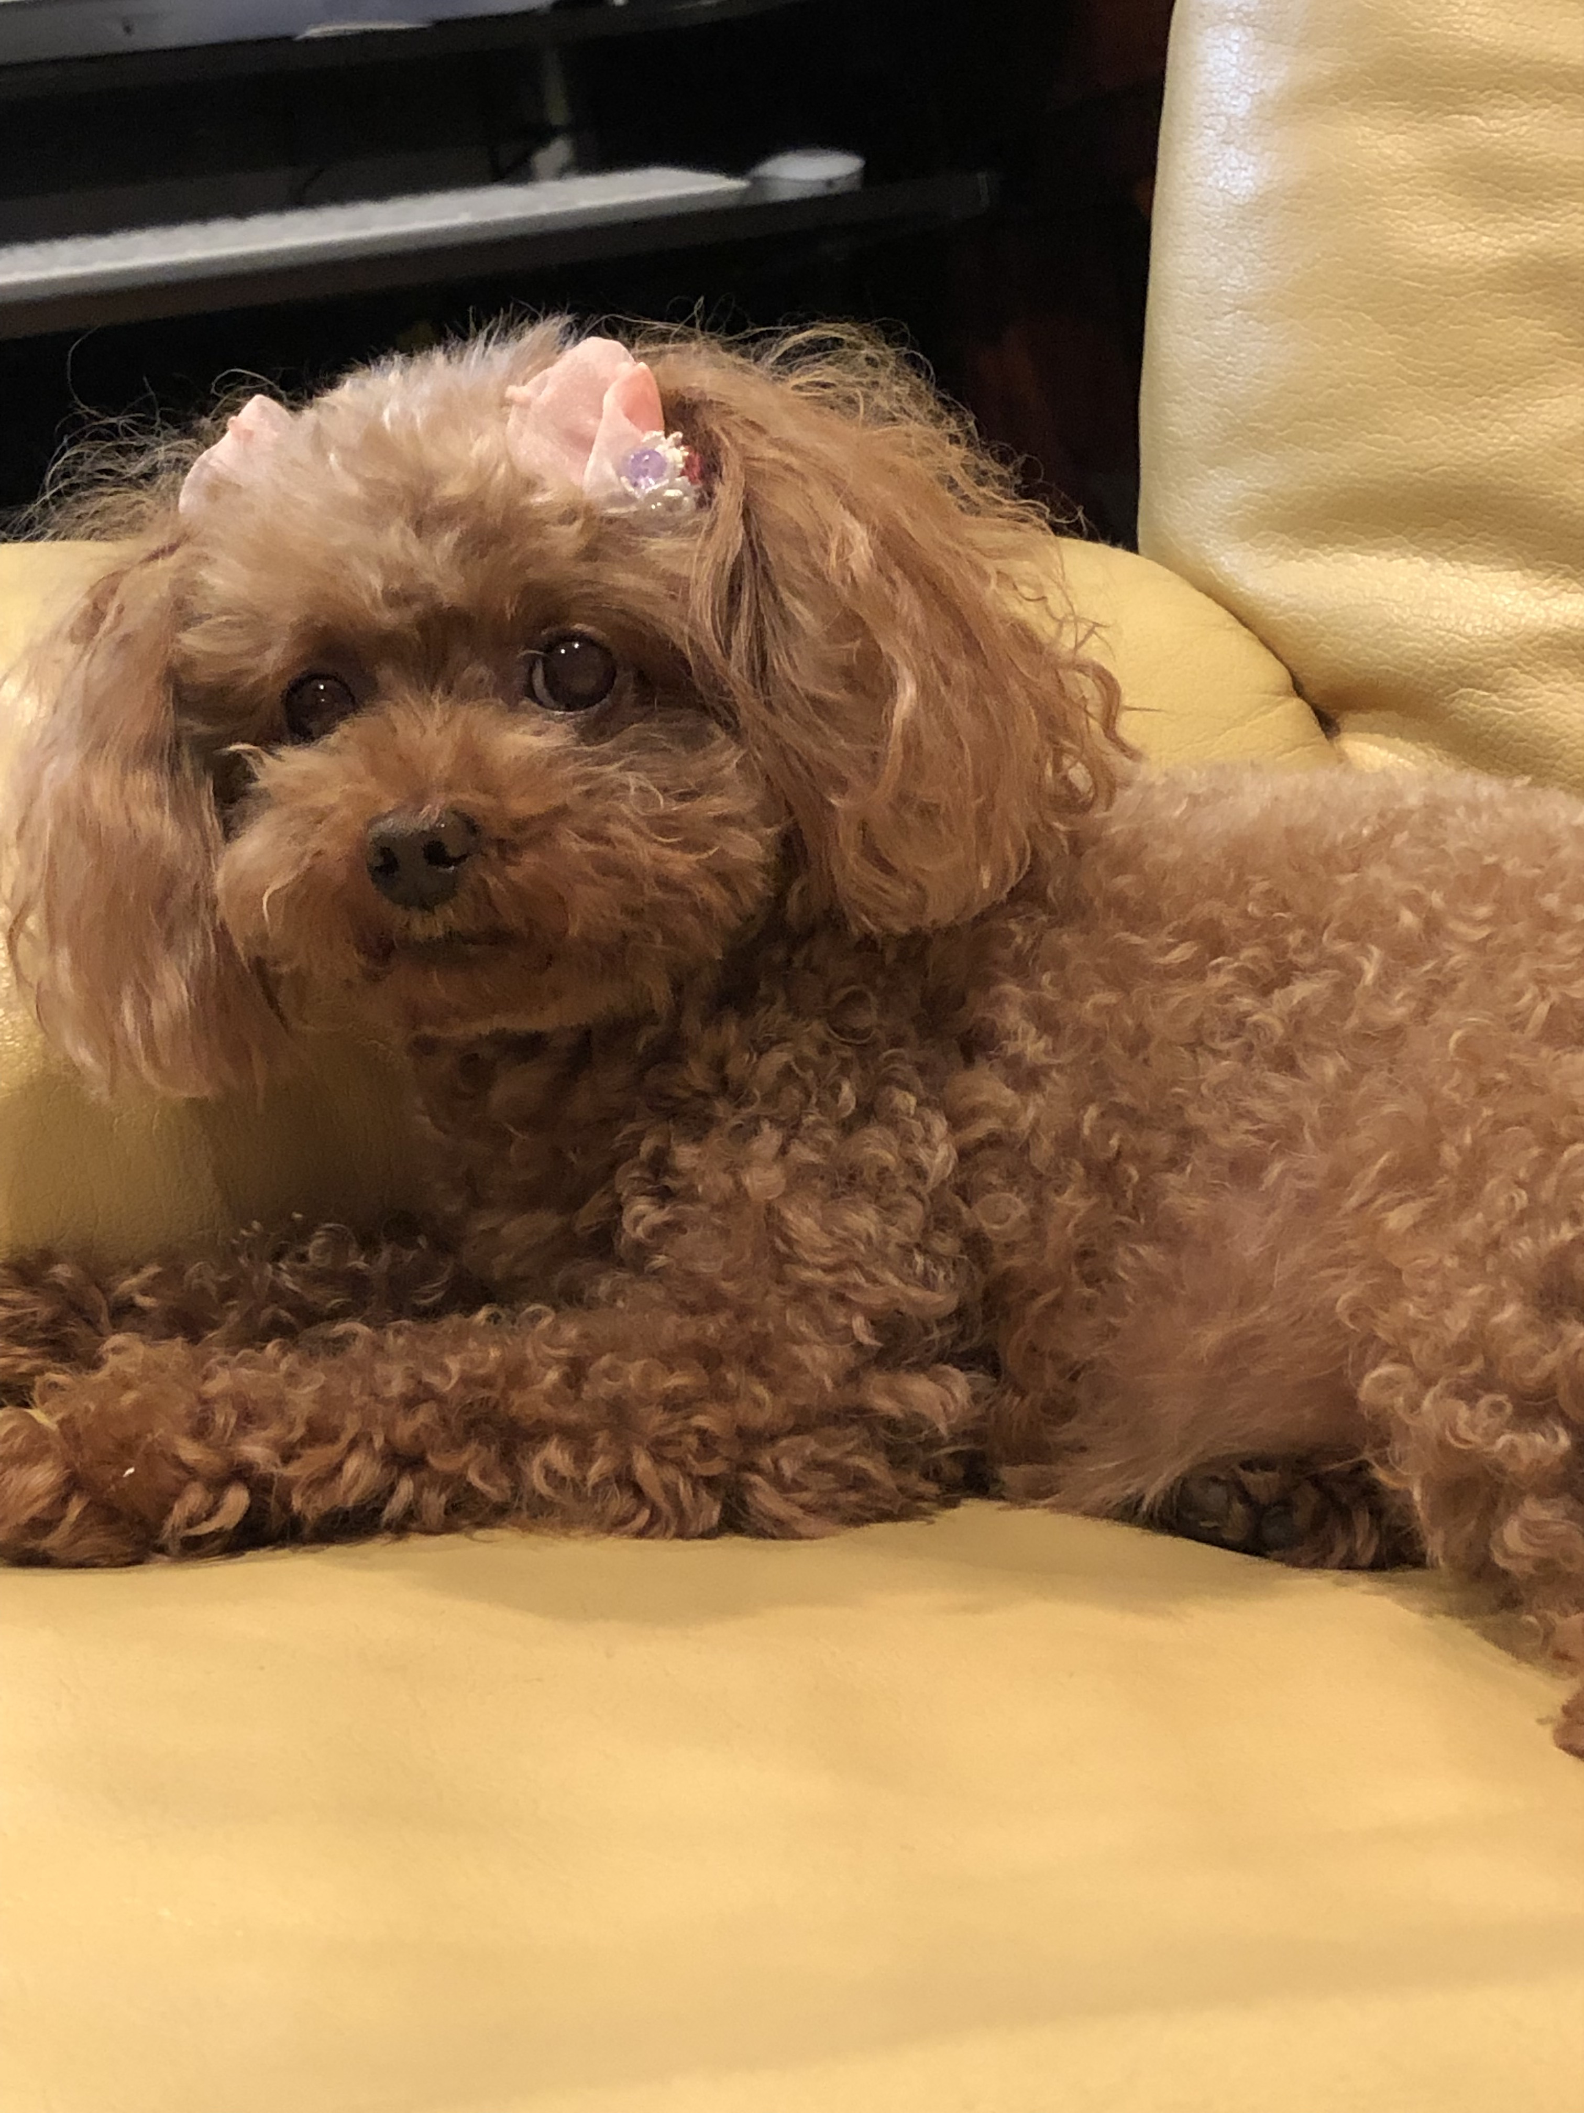
My pet
Dog

Slide 8
Three words describe me
1.Shy
2.Kind
3.Friendly

Slide 9
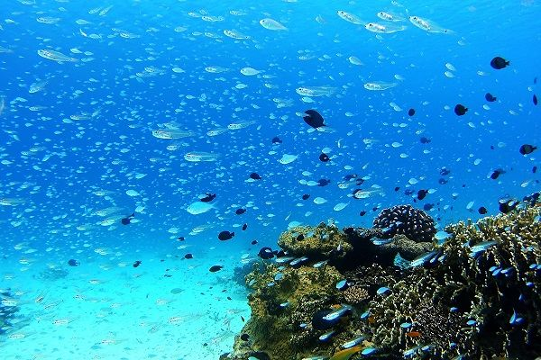
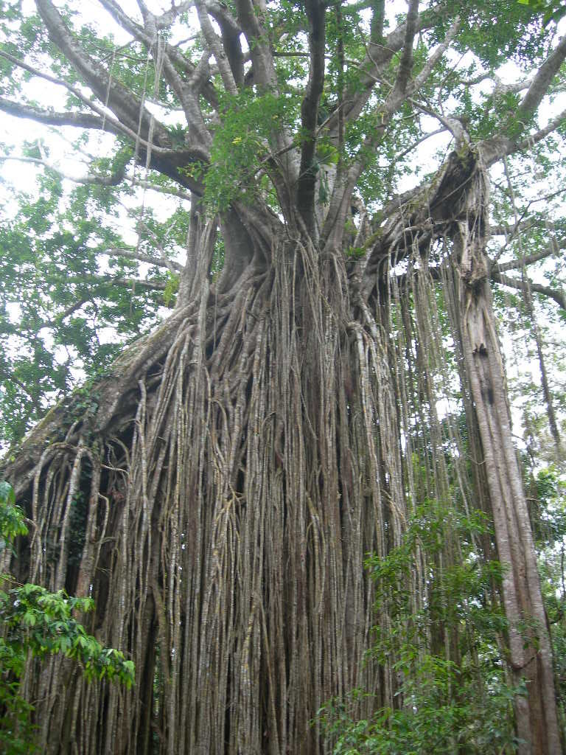
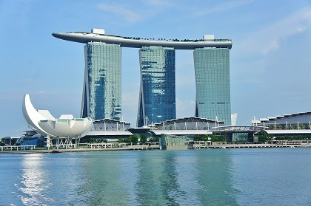
Place I traveled
Australia
Okinawa
Singapore

Slide 10
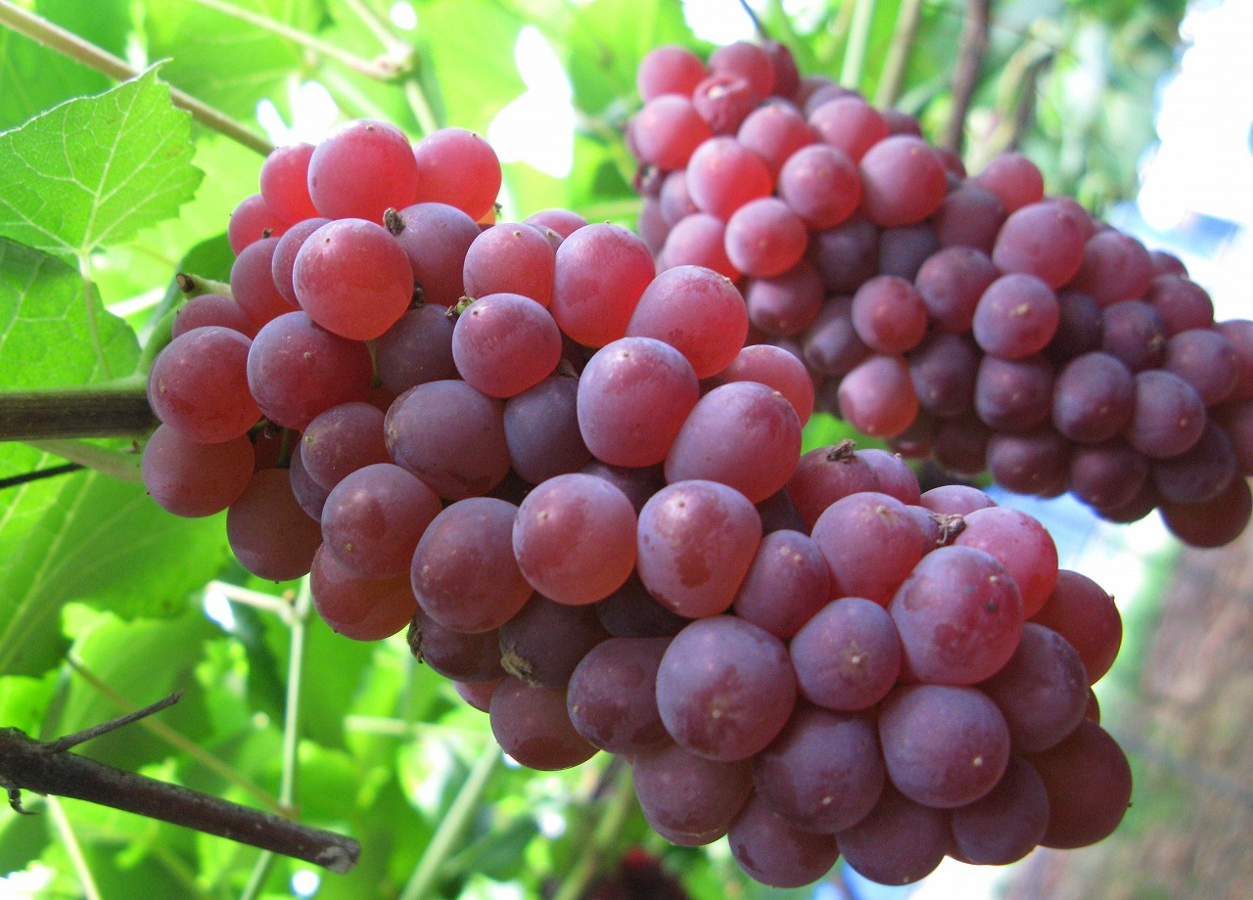
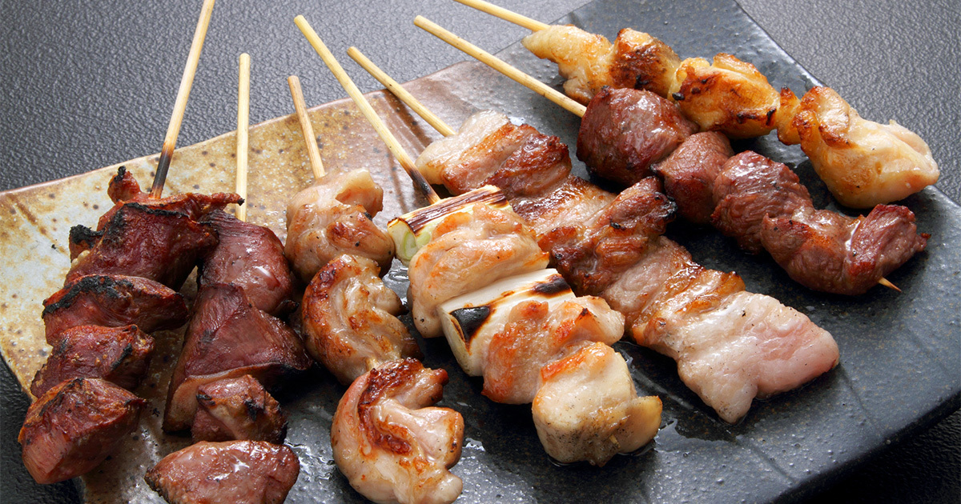
Favorite foods
Grape Yakitori

Slide 11
Favorite apps
LINE
YouTube
Twitter

Slide 12
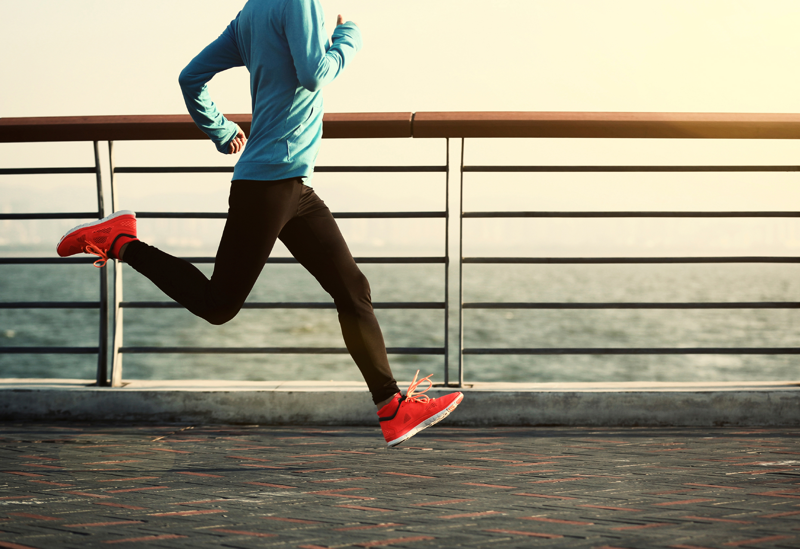
Three things I like
Watching Movies
Running Soccer

Slide 13
My dream
1.Travel to Europe
2.To be good at speaking English
3.Change my hair color

Slide 14
Favorite quote
If you can dream it ,
you can do it.
by Walt Disney

Slide 15
Thank you

