Slide 1
Programs as Directions
Start the Car

Slide 3
Ambiguous?
Notes:
People can decipher ambiguity. Computers cannot. What would be a problem with a program that had an ambiguous direction like deciding if this is a duck or a rabbit?

Slide 4
Programming languages use words similar to those that people use, but they have a highly specific syntax (structure, order, grammar and spelling) that allows little room for ambiguity.

Slide 5
Directions with errors
There are two errrors in this sentence.
What is the problem here?
Syntax Errors
Logic Errors

Slide 6
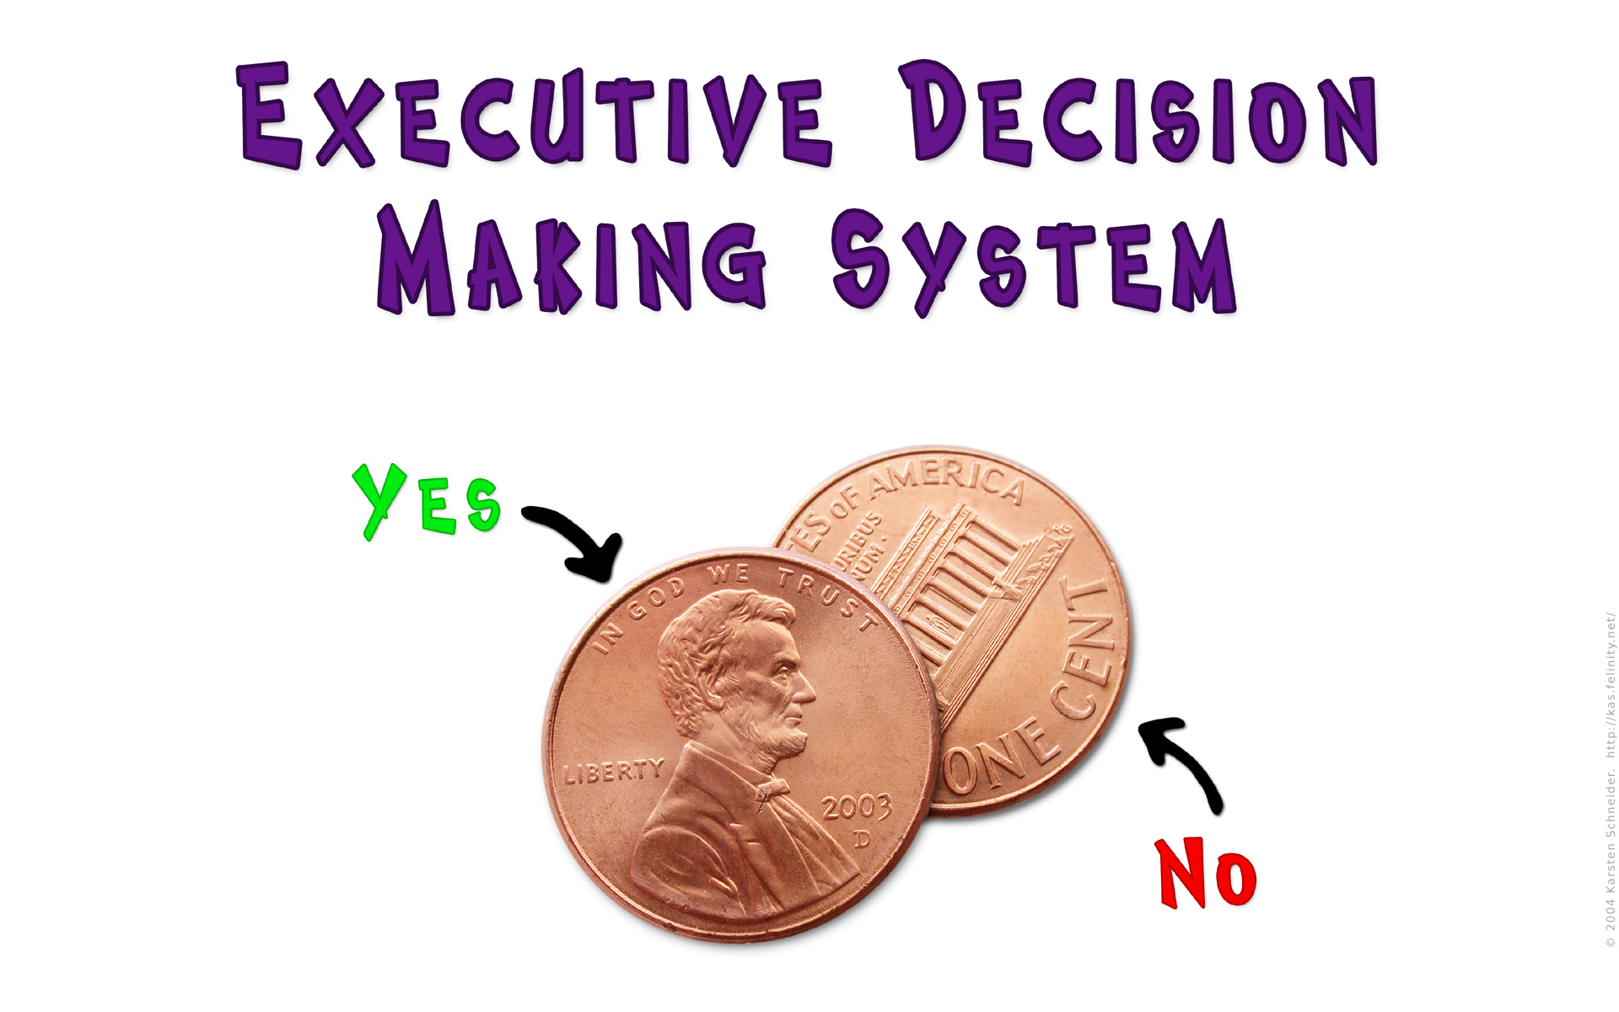
Decision Making

Slide 7
Decision Making
We looked yesterday at sequential program flow. What is an example of a decision that has to be made when making the Jell-O?
Anytime a program makes a decision it can only go down one of two paths.
This breaks down to a yes or no (True or False) response.
What could be an example of a basic decision that a student might have to make related to school? Write a set of directions for this decision and possible outcomes.
Notes:
Example should follow: IF (some event), then do (some response); else do (some response).

Slide 8
Decision Making Con’t
Many decisions are related to certain conditions being met or not met. Look back at your recipe directions and identify possible areas where decisions might have to be made.
Many decisions will break down into “if” statements. Ex. If “a” is true then do “b”, if “a” is false then do “c”.

Slide 9
Programming Flow

Slide 10
Programming Flow
What happens when?
What concepts did we discuss yesterday that could relate to understanding programming flow?
Important terms:
Loops (Repeat until, Do….While, For, While)
Functions
Decisions (If, Then)
Commands (Start, Stop, Wait, etc)

Slide 11
Flow is the order in which individual statements, functions or instructions are executed or evaluated.
Construct a basic payroll system program with the following directions:
Anyone working less than 40 hours gets their regular hourly wage
Anyone working between 40 hours and 50 hours gets time and a half for the hours between 40 and 50.
Anyone working over 50 hours gets double time for the hours over 50.

