Slide 1
Life experiences (cooking)
By: Ken G.

Slide 2
Best Food = Best Experience
What more is there to life than having the best, mouth-watering food? Cooking the meal for your friends or family is one of the best and most fun experiences you could have, even better than eating!
Link: https://fortytravels.com/blog/wp-content/uploads/2016/02/Experience-Dubai-Top-Notch-Food-734x390.jpg

Slide 3
Pick icing on beach
One of the best experiences I had is when my family and family friends went boating on Tsawwassen Beach and it was a hot and sunny day that was perfect for a summer vacation on the beach.
Link: http://static.panoramio.com/photos/large/14201281.jpg

Slide 4
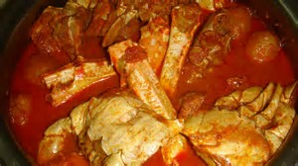
Catching and cooking crabs!
By afternoon at around 5:30 p.m. the winds pressure felt really cold so we went back and caught about 2 buckets of crabs but the real fun was cooking them!

Slide 5
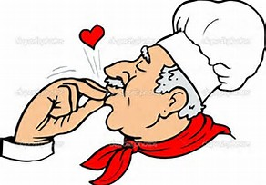
Life + Food= Happiness
Reflecting on myself, I like helping out people and my very first job was a cook and would like to spread my experience of good food to everyone when I am able to cook more variety of food.

Slide 6
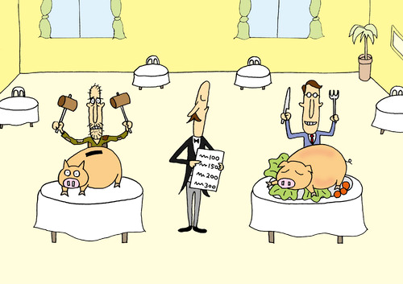
MY Future!!
The memorable feast on the beach helped me to realize that I could become someone who could make nice and awesome food that would want people to come back to my restaurant someday!

