Slide 1
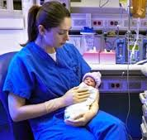
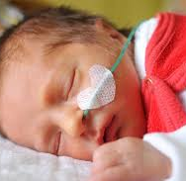
Neonatal Nursing (NICU)
A specialty field of nursing that deals with newborn babies, many with a variety of problems from pre mature births to birth defects.
By: Keisha Nagorr

Slide 2
Are you/Do you have…
An interest in newborns
Resilient
Empathetic
Committed
Keen
Good at Multitasking
Good Physical Endurance
Flexibility
Optimistic
Observant
Good attention to detail
Good With Communication
Compassionate
Then the NICU might be right for you!

Slide 3
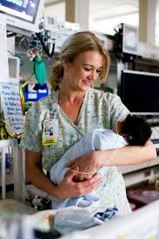
A Day in the Life:
Being a neonatal nurse requires you to do some of the following:
As well as hands on care such as administering medication , monitoring, and feeding the newborns, neonatal nurses work with the moms and dads, who are going through this tough and emotional experience with their child. The nurses give comfort and educate the parents to try and help the families get through things.

Slide 4
A Day in the Life
Highlighting the big milestones achieved for the day: my 31-weeker’s feeds were advanced from 18 mL to 21 mL, and she tolerated the increase very well; my 33-weeker was stable and going to be just fine. These may seem like small changes in the grand scheme of things, but they can have a huge impact on the health and well being of the infant. This leads me to NICU rule number three: our work may be based on tiny little victories, but those tiny little victories are what leads to healthy, happy babies.”
- Laura Kinsella

Slide 5
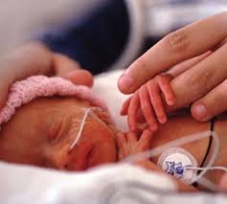
Average Salary
On Average Neonatal Nurses make...
Hourly :
$35 to about $65
Yearly:
$70,000 - $104,000

Slide 6
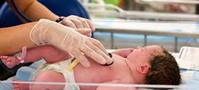
Schooling

Slide 7
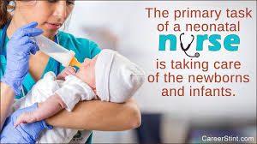
Education
Level of education Required: Bachelors Degree
Bachelor of science in nursing degree
Years of Schooling:
4 Years (Bachelor of science in nursing degree)
2 – 3 years (Specialization in Neonatal Nursing)

Slide 8
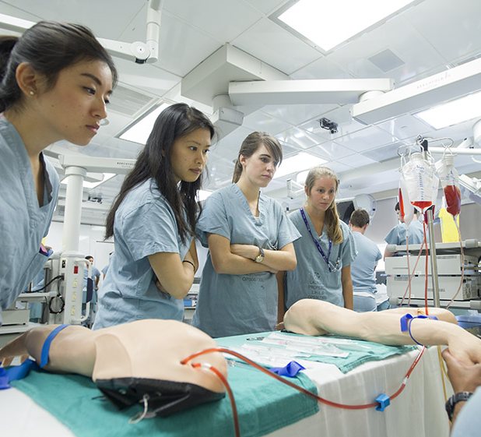
British Columbia Institute of Technology (BCIT)
Program:
Neonatal Nursing Specialty
Overview:
Gives Training that covers every aspect of neonatal nursing
The program is a mix of theory courses and some clinical courses
Program trains you in both technical and emotional skills that will help you support newborns and their families.

Slide 9
Algonquin College
Program:
Perinatal Nursing
Overview:
Can lead to a job as a Neonatal Nurse since they are both closely related
Builds on the formal nursing education and prepares you to work in various areas on perinatal nursing
Program is done through the use of theoretical, laboratory, simulation based and clinical learning

Slide 10
Work Cited:
https://www.bcit.ca/study/programs/680fascert
https://dailynurse.com/day-life-nicu-nurse/
https://nurse.org/resources/neonatal-nicu-nurse/
http://www.algonquincollege.com/ccol/program/registered-nurse-perinatal-nursing/part-time-on-campus/
https://www.healthcareers.nhs.uk/explore-roles/nursing/roles-nursing/neonatal-nurse/personal-characteristics-and-skills-required-neonatal-nursing

