Slide 1
My Culture ~ My Traditions ~ My Family
By: Keisha Nagorr

Slide 2
Pumpkin Patch 🎃
My family has made it a yearly tradition to visit the Laity pumpkin patch every Halloween. My mom started this tradition about 20 years ago as a way to have fun with my sister and then with me. She thought that it would be a fun activity that we could all bond over. This is something that is enjoyable as there are so many things to do at the pumpkin patch from hay rides to mazes, there are countless things to do that could get us in the Halloween spirit. This is something that I always look forward to when it gets closer to Halloween. I will continue to do this in the future as I really hope that those I go with will also start to look forward to and deem as a good way to have fun and spend time together.

Slide 3
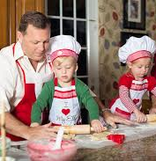
Christmas Cookies
Every year just before Christmas my nana and I have this tradition of making Christmas cookies together. Though she had always made cookies in preparation for the Christmas eve celebration, she had started this tradition with me hen I was around 5 years old. I think the reason as to why she started this was because she wanted to spend some quality time with me as well as the fact that I love baking and would always try to help her bake. I think that spending quality time with someone one on one is important in strengthening that bond that you share. I think that I will continue to do this in the future with those close to me since I cherish those people and the time spent with them.

Slide 4
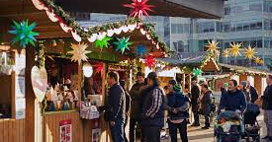
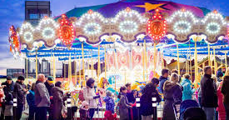
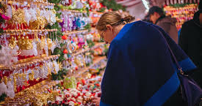
German Christmas Market
My family started this tradition about 3 years ago , when my nana had brought up the idea of going during dinner one day. My mom and nana had thought that going to this Christmas market would help my sister and I get a little taste of our German culture. Needless to say after going to the market the first time, we’ve been hooked, and now go every year. From the food and drinks to the music and little knick knacks, There are so many fun things for my family and I to enjoy and do together that really allows for some bonding time. We’ve also made it a part of this tradition to go through the ornament shop and pick a handmade ornament that we like and can hang on the tree. I think that this tradition is a fun way to learn a bit about my culture as well as to spend some quality time with my family, which is why I think that this is an important tradition that I would like to keep for the future.

Slide 5
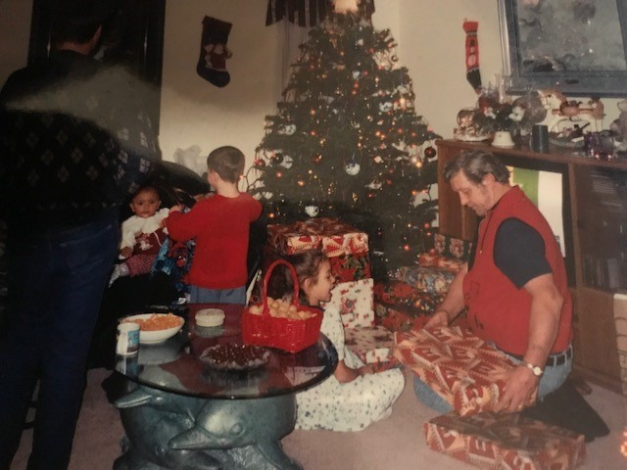
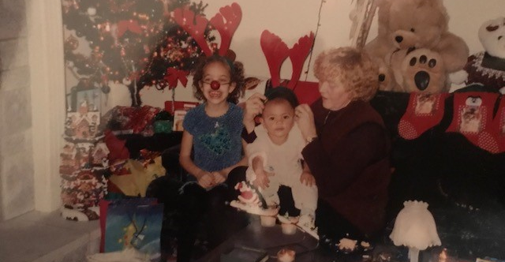
German Christmas 🎄Celebration🎄
Every year on Christmas eve my nana will invite our whole family to her house for a German Christmas celebration. During this celebration we enjoy many treats such as stollen (German dessert) and shrimp cocktails, and open our Christmas gifts. This has been a tradition that has been in our family for over 23 years and was started by my nana. She had started this tradition as a way to bring the whole family together and celebrate Christmas like she would normally do when she was in Germany. I think that she did it to both have fun with the family as well as teach us a little about German culture and seasonal traditions. I would love to continue this tradition with my family in the future since I do think that it is a really fun way to learn seasonal traditions from my culture as well as celebrate Christmas compared to how people normally celebrate it.

Slide 6
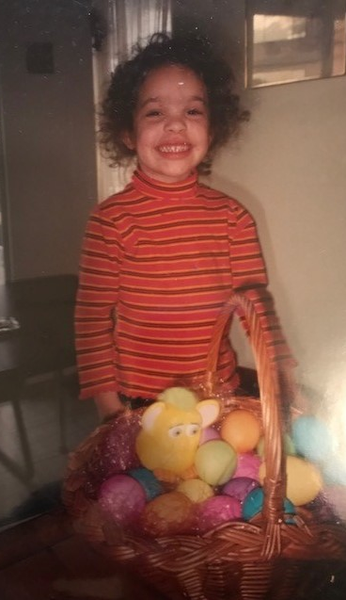
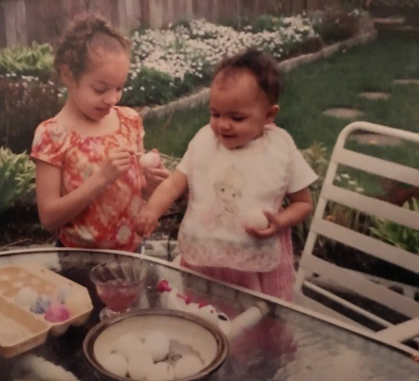
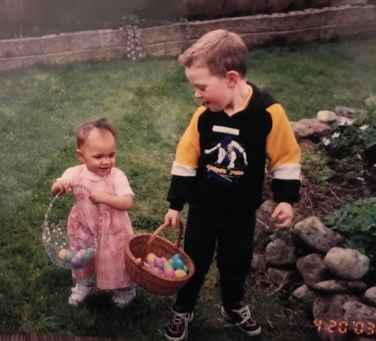
Dyeing Eggs🥚
The tradition of dyeing eggs at Easter started a little after my sister was born, about 20 years ago, and was another tradition that my nana had started. I think that my nana had started this as a way to spend time with the children in the family, as well as to keep us busy (as they hid eggs in the yard), and allow us to express our creativity. Though we don’t do this anymore as all the children in the family have grown up, if I have children of my own I would like to continue this tradition. Even today, I still have memories of dyeing eggs with my sister and spending enormous amounts of time having fun and laughing, it’s something that really stuck to me from my childhood.

Slide 7
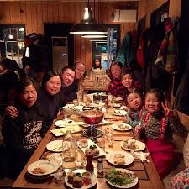
Sunday Dinner
My mom began to make it a routine to go to my nana house every Sunday for dinner. She began this 23 years ago when my sister was born, and continues to do it today. She started this due to my nana who really enjoys family time and cooking. They both wanted my sister and I to grow up with a lot of memories of our family spending time together. I think that this is a good tradition that I may want to alter and continue in the future. Though I do really like this tradition I don’t think I would be able to do it on a weekly basis, instead I would do it on a bi-weekly basis. Other then that I wouldn’t change a thing about this tradition, it allows for great quality time.

Slide 8
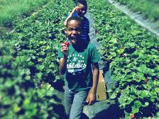
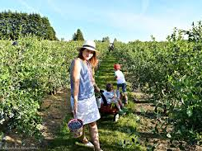
Berry Picking
Berry picking is something my nana stared doing almost 40 years ago, with my mom and her brothers, and has continued to do so with my sister and I. We do this every summer when the fruits have ripened and are ready to pick. My nana had started doing this because she does a lot of baking and canning and though that it would be easier if she had some helpers with her to pick the berries. When she started to do this with my sister and I, we quickly took a liking to it, and so we continue to do it every year. As someone who loves fresh fruit I will most certainly continue to do this in the future as it results in something both healthy and delicious and can allow for a lot of fun.

Slide 9
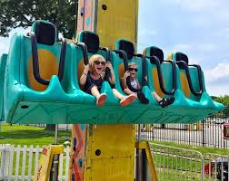
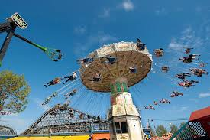
Playland
Every August my mom and nana take my sister and I to playland. We always make sure that when we go we not only go on rides, but also visit the barn and taste a variety of different foods that we normally wouldn’t eat. My mom and nana started to bring us to playland about 13 years ago. Not only did they think it would provide us with valuable family time, but it would also be a fun activity for us all to do together. In the future I would like to bring my children or partner to playland and continue this tradition since every year I enjoy going. I remember going on all the rides and the excitement I felt when on a ride.

Slide 10
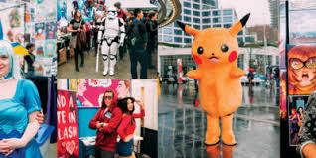
Fan-Expo
Every year there is a fan-expo in the Vancouver convention center that my family and I go to. My sister started this tradition 2 years ago when she wanted to go to meet these actors that she really liked. When we had gone for the first time, though it was a large convention, and a lot to take in at first, we all thoroughly enjoyed it. There were many things that we each found interesting about it, from the costumes that some people wear to the comic books, to the artwork. I love going to this even as a way of spending quality time with my family and as a way to spend time browsing things that I deem to be very interesting. In the future I will continue to do this since it isn’t an event that you typically don’t get to go to and I think that it’s a good way to learn about many different things.

Slide 11
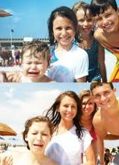
Family Photo Recreation
The tradition of having the same family photo taken every year is something that I would like to start doing in the future. I’ve seen this tradition around online of families recreating old family photos and have really taken a liking to the idea behind it. I would love to do this with my own family once a year, where we would keep re-creating the same family photo. I would like to start doing this as a way to document the growth of my family and each of us individually. It could also prove to be a fun activity that we could end up turning into a scrap book or slide show after a few years.

