Slide 1
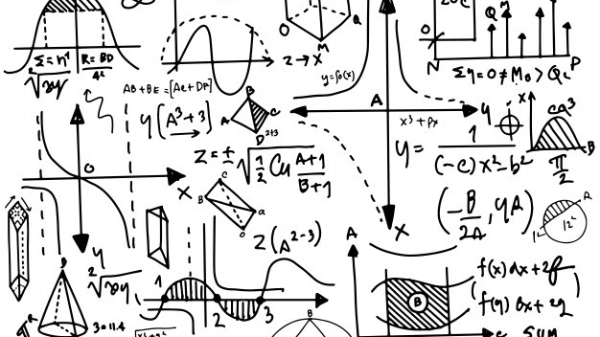
Newton's laws of motion
FOR KIDS!
By Charles

Slide 2
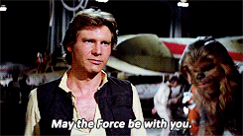
What are forces?
Forces are everything that makes things happen - and even beyond in the space, the universe!
For example, think about gravity, what is pulling everything down? What is stopping us from flying?

Slide 3
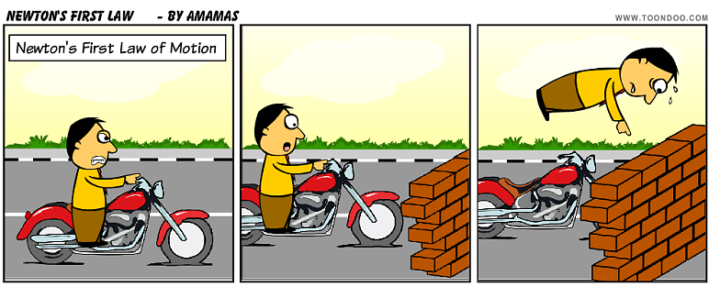
Example:
Oh no! I’m
going to crash!
The bike will continue to move forward at a high speed unless there is a wall
stopping the bike, and the person above would probably become a stuntman working
for the circus!
This rule is about objects keeping the same speed (the bike) unless something else (the wall) blocks it!

Slide 4
Here’s a question!

Slide 5
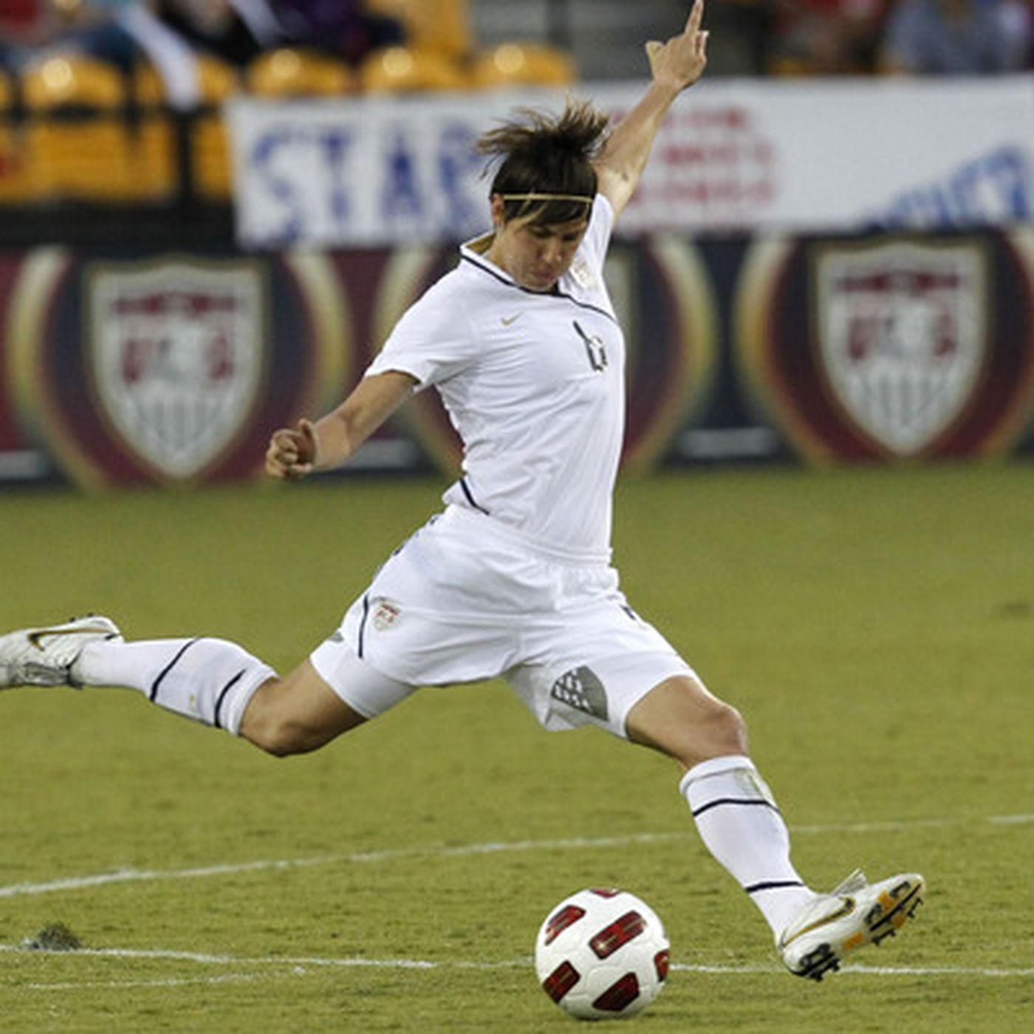
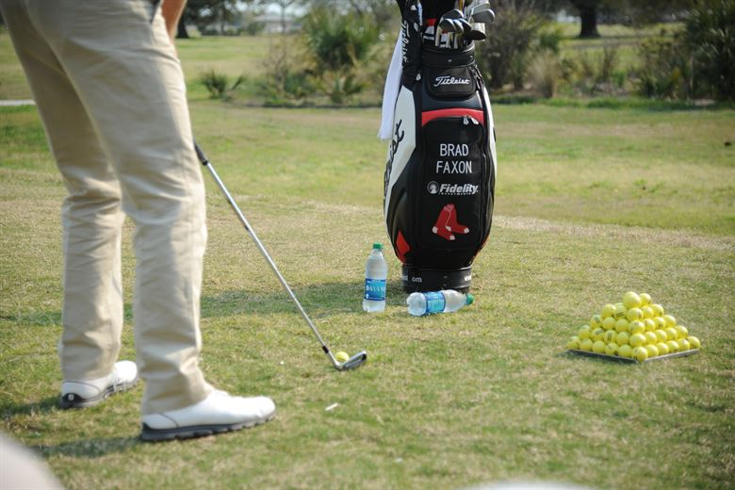
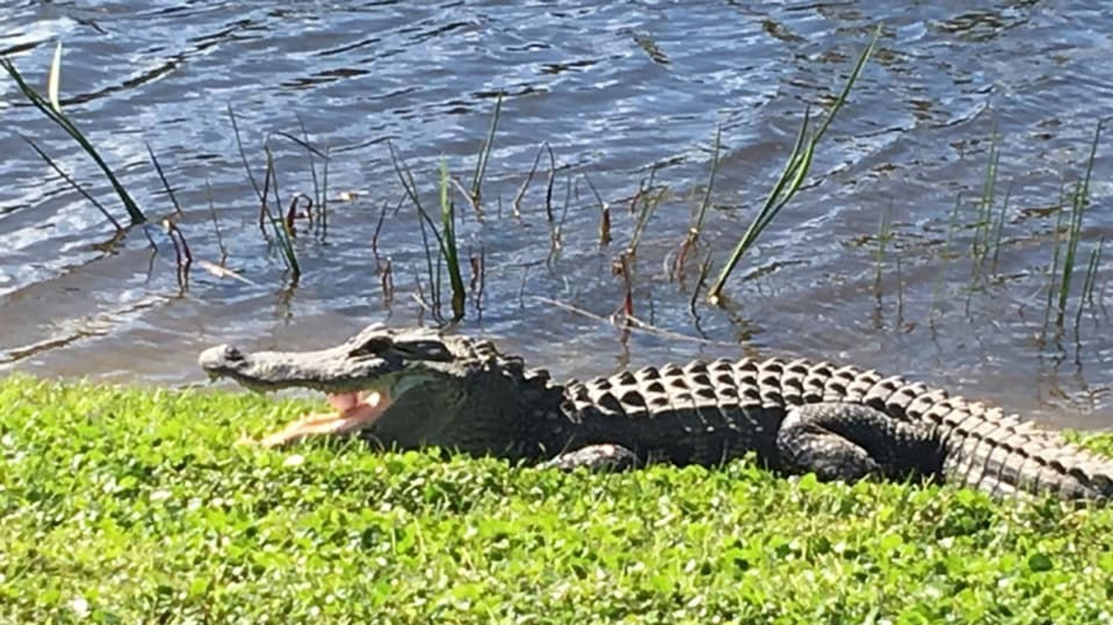
What happens if a golfer is about to hit the ball with a club?
Look in the slide notes below for topics to consider talking about
Answer: As the ball is struck with power from the club, the ball will be sent flying high in the sky! Although the ball won’t be able to stay in the air for long, it will be slowed down by air and pulled down by gravity later
Newton’s second rule is about objects gaining speed if a power is used,
exactly like how you kick a ball and sending it towards the sky.
and only to get eaten by an alligator, poor ball D:
Notes:
Consider talking about:
Newton's first law
Newton's second law
Newton's third law

Slide 6
One more step to become a physics master!

Slide 7
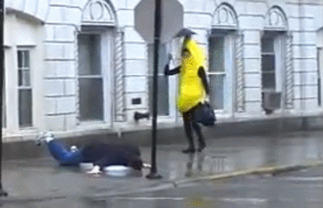
Guess what happens next?
The unfortunate “banana” stepped on the ”peel”, it slides on the walkway, causing the victim to kick
and fall backwards!
It represents the last rule, where every action brings in the result (the kick) and the opposite! (falling back)

Slide 8
CONGRATULATIONS! YOU’VE BECOME A MASTER OF FORCE! Give yourselves a big hand!

