Slide 1
Poetry Analysis
By: Zayd, Kaiden, Peter and James

Slide 2
Poem 1: No Man is an Island
By: John Donne

Slide 3
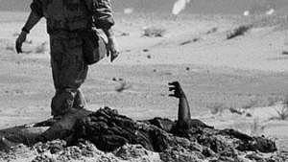
Summary
In short, the poem says how we are all part of humanity. You cannot be entirely self-dependent. The author makes it clear how every person’s life matters, and how every loss is a loss of the entire human collective. Every man’s life matters to him, because that man was part of humanity, a humanity that he is a part of.
John Donne
Born:22, 1572, London, England
Died:31, 1631, London, England
As well as a poet, he was also a priest and a lawyer

Slide 4
Poetic Devices
No man is an island entire of itself; every man is a piece of the continent, a part of the main; if a clod be washed away by the sea, Europe is the less, as well as if a promontory were, as well as any manner of thy friends or of thine own were; any man’s death diminishes me, because I am involved in mankind. And therefore never send to know for whom the bell tolls; it tolls for thee.
Open-style prose poem
Relies on land metaphors to represent people
Contains some sound devices like alliteration
Repetition of “as well as”

Slide 5
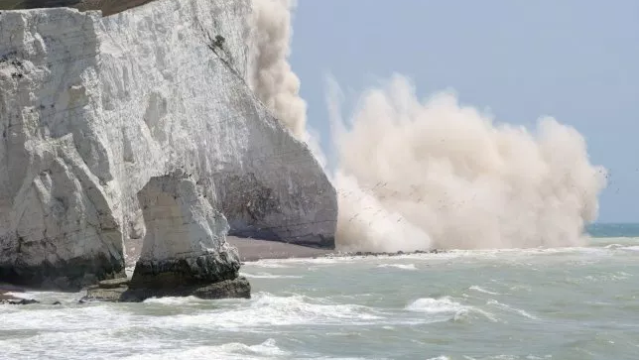
Analysis
"No man is an island entire of itself; every man is a piece of the continent, a part of the main"
"if a clod be washed away by the sea, Europe is the less, as well as if a promontory were"
"therefore never send to know for whom the bell tolls; it tolls for thee."

Slide 6
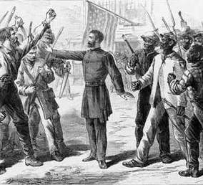
No man is an island
Imagery
- No man is an island trying to blur the lines between our selfish differences in humanity, and what we believe divides us.
- John Donne famous line "for whom the bell tolls; it tolls for thee."
- no matter who you are the bell will ring for you.

Slide 7
Poem 2: The Man He Killed
By: Thomas Hardy

Slide 8
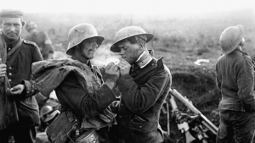
Summary
Thomas hardy
Born: Jun 2, 1840, Stinsford, Dorset, England
Died: Jan 11, 1928, Dorchester, Dorset, England
He also worked as a stonemason and a builder.
He joined Arthur Bloomfield's practice as assistant architect in April 1862 and worked with Bloomfield on all saints' parish church in Windsor. He also spoke out against the Boer war when most of england was in favor of it.
The poem is about A soldier who recounts a time he killed someone in a war. He shows deep regret, stating how in the end, the two were very much alike and had they met under different circumstances, they could have been friends. The poem ends with a statement about how war can make a man kill even potential friends for the most trivial of reasons.

Slide 9
Poetic devices
Had he and I but met
By some old ancient inn,
We should have sat us down to wet
Right many a nipperkin!
But ranged as infantry,
And staring face to face,
I shot at him as he at me,
And killed him in his place.
I shot him dead because —
Because he was my foe,
Just so: my foe of course he was;
That's clear enough; although
He thought he'd 'list, perhaps,
Off-hand like — just as I —
Was out of work — had sold his traps —
No other reason why.
Yes; quaint and curious war is!
You shoot A fellow down
You'd treat if met where any bar is,
Or help to half-a-crown.
5 quatrain stanzas
Iambic trimeter, except for some lines (every 3rd line)
ABAB rhyme scheme
Heavy use of diction (1600’s low class language)
Spoken from an English soldier’s POV
Includes repetition

Slide 10
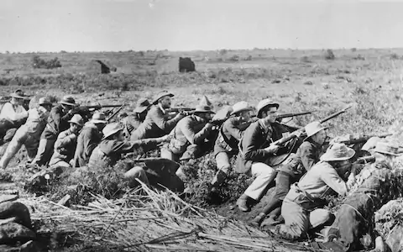
Analysis
"Had he and I but met By some old ancient inn, We should have sat us down to wet Right many a nipperkin!"
"I shot at him as he at me, And killed him in his place."
“Just so: my foe of course he was; That's clear enough; although.”
“ You shoot a fellow down You'd treat if met where any bar is, Or help to half-a-crown."

Slide 11
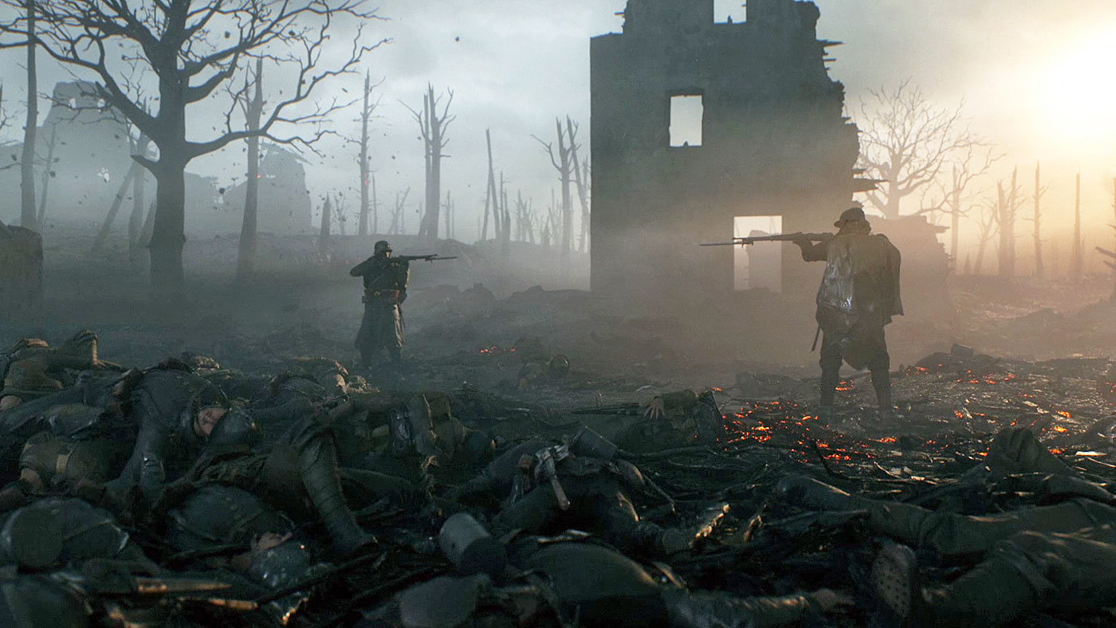
The man he killed imagery
- Photo from battle field 1
- "You shoot a fellow down
You'd treat if met where any bar is,
Or help to half-a-crown."
- In any other situation these men wouldn't be fighting.
- battle field 1 photo portrays the two sides in the same way

Slide 12
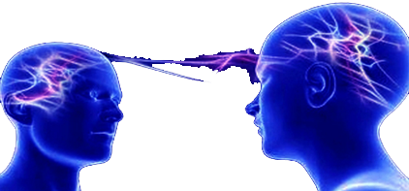
Connections Between The Two Poems
Both poems touch on the theme of people, and our value
They show that we are more in common than we think, and
we all strive for more or less the same goal
Both show the value of life, comparing a soldier’s death to a piece of land
Both mention the class system

Slide 13
The end

Slide 14
Bibliography
- Image 1: https://www.thestatesman.com/technology/science/
huge-iceberg-on-verge-of-breaking-away-from-antarctic-shelf-1496483988.html
- Image 2: https://www.nytimes.com/2017/02/17/opinion/the-grunts-war.html
- Image 3: http://themodernape.com
- Image 4: https://ethicsoftheenivronment.wordpress.com
No Man is an Island
https://www.phrases.org.uk/meanings/no-man-is-an-island.html
The Man He Killed
https://www.poetryfoundation.org/poems/44329/the-man-he-killed

