Slide 1
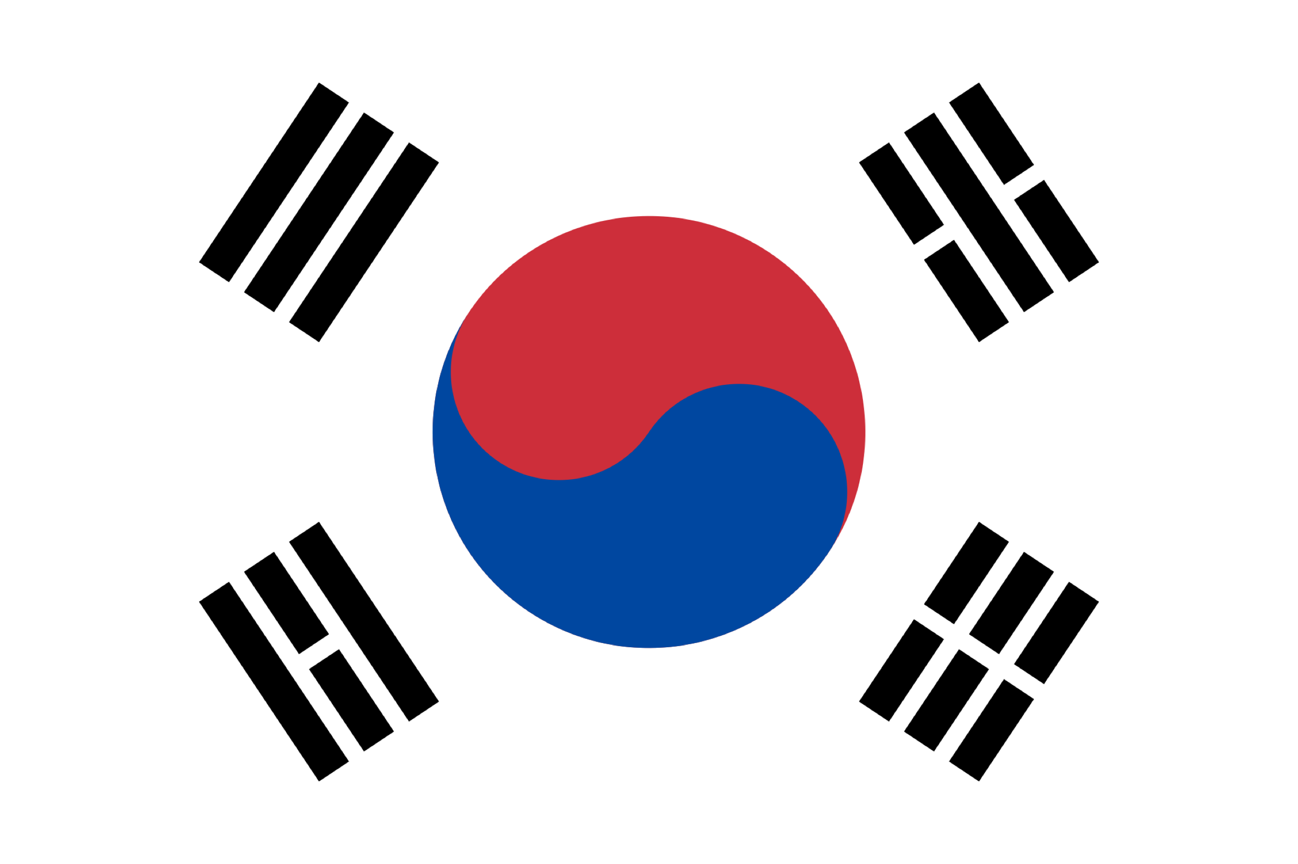
South Korea
Joy Kim & Jordan Beveridge

Slide 2
Geographical Location
East Asian nation
southern half of the Korean Peninsula

Slide 3
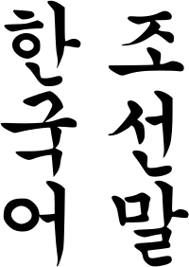
Language
Korean, also called Hangul (한국말)
Hanguk dialect

Slide 4
Religion
major religions: Christianity, Buddhism, Confucianism and Islam
44% of the Korean population has a religion

Slide 5
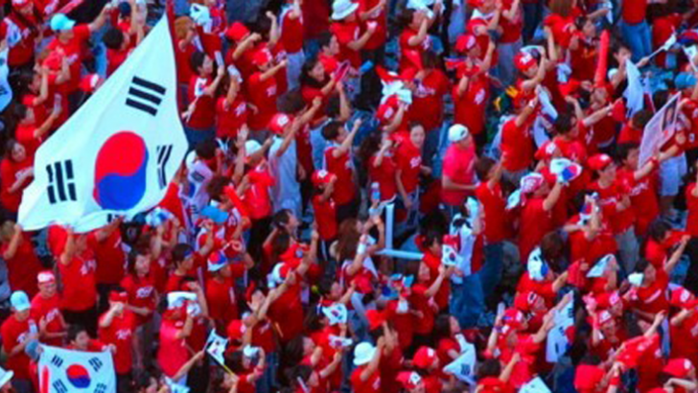
Ethnicity
Over 99% of South Koreans identify as ethnically Korean.

Slide 6
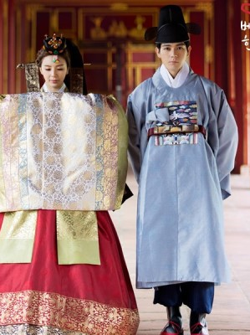
Marriage
Marriage in South Korea mirrors many of the practices and expectations of marriages in familiar to other societies, and as such, is constantly changing.

Slide 7
Marriage: Arranged
decided by the bride and grooms elders
elite families
maintaining a social status
weddings (Honrye) were held in the bride's yard or house.
The groom traveled by horse to the bride's house

Slide 8
Marriage: Modern
wedding halls
Buffet
gift for a new couple is cash
Pyebaek

Slide 9
Engagement customs
Rings
Permission from both parents of the couple
Engagement photoshoot

Slide 10
Marriage Superstitions & Traditions
Bouquet
wooden goose called kireogi.
dates and chestnuts

Slide 11
Household
average household size is 2.5 people per household
Usually consisting a mother, father, and children
Often Grandparents also live with in the same household
People usually live in apartments or condos because of how compact the city is

Slide 12
Household Responsibilities
Traditionally
women stay at home
the men go to work
Patriarchal
Modern
Equally divide the work
Both parents have jobs

Slide 13
Job and Lifestyle
Jobs/lifestyle

Slide 14
Children: Birth Rituals
Hospitals
Men would await the news of the delivery in another location.
A straw rope would be tied at the doorframe of the house to announce the birth with chili peppers laced within for a boy, and for a girl, charcoal.

Slide 15
Children: Names
A Korean name consists of a family name followed by a given name
No middle name in the English language sense

Slide 16
Children
Average number of kids per house hold is 1.3.

Slide 17
Education
Kindergarten
6 years of elementary school
3 years of middle school
3 years of high school
Children between the ages of 6-15 are required to attend school
University is very important

Slide 18
Divorce
Divorce Law in Korea. A divorce may be obtained in Korea based on the mutual consent of spouses. When the death or life of the spouse has been unknown for three years

Slide 19
Divorce
claim for division of property
division of property under Korean law shall be extinguished at the expiration of 2 years from the date of divorce

Slide 20
Divorce
Support of Children and custody goes is very circumstantial.
It depends on the situations
Flexible judge opinion

Slide 21
Care of Elders
A deep routed tradition is to respect the elders.
It is expected to take care of your parents after they retire.

Slide 22
Death rituals
-Funeral on third day after death
56.9% of the population were not formal members of a religion
May not have funerals for those who were not religious

Slide 23
Afterlife Beliefs
Christian beliefs: heaven and hell
Buddhists beliefs: reincarnation

Slide 24
Other interesting facts
relatively small country (it is about the size of England) has seen its economy grow steadily since 2009 and currently has the 11th largest GDP in the world.
the world’s fastest internet connection speed

Slide 25
Conclusion
Compared to Canada, South Korea still holds traditions from far back.
Very religious
They have similar divorce process

Slide 26
Bibliography
https://www.soompi.com/article/738257wpp/korean-weddings-101-a-basic-guide-to-wedding-customs-in-korea
https://www.linandjirsa.com/korean-wedding-traditions/
https://en.wikipedia.org/wiki/Marriage_in_South_Korea
https://search.naver.com/search.naver?where=image&query=%EA%B2%B0%ED%98%BC%EC%8B%9D+%EC%A0%84%ED%86%B5&sm=tab_stc
https://thepienews.com/data/south-korea-record-high-growth-in-intl-student-numbers/
https://www.greentechmedia.com/articles/read/south-korea-strengthens-grid-to-take-more-renewables

