Slide 1
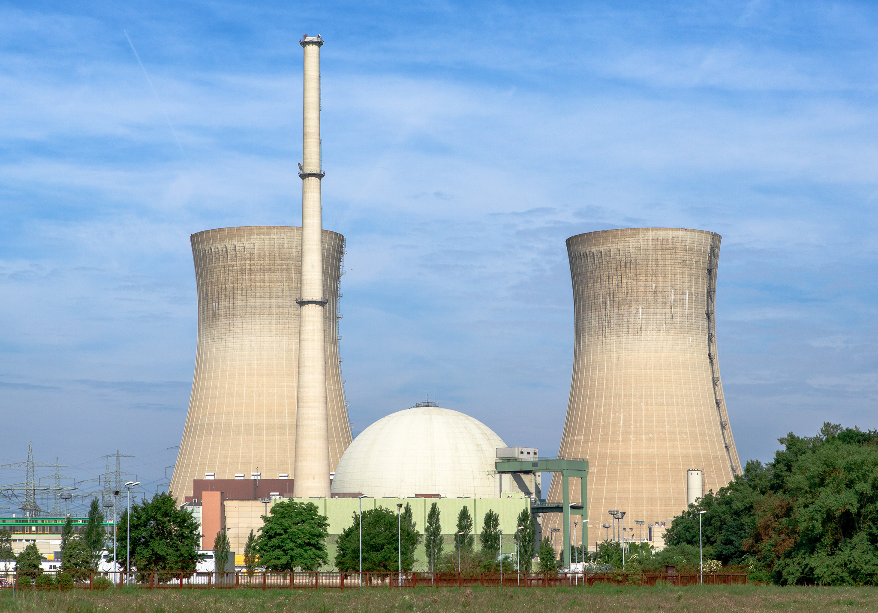
Nuclear power
John and jacob

Slide 2
What is Nuclear power?
Nuclear power is a and productive way of boiling water to create steam, which activates turbines to spin and produce electricity. Nuclear power stations work similarly to coal or gas-powered stations.

Slide 3
Is Nuclear power reliable or superior between all power?
A scale created by the United states shows that which nuclear power is more used than any other power. This means that Nuclear power plants maximize their power that is created.

Slide 4
Why nuclear power is not good
A small group of science stated that nuclear power should replace all other power because “its clean carbon-free source of power” But other people were worried and confused because of how it impacts climate change. Around 7 million people died from polluted air last year. 9/10th of these deaths came from energy related. So imagine if we switch to all nuclear, that would almost have about 100 million deaths each year.

Slide 5
Should we use nuclear power
A good reason we should use more nuclear power is that is produces high amounts on electricity with out “harming environment and atmosphere” Nuclear power is also more efficient then solar power and many more.

