Slide 1
Childhood trauma
Jenna Milot

Slide 2
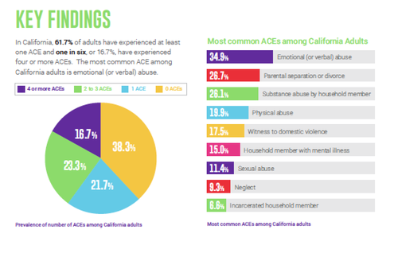
The experience of an event by a child that is emotionally painful or distressful, which often results in lasting mental and physical effects.
Commonly associated with being abused in their home, so many other sources of trauma
Adverse Childhood Experiences

Slide 3
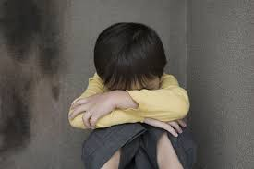
This type of trauma can potentially lead to much more anxiety, distorted cognition, personality deficits and lower levels of social support in a child. Can develop psychiatric disorders after the experience
Important that people in their lives are aware of the red flags that children are showing

Slide 4
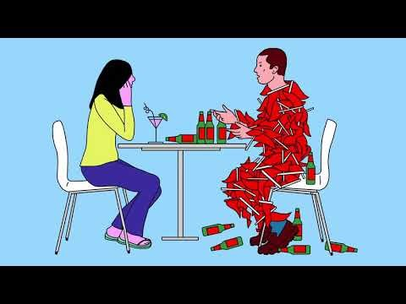

Slide 5
Importance of receiving help from young age
Consequences of not getting help when younger - because they’re still developing the trauma can lead to major affects when older
Having a rough childhood is a main trigger to the actions they make in the future
Most of the time when hearing about serial killers and criminals, the persons story ties into a difficult upbringing – if they were given the chance to receive help when they needed it, there’s the possibilty they would not have turned out who they are today
41% of prisoners experienced trauma as children

Slide 6
Bibliography
https://www.ncbi.nlm.nih.gov/pmc/articles/PMC6258995/
https://www.huffpost.com/entry/most-californians-have-ex_b_6111924
https://youtu.be/NIk1-ck4c6Q
https://youtu.be/N2oUfg7qNG0
http://www.practicenotes.org/v17n2/brain.htm

