Slide 1
Burning Books Section
By: Max, Alyah, Jayna, Tiana, Victor

Slide 2
The Summarizer
Clarisse goes missing, the hound is around Montag
Montag is at the firehouse working
Montag realizes that there is no individuality between the men at the firehouse
Montag feels for the people who had their homes and books burnt comparing it to how it would be to be in their position and Beatty grows suspicious
Beatty reminds montag of “rules” regarding burning the books
the fire bell rings and the men respond immediately dispatching the crew
they arrive at the house where the neighbour confirms the house containing books
they swiftly pour kerosene into the house and all over the books
Montag had almost subconsciously taken a book from the woman’s house and shoved it in his fireman jacket
the woman from the house refused to leave as she wanted to stand for what she believed in
the woman held a match and took it upon herself to light the kerosene up in flames
as the house was set ablaze, the men backed away and the people in the neighbouring houses had ran down the street
the men returned to the firehouse where montag questioned the last thing the woman had blurted out before she committed suicide
Beatty explains to montag that 2 men were burned alive at oxford for hersey, and it seemed that the woman just wanted to do the same

Slide 3
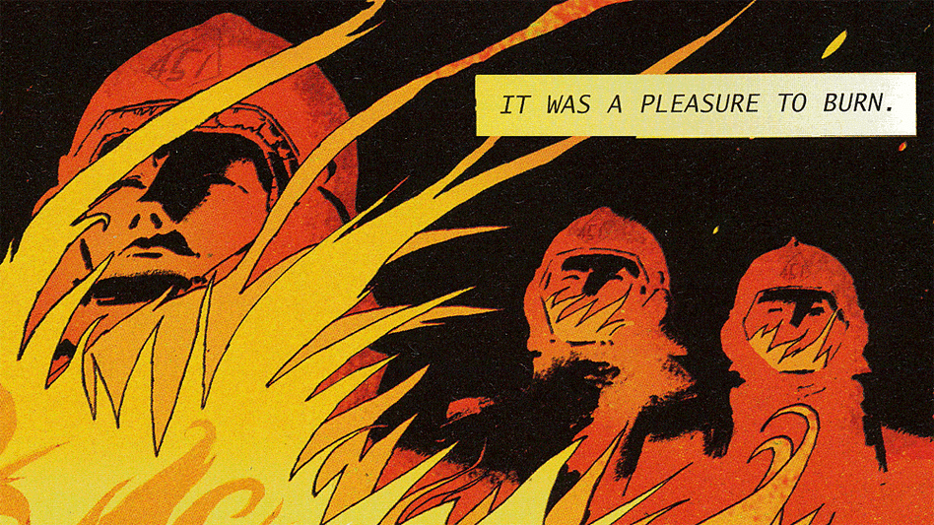
Discussion Director
Why does Bradbury put so much emphasis on darkness then goes to talking about light?
Why does Beatty change the history of the fireman?
Why does it take Montag so long to realize the fireman are bad?
How does Beatty know a lot about books?
Does Beatty know Montag has books?

Slide 4
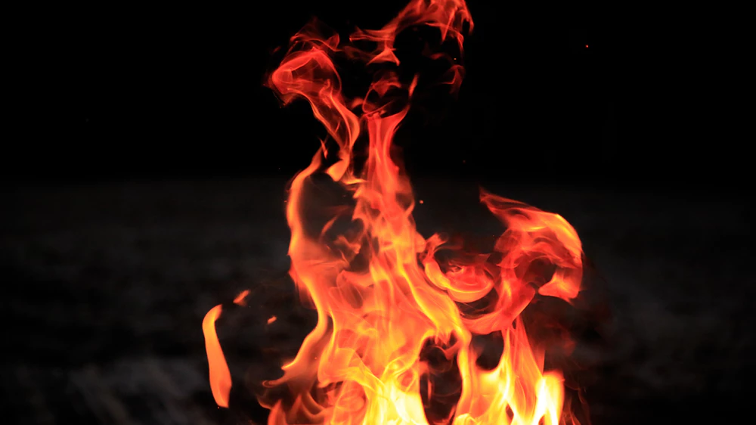
Literary Luminary
"Montag blinked. Beatty was looking at him as if he were a museum statue. Any moment Beatty might rise and walk about him, touching, exploring his guilt and self consciousness." Pg. 33
"These men who looked steadily into their platinum igniter flames as they lit their charcoal hair and soot-colored brows and bluish-ash-smeared cheeks...Had he ever seen fireman who didn't have black hair, Black brows, a fiery face... They were all mirror images of himself.. Picked for their looks rather then their proclivities?... Colour of cinders and ash about them..." Pg. 33

Slide 5
"But in his mind, a cool wind started up and blew out of the ventilator grille at home, softly, softly, chilling his face." Pg. 34
"You were simply cleaning up, Janitorial work, essentially. Everything to its proper place, Quick with the kerosene! Who's got a match!" Pg. 37
"A book lit almost obediently, like a white Pidgeon, in his hands, wings fluttering... A page hung open and it was like a snowy feather, the words delicately painted thereon... The men above were hurling shovelfuls of magazines into the dusty air. They fell like slaughtered birds" Pg. 37
"Captain Beatty, keeping his dignity, backed away slowly through the front door, his pink face burnt and shiny from a thousand fires and night excitements. God, thought Montag, how true! Always at night the alarm comes Never by day! Is it because of the fire is prettier by night? More spectacle, a better show?" Pg. 39

Slide 6
"Montag's hand closed like a mouth, crushed the book with wild devotion, with an insanity of mindlessness to his chest... Montag had done nothing. His hand had done it all, his hand with a brain of its own, with a conscience and a curiosity in each trembling finger had turned thief." Pg. 37.
"Montag felt the hidden book pound like a heart against his chest." Pg. 39
"Montag felt himself back away and away out the door, after Beatty, down the steps, across the lawn, where the path of kerosene lay like the track of some evil snail." Pg. 39

Slide 7
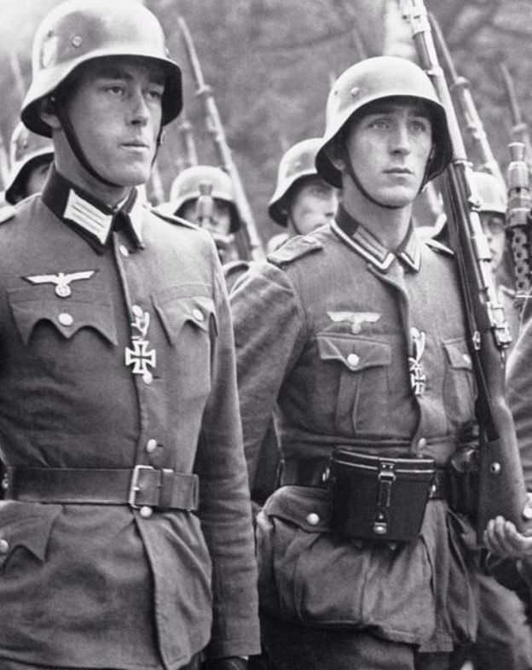
Connector
“…these men whose faces were sunburnt by a thousand real and ten thousand imaginary fires… These men were all mirror images of themselves.” Pg. 33
Specifically chosen for their job, they all look the same.
Like machines that work without questioning why and what they are doing.
People fought in war without thinking about what might happen.

Slide 8
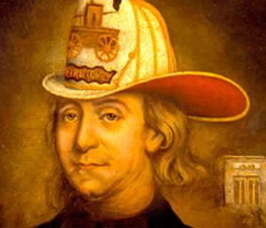
Connector
“Established, 1790, to burn English-influenced books in the Colonies. First Fireman: Benjamin Franklin.” Pg. 34
Beatty was trying to get his point across to Montag by lying about history.
Benjamin Franklin established the first fire brigade.
Bad history gets removed, history is told from the victor's point of view.

Slide 9
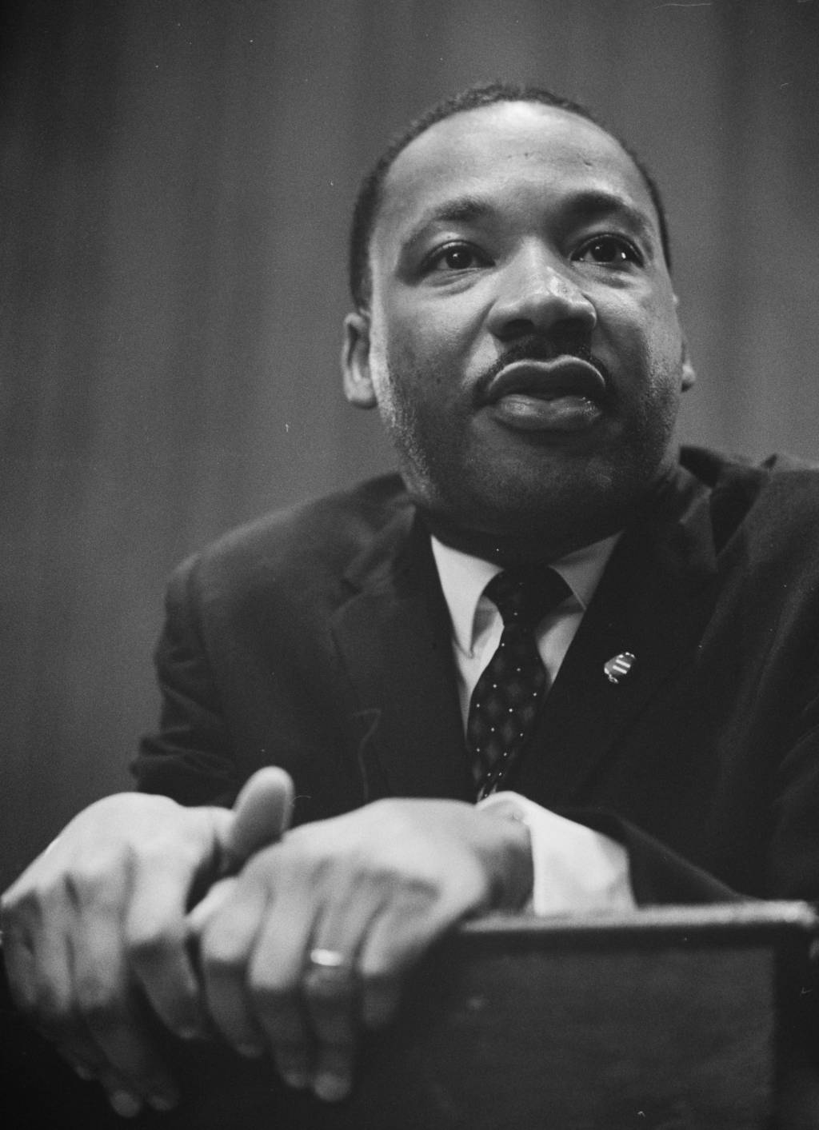
Connector
“Play the man, Master Ridley; we shall this day light such a candle, by God’s grace, in England, as I trust shall never be put out.” Pg. 36
A quote from Book of Martyrs by John Foxe.
She wants her death to be the spark of a revolution.
Martin Luther King Jr stood up against the unjust treatment towards the African American community in America.

Slide 10
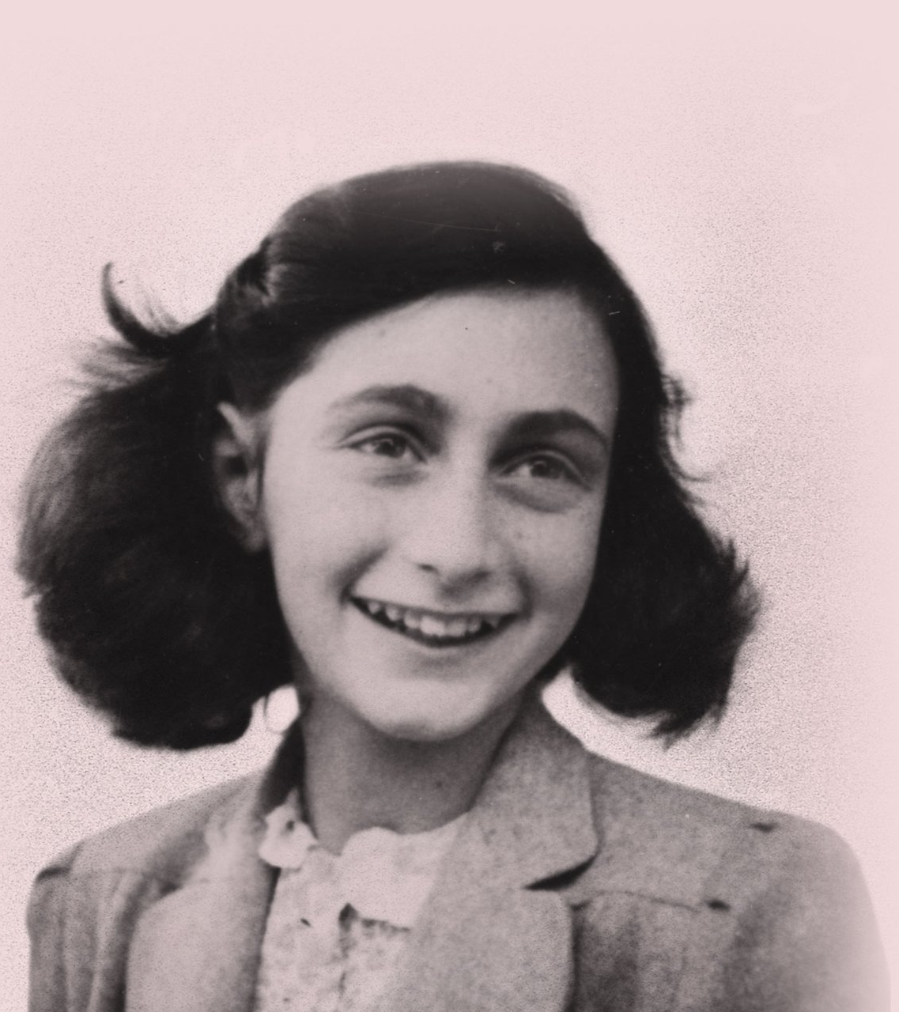
Connector
“That would be Mrs. Blake, my neighbor.” Pg. 36
Mrs. Blake was the one that told the fire department about the books.
Society that is ruled by fear pressures people to obey their laws.
Anne Frank was turned in to the Nazis.

Slide 11
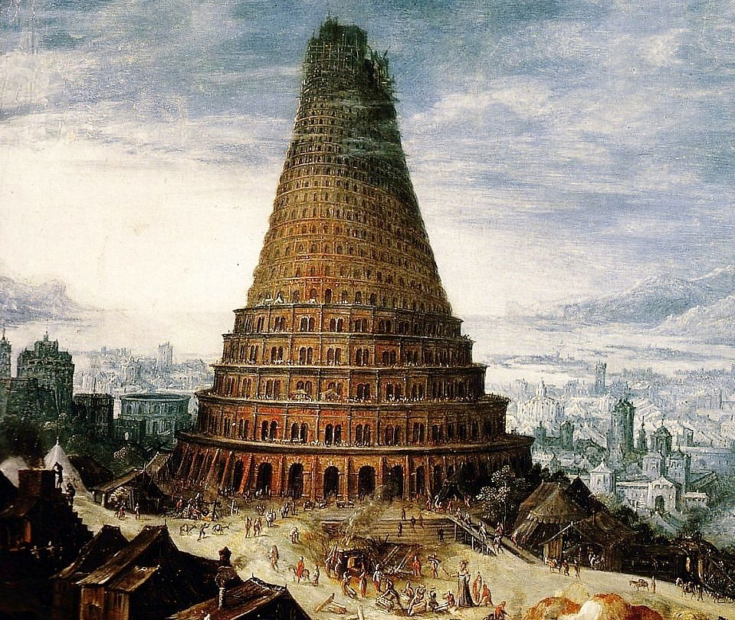
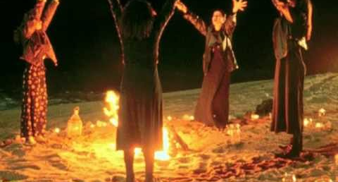
Vocabulary Enricher
Tower of babble According to the story, a united humanity in the generations following the Great Flood, speaking a single language and migrating eastward, comes to the land of Shinar. Symbolizes the beginning of language and knowledge
Heresy belief or opinion contrary to orthodox religious (especially Christian) doctrine.
Ritual a religious or solemn ceremony consisting of a series of actions performed according to a prescribed order. a religious or solemn ceremony consisting of a series of actions performed according to a prescribed order.

Slide 12
Vocabulary Enricher
Spectacle anything presented to the sight or view, especially something of a striking or impressive kind: The stars make a fine spectacle tonight.
Dis-ease
a disorder of structure or function in a human, animal, or plant, especially one that produces specific signs or symptoms or that affects a specific location and is not simply a direct result of physical injury. Has a double meaning of being uneasy

Slide 17
https://siftingthroughpatterns.files.wordpress.com/2013/10/451-neary_wide-8e97cfe5174fb467ab94d52a9b9681588d0eaead-s6-c30.gif
http://wallpoper.com/images/00/38/82/48/light-bulbs_00388248.jpg
http://3.bp.blogspot.com/-VkrphhjP0yQ/UDuR-4p8VnI/AAAAAAAAVWA/xUP2dGv57po/s1600/IMGP5233.JPG
https://en.wikiquote.org/wiki/Hugh_Latimer
https://www.history.com/topics/american-revolution/benjamin-franklin
https://www.history.com/topics/black-history/martin-luther-king-jr
https://www.youtube.com/watch?v=ond6r5pafjw

