Slide 1
The Heroic journey
By Jacob Korlacki

Slide 2
Brent bishop vs. Percy Jackson

Slide 3
The call to adventure
1.
Brent Bishop The Whirligig
Percy Jackson Percy Jackson the Lightning Thief
In the beginning Brent has a normal life in Chicago with his parents. One night Brent went to a party and started drinking, he was later called out by Brianna which caused him to leave the party. He then tried to kill himself and accidentally killed someone else on the road, Lea. This shows that at the beginning of Brent’s heroic journey he has a low self esteem, that grows throughout his journey. After the incident Brent and his parents went to go meet with Lea’s mother, Mrs. Zamora. Mrs. Zamora turned out to not want revenge in any way, instead she wanted Brent to go on a journey of redemption building whirligigs around the country to receive forgiveness and to revive Lea’s spirit. The moment when Lea’s mother proposes the offer to Brent and he accepts, is the beginning of his journey, he has accepted his call to adventure.
Percy began his heroic journey as a kid that had no idea about his own identity, he goes to a school for troubled children called Yancy Academy. When he is on a field trip at a museum to Percy’s surprise he is attacked by one of his teachers who turns out to be a monster. He was attacked because he supposedly had Zeus’ lightning bolt which had recently gone missing, but Percy didn’t actually have it. After this Percy contacted his mother and she knew that it was time for Percy to go to Camp Half Blood, a summer camp for demigods or half bloods (kids with a god as a parent). Percy getting attacked is what caused this all to come about, when he went to Camp Half Blood he accepted his call to adventure.

Slide 4
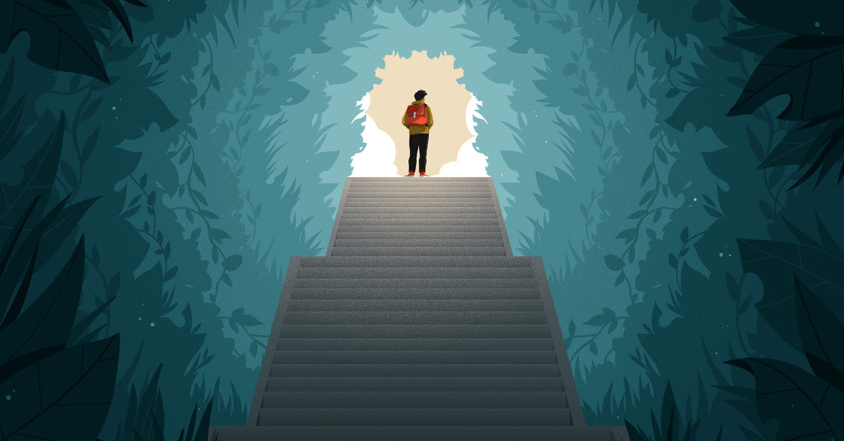
The call To adventure media
Percy Jackson Percy Jackson the Lightning Thief
Brent Bishop The Whirligig
“He'd never traveled on his own before. The idea held sudden appeal. He smiled inside. He cleared his throat. Then he spoke the words, “I’ll do it.“” (pg. 42)

Slide 5
Allies
2.
Brent Bishop The Whirligig
Percy Jackson Percy Jackson the Lightning Thief
On Brent’s journey of redemption he is helped by many people without them even knowing, which relates to the theme of interconnectedness. Many of these allies help him work towards his goal of restoring justice for Lea and her mother. In Bellevue, Washington a cyclist kindly shares his campsite with Brent. In San Diego he stayed at a hostel, which was only for people who lived out of America but the man at the front desk let him in. At the hostel he met another ally from Germany named Emil who passed on a meaningful book relating to the heroic journey. In Miami, Florida he met some kids who helped him build his whirligig. All of these allies had a great impact on Brent growing into his new self.
Many allies helped Percy on his journey. Not only did they help along his journey, but they also made him feel better about himself and taught him about his shocking new identity. These allies also helped him grow into his new self. Percy has to go on a quest to retrieve Zeus’ stolen lightning bolt to stop the conflict between the gods. Percy goes on the quest with the help of his allies, his satyr friend Grover who he knew from school and Annabeth, daughter of Athena who he had met at Camp Half Blood. They accompanied him and helped him throughout the journey, especially in times of battle where he had little experience and knowledge.

Slide 6
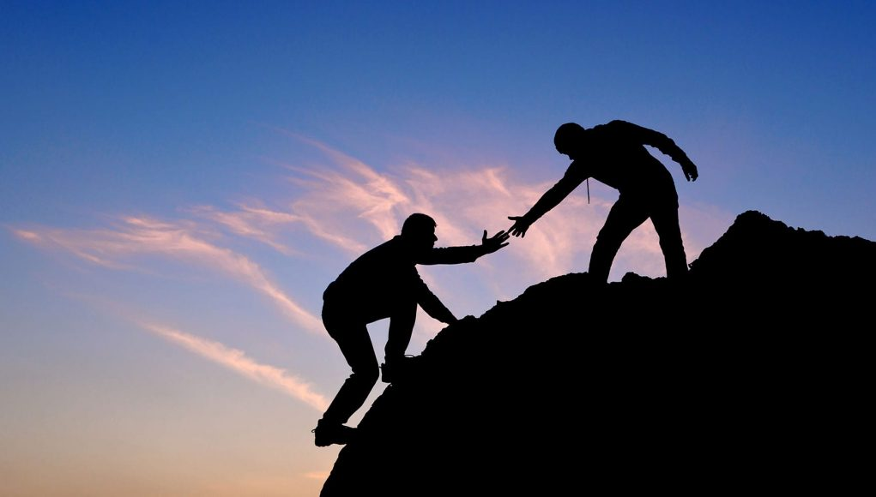
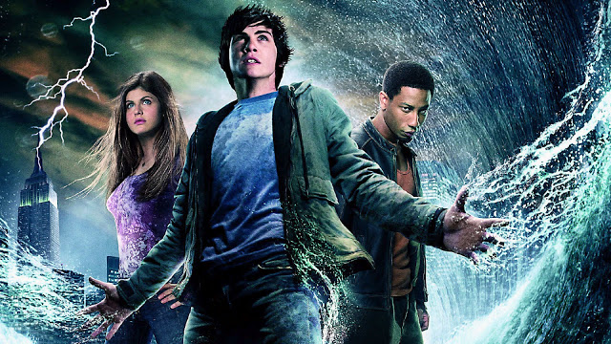
Allies media
Brent Bishop The Whirligig
Percy Jackson Percy Jackson the Lightning Thief
“His companion mentioned that he'd just finished Two Years Before the Mast and would pass it on to him.” (pg. 69)
“They had done nothing but save me, over and over, and now they wanted to sacrifice their lives for my mom.” (pg. 330)

Slide 7
Road of trials
3.
Brent Bishop The Whirligig
Percy Jackson Percy Jackson the Lightning Thief
Brent goes through many hard times over the course of his journey, those are his trials and tests to see if he can pass. At first Brent had no confidence building whirligigs and it was very difficult since he had no experience. He was tested several times when he had troubles building the whirligigs. Brent did get frustrated and doubted himself but he did not give up. He doubted himself about being where he is and questioned whether his journey would actually lead to redemption. This was a difficult internal conflict with himself. He did however persevere through this and passed his trials which led him to be more confident and have a higher self esteem as well as identity.
Percy faces many trials, his first being when a minotaur chases him, his mother, and Grover in a car while driving to Camp Half Blood. They manage to get out alive but without Percy’s mother. He defeats the minotaur which is a very difficult task and passing this trial boosted his self esteem and helped him continue on his heroic journey. He then goes on a quest to find the missing lightning bolt that Chiron thinks is in the Underworld. They have to travel a long way to get to the entrance of the Underworld which is in Los Angeles. Along the way they have to face several monsters which Percy defeats with courage. This is one of many conflicts that he comes across and resolves on his journey.

Slide 8
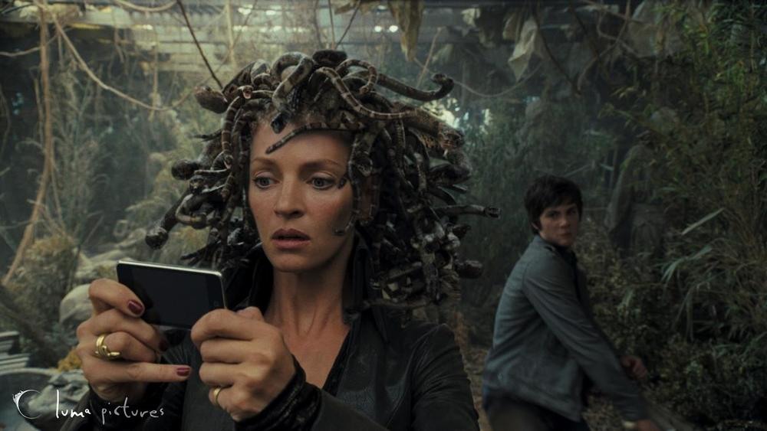
Road of trials media
Brent Bishop The Whirligig
Percy Jackson Percy Jackson the Lightning Thief
““Why am I doing this?” he said aloud. The whole enterprise seemed taken from a dream, incomprehensible in the light of day.” (pg. 52)

Slide 9
Achieving the Goal through the help a of mentor
4.
Brent Bishop The Whirligig
Percy Jackson Percy Jackson the Lightning Thief
After Brent finishes his last whirligig, his journey is not yet completed. He has not told anyone about what he had done and that he was trying to kill himself on the night of the crash. Brent is conflicted about telling the artist what he did. Brent finally tells her about what he has done and why he is on his journey. She listens to Brent and to his surprise she tells him that he can still be a good person after what he did. She forgives him and becomes his mentor. She gave him a new knowledge about his self identity and helped him forgive himself. This helped him resolve his internal conflict of guilt. This also helps him achieve his final goal and complete his final transformation.
Percy actually meets his mentor very early in the novel unlike Brent where he meets his mentor in the last chapter. His mentor was his Latin teacher named Mr. Brunner. What Percy didn’t know was that he was a centaur in disguise, half man half horse. Later on, when Percy goes to Camp Half Blood he learns that Mr. Brunner’s real name is Chiron, the activities director at the camp. He shares his knowledge and helps Percy resolve his own conflict about his new complicated identity. Chiron is the one who tells Percy to go to the Underworld on his journey and what to do. Even though Percy meets Chiron early on, he still is left with a new self knowledge about his true identity from his mentor.

Slide 10
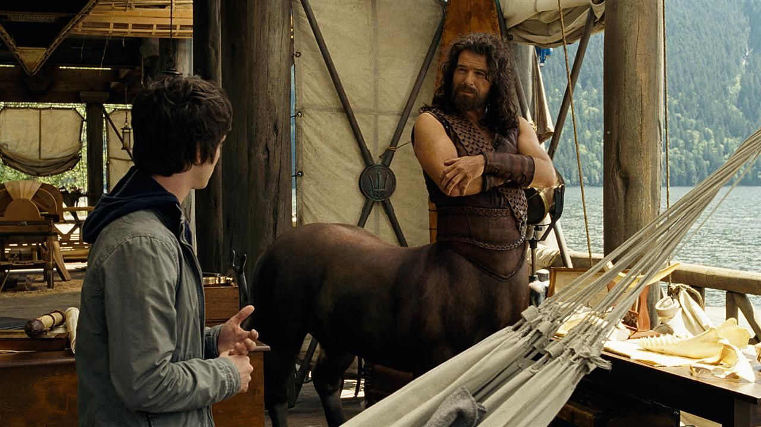
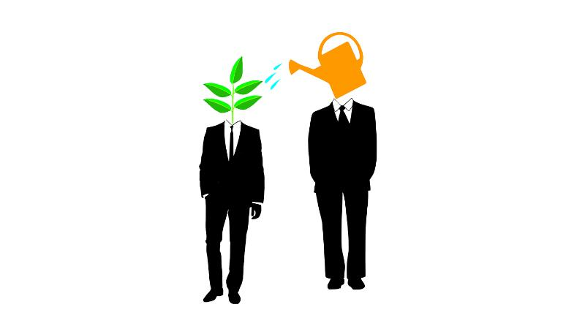
Achieving the goal through the help of a mentor media
Brent Bishop The Whirligig
Percy Jackson Percy Jackson the Lightning Thief
“This, though, was different--hearing himself forgiven freely, by someone he trusted. He wasn't sure, though, that she knew enough to forgive him. He told her the story in detail. It didn't seem to change her mind.” (pg. 129)

Slide 11
A new normal
5.
Brent Bishop The Whirligig
Percy Jackson Percy Jackson the Lightning Thief
After the artist openly forgave Brent for the terrible thing he had done, he was a new person. His journey across the country building whirligigs has caused his personality to change completely, now that he has redeemed himself and restored justice. After succeeding in his heroic journey, he now has a much higher self esteem. Brent now has the confidence to return home and start a new life. After Brent finished talking to the artist he walked into a contradance. Since he was a different person now, he shared his positivity and joined in the dance when a woman asked him to. He even considered going to more places around the country to build more whirligigs because he seemed to want to share his gift with the world.
Percy was framed for stealing the lightning bolt. Percy found it in his own backpack, but he was set up by Ares and Luke with the intention of starting a war between the gods. However, Percy does return the lightning bolt in time to Olympus to stop the conflict. He took what he had learned and saved the world from a great disaster. Percy also helped out his father Poseidon when he was found to be innocent after Percy brought back the bolt. In the end Percy achieved his goal of resolving the conflict and making peace between the gods. Percy then decides he fits in at camp and is where he belongs. The camp is Percy’s new normal because he has learned to embrace his new identity.

Slide 12
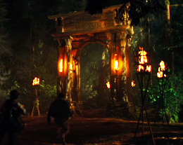
A new normal media
Brent Bishop The Whirligig
Percy Jackson Percy Jackson the Lightning Thief
He thought he might build some more whirligigs. Maybe he'd start on a lifetime project of putting one up in every state. (pg. 132)

Slide 13
Theme of self identity summary
Brent Bishop The Whirligig
Percy Jackson Percy Jackson the Lightning Thief
At the beginning of the novel Brent feels quite insecure since he never really has time to settle in because he is always moving. He feels even worse after he killed Lea in the car crash. Brent goes on a journey of redemption building whirligigs across the country. This journey changes him a lot and changes how he looks at the world. He finishes the journey with a much higher self esteem and a new skill set to add to that. Brent learns to embrace this new identity. In the end Brent learns to look at the world differently and changes the way he does things. His life takes a turn for the better.
At the start of the book Percy is just a troubled kid with dyslexia and ADHD. He doesn’t like these disabilities and doesn’t think very positively about himself. The thing is that these disabilities are there for a reason that Percy does not know. They are there because he is a demigod and it is common for people like him. After his battle with his teacher he finds out that he has to go to Camp Half Blood, where he finds his true identity, he is a son of Poseidon. Percy then goes on a quest and once he comes back he decides he wants to stay at Camp Half Blood and embrace his true identity.

Slide 14
Bibliography
Whirligig (novel)
En.wikipedia.org
https://en.wikipedia.org/wiki/Whirligig_(novel)
Amazon.ca
https://www.amazon.ca/Percy-Jackson-Olympians-Lightning-Thief/dp/0786838655
Your COVID-19 ‘Choose-Your-Own-Adventure’ Mental Health Guide
Healthline
https://www.healthline.com/health/mental-health/covid-19-choose-your-own-adventure-mental-health-guide
Sutori
Sutori.com
https://www.sutori.com/story/percy-jackson-and-the-olympians--t6NLXQsDhvLqJrzimNPwVydf
3 reasons why helping people is not always good for business | AlphaGamma
AlphaGamma
https://www.alphagamma.eu/entrepreneurship/3-reasons-helping-people-good-business/
The Lightning Thief - Chapter 19
Readpercyjacksonforever.blogspot.com
http://readpercyjacksonforever.blogspot.com/2012/05/the-lightning-thief-chapter-19.html

Slide 15
bibliography
3 Influencers Share Their Wisdom on Overcoming Obstacles - Growth Freaks
Growth Freaks
https://growthfreaks.com/influencers-overcoming-obstacles/
MEDUSA — MATHIEU AERNI
MATHIEU AERNI
http://mataerni.com/percy-jackson
16 mentoring definitions
Training Journal
https://www.trainingjournal.com/blog/16-mentoring-definitions
Pinterest
https://www.pinterest.ca/pin/243968504793131308/
A Better World through Chemistry
Andersondevelopment.com
http://www.andersondevelopment.com/blog/a-better-world-through-chemistry/
Percy Jackson: The Lightning Thief
lightningboltmy
https://lightningboltmy.wordpress.com/2015/07/04/percy-jackson-the-lightning-thief

