Slide 1
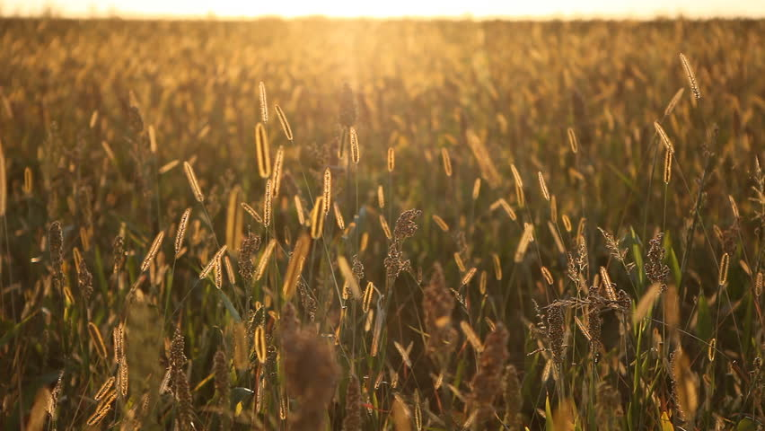
Biofuels
By: jacob k

Slide 2
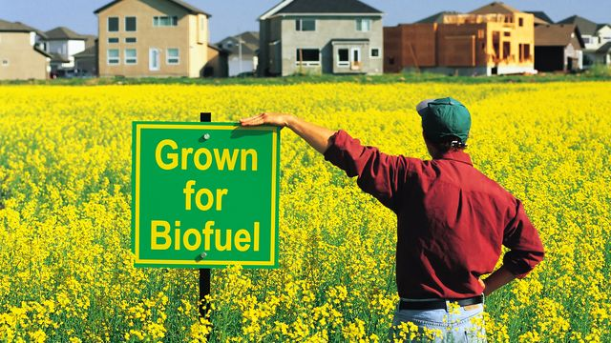
What are biofuels?
Biofuels are designed to replace gasoline, diesel fuel and coal. Biofuels are non fossil fuels. They are made from animals and plants that died millions of years ago. Biofuels are made mostly from plants that have just been harvested. There are two main types of biofuel Ethanol and biodiesel.

Slide 3
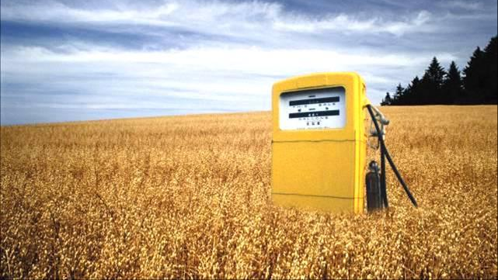
What is ethanol and biodiesel?
Ethanol: Is mostly used in cars, ethanol is a type of alcohol and is most commonly made from corn or sugarcane.
Biodiesel: Is a substitute for diesel fuel, which is used mostly in trucks in the US but also in an increasing number of diesel cars. Most commonly made from soybeans. Based on oils.

Slide 4
What is biofuels best used for?
Transportation
Energy Generation
Provide Heat
Charging Electronics
Clean Oil Spills and Grease
Cooking
Create energy when fossil fuel runs out
Remove paint and adhesive
Reduce cost and need for imported oil
Lubricate

Slide 5
What Kinds of Things can Biofuel be Made From?
Ethanol can be made from:
Corn
Sugar cane
Sugar beet
Wheat
Grass
Biodiesel can be made from:
Jatropha – A cactus-like plant
Camelina – A flowering plant
Soybeans
Rapeseed – A kind of seed
Canola Oil
Palm Oil
Peanut Oil
Vegetable Oil
Animal Fat
Algae oil – Oil made by algae that live in water

Slide 6
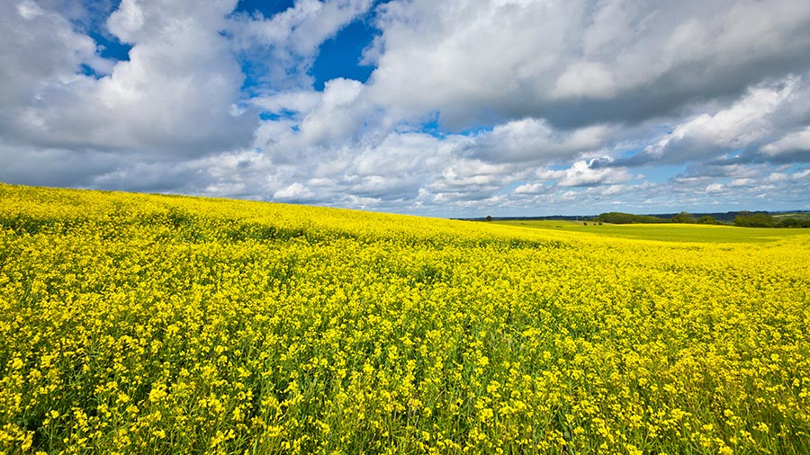
Pros / Changing the world
Inherently renewable
Biofuels are environment-friendly
Absorbs carbon dioxide as it grows
Can be grown on land unsuitable for other types of agriculture
People/Company’s are investing into biofuels
Research has been underway for 50 years
Both waste CO2 and wastewater can be used as nutrients
Burning biofuels is carbon natural
Cars using biofuels have lower road tax
As petrol gets more expensive cars using biofuels will be cheaper to run

Slide 7
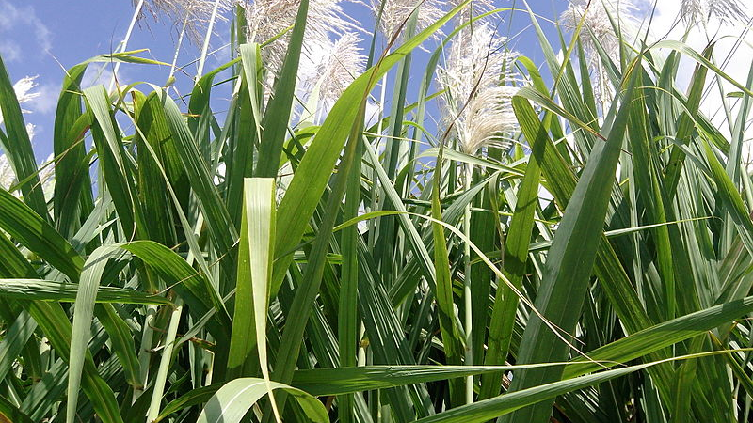
Cons
Requires a extensive amount of land and water
Needs to be grown under controlled temperature
Loss of habitat
Harmful Nitrous oxide production
Limitations in its use in vehicles in some kinds of biofuels require ad justifications to vehicle engines
Not clear yet what the ultimate cost per gallon will be. Presently too high.
Biofuels are not widely available and not many people are aware about it.

Slide 8
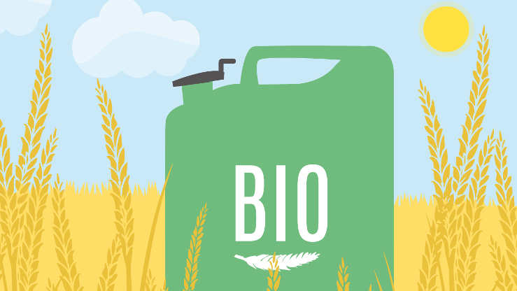
Biofuel video
https://www.youtube.com/watch?v=ZGmwtDffc74​

Slide 9
Reference
https://www.nationalgeographic.com/environment/global-warming/biofuel/
https://www.greenfacts.org/en/biofuels/l-2/1-definition.htm
https://www.studentenergy.org/topics/biofuels
http://www.nrcan.gc.ca/energy/renewable-electricity/bioenergy-systems/biofuels/7391
http://biofuel.org.uk/biofuel-facts.html
http://thinkbioenergy.com/six-fast-facts-about-biofuels/
https://www.bio.org/articles/fact-sheet-sustainable-production-biofuels

