Slide 1
Secret path - Home
By:Grace McLeod

Slide 2
Where Is my home,
Is it the place you fall asleep at night,
Or is the warm embrace of another

Slide 3
Maybe it’s the sound of a soft voice, the smell of winter
No, that’s not it, not for me

Slide 4
Home lies within my dreams
In my subconscious, my always buzzing brain,
Never the same but always in a certain pattern of existence,
Always with me,

Slide 5
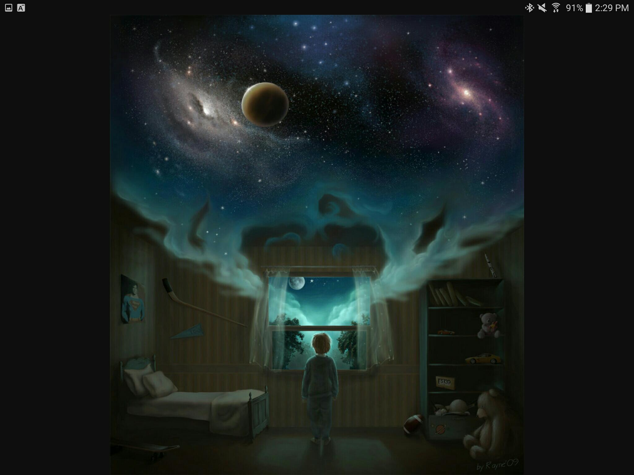
Like a mystery novel you never know what will been shown as you close your eyes,
What story or person is awaiting around the corner,

Slide 6
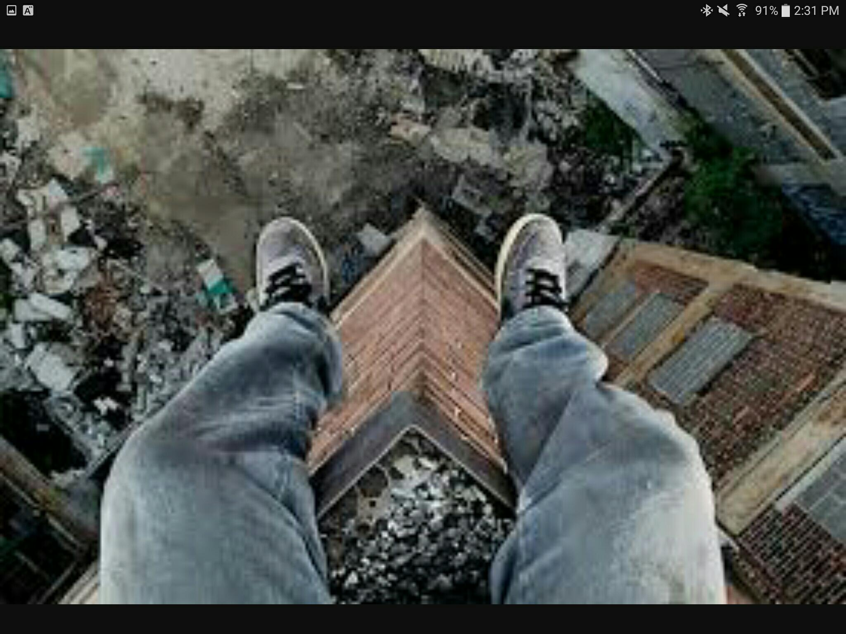
Fear doesn’t fall from the cliff as I step into the dreams,
instead a warmth of relaxation fills that spot,

Slide 7
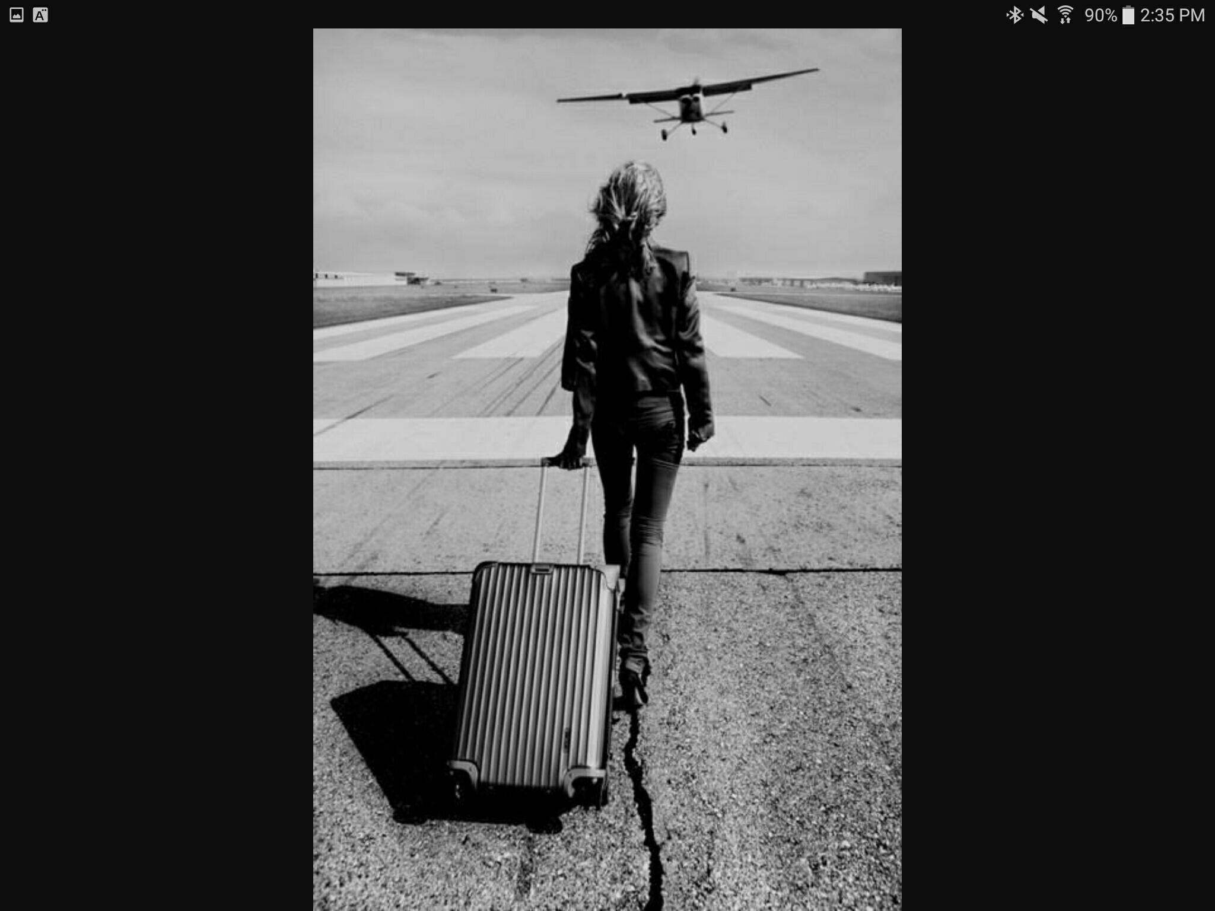
Waking up from my dream is like moving away,
A sense of worry and panic takes hold of my feelings,
I don’t want to move, I can’t leave, I’m scared
The outside world doesn’t understand,

Slide 8
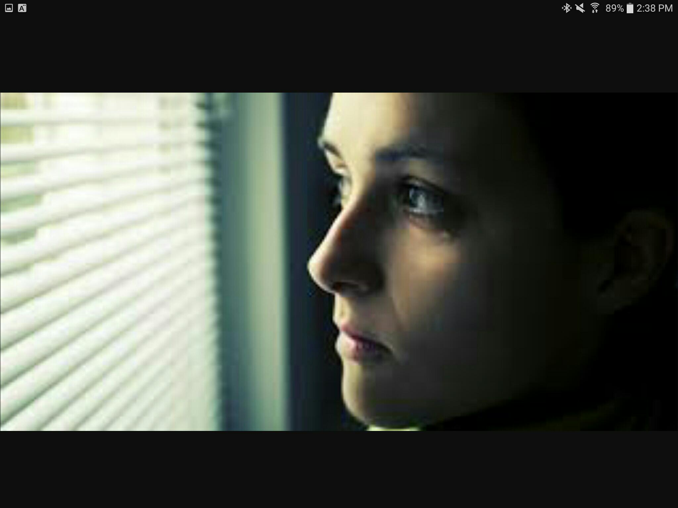
My passage way to happiness and safety is within the very walls of my thoughts,
My fears and insecurities can be locked away,
Until tomorrow, then I awake,
Waiting and waiting until the clock strikes,

Slide 9
My home is in my dreams
Home

