Slide 1
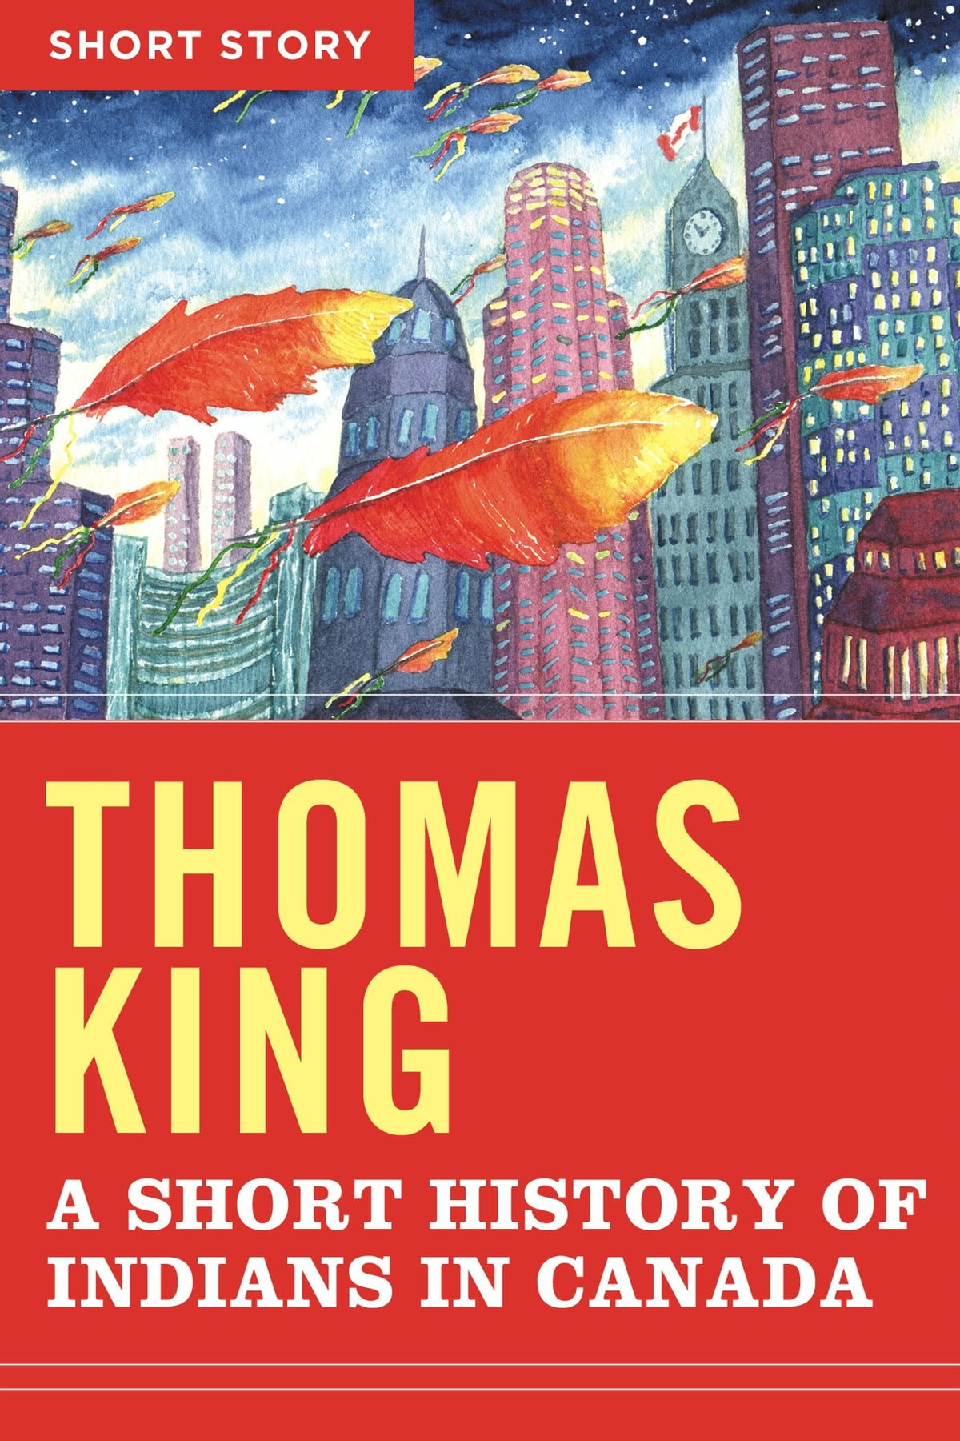
Synthesis Essay- EFP 12
Otherwise known as a Compare and Contrast Essay

Slide 2
To compare means to point out similarities. To contrast means to point out differences So what means what can you conclude about this analysis? How can you relate this to a life lesson or insight into humanity?

Slide 3
They must be alike enough to result in a meaningful comparison. Choose subjects that are similar enough to be compared or contrasted.
E.g. the effects of stereotypes on identity

Slide 4
Synthesis
ONLY using four sources to produce new ideas, insights or understanding. It is a melding of themes from a limited number of sources.
Used in many College or University exams when the professor wants you to show your strong understanding of the sources analyzed in class. No outside research is required.

Slide 5
Objective of a “synthesis” essay. To help the reader….
Clarify
Clarify something unknown or not well understood
Insight
Lead to fresh insight or new ways of viewing humanity
Focus
Bring one or both of the subjects into sharper focus
Superiority
Show that one subject is better than the other.

Slide 6
Notes on Formal, Academic Writing
No “I”, “you”, “we”
Present tense
No conversation (“This quote shows..”)
No absolutes or superlatives or cheerleading (“This will always be a fantastic book..”)
No contractions ( “They did not…” “They didn’t”)
Refer to authors by their last name
Write out the number if less than 10, otherwise you can use a numeral

Slide 7
Step one
Brainstorm

Slide 8
Brainstorm using a graphic organizer
Venn Diagram
Chart

Slide 9
Highlight the key ideas that present the most INSIGHTFUL argument
Which one of your points is the most interesting?
Which one of your points is the most insightful and shows a deep understanding of the text?
Which one of your points answers your focus question the best?

Slide 10
Step two
Modify and tweak your question

Slide 11
Modify and tweak your question to fit your purpose and sources
How has Hollywood affected the Indigenous identity?
How are Indigenous people reclaiming their culture and their identity?
How and what has affected the Indigenous identity?

Slide 12
More ideas on how to narrow your focus
How does the connection to land affect Indigenous identity?
How did residential schools affect the identity of the Indigenous people?
What effect did colonization have on the Indigenous connection to the land?

Slide 13
Step 3- Thesis Statement
This is one of the most important and difficult steps!! Go deep.

Slide 14
Thesis
The blueprint of your essay.
The main argument of your essay
The “so what” of your essay

Slide 15
Thesis specifics
It must include all stories
1-3 sentences
It must be specific and insightful
It should not include the first or second person (no “I” or “you”)
It should use transition words
It should have a “so what” in the thesis OR it can be stated clearly in the body paragraphs or conclusion

Slide 16
Continued
Directly answers the question. A thesis is an interpretation of a question or a subject, not the subject itself. The subject, or topic, of an essay might be WW II or To Kill a Mockingbird, a thesis must then offer a way to understand the war or the novel
Makes a claim that others may dispute
Is usually 2 or more sentences in the introduction that presents your argument to the reader. The rest of the paper, the body of the essay, gathers and organizes evidence that will persuade the reader of the logic of your interpretation https://writingcenter.unc.edu/tips-and-tools/thesis-statements/

Slide 17
Thesis Statement in a Synthesis Essay
Personally, I like the thesis statement to have the following:
1. how are the sources the same
2. How are the sources different
3. So what? What new insight, or understanding, or clarification is shown by synthesizing these sources? Maybe one is better at showing something than another. What have we learned about our world, the human condition or experience, from these sources?

Slide 18
Transition words for thesis
SAME (in addition, just as, likewise, similarly)
DIFFERENT? (however, whereas, conversely, although meanwhile)
SO WHAT? (ultimately, regardless, furthermore, therefore, one learns, the author teaches the viewer..)

Slide 19
Objective of a “synthesis” essay. To help the reader….
Clarify
Clarify something unknown or not well understood
Insight
Lead to fresh insight or new ways of viewing humanity
Focus
Bring one or both of the subjects into sharper focus
Superiority
Show that one subject is better than the other.

Slide 20
This is a good thesis for an essay using two sources
Although “Sorry for Being a Stereotype” is an opinion piece about the First Nation identity and “What Kind of Asian Are You” is a slam poem about the Asian identity, both these pieces show that stereotypes may lead to shame, confusion of one’s self, and a feeling of isolation in one’s own country. By comparing these pieces, one recognizes the effect negative stereotypes have on cultural identity.

Slide 21
Three source thesis
These three sources similarly show the usage of art by Indigenous people to harden their identity in Western culture; their art opposes stereotypical/racial expectations with their authentic values and brings indigenous culture into the mainstream. Regardless of its kind, modern indigenous artists educate the heavily Westernized society about its false representation of Indigenous culture.

Slide 22
Four source thesis
All the sources address the matter of the stereotypes and the racist views against the Indigenous community. Additionally, they all find a way to combat these views through their mediums. Two of the sources challenge the misconceptions through the means of hip-hop to bring the issue at hand to a larger audience; however, the other two take on the form of a spoken word to invalidate, through personal experiences and knowledge, the way that Indigenous people are commonly perceived. Consequently, it is important as a listener that we learn to question our stereotypical ideas of indigenous so we can embark on the path of reconciliation.

Slide 23
Four source thesis
These four sources share common themes such as the dangers of conformity, the perils of youthful innocence, and the despotic, tyrannical nature exhibited so often by those who are of a higher status. Most importantly however, they all demonstrate the significant need for critical, free thinking.

Slide 24
Step 4- Do an outline
I will give this to you.

Slide 25
Outline
Point form
Main arguments and ideas
Collect your quotes now- there is no time when writing in-class essays to find quotes
The outline prompts you about what is needed for each section.
You cannot start writing your essay until I have checked it!!

Slide 26
Step 5- Write the essay

Slide 27
Notes on Formal, Academic Writing
No “I”, “you”, “we”
Present tense
No conversation (“This quote shows..”)
No absolutes or superlatives or cheerleading (“This will always be a fantastic book..”)
No contractions ( “They did not…” “They didn’t”)
Refer to authors by their last name
Write out the number if less than 10, otherwise you can use a numeral

