Slide 1
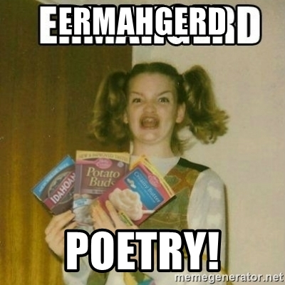
Poetry

Slide 2
Learning outcome?
*You will have a working knowledge of some basic poetic devise and how to recognize them in a Poem.
*you will learn to connect yourself within land and places as well as recognize their significance in poems.
*you will develop your own voice and opinions within poetry and our theme around land in order to have something meaningful to say for your final project.

Slide 3
Let’s learn some poetry. It’ll be fun!

Slide 4
* What do you remember from previous years? https://jamboard.google.com/d/1PTIBJJjFIdazDRC6Wtc2Wh5bRgrjfgnKstz6cHw5RL4/viewer?f=0

Slide 5
*What things from the short story’s unit can you apply to poetry?

Slide 6
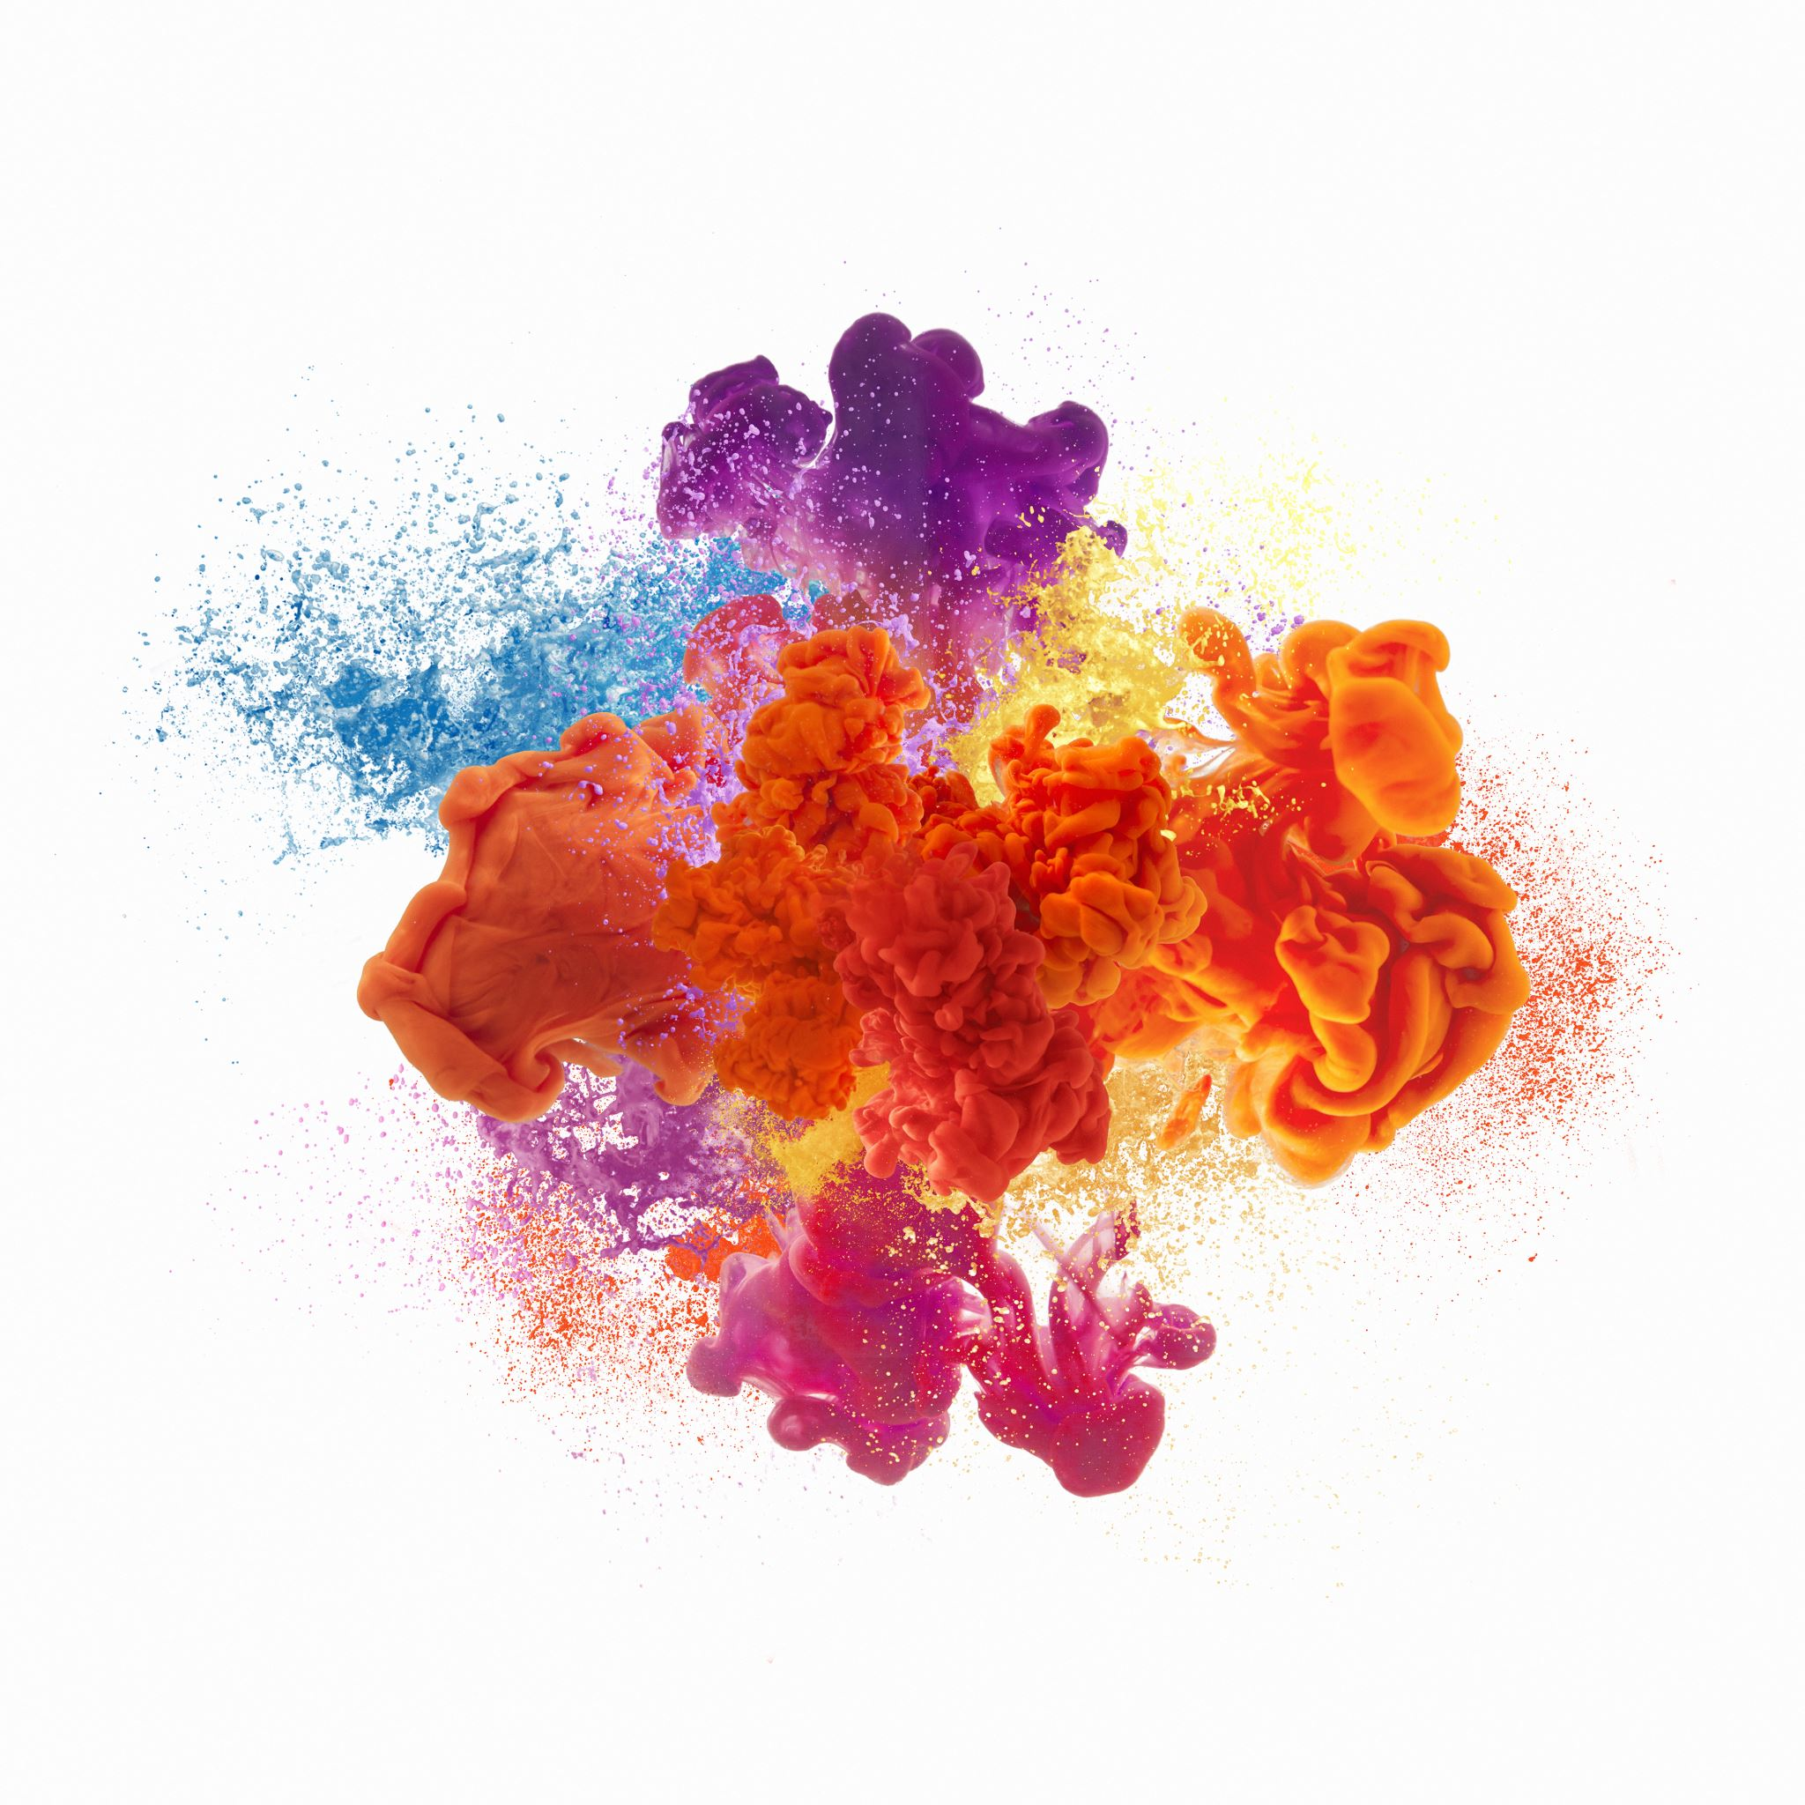
Imagery

Slide 7
Describing words
The 5 senses Sight – Shadowy, Radiant, Shiny Hearing – Buzzing, Thundering, Echoing Smell – Fresh, Overpowering, Fragrant Taste - Spicy, Sour, Unsavory Touch – Bristly, Oily, Tacky
https://jamboard.google.com/d/1Akep7m27UsIg5xqRN7bNlmxwryrEqnAjFrHZbSbt1oE/viewer?f=0 Page 1

Slide 8
Alliteration
The repletion of a letter or sound at the beginning of words next to each other
Like a tongue twister:
“She sells seashells by the seashore.”
“With swift, slow; sweet, sour; adazzle, dim” from Gerard Manley Hopkins’s “Pied Beauty.”
On the jamboard, think of 3 words that start with the same letter or sound. https://jamboard.google.com/d/1ql9acJH6IwvNs73tVs8JKDDTendiwMBrtWOMjY-RVRQ/viewer?f=0

Slide 9
Onomatopoeia
A word that is the sound it describes. - BAM! BOOM! Used a lot to grab attention! - burble, swish, ping, clang…
Looking at the images, see if you can’t think of an onomatopoeia to describe something within them.
https://jamboard.google.com/d/1Akep7m27UsIg5xqRN7bNlmxwryrEqnAjFrHZbSbt1oE/viewer?f=0 Page 2

Slide 10
Simile
Using the words like or as to compare two things that are not alike that replaces the word with another. - Mild~
Examples: I’m as hungry as a bear. He swims like a dolphin. NOTE the as (blank) as a (blank) //or// something (blanks) like a (blank)
“A Red, Red Rose,” Robert Burns declares: O my Luve is like a red, red rose That’s newly sprung in June; O my Luve is like the melody That’s sweetly played in tune.
Looking at the images, see if you can’t think of a simile to describe a) a character and how they look… b) a setting and how it looks… c) an object and how it looks…
https://jamboard.google.com/d/1Akep7m27UsIg5xqRN7bNlmxwryrEqnAjFrHZbSbt1oE/viewer?f=1 Page 3

Slide 11
Metaphor
A non-literal comparison between two things that are not alike that replaces the word with another. - Spicy!
“‘Hope’ is the thing with feathers— / That perches in the soul—.” by Emily Dickinson NOTE we do no use AS, LIKE or THAN to make the comparison like we would with simile.
Looking at the images, see if you can’t think of a metaphor to describe a) a character and how they look… b) a setting and how it looks… c) an object and how it looks…
https://jamboard.google.com/d/1Akep7m27UsIg5xqRN7bNlmxwryrEqnAjFrHZbSbt1oE/viewer?f=1 Page 4

Slide 12
Personification
Giving human qualities to non-human things. TOY STORY
Take one of the non-human characters or objects and describe it with a human quality~
https://jamboard.google.com/d/1Akep7m27UsIg5xqRN7bNlmxwryrEqnAjFrHZbSbt1oE/viewer?f=1 Page 5

Slide 13
Imagery: look back at the jamboards whenever to see all the wonderful examples you all came up with!
Describing words - 5 senses (smell, hearing, sight, taste, touch)
Alliteration - The repletion of a letter or sound at the beginning of words next to each other
Onomatopoeia - A word that is the sound it describes.
Metaphor - A non-literal comparison between two things that are not alike that replaces the word with another.
Personification - Giving human qualities to non-human things.
Simile - Using the words like or as to compare two things that are not alike that replaces the word with another.
Vivid Language
Word choice

Slide 14
Things to think about…. Why does the poet choose these words? What effect do they have to the overall poem?

Slide 15
Tone / Attitude
Words that give the feeling and emotion that the poet wants to express.
Words are chosen to create a mood/feeling
The tone can change in a poem and this can be significant
Is the poem satirical, Ironic, thoughtful… (sometimes this will be determined by the style of poem)
Word choice: connotation (emotions attached) denotation (actual meaning of words)

Slide 16
Tone: Changes
Tone can set the mood, but the interesting stuff, or TENSION, happens in a poem or story when tone CHANGES.
Is the first Harry Potter book the same as the last? Do we think and see the world the same way we did when we were young?
**You will be reading a short poem or you will have already read it. I want you to think about this idea of changing tone for that poem.

Slide 17
Attitude: Denotation Vs Connotation
Literal Vs Emotional White Dove Defined as: a small white bird Associated with:
-Innocence
-Gentleness
-Tenderness
-Peace
-Love
-Harmony https://jamboard.google.com/d/1Akep7m27UsIg5xqRN7bNlmxwryrEqnAjFrHZbSbt1oE/viewer?f=0 page 6

Slide 18
Style
We will be looking at a → Narrative - a poem that tells a story. → Lyrical – A short poem of intense feeling and emotion and if we have time… → Free Verse poem – irregular in shape, size and rhythm. but these are not the only kinds...
Features: Stanzas (how many [how long]) – A paragraph of writing in a poem. Couplets – 2 lines of poetry that rhyme. Quatrains – 4 lines of poetry that have a rhyme scheme.

Slide 19
Style
We pay attention to: Line length Line groupings Metrics Patterns Depending on the type of poem and style it can be OPEN and play around with these things or CLOSED and stick to very clear patterns.

Slide 20
Interpretation
What is the poet trying to say: Message
Who or what is the poem for? Is the poem written for someone, is the poem a historical, psychological event (love, birth, death, mental illness, etc) mythological event?
Who is the narrator? Who is speaking to whom and under what circumstances?
What does it mean to you? What message/meaning do you pull from it?

Slide 21
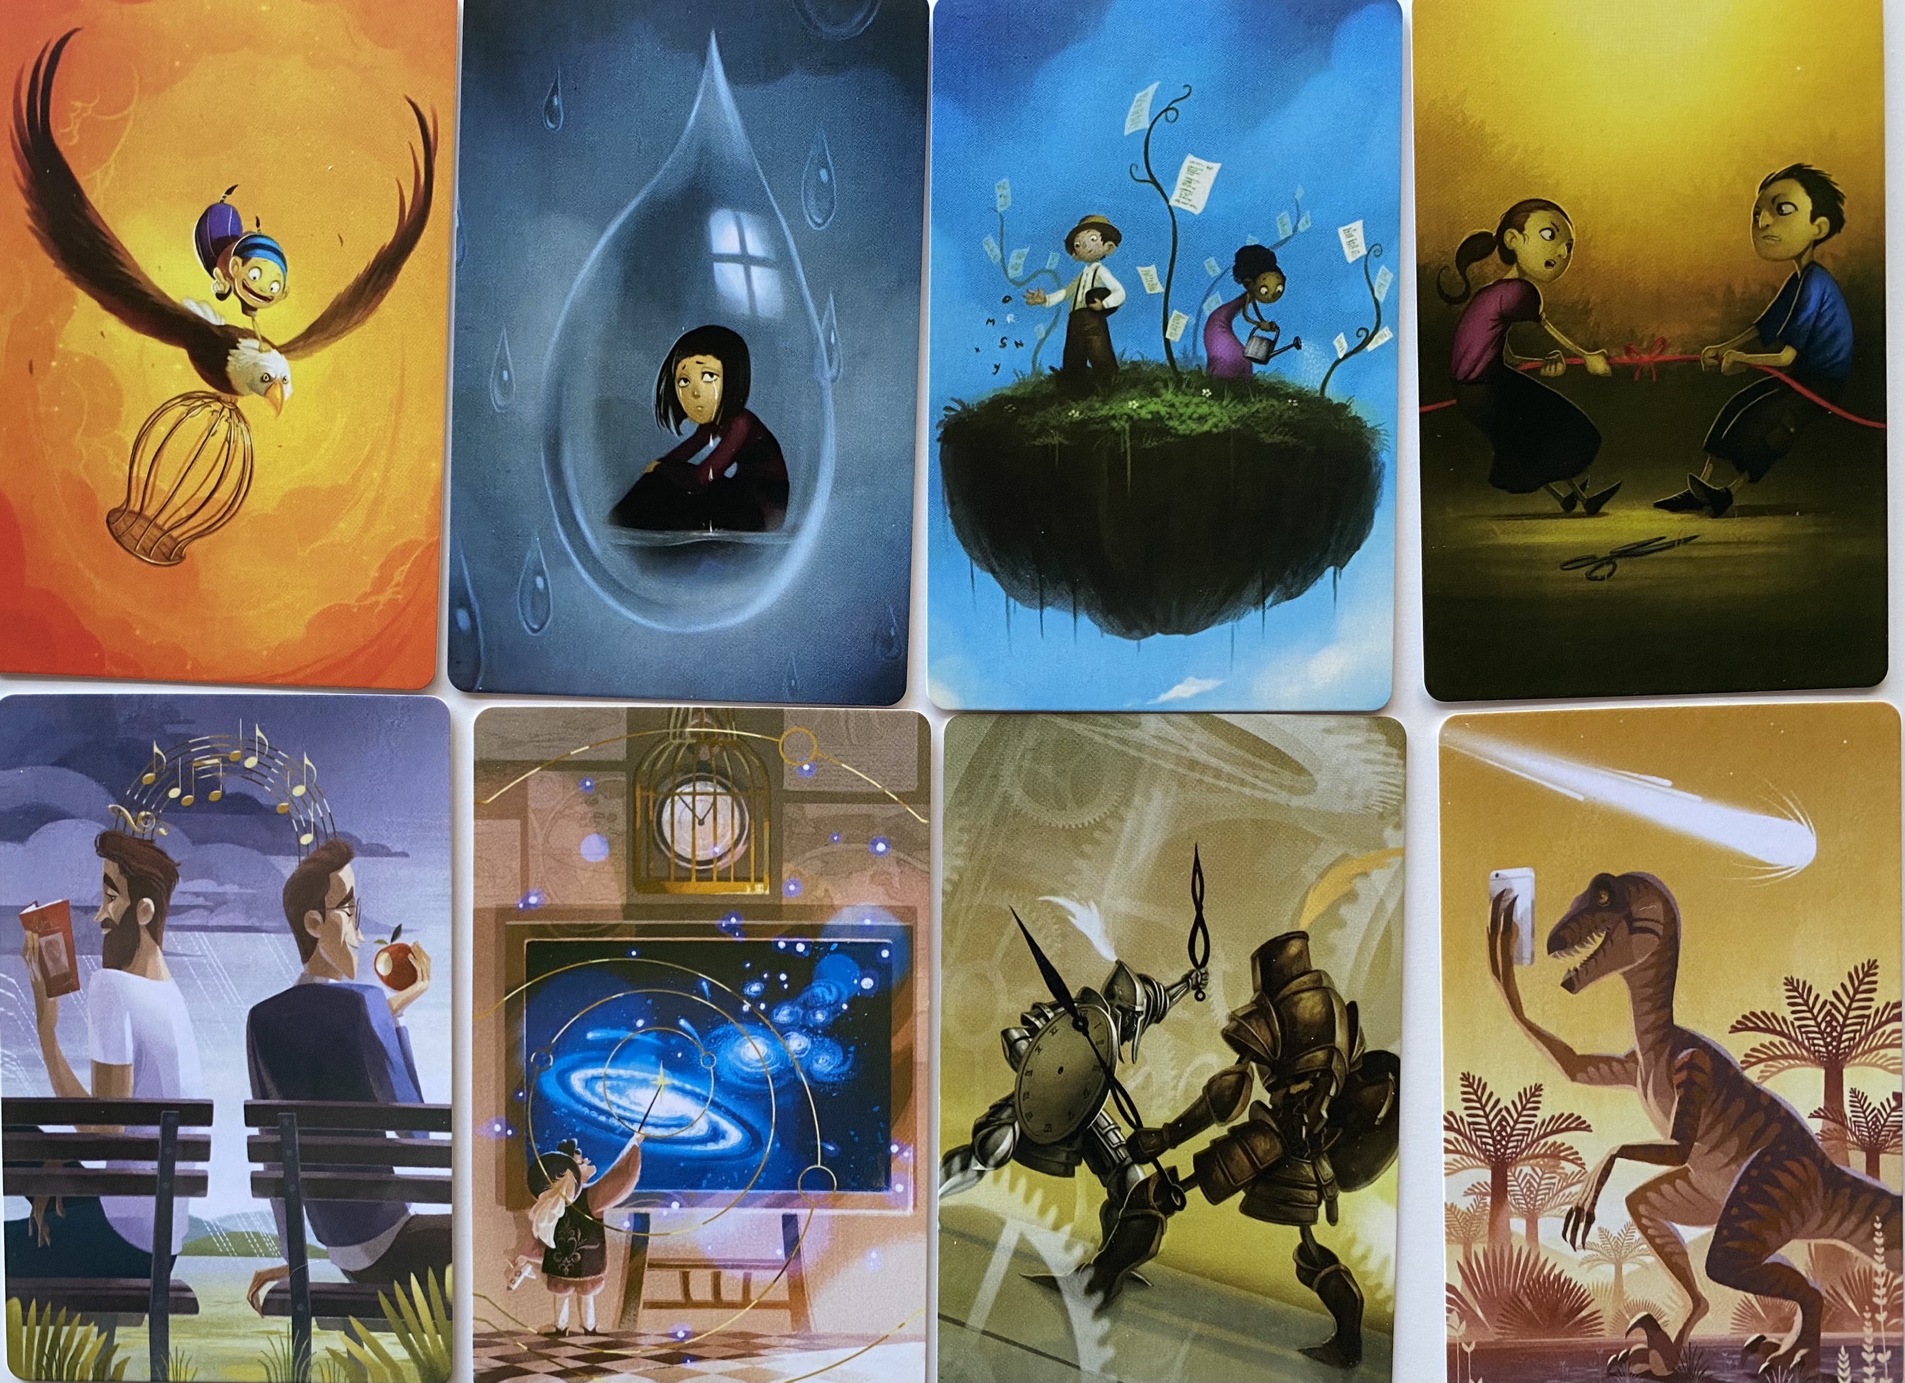
Notes:
This page is meant for you, the student, to reflect on which image you are today. It doesn’t have to be more complicated than I was eating an apple so the guy on the bench is my image today. This simple act is you finding a personal meaning is interpreting. Genius!

