Slide 1
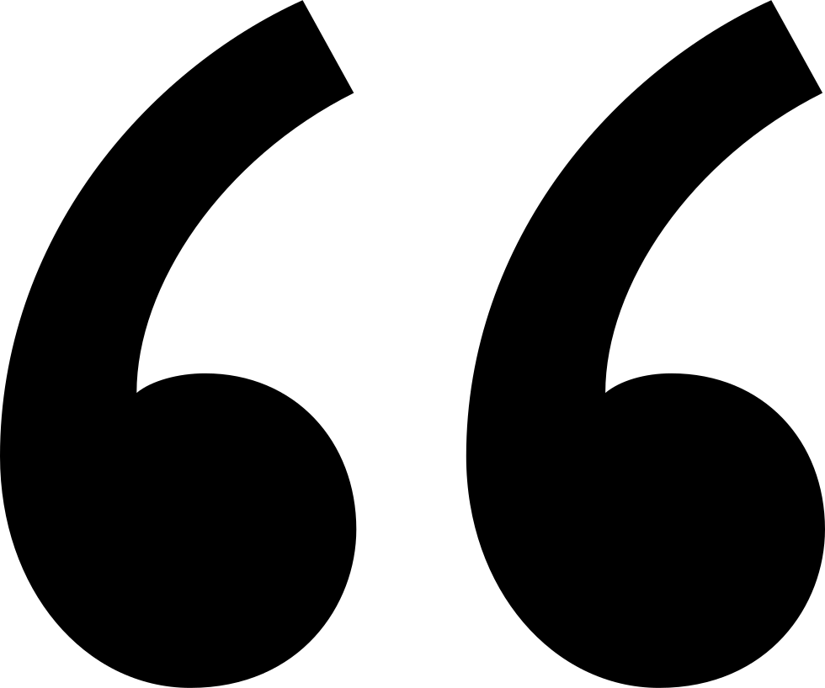
Name: _______________________
Date: __/__/___ Class: _____
Figurative Language in the Marvel Universe (2015 - 2019)
Before viewing the clip, match the figurative language techniques below to their correct definition.
Repetition; Rhetorical Questions; Simile; Metaphor; Juxtaposition; Onomatopoeia
Before viewing | First viewing | Second viewing
Technique
Definition
Tally in clip (number)
Example from clip
A comparison of two things using “like” or “as”.
A comparison of two things without using like or as.
A question that does not require an answer.
Two opposite ideas or images placed side-by-side for effect.
A sound, phrase or image repeated two or more times.
Where a word’s sound and/or spelling mimic a sound.
Clip: https://www.youtube.com/watch?v=ccx2VMZbErE
© Growth Through the Middle Years 2019

Slide 2
Name: _______________________
Date: __/__/___ Class: _____
Click for
ANSWERS Figurative Language in the Marvel Universe (2015 - 2019)
Before viewing the clip, match the figurative language techniques below to their correct definition.
Repetition; Rhetorical Questions; Simile; Metaphor; Juxtaposition; Onomatopoeia
Before viewing | First viewing | Second viewing
Technique
Definition
Tally in clip (number)
Example from clip
A comparison of two things using “like” or “as”.
IIII IIII (9)
This is a man… It’s like a pirate had a baby with an angel” (Drax, Infinity War)
simile
metaphor
A comparison of two things without using like or as.
IIII III (8)
You put a dime in him, you gotta let the whole song play out” (Dave, Ant-man and the Wasp)
rhetorical question
A question that does not require an answer.
IIII II (7)
How was I supposed to know? I’m not a witch” (Loki, Thor: Ragnarok)
Two opposite ideas or images placed side-by-side for effect.
IIII I (6)
Don’t do anything I would do and… don’t do anything I wouldn’t do” (Stark, Spiderman: Homecoming)
juxtaposition
repetition
A sound, phrase or image repeated two or more times.
IIII (4)
Whatever it takes” (Avengers: Endgame Trailer)
onomatopoeia
Where a word’s sound and/or spelling mimic a sound.
II (2)
I’m like BOOM… you lookin’ for this?” (James Rhodes, Age of Ultron)
Clip: https://www.youtube.com/watch?v=ccx2VMZbErE
© Growth Through the Middle Years 2019

Slide 3
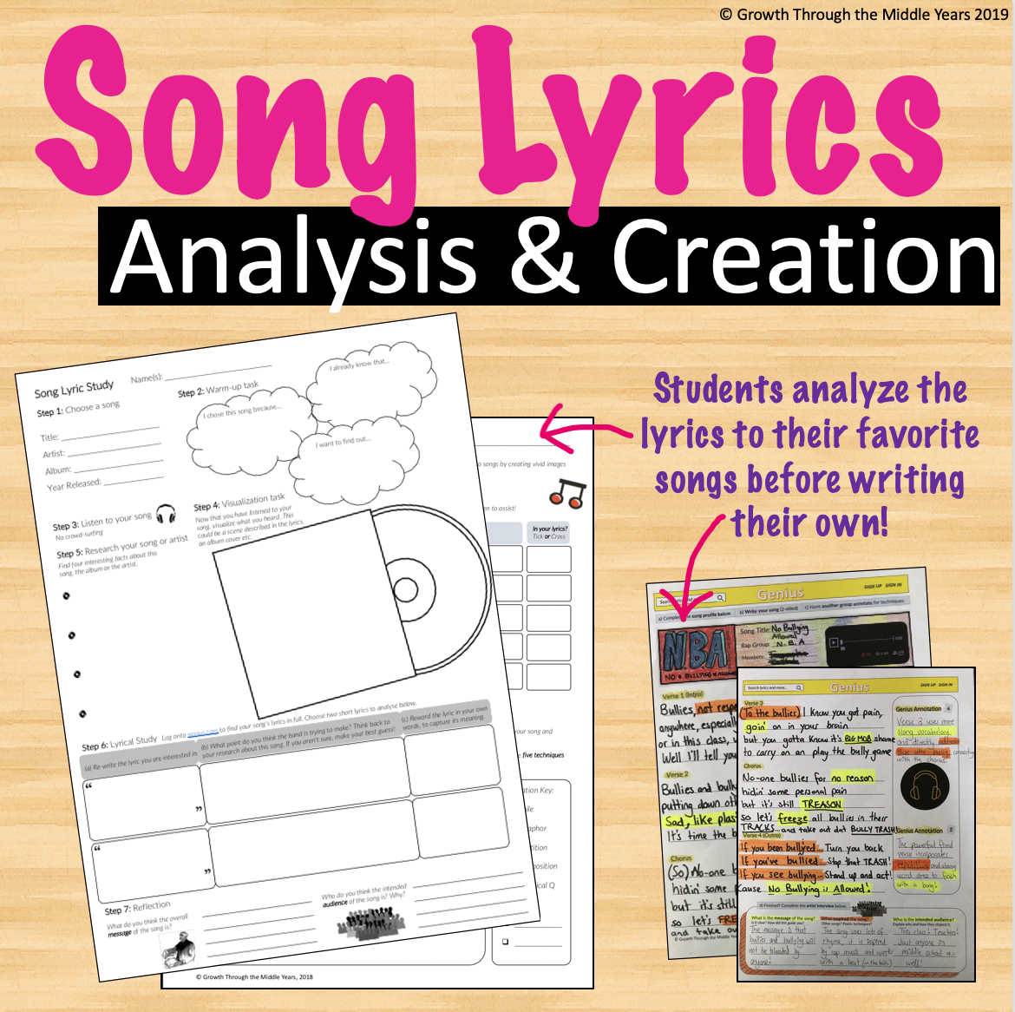
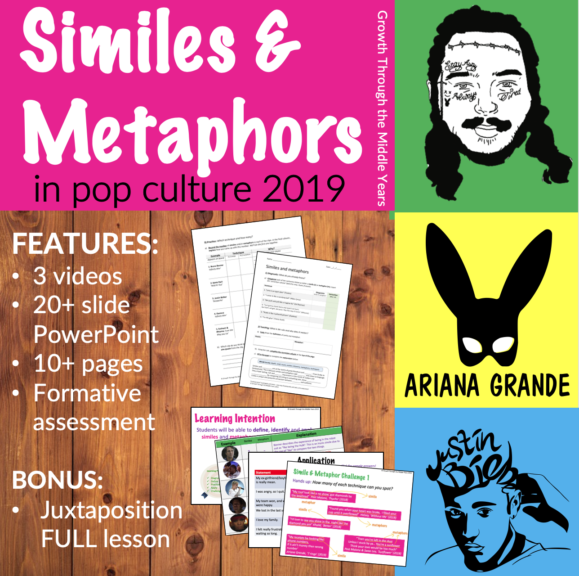
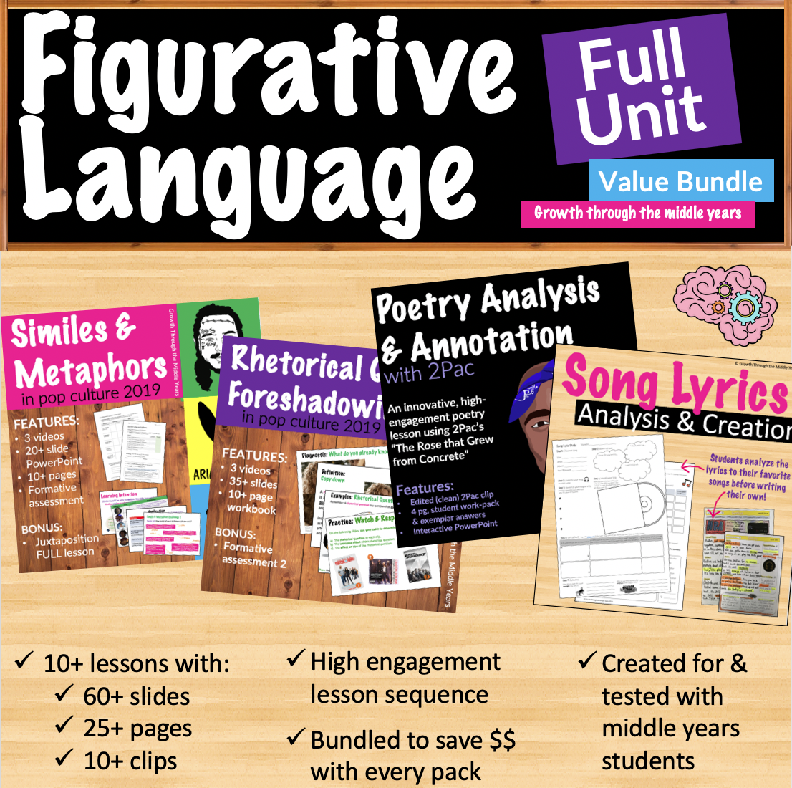
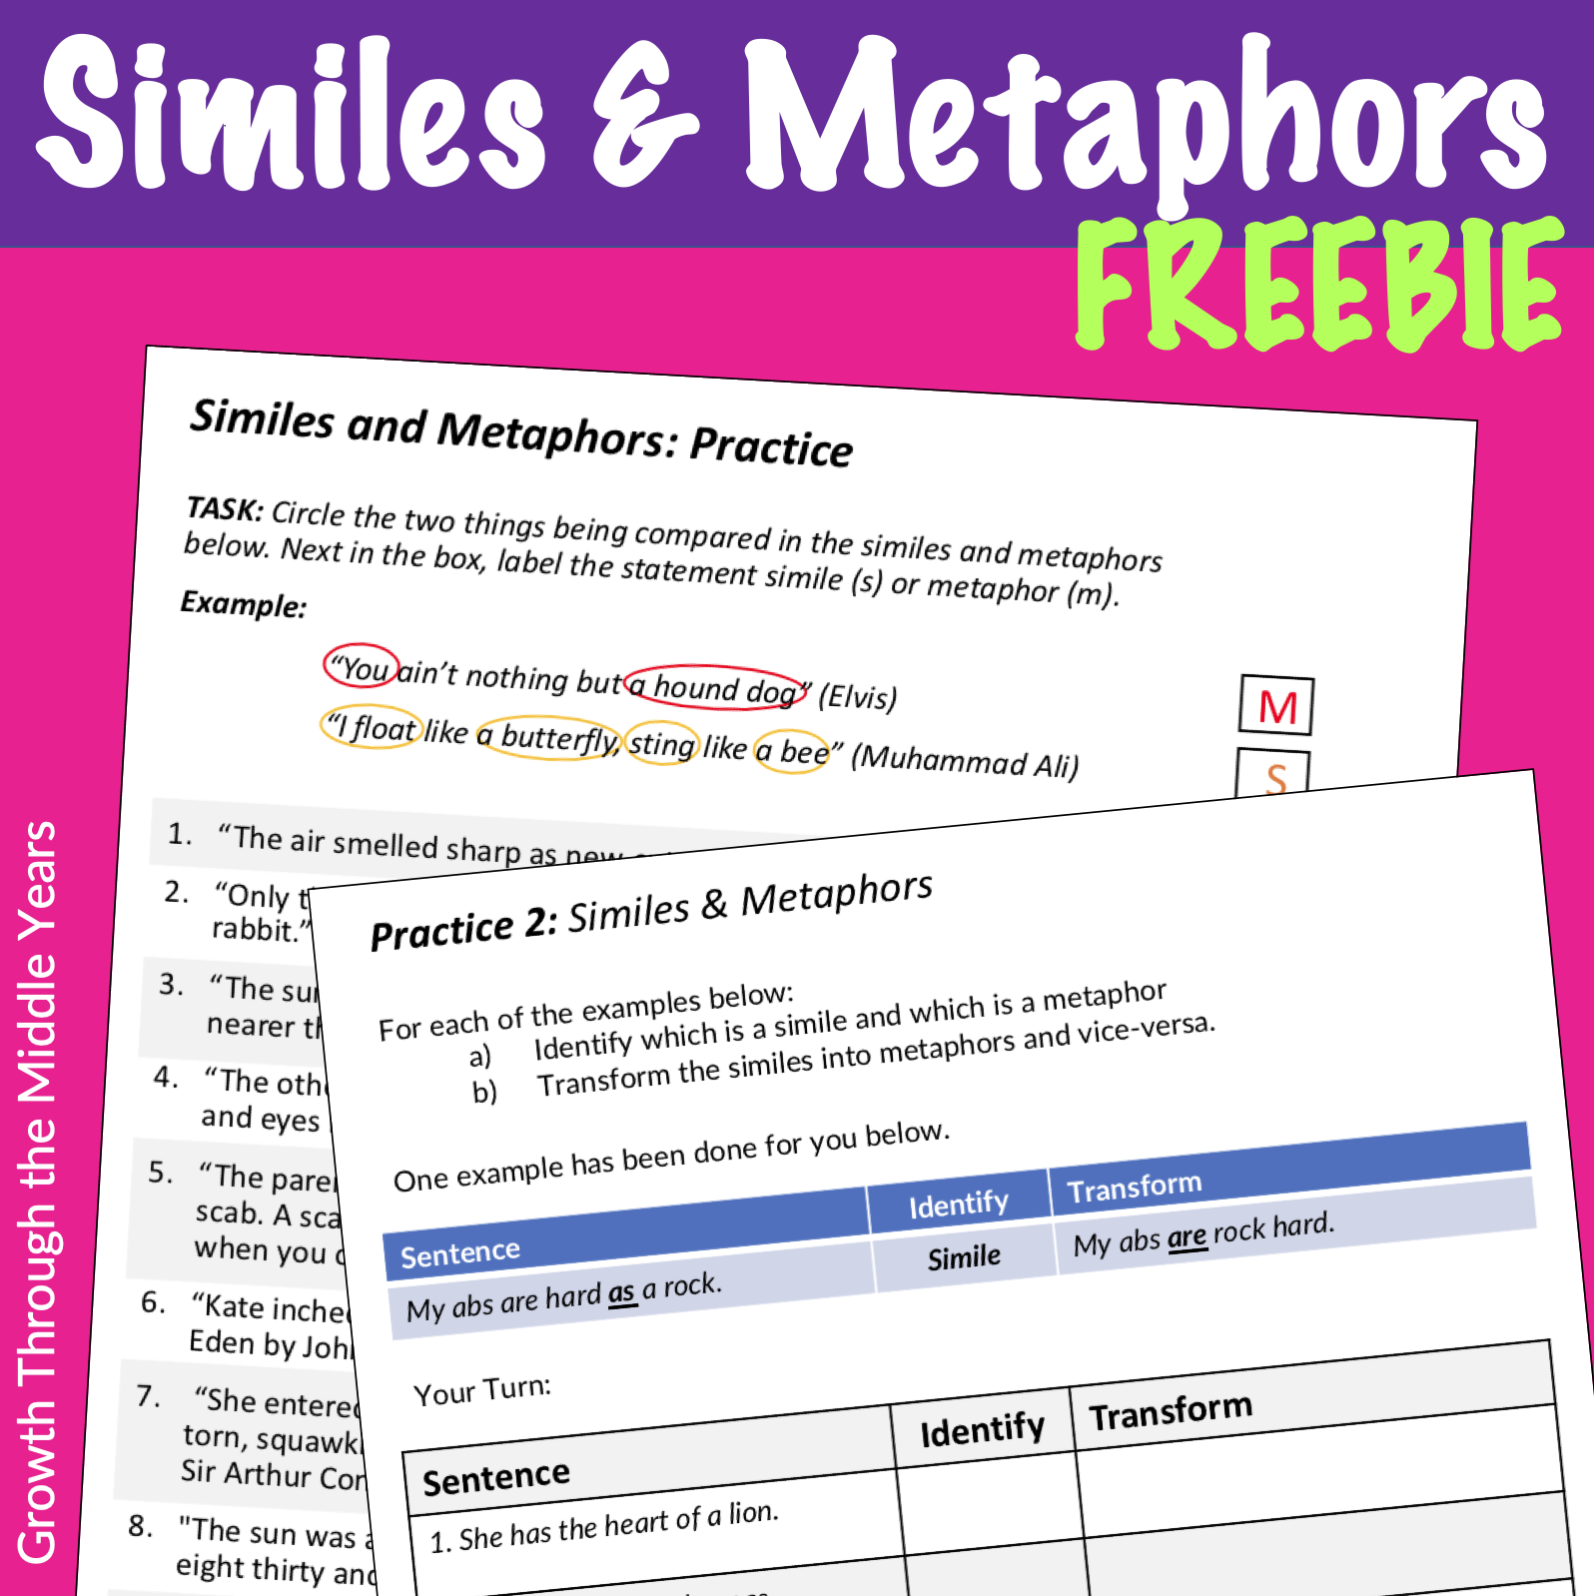
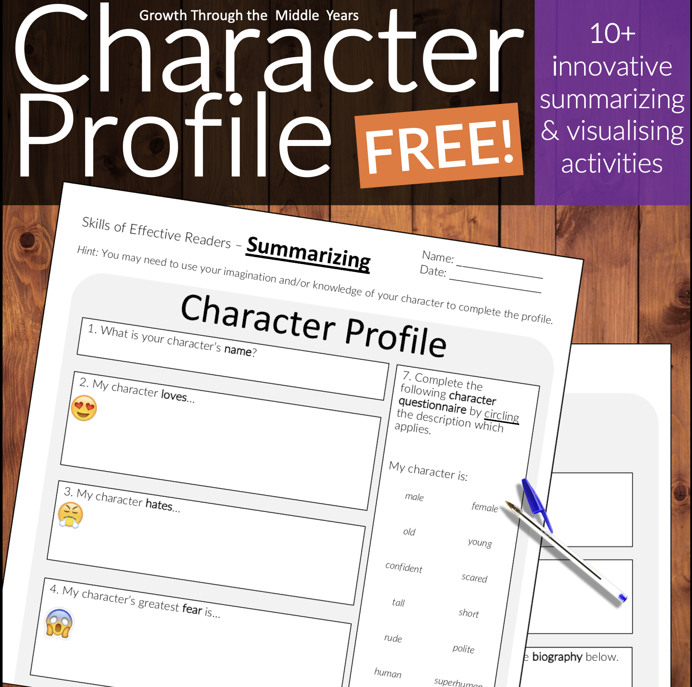
© Growth Through the Middle Years 2019
Enjoyed this resource? Some products you might like…
Students analyze ANY song for figurative language before writing their own
Students study similes and metaphors using pop culture movies and songs.
Full Figurative Language Unit Bundle, 4+ weeks of classes including assessments.
More freebies:
YouTube links:
Simile & metaphors in songs (2019)
Rhetorical Questions in movies (2019)
Juxtapositions in movies and TV
Similes & metaphors “taster” task.
Character Profile for ANY book, movie or artist.

Slide 4
Thank you for downloading this product! I hope that you and your students find it as useful as mine have!
This product is licensed to the purchaser only for classroom or personal use as a single user. You may reference this product on social media or in person provided credit is given to the author and a link to the TpT store is included.
You may not claim this work as your own, alter the files in any way or attempt to remove copyright symbols.
You may not sell any part of this product or combine them with any other products other than for classroom use. You may not make copies available to others, this is a strict violation of TpT’s Terms of Use.
Please respect the time and effort put into this product. I would love for your colleagues to use my resources too – please direct them to my TpT store at https://www.teacherspayteachers.com/Store/Growth-Through-The-Middle-Years
Images and clips compiled as part of this educational resource are used under Fair Use copyright.
Under section 107 of the Copyright Act of 1976, allowance is made for “fair use” for purposes such as criticism, comment, news reporting, teaching, scholarship, education and research. Fair use is a use permitted by copyright statute that might otherwise be infringing.
All clips edited and compiled from: https://www.youtube.com/ using https://www.4kdownload.com/
YouTube description: Includes full list of clips, original URLs and copyright details.
Emojis: http://emojione.com
Make my day and review this resource.
Return to the TpT download page and follow the review prompts!

