Slide 1
The Indian Act
Past and present impacts on First Nations in Canada

Slide 2
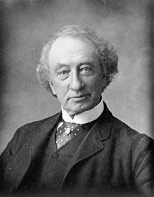
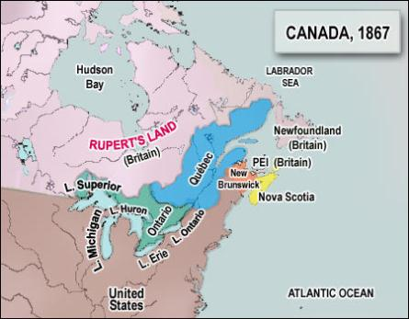
Confederation 1867
Responsibility for Aboriginals transferred from Britain to the Federal government
Questions?????
Expanding the country
Building the CPR
Settling the West
Costly wars in America for land
Notes:
Stark contrast between Royal Proclamation and Confederation regarding ownership of land and Ab sovereignty
John A. Macdonald had a conflict of interest: he was negotiating for both Canada and Aboriginals; can you fairly negotiate for both? i.e. you want to build the railway and you need land – how do you get it…do you take it b/c that is cheaper than paying full price?
US had fought costly wars with Aboriginals over land; Canada didn’t want to do the same thing

Slide 3
Indian Act 1876
Goal: Assimilate the Aboriginal population into the dominate, white, European society = eliminate the “Indian problem”
The Indian Act allowed the Government of Canada to extinguish Aboriginal rights and title to land completely and created treaties that granted back certain specified rights
Indian Act
Indian Act
Law
that governs Indians
Notes:
By 1876, there were so many aboriginal related laws that Parliament consolidated them and created the Indian Act
What was the problem? Who’s problem was it?
Gov’t believed they were protecting F.N. from whisky traders and Americans with this Act: the gov’t would look out for Aboriginals’ best interests (as they couldn’t do it themselves…idea of ‘savage/uncivilized’)
Gov’t could begin the process of assimilation once Aboriginals were forced to live in specified areas

Slide 4
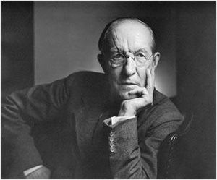
“I want to get rid of the Indian problem. I do not think as a matter of fact, that the country ought to continuously protect a class of people who are able to stand alone… Our objective is to continue until there is not a single Indian in Canada that has not been absorbed into the body politic and there is no Indian question, and no Indian Department…
Dr. Duncan Campbell Scott – 1920
Department of Indian Affairs
1913 - 1932
Notes:
Through the Indian Act, the Department of Indian Affairs was created: this federal department would control the lives of First Nations, and still does even to this day (now called Aboriginal Affairs and Northern Development Canada)

Slide 5
Loss of Aboriginal Rights
Defined who was “Indian” (identity was a number)
Couldn’t govern themselves (end to hereditary chiefs)
Not allowed to vote
Prohibited from buying or consuming alcohol
Couldn’t leave the reserve without Indian Agent permission
Limited economic activities on the reserve and couldn’t sell products off the reserve
Forbidden from holding traditional ceremonies (i.e. potlatch, Sun Dance)
Educated at government run schools only
Choice of marriage partner had ramifications
Notes:
The Canadian gov’t believed First Nations were unable to make intelligent decisions or control themselves – thus began a paternal relationship (tutelage): gov’t is the parent and First Nations are the children
To be given status, one had to be a member of an Aboriginal band that was granted a reserve or government funds or negotiated a treaty (Indian Act doesn’t govern non-status, Inuit, and Metis people)
Couldn’t govern themselves – had to have elected chiefs, not hereditary; governed by Indian Agent, RCMP, federal gov’t
Not allowed to vote in BC until 1947; not allowed to vote in Canada until 1960
Not allowed to leave – for work, school, health services
Have student refer back to their personal rights list – which ones have been covered thus far
Simulation of marriage – hand out cards with gender/ethnicity; get students to pair up, then discuss the implications for marriage partner

Slide 6
Further amendments that took away rights
Forced relocation if your reserve was near a town of more than 8,000 people
Couldn’t appear in Aboriginal regalia without permission
Indian Agent is the justice of the peace on reserves
If you obtained post secondary education = automatically lose your Aboriginal identity

Slide 7
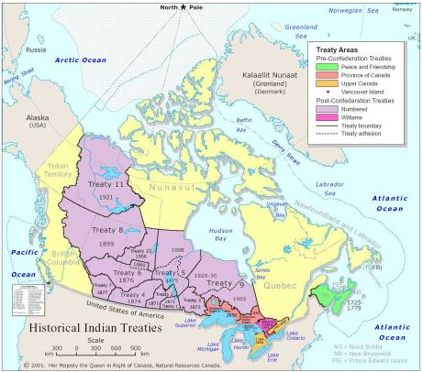
Loss of Aboriginal title to land
11 treaties were signed between 1871 and 1929
Why did Aboriginals sign these treaties?
Didn’t believe they were giving up their claim to the land – they were negotiating its use
Believed they were protecting their people and rights
In some cases, their way of life was collapsing and needed a new means of livelihood
Notes:
1871-1877: Treaties 1-7 were signed (Prairies and Ontario)
1899-1906: Treaties 8, 9 10 signed for transportation routes, resources, influx of Am gold miners into Klondike with 1896 gold rush
1921: Treaty 11 signed
Questions around treaty negotiations: comprehension of language, do all the words/concepts translate (i.e. there is no concept of ownership of land for F.N.)
Collapse of buffalo: in 1800, there were 50 million, but by 1889, there were only 635 left!; loss of buffalo meant not only loss of food, but also loss of clothing, shelter, tools; this starvation forced them to sign deals with the gov’t = gov’t would provide food and new livelihood – farming; link to Metis support for F. N. as they were pushed West between 1870-1885 and one of the causes of the NW Rebellion 1885

Slide 8
Terms of the treaties
Treaties promised the following:
land grants of 160-640 acres per family of 5
schools and education
livestock and farming tools, seed, farming education
$5 per person per year
right to hunt and fish in unoccupied land, ammunition
Notes:
First Nations thought they would be educating children, but gov’t took this over through residential schools
Gov’t believed reserves would be a temporary place of residence prior to integration into the dominant society (assimilation) ; when in fact the Indian Act worked counter to this goal; the act isolated Indians from mainstream Canadian society instead of integrating them into it.
Ask students if they have been on or seen a reserve…describe what it looked like?

Slide 9
Government creates reserves
Gov’t decided the location and size of reserves
If there was any negotiation, it wasn’t a fair and equal process
Given poor land to settle upon
Houses would be built and owned by the Cdn gov’t
Families were given a certain amount of land
Notes:
When deciding size and location of reserves, the gov’t didn’t take into account summer and wintering activities/camps; just saw them living in that location and said “They live here; this is where the reserve will be”; made traditional ways of life difficult to continue (gathering food, clothing, shelter, conducting ceremonies)
Problems with negotiations: a) language barrier – were all words/ideas correctly translated? b) differing concepts of land ownership (guardians of land vs. owners of land) c) F.N. at times were starving and coerced into signing treaties to get food
Poor land for reserves – located near railways, garbage dumps, polluted land; not good farming land even though the gov’t wanted them to become farmers = civilized Europeans; saved best land for railway development & settlement of immigrants
Gov’t builds and owns houses – can’t make upgrades to housing – explains poor conditions on reserves; if you choose to leave the reserve, you have no credit at the bank to prove you could get a loan and pay back
Given a certain amount of land – as more generations were born and the number of family members increased – this led to overcrowding and less land per person…do simulation of 2 parents, 3 kids, 3 spouses + each have 3 kids, who then marry, and have kids of their own, etc. – gets crowded pretty quickly! = DO SIMULATION ON THE FLOOR WITH TAPE

Slide 10
Were the terms of the Numbered Treaties honoured?
Disputes now surround the lack of fulfillment of treaty terms and misinterpretation
Gov’t only provided financial support for farming for the first 3 years; future assistance was only given to those who continued farming
Different concepts of land ownership
Belief that the terms of one treaty should apply to all signed treaties
Oral promises have not been upheld
Notes:
Gov’t spent $ on building the CPR, instead of providing farming tools and education; government’s intention was to not let the F.N. prosper – goal of assimilation
Concepts of land ownership: guardians of land, not owners of land = can’t buy or sell land; believed they were sharing the land with Europeans; never explained the size of reserves = no concept of space (link to Metis scrips – didn’t realize the value of scrip paper thus gave it away or sold it for less to land speculators)
Terms of treaty should apply to all treaties – for example, medical services were added to Treaty 6 in 1876, so F.N. believed it should also be provided in T 1-5
Importance of oral history to F. N. vs a written document

Slide 11
Why didn’t Aboriginals fight for their rights and land?
Changes were made to the Indian Act to ensure Aboriginals couldn’t fight for their rights or land
Since they were not citizens, they had no representation in court
Were not allowed to hire lawyers
Were not allowed to raise money for land claim disputes
Were not allowed to create organizations to fight for land claims
Notes:
In 1885, Indian Act outlawed the potlatch (feasting ceremony). For the Nisga’a, these ceremonies recognized the succession of chiefs and transfer of cultural property and territory; if the potlatch couldn’t occur, the stories wouldn’t be told and the ability of a family to recite its history and claim to land/living in region would be lost
Amended Indian Act in 1927
As a way to discourage education; Gov’t amended the Indian Act to state that if you got a degree or became a doctor/lawyer/member of clergy, you were enfranchised and you lost your status

Slide 12
Created by Ms. Ross
The Indian Act
Socials 9
Riverside Secondary
Updated January 2017

