Slide 1
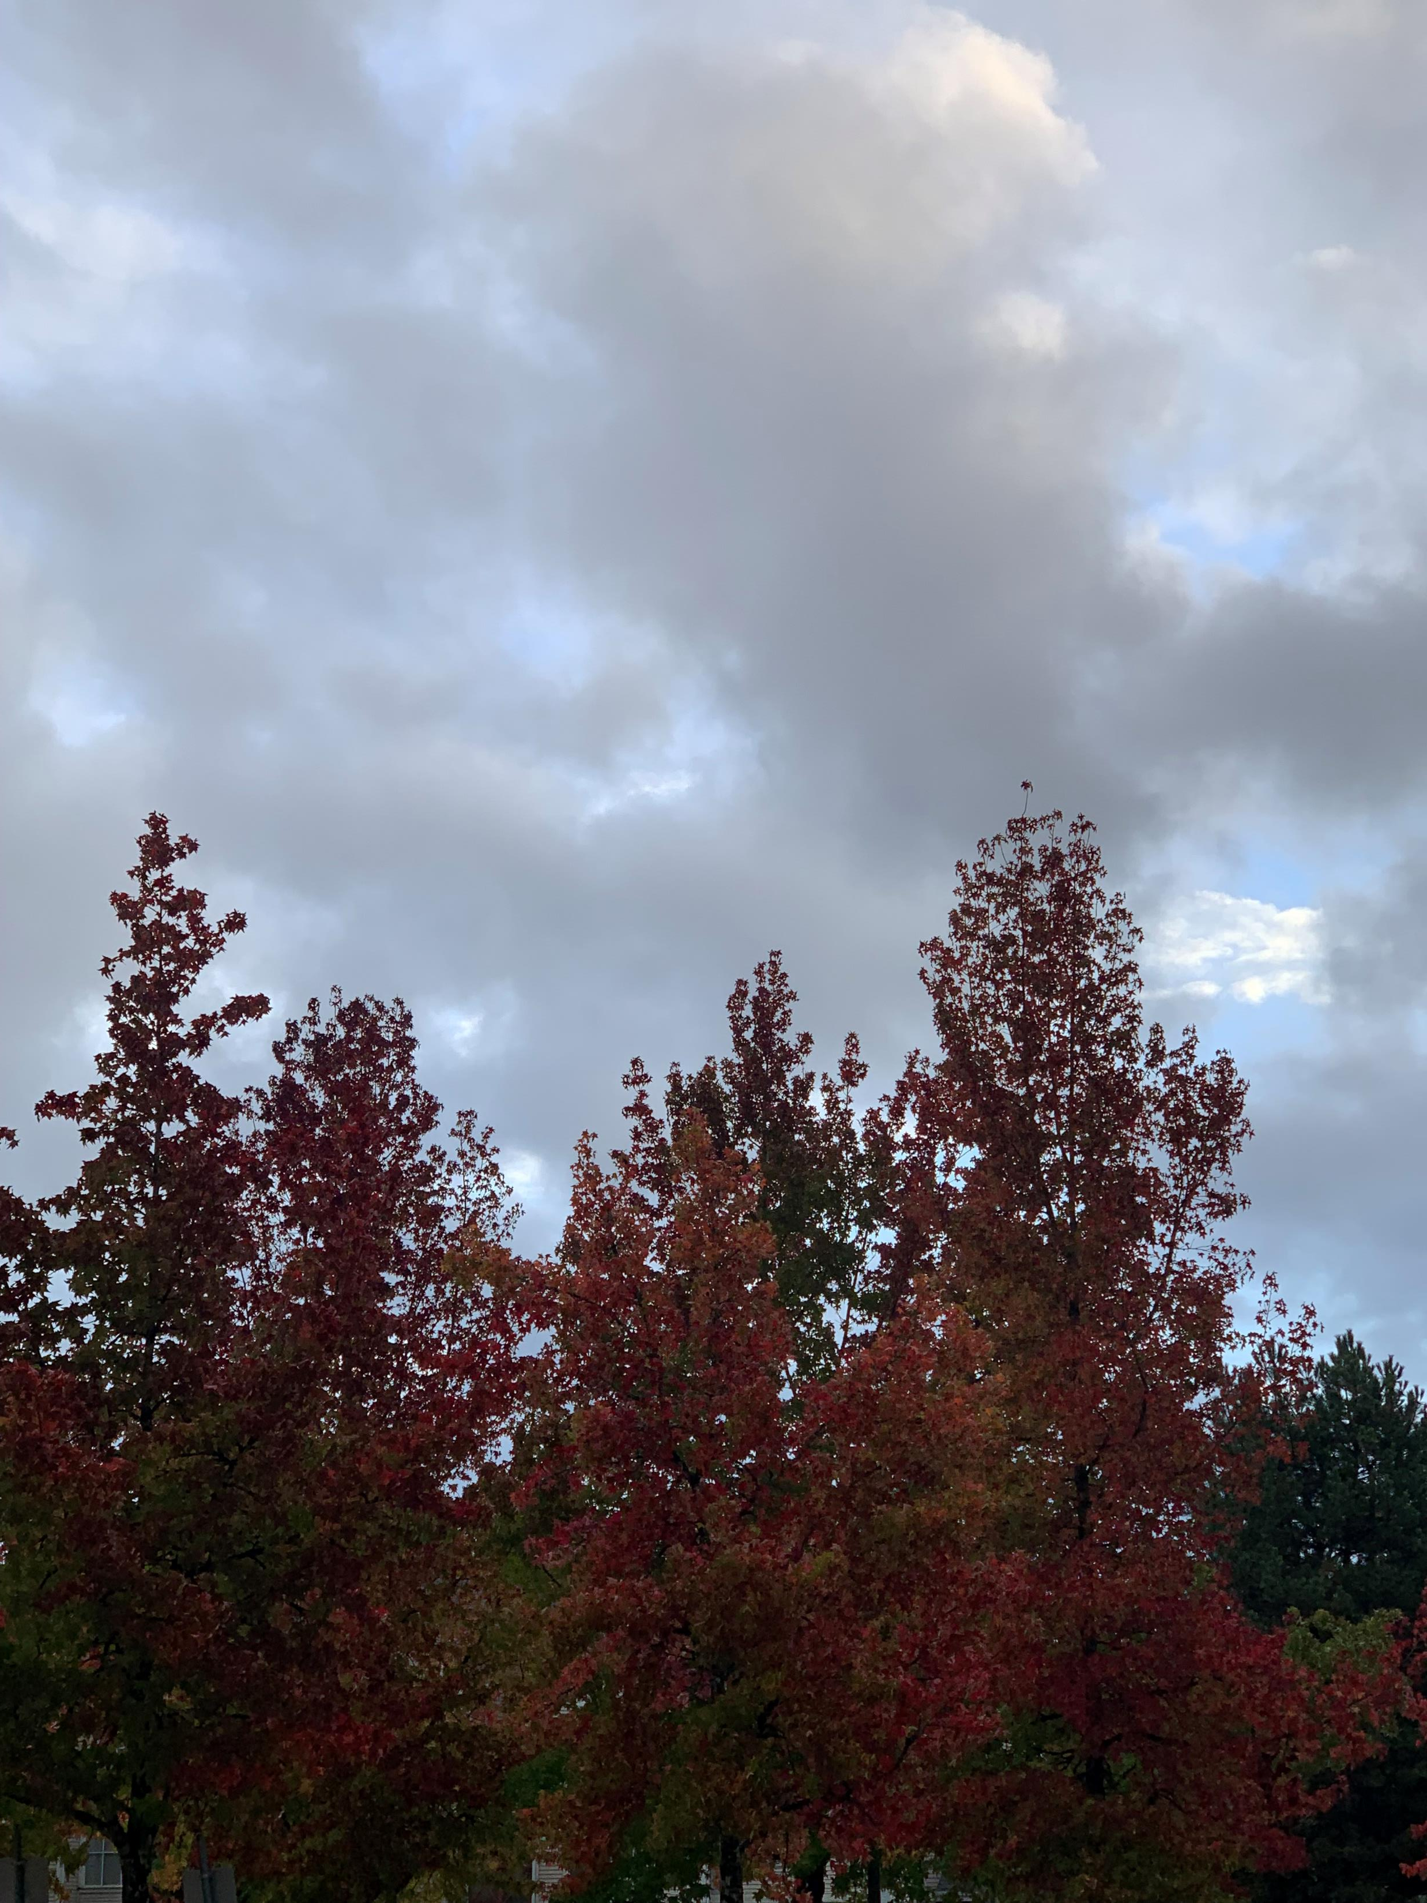
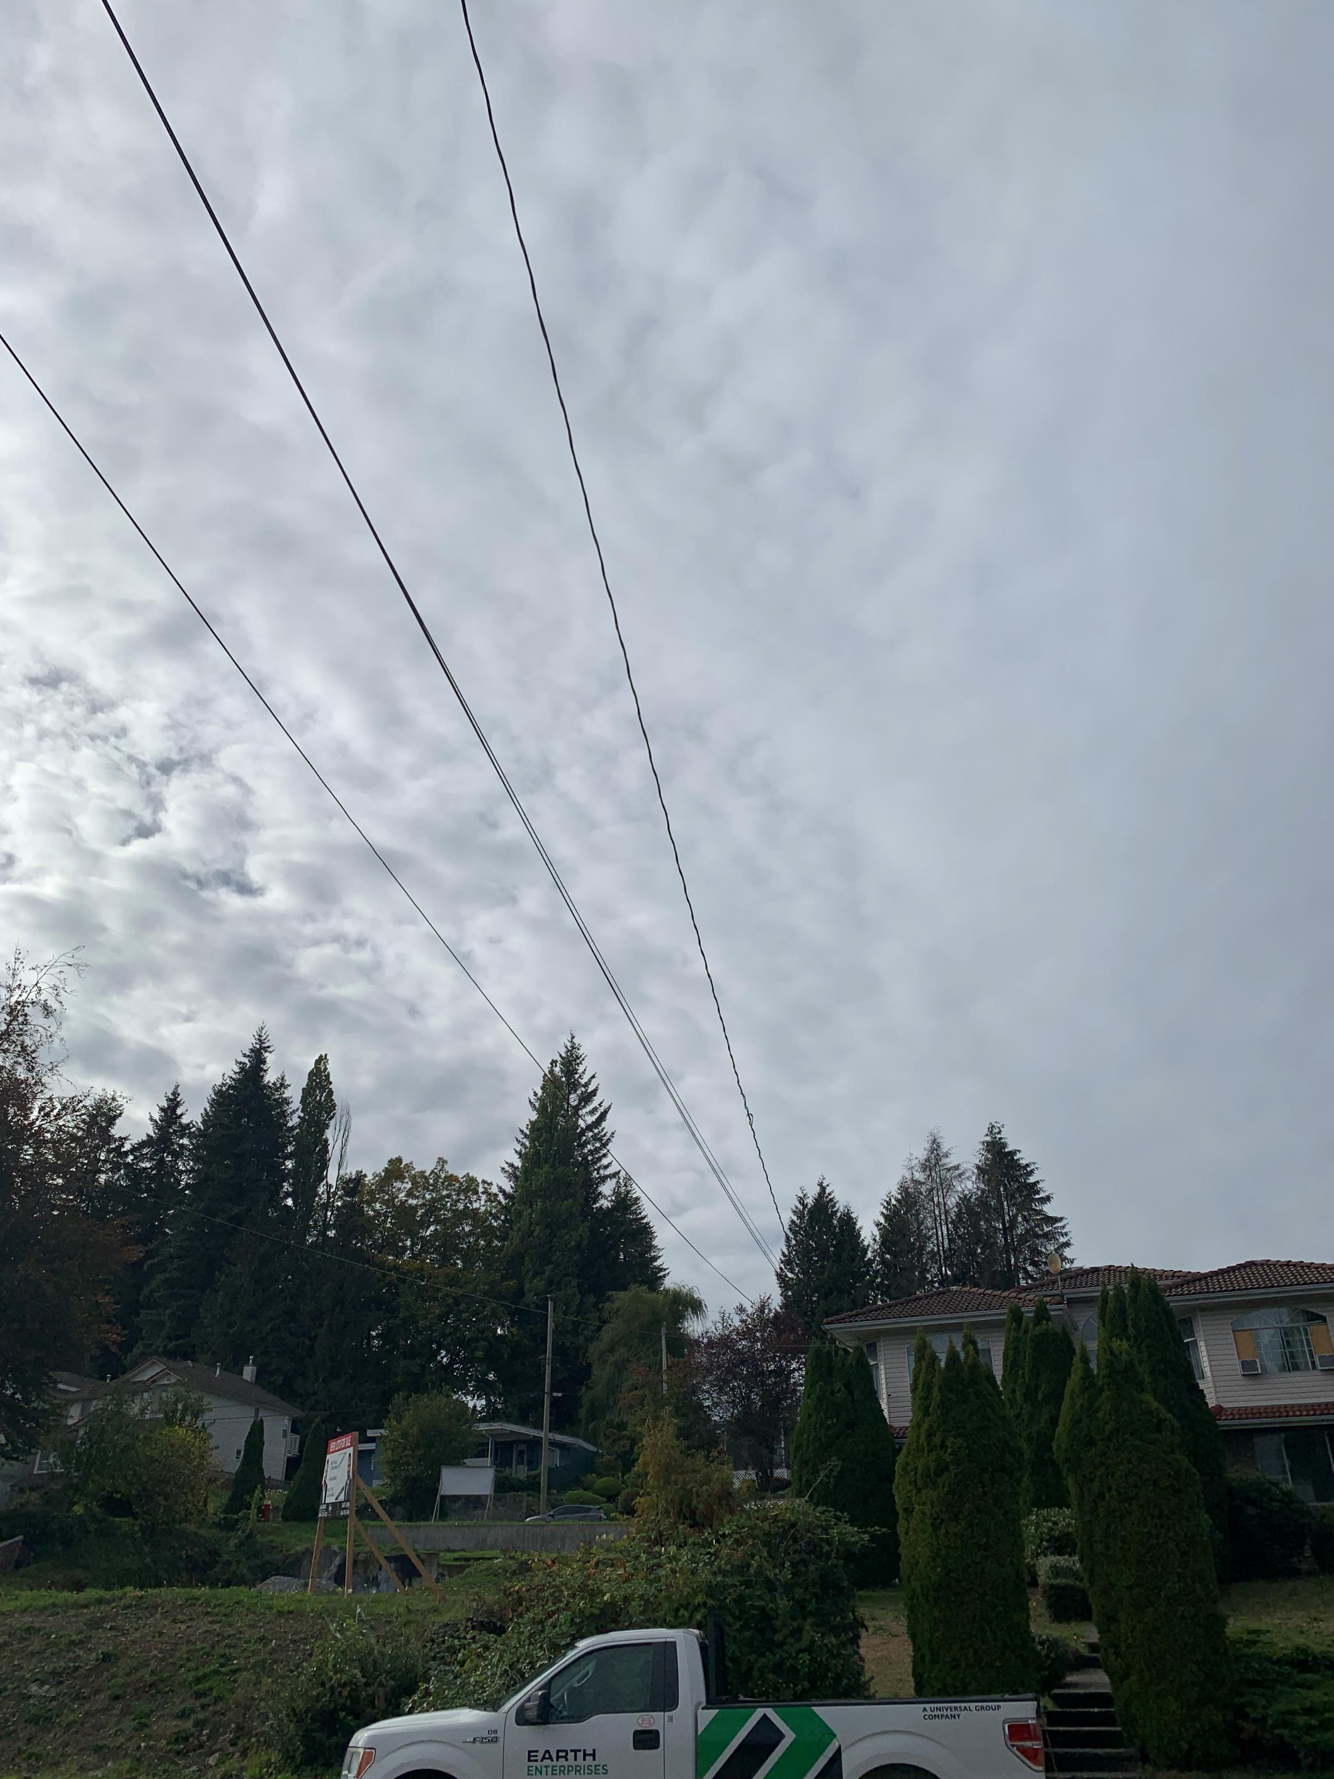
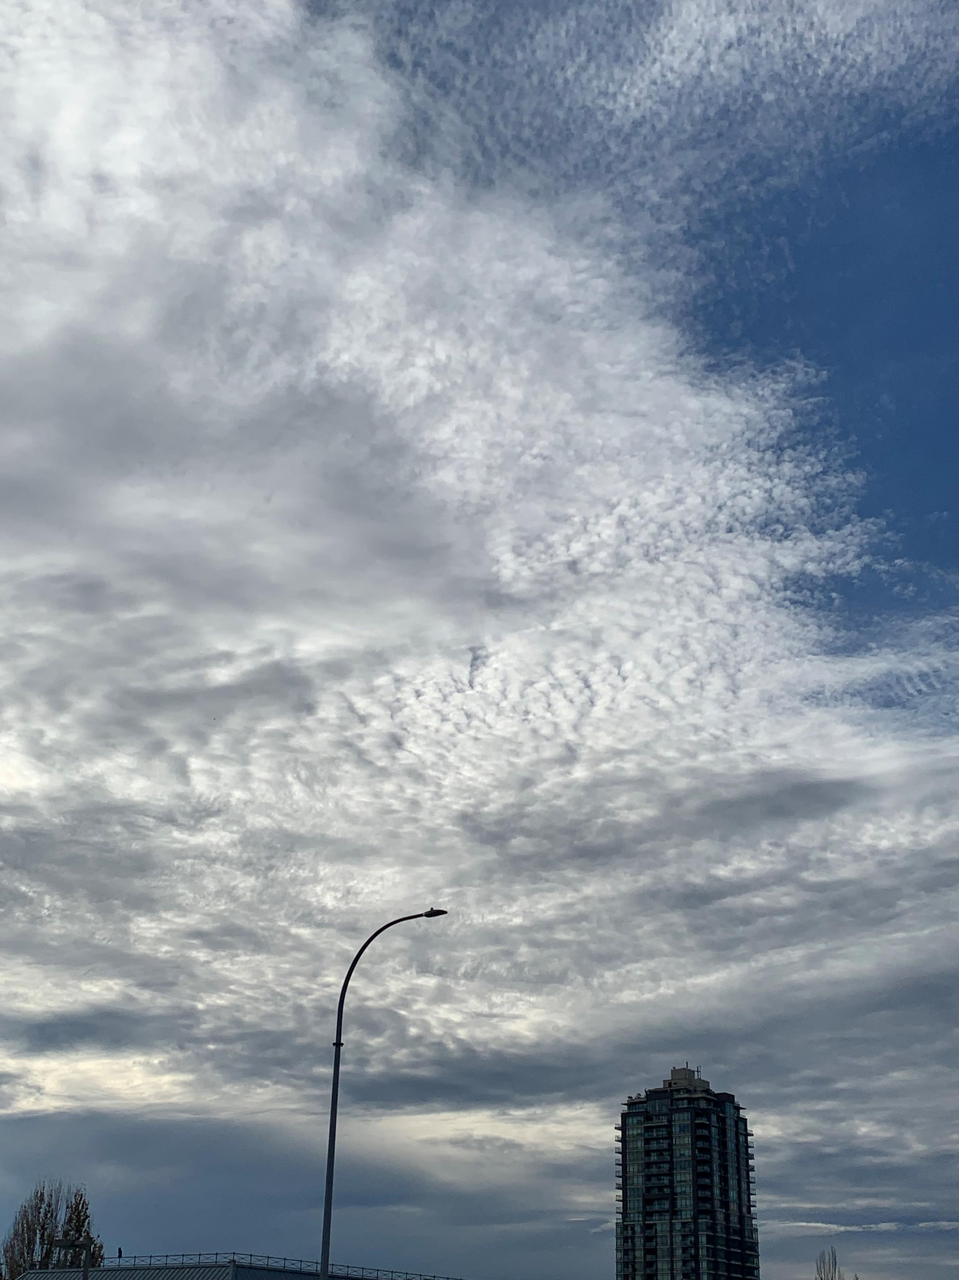
Cloud Project
Elsie Chabot

Slide 2
Types: Cirrus, stratus
Taken on 10-13-2023 at Lougheed hwy (4:04 pm)
I believe it is a cirrus cloud because it is relatively thin and feathery. There was also good weather
I believe it is a stratus cloud because it covers large patches of the sky

Slide 3
Types: cumulus
Taken on 10-15-2023 at Pitt river road (1:47 pm)
I believe it is a cumulus cloud because they look like white fluffy cotton balls

Slide 4
Types: cumulus
Taken on 10-17-2023 at riverside secondary (8:18 am)
I believe they are cumulus because they are fluffy clouds however since they are not white, and it rain that day I thought they were also nimbus but wasn’t sure how to write that because cumulonimbus is a thundercloud, and they was no thunder that day.

