Slide 1
Popular Mechanics
By Raymond Carver

Slide 2
Psychological Analysis & Character Profile of the mother:

Slide 3
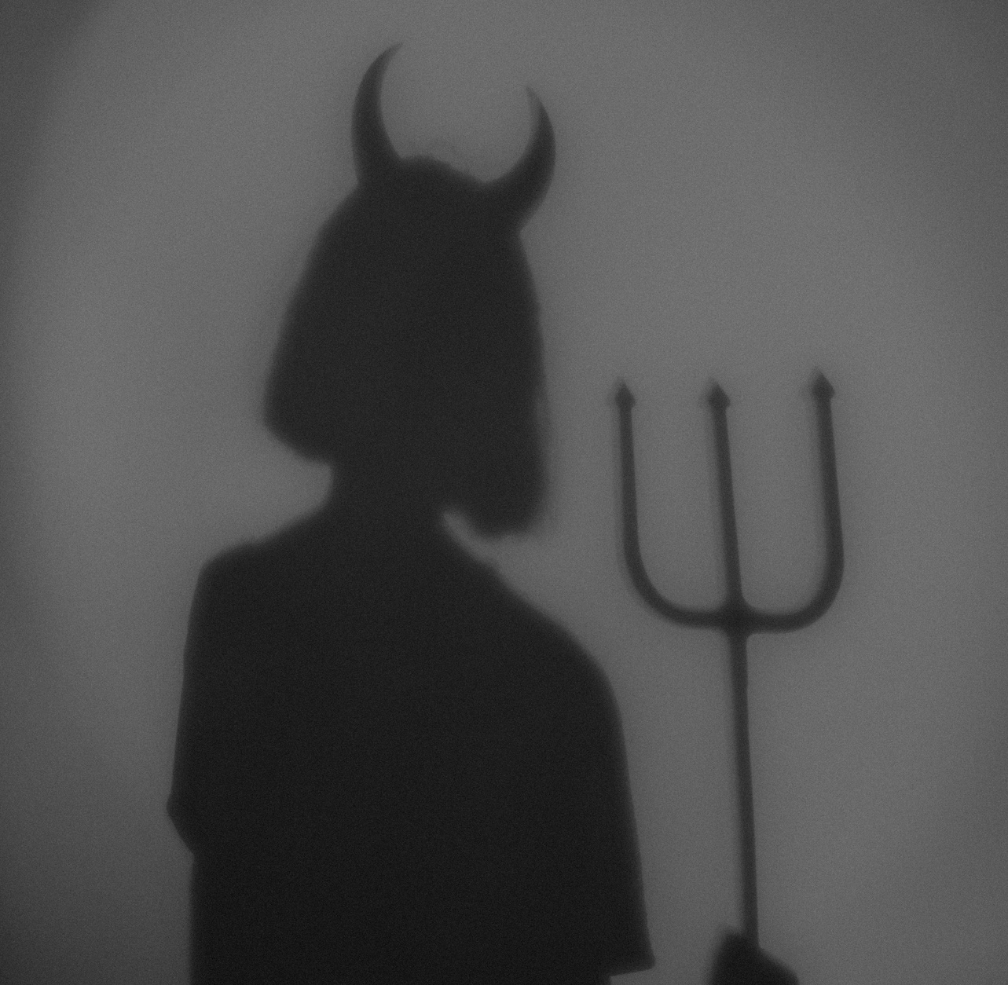
ID
In Popular Mechanics the ID can be seen as the driving force behind many of the mother actions.
Throughout the course of the story the ID leads the woman to act irrationally as she tries to gain possesion of the baby: “The baby was red-faced and screaming. In the scuffle they knocked down a flowerpot that hung behind the stove” (Carver 2).
The ID causes the mother to loose control over her decision making skills, “She would have it, this baby. She grabbed for the baby’s other arm. She caught the baby around the wrist and leaned back” (Carver 2). Her desire for the baby grows strong making her fight for what she views as best. This action ultimateley led to the assumed death of her baby.

Slide 4
Superego
Throughout the story, the woman’s superego is pushed aside by her ID, which has lead her to make irrational decisions.
As the story concludes, the superego tries to regain control, “Don’t, she said. You’re hurting the baby, she said” (Carver 2).
She realizes the harm that the ID is causing the baby and tries to fix the situation.
The superego tries to take over in ensuring the safety of the baby but it is not successful.

Slide 5
Ego
The initial conversation between the couple may be viewed as the presence of the ego: “He looked at her and she wiped her eyes and stared at him before turning and going back to the living room” (Carver 1). Although there were some harsh statements used, the superego kept the ID under control in the very beginning of the story by suppressing the violence that comes with the primal instinct to fight for their child.
As the story progressed the superego slowly loses control of the ego as the situation escalates and becomes more physical.

Slide 6
Character Profile
The mother in the story is primarily driven by her ID. Many of her actions demonstrate that her ID had gained control over her superego. When the story begins we can see some of the superegos characteristics shine through, but as the story progresses the ID quickly gains control of the mother.

Slide 7
Thank you!
By Ella and Onikka

Slide 8
Work Cited:
Carver, Raymond. “Popular Mechanics.” What We Talk About When We Talk About Love, pp. 123–125.

