Slide 1
Station Eleven Background Information.
By: Ava, Sophia, Connor, and David

Slide 2
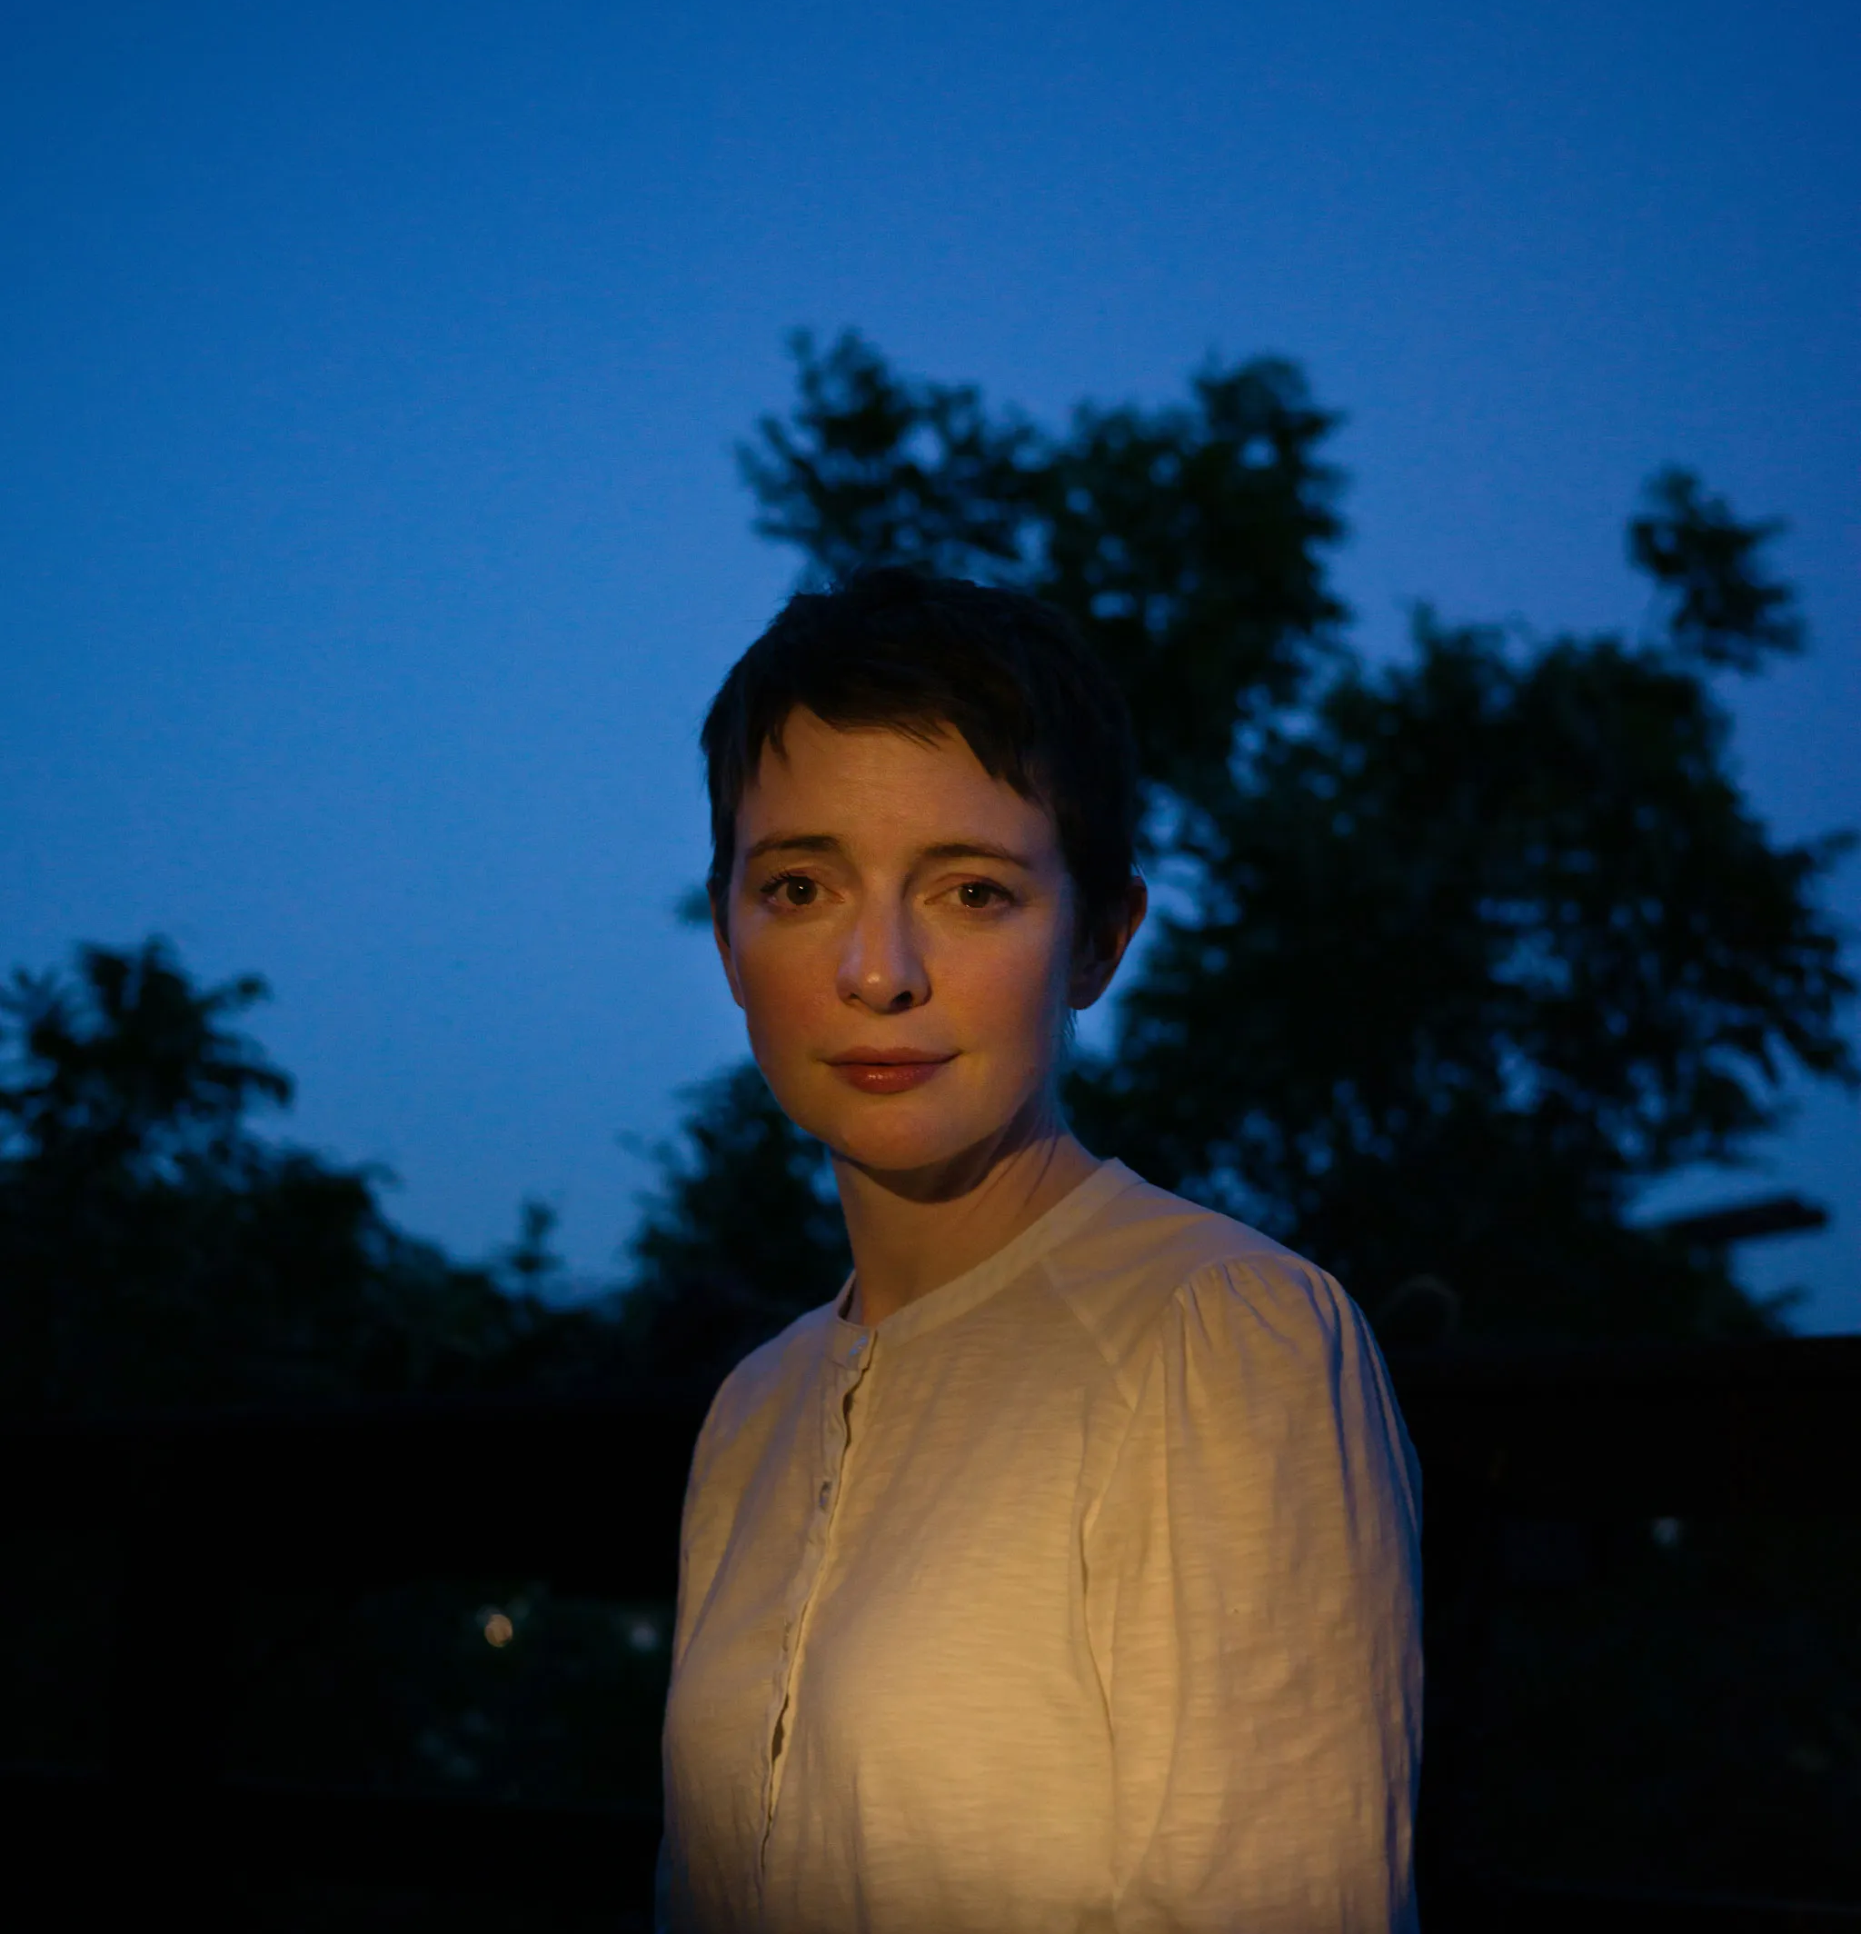
Background of the Author:
Emily St. John Manel was born in 1979 in Merville BC to a social worker mother and a father who was a Plumer.
She made over 100 stops and was pregnant during the book tour for 'Station 11' in 2014.
Emily got her post-secondary education from the school of Toronto dance theatre, where she studied but before that she was homeschooled until she was 15.
All of Emily's books connect somehow, through characters, settings etc.
Emily gave permission in 2021 to start to production of a ten-part mini-series on HBO Max for ‘station 11’ to be turned into a show. The show premiered on December 16, 2021.

Slide 3
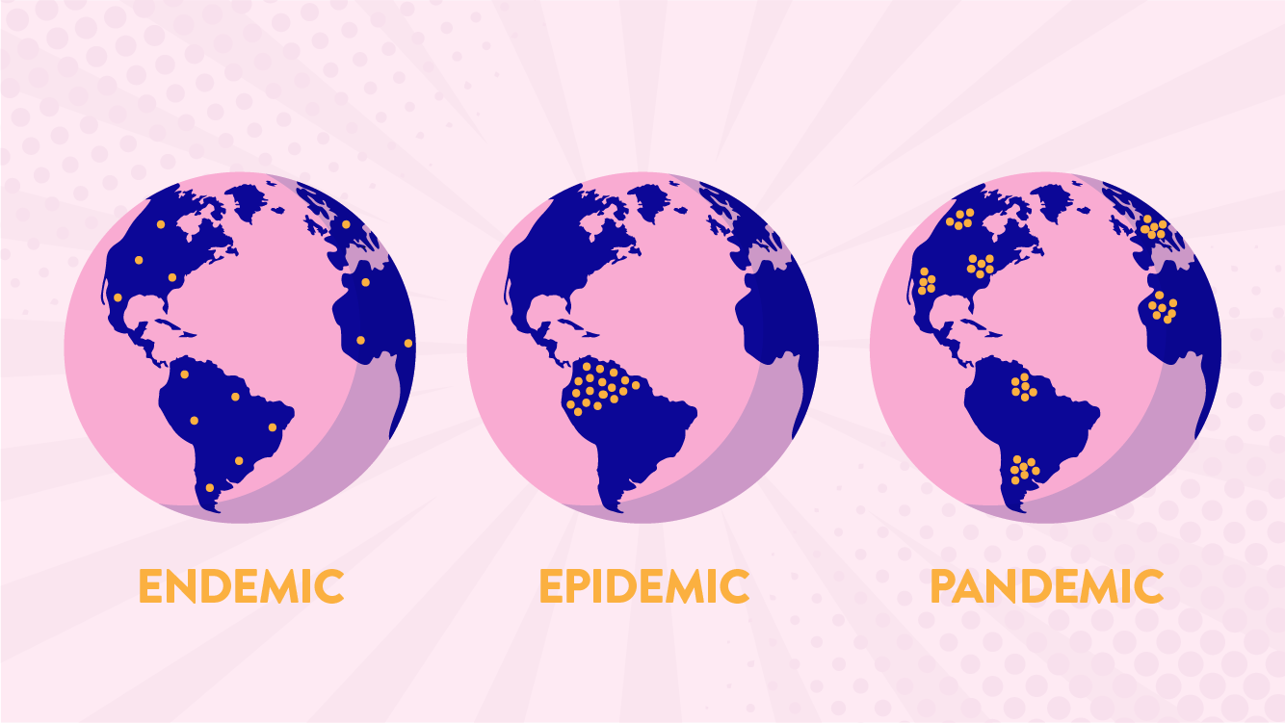
What is a pandemic?
A pandemic is a disease outbreak that spreads across countries or even the world.
It is different from an endemic or an epidemic.
An example of a pandemic is the recent Covid-19 pandemic.

Slide 4
What would life be like without technology?
Life without technology would be extremely difficult to live in, because of how many things we rely on today. We would lose the internet, making all mobile devices such as, TV’s, desktops. laptops, phones and other devices completely useless, because you cannot watch, download, or stream any type of apps or videos. We would lose the ability to connect with loved ones from long distances due to the loss of internet, meaning no FaceTime, Skype, Discord, WhatsApp and more.
With no technology, less human advancements regarding tools, machinery, vehicles, new findings and developments of medicine and etc, will be developed.
Social media, which is a big part of many people’s lives, would be gone meaning a loss of entertainment, for some, their careers, societal trends, posting yourself to keep yourself updated with others and other losses of enjoyment.

Slide 5
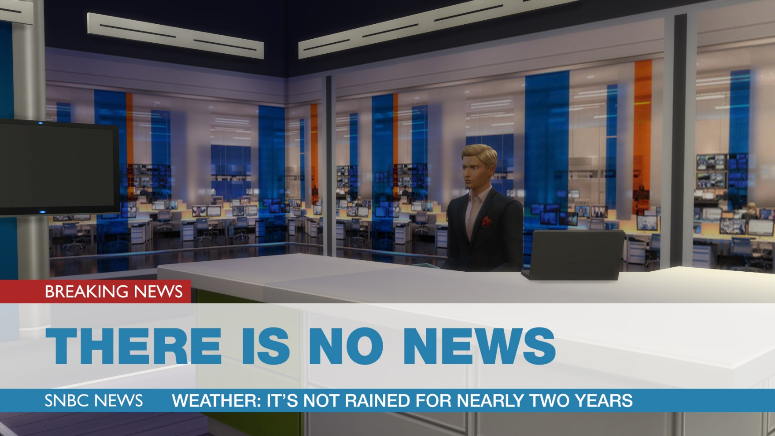
What would life be like without technology?
Many would lose their careers due to the large job market that technology has to offer. From careers such as a computer programmer, web designer, e-commerce entrepreneur, social media influencer and many more. However, there is a huge market that would take a toll. The stock and crypto market, which is media influencer, and many more. However, there is a powered and operated via technology, would not only put many out of jobs, but would take a huge toll on the finance industry.
News and radio stations would not be able to operate, because they are broadcasted via Television, car and other methods that require technology. This would be extremely harmful to society, because they will be unable to report stories that may affect many in a society.

Slide 6
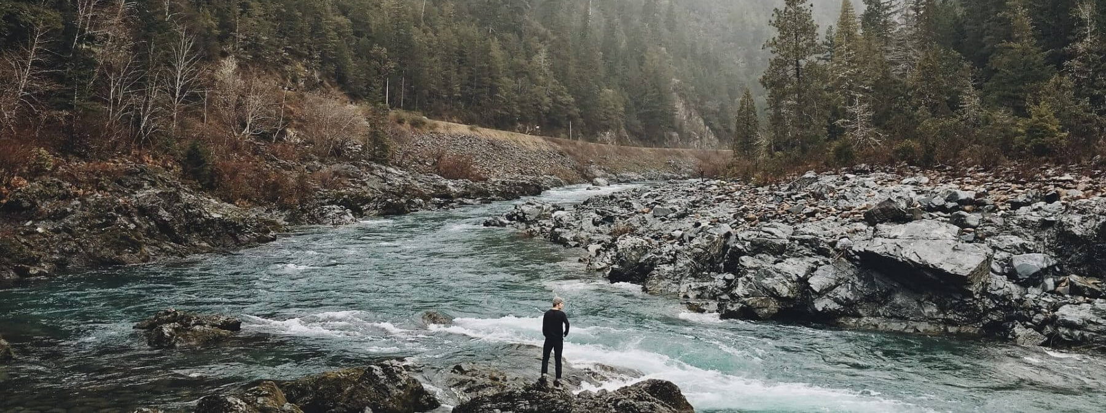
Define Survival and what does it mean?
Survival definition: The State or Fact of continuing to live or exist, typically in spite of an accident, ordeal, or difficult circumstances.
Survival is a human instinct that occurs when we may experience an injury, an accident of some sort, or are actively in a challenging situation that may seem threatening to an individual’s life. As a result, they will do anything to sustain themselves from any danger, threats or instances that their lives or well-being may be at risk.

Slide 7
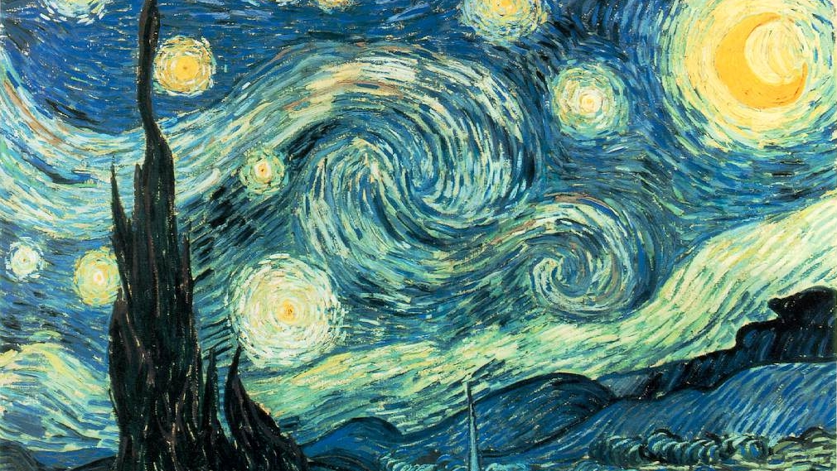
Why is art important in a society?
Art helps people in society to develop a deeper understanding of what we are as humans and how we relate to each other. People use art as an expression of their inner feelings, thoughts and perspective on a subject. Many artists start with a dark or negative topic but express with themselves in their artwork to change and create a beautiful piece.

Slide 8
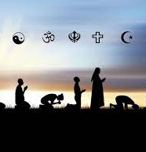
Why is religion important in a society?
Depending on each person, religion can affect them differently. For some, religion gives some people the will to live, giving them hope and the opportunity to change themselves into a more positive person. Religion can also stabilize communities, building deeper connections with each other, controlling social behavior.
Although religion creates multiple positive outcomes, religions can also result in social conflict. Aggressive attitude projected to certain religious groups motivated by religious differences.

Slide 9
Citations:
https://www.prhspeakers.com/speaker/emily-st-john-mandel
https://www.thestar.com/entertainment/books/reviews/2022/04/06/in-emily-st-john-mandels-new-book-sea-of-tranquility-our-humanity-follows-us-wherever-we-go-even-to-the-year-2401.html#:~:text=Vancouver%20Island's%20Mandel%20connects%20her,Hotel'%20through%20time%20and%20place&text=In%20%E2%80%9CSea%20of%20Tranquility%E2%80%9D%20British,between%20fiction%20and%20real%20life.
https://www.newyorker.com/culture/persons-of-interest/the-rewriting-of-emily-st-john-mandel
https://fghsnews.com/3391/featureandopinion/what-if-technology-never-existed/
https://www.eden-gallery.com/news/why-is-art-important#:~:text=Art%20%26%20Its%20Role%20in%20Society&text=It%20helps%20us%20understand%20what,self%2Dreflection%20or%20social%20influence.
https://www.webmd.com/cold-and-flu/what-are-epidemics-pandemics-outbreaks
https://open.lib.umn.edu/sociology/chapter/17-3-sociological-perspectives-on-religion/#:~:text=Religion%20serves%20several%20functions%20for,work%20for%20positive%20social%20change.
https://simsvip.com/2016/03/18/breaking-local-broadcasters-left-with-no-news/
https://www.technologynetworks.com/immunology/articles/epidemic-vs-pandemic-323471

