Slide 1
Metonymy / Synecdoche
By: David Gilaev & Adam Silver

Slide 2
What is a Metonymy?
Metonymy is a figure of speech in which it is a way of replacing an object or idea with something related to it instead of stating what is actually meant.
A metonymy and a metaphor are quite similar but not the same thing. A metonymy associates the qualities of one word or phrase with another word. A metaphor, however, substitutes a word or phrase with another word or phrase.

Slide 3
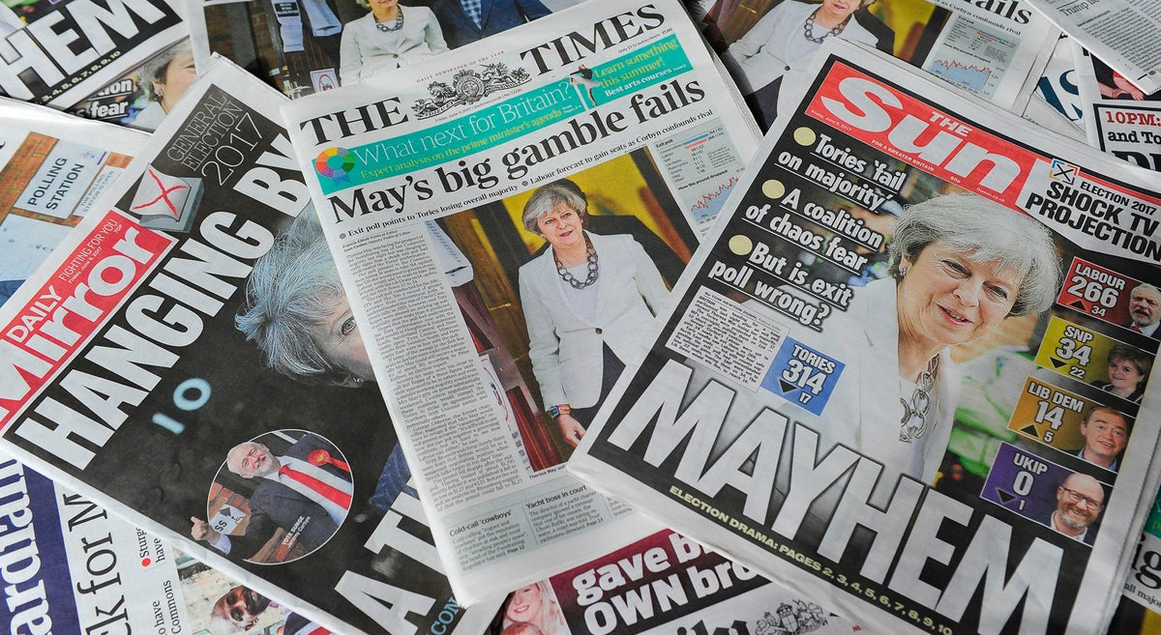
Metonymy Examples
"Hollywood" refers to the entire film industry, this includes producers, actors, and film makers. In reality, Hollywood is a district in Los Angeles, but it's become very synonymous with the movies, making it a Metonymy.
"The press" refers to the news media, this includes newspapers, broadcasted news, and the internet. However, the literal meaning of "the press" is printing press, which is a mechanical device for applying pressure to an inked surface.

Slide 4
Examples of Metonymies
Julius Caesar by William Shakespeare: "Friends, Romans, countrymen, lend me your ears;" the ability to listen is represented by "ears" in William Shakespeare's play. Shakespeare is not urging that everyone should cut off their ears; rather, he is asking that everybody pay attention.
"Okay everyone, let's do a head count." A head count is when somebody determines the number of people in a particular place. This is also a synecdoche too since head is a part of a person.

Slide 5
Difference Between a Metonymy and a Synecdoche Example
Now that we've looked at a couple of examples of metonymies, let's look at an example of a synecdoche that looks like a metonymy but isn't.
A boy has been admitted to the hospital. The nurse says, "he's in good hands." The boy is not literally being taken care of by two hands. Rather, he is being taken care of by an entire hospital system, including nurses, assistants, doctors, and many others. This is an example of synecdoche, as a part signifies a whole.
A synecdoche is a figure of speech that refers to a part of something as if it were the complete thing, and vice versa.

Slide 6
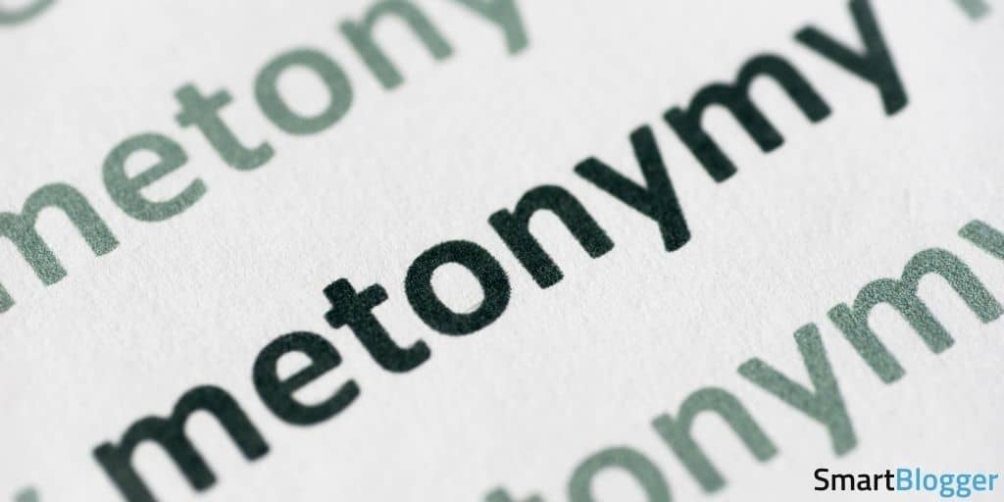
Tips and tricks to find a metonymy
Metonymies use symbols often, so something to look out for are common symbols. For example, "the Crown" is a metonymy for monarchy rule.
The main idea for writing a metonymy is examining a sentence for a phrase that can be shortened or replaced with a similar idea.

Slide 7
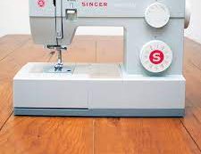
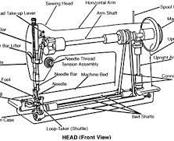
What is a Synecdoche?
A Synecdoche is a figure of speech used to refer a part of something to its whole and vice versa.
However, a whole of something referring to a part of it self is very uncommon when using a synecdoche.
A useful way to interpret a sentence possibly containing a synecdoche is to understand the context clues in a sentence or phrase, and analyze any words that seem vague and may relate to a bigger or smaller component of itself.

Slide 8
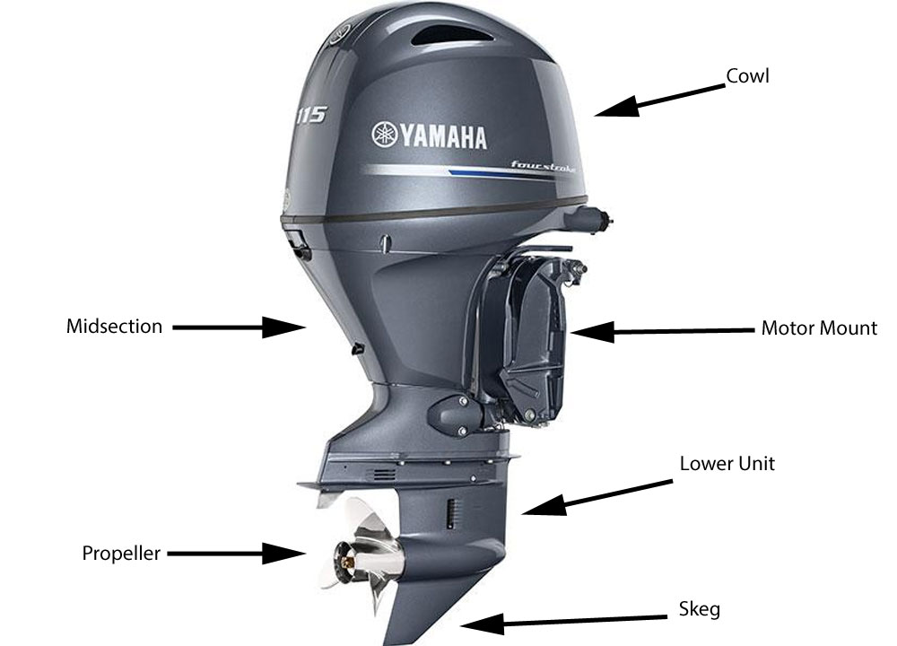
Why is a Synecdoche Useful?
Usage of a synecdoche allows speakers to emphasize and focus on certain parts of a whole component, to showcase their importance and significance.
In some cases, readers are also challenged to think how parts of a whole, in some cases, are more useful than the whole itself, and vice versa.

Slide 9
Synecdoche Examples
Considering the definition and its significance, let’s look at some examples of a synecdoche and how we can use our understanding to find a synecdoche.
“The man was put behind bars because he robbed a bank.”
In this example, the words in red are things that we can identify as a noun and a verb, but the phrase underlined in blue is something that doesn’t have complete context to it and can be referenced to something else.

Slide 10
Synecdoche Examples
“The man was put in jail because he robbed a bank.”
This sentence is essentially the same sentence as the last one, except we know more context as to where the man was put in. Being put, “behind bars” represents a part of a whole which in this case is a jail.

Slide 11
Synecdoche Examples
Let’s look at a common phrase used when asking for help, and analyze it to see if it can be a synecdoche.
“Lend me a hand.”
In this commonly used phrase, the person saying the phrase is asking for help by referring to the person’s hands specifically, although the person helping (in most cases), will end up using their entire body.
In relation to a synecdoche's importance, this phrase highlights the fact that even though our hands are part of our body, they are extremely useful which proves the importance of demonstrating individual parts, compared to the whole.

Slide 12
Difference Between a Synecdoche and a Metonymy Example
Now that we’ve looked at two examples of sentences that include a synecdoche, let’s take a look at an example that seems like a synecdoche but actually isn’t.
“Check out my new ride!”
In this phrase, we can assume that, “ride” refers to a car. Although this is correct, this phrase does not have a synecdoche, it uses a metonymy.
As mentioned, a metonymy uses different words or meaning to relate to another word entirely, and a synecdoche uses parts of a whole to relate to it and vice versa.

Slide 13
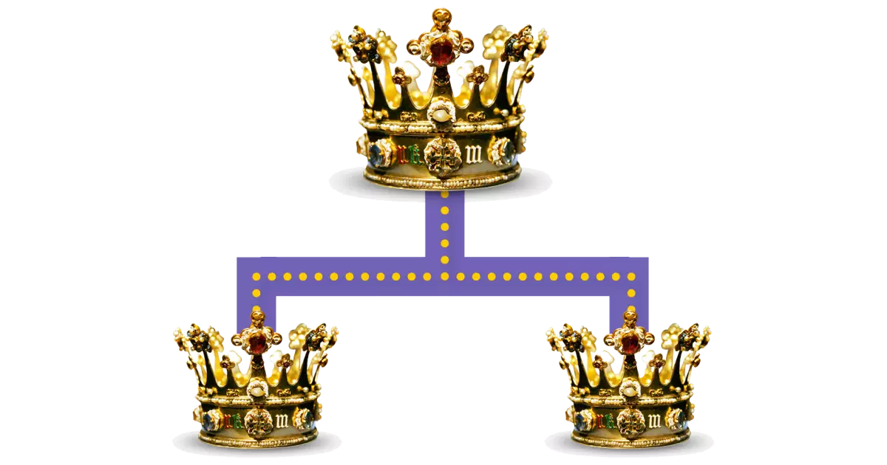
In Summary…
To recap, a metonymy is a figure of speech that consists of the use of the name of an object or concept with something similar to it rather than stating what it literally means.
Metonymies use symbols often, so having a gexneral knowledge of common symbols is helpful in finding metonymies in literature.

Slide 14
In Summary…
To sum things up, a synecdoche is used to reference a part of something to its whole, to highlight its significance and vice versa.
Its important to remember to consider words in a sentence or phrase that may seem to lack context or something that possibly connects to another thing, contributing to its whole, or a whole referring to a part of its self.

Slide 15
Thank You for Watching our Presentation!

Slide 16
Cites Used
“Boat Repairs.” Blue Water Marine - Engines, Stern Drives and Outboards Repairs, www.blue-water-marine.com/sterling_heights/sterling_heights_boat_repairs.htm.
“Boats for Sale: Boat Buyer's Guide.” Boats for Sale : Boat Buyer's Guide, www.boats.com/boat-buyers-guide/.
Hudiemm. “Close-up of Airplane Wing Flying at Sunrise.” IStock, www.istockphoto.com/photo/close-up-of-airplane-wing-flying-at-sunrise-gm1157137642-315635308.
Joan, Rebekah. “Singer's Heavy Duty Sewing Machine Boasts Seamless Use.” The Spruce, The Spruce, 21 Aug. 2019, www.thespruce.com/singer-heavy-duty-4423-sewing-machine-review-4768230.
Kianna. “Difference between Synecdoche and Metonymy.” Difference Between Similar Terms and Objects, 8 June 2016, www.differencebetween.net/language/difference-between-synecdoche-and-metonymy/%C2%A0.
“Laws - Legal Information, Attorneys, Free Legal Forms, Statutes, Cases, Lawyers.” LAWS.com, 1 Aug. 2021, laws.com/penology/prison-cell/prison-bars%C2%A0.
“Literary Devices and Literary Terms - the Complete List.” Literary Devices, 8 Aug. 2020, literarydevices.net/synecdoche/%C2%A0.
Press, REBECCA BOONE Associated. “Report: Idaho Could Save Money by Building State Prison.” KBOI, KBOI, 29 Jan. 2020, idahonews.com/news/local/report-idaho-could-save-money-by-building-state-prison.
“Sewing Machine.” Wikipedia, Wikimedia Foundation, 31 Mar. 2022, en.wikipedia.org/wiki/Sewing_machine%C2%A0.
ShortsleeBetts, Jennifer. “Examples of Metonymy: Understanding Its Meaning and Use.” Examples, https://examples.yourdictionary.com/examples-of-metonymy.html.
“Cinema of the United States.” Wikipedia, Wikimedia Foundation, 26 Mar. 2022, https://en.wikipedia.org/wiki/Cinema_of_the_United_States.
“'The Freedom of the Press in the UK Has Declined Dramatically – Threatening the Basis of Our Democracy'.” The Independent, Independent Digital News and Media, 25 Apr. 2018, https://www.independent.co.uk/voices/press-freedom-uk-mainstream-media-democracy-phone-hacking-leveson-a8321216.html.
Malone, Tara, and About The Author Tara Malone Tara Malone is the content editor at the online education company Mirasee and specializes in creating online content for software. “20 Metonymy Examples That Will Sweep You off Your Feet.” Smart Blogger, 18 Oct. 2021, https://smartblogger.com/metonymy-examples/.
Malone, Tara, and About The Author Tara Malone Tara Malone is the content editor at the online education company Mirasee and specializes in creating online content for software. “20 Metonymy Examples That Will Sweep You off Your Feet.” Smart Blogger, 18 Oct. 2021, https://smartblogger.com/metonymy-examples/.
MasterClass. “What Is Metonymy? Definition, Examples, and Uses of Metonymy in Writing - 2022.” MasterClass, MasterClass, 10 Sept. 2021, https://www.masterclass.com/articles/what-is-metonymy#3-reasons-why-writers-use-metonymy.
“Metonymy: Definition and Examples.” Literary Terms, 1 Oct. 2017, https://literaryterms.net/metonymy/.
Studio, Saxtech. Metonymy, https://www.alanpedia.com/literary_terms/metonymy.html.
ve, Cassie. “How to Meditate on a Plane (Everyone's Doing It).” Condé Nast Traveler, Condé Nast Traveler, 27 Oct. 2016, www.cntraveler.com/story/why-you-should-meditate-on-a-plane-and-how-to-do-it.
“Synecdoche: Definition and Examples.” Literary Terms, 15 Sept. 2017, literaryterms.net/synecdoche/#:~:text=Synecdoches%20allow%20speakers%20to%20emphasize,the%20whole%20and%20vice%20versa.
Through Their Eyes - Ceylon Today. ceylontoday.lk/features-more/5101.
“Fun Facts for Kids on Animals, Earth, History and More!” DK Find Out!, https://www.dkfindout.com/us/more-find-out/special-events/how-is-british-crown-inherited/.

