Slide 1
Fast food is good
By: Damon

Slide 2
Why fast food
Cheap food sold over decades
Iconic food of America
Rise in obesity

Slide 3
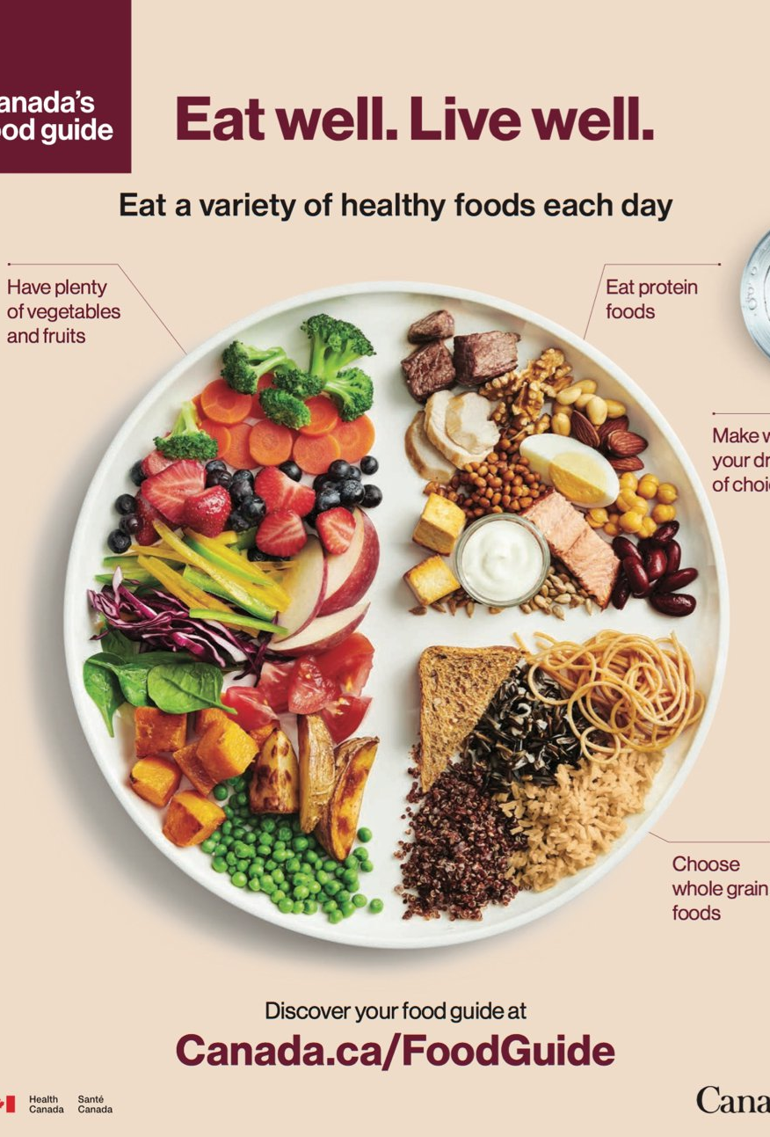
Canadian food guide 2019
Years ago the Canadian food guide took an approach in a variety of foods in someone’s diet
Current food guide consists of vegetarian based foods with little to no meat ideas
Meat aren’t bad choices, vegetables offer high sources of vitamins alongside with vitamins

Slide 4
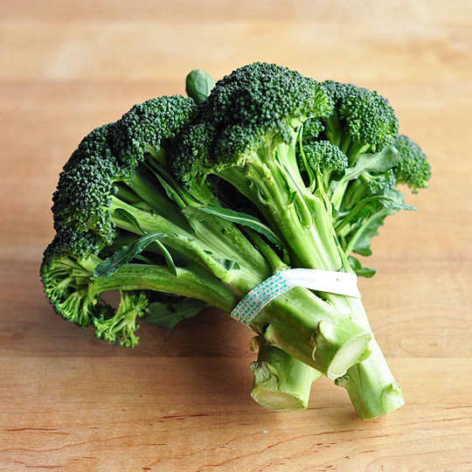
Healthy choices
People usually neglect their health and eat food based on their mood
Healthy choices are recommended, not enforced

Slide 5
What fast food does to you
The obvious:
- heart disease
- increased acne outbreak
- weight gain
- increased blood pressure
The not so obvious:
- causes depression and stress
- break down in enamel

Slide 6
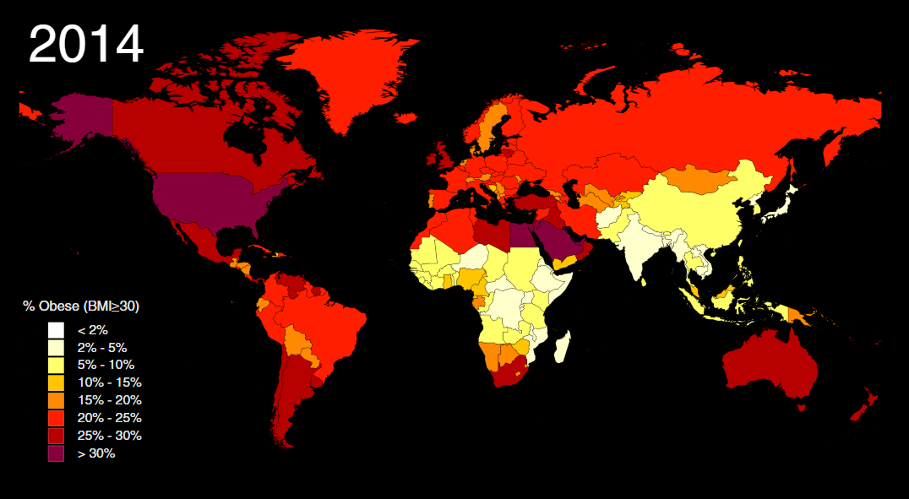
Conflict with society
160 million Americans (2016)
38% are men
41% are women
6.3 million Canadians (2017)
27% are men
27% are women

Slide 7
Preference
Majority of the people choose fast food mostly for preferences
Branches are everywhere
Literally fast, and cheap

Slide 8
Interrogations
Sibling
Friend (A&W employee)
Price for a fast food meal is nothing
We live right beside an A&W
Food is good for its price
Eating at different restaurants would be nice but there are so many fast food chains, why not eat there instead?
Discounted food
Tons of fast food chains exist
With or without discount/coupons, it’s still cheap
Eating out would be an option but only if it is close within the proximity
Similar answers

Slide 9
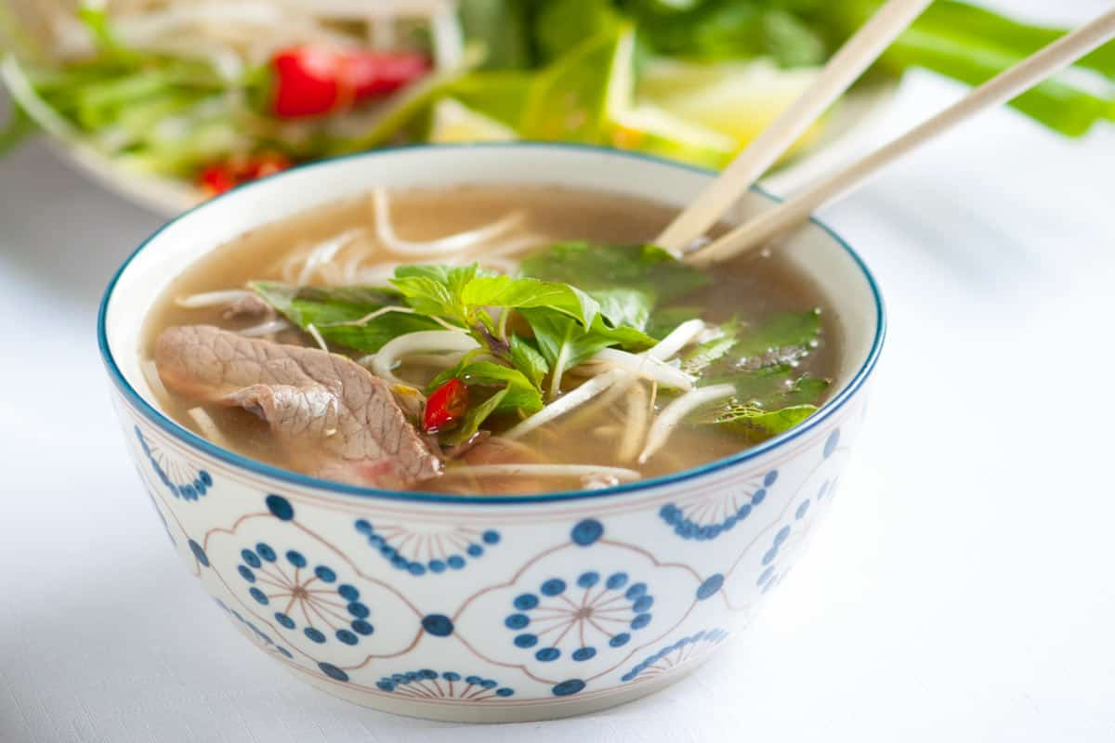
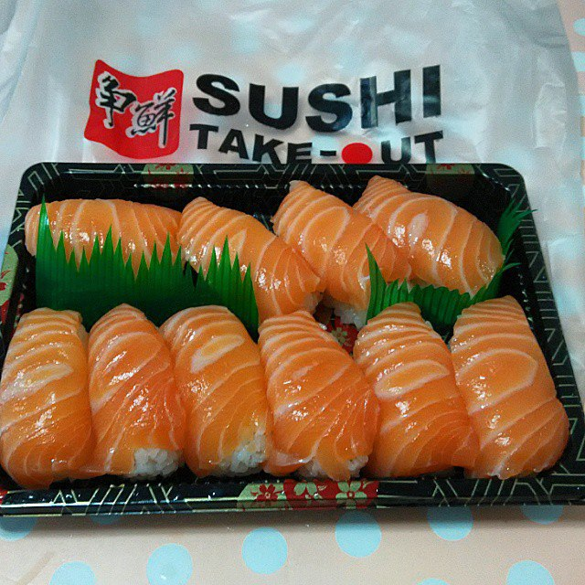
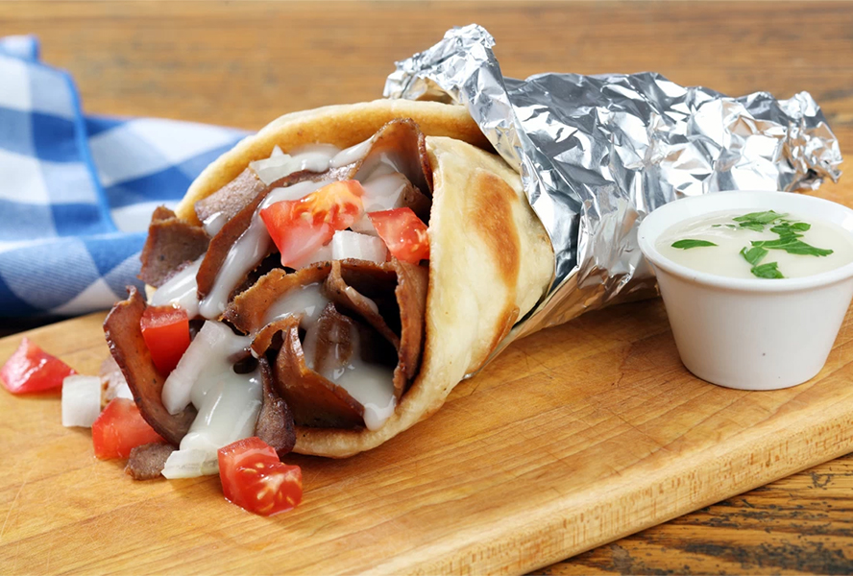
Better choices
Plan ahead on your next meal
Take out is an option if you didn’t already know
Many healthier options exist in the world

Slide 10
Possible solutions?
Just think, how is your life going to end?
Old age?
Car crash?
Those food choices you made over your whole life?
The world has enough food to feed 14 billion people
Majority of the food is meat products
To reduce the rate at which food is being consumed, we all have to become vegetarian

