Slide 1
Leche flan

Slide 2
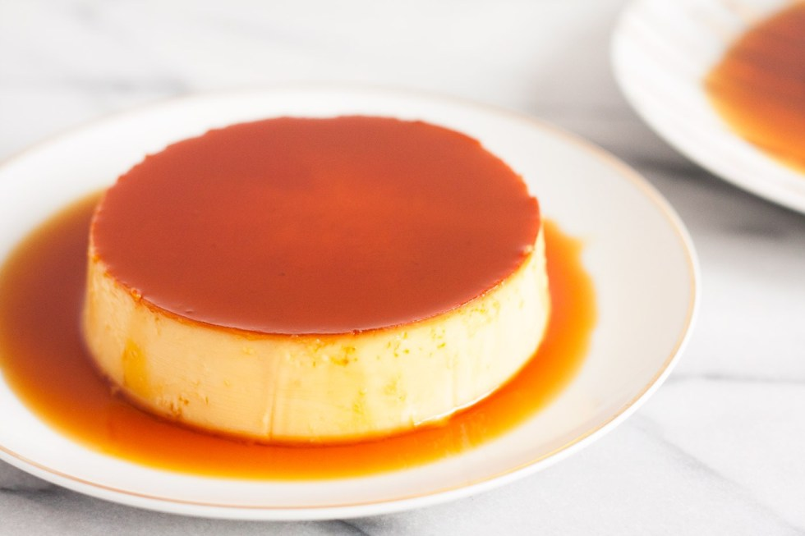
About this dish
It’s the Philippine version of European caramel custard.
The word leche came from the Spanish-speaking countries for “milk” and flan for “crème caramel.”
It was brought by the Spaniards in 16th century.

Slide 3
Why I chose this dish?
Its easy to make
It’s the basic dessert of Filipinos
Every Filipinos favorite dessert
Can be served in every occasions.

Slide 4
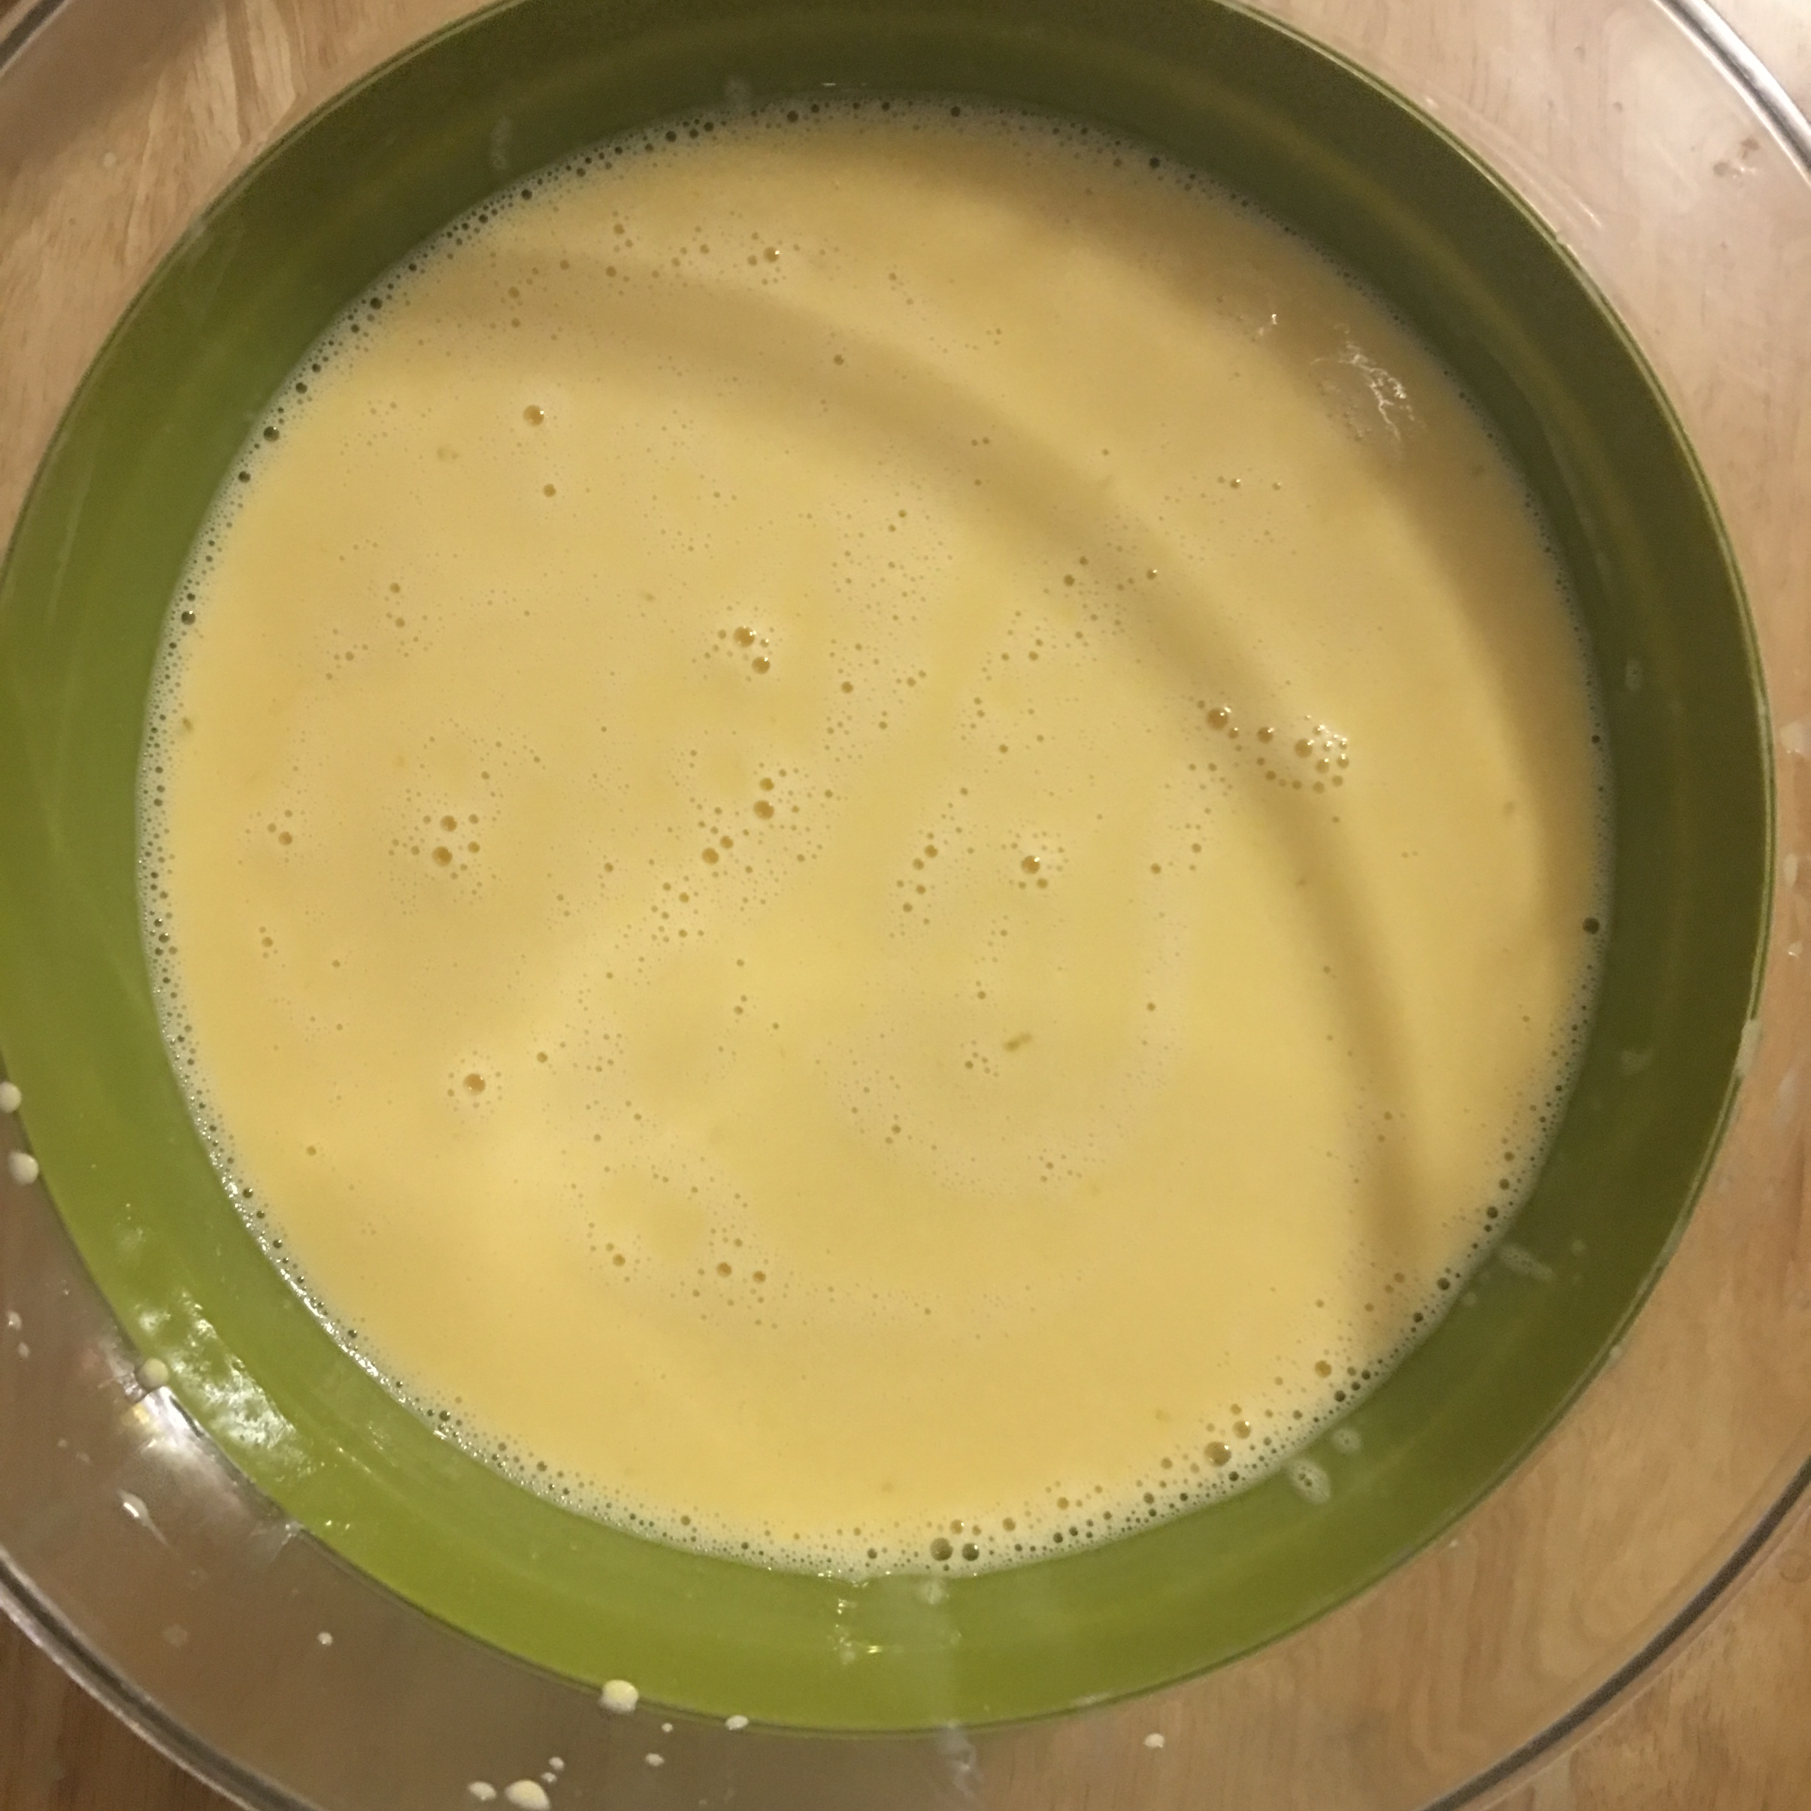
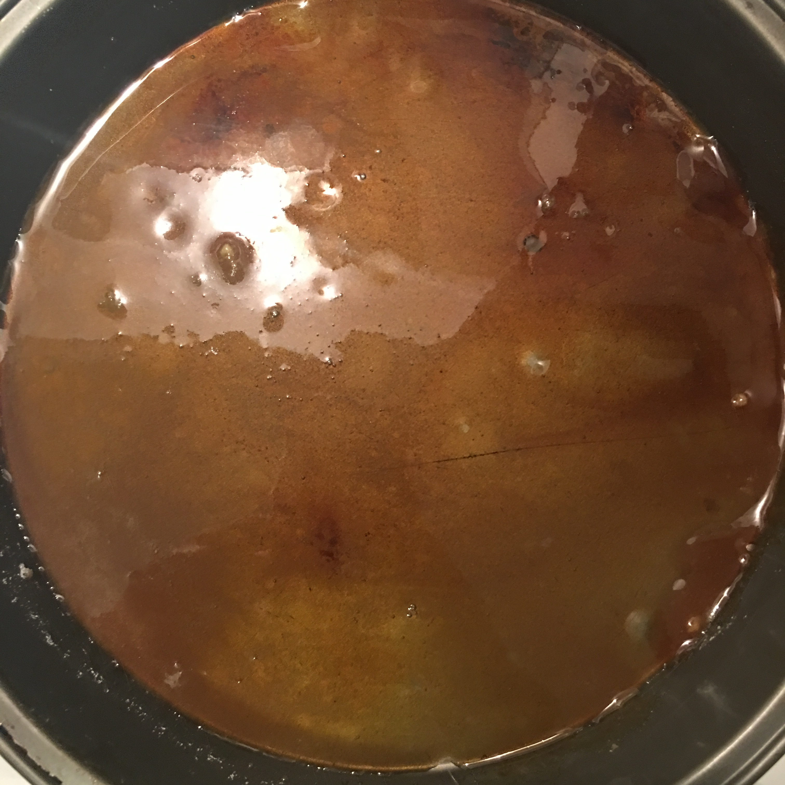
Ingredients
Egg yolks
Sugar
Condensed milk
Evaporated milk

