Slide 1
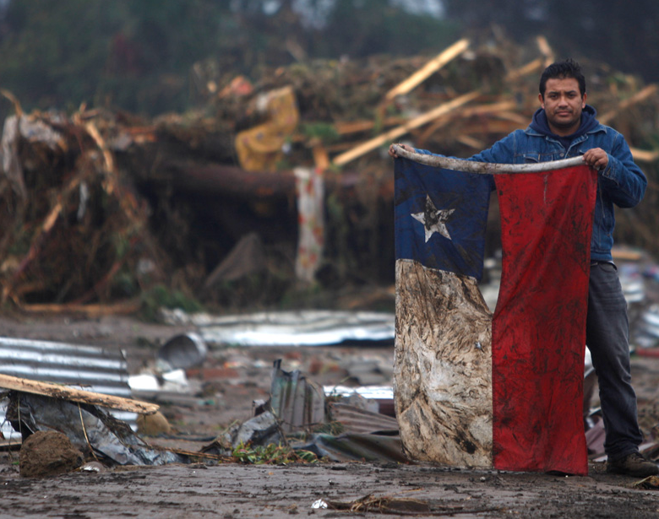
Los Desastres Naturales en Chile
(Cavallo, 2015)
SP11 – Emily, Morgan, Cleon, y Samuel

Slide 2
How are Hispanic countries/cities facing and solving the problems challenging their communities?
(Hispanic Countries, Unknown)

Slide 3
El Problema en Chile (Ejemplos)
Forrest and urban fires
Volcanic Eruptions
Earthquakes
Tsunamis (due to its extensive coastline and geographic location)
Floods
Avalanches
Notes:
Morgan/Emily

Slide 4
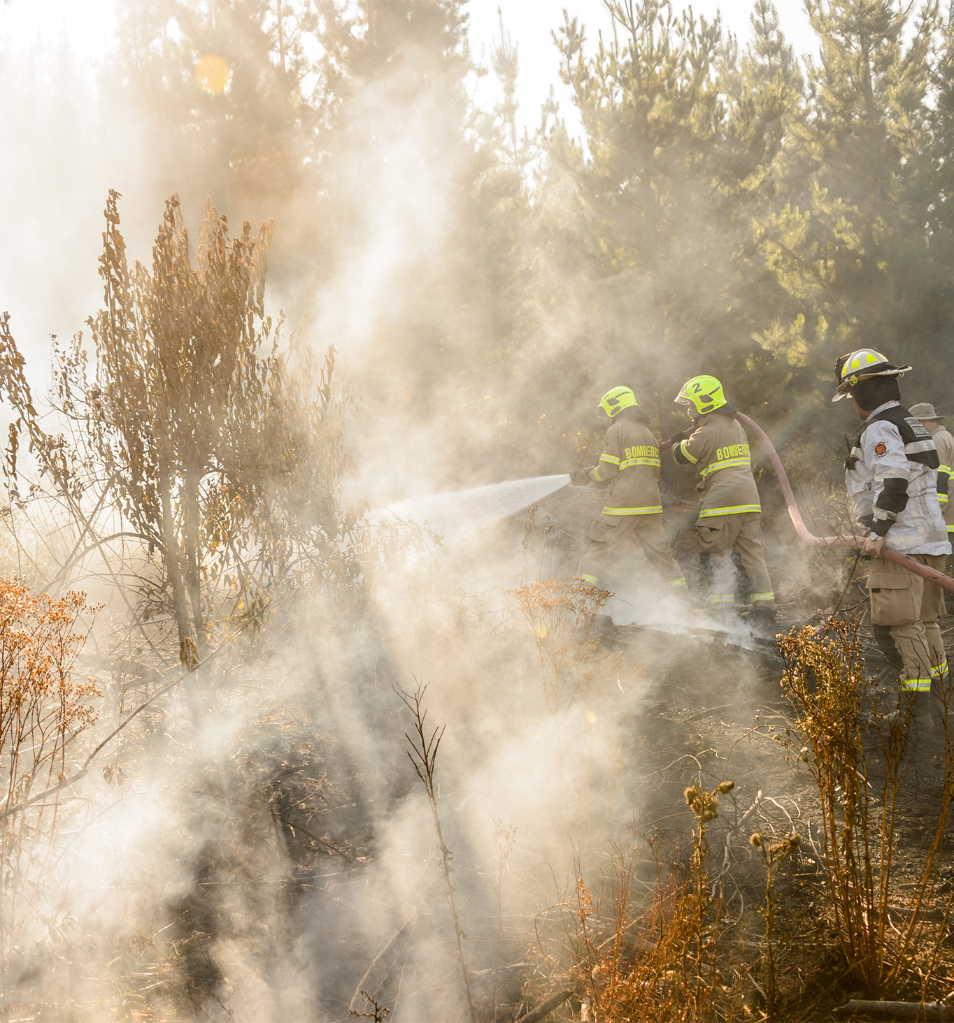
El Problema en Chile
(Guzman, 2019)
Defining natural disasters: Natural disasters are non-manmade events which negatively affect a community or populace. They cause widespread damage rather than only affecting single individuals and/or families, and include earthquakes, hurricanes, floods, etc.
Specifically, Chile is heavily affected by natural disasters due to its vulnerable geographical location.
Notes:
Samuel

Slide 5
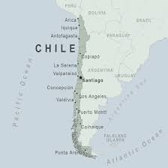
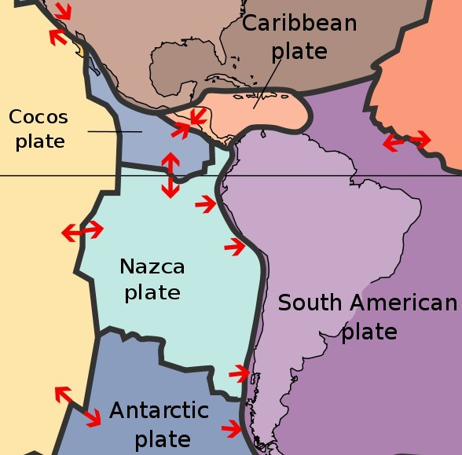
¿Donde se pasa?
Chile has one of the longest coastlines in the world. Estimating to about 6500km long.
Chile lies along the edge of two tectonic plates. The northern 2/3 of Chile is located on The Nazca Plate, an oceanic tectonic plate that shares a subduction line with the South American Plate, creating a geologically active location.
(Chile - Traveler View, Unknown)
(Messer, 2014)
Notes:
Emily:
- Geographicly, its pretty clear to see that chile has a huge exposure to the ocean.
---> economically that may be beneficial to chile, as they have many ports and lots of access for fishing...
- Unfortunately, as much as it has beautiful scenery of the pacific ocean, it is also comes with many consequences.

Slide 6
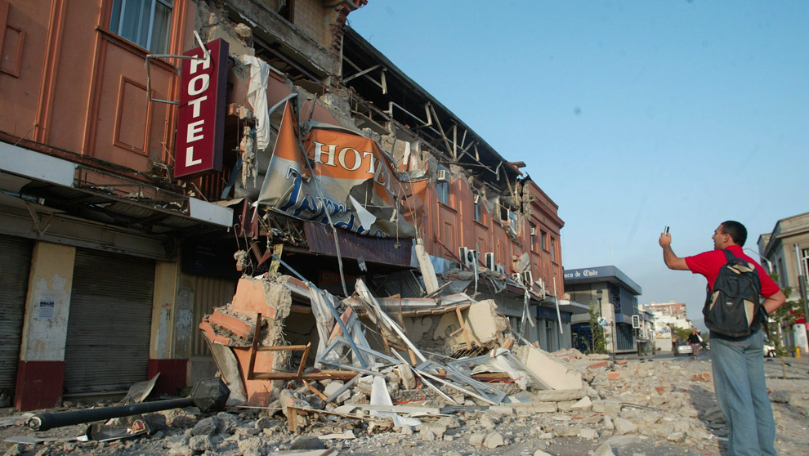
Terremotos (Earthquakes)
(Fredes, 2010)
Notes:
Emily

Slide 7
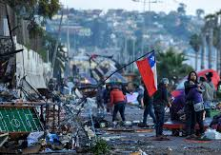
Terrmotos en Chile
Chile has frequent earthquakes each year, some much bigger than others. Average "Chileanexperiences" what are called "tremors," or small earthquake shakes. Most of these small earthquakes are so tiny that most people don’t even notice them.
The most recent 6.4 magnitude earthquake occurred on Tuesday (January 18th at 6:46pm) in the City of Mendoza, Argentina that managed to reach out ~400km into parts of Chile (at ~5.0 Magnitude).
Earthquakes often lead to tsunami's, volcano eruptions, and floods
(Pizzaro, 2015)
Notes:
Emily

Slide 8
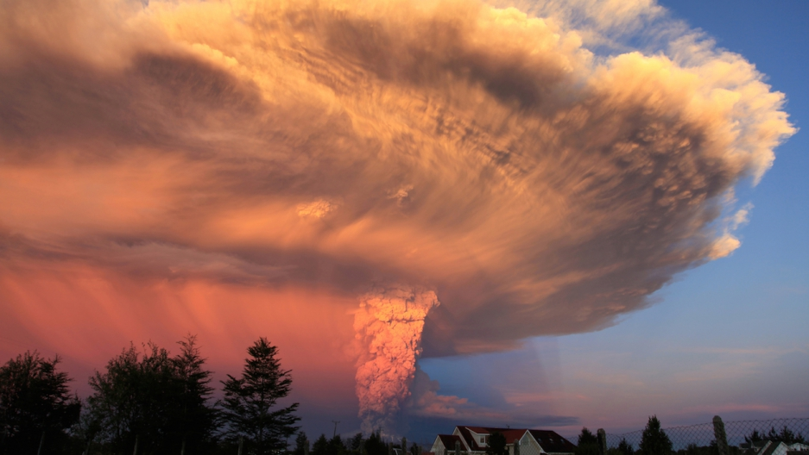
Erupciones Volcánicas (Volcanic Eruptions)
(Diego, Unknown)
Notes:
Samuel

Slide 9
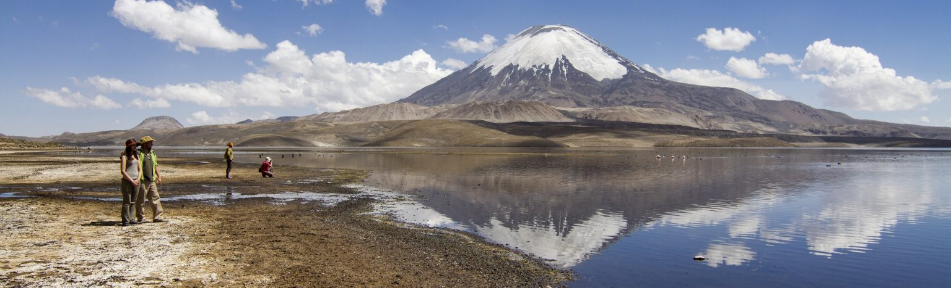
Erupciones Volcánicas en Chile
(Chile, 2020)
Chile lists as the nation with the absolute greatest number of Volcanoes in all the Americas.
Among these volcanos, there is even the tallest active volcano in the entire world, the Nevado Ojos del Sado.
One example of a recent volcanic disaster in Chile is the Villarrica volcano eruption in 2015.
Chile is also one of the countries in the Ring of Fire, which is a "ring" which includes about 75% of volcanoes in the world.
Notes:
Samuel
Chile is a country known for its high quantity of volcanos; it lists as the nation with the absolute greatest number of them in all of the Americas. Among these volcanos, there is even the tallest active volcano in the entire world, the Nevado Ojos del Sado, which is pictured above.
Nowadays, these volcanos act as mostly tourist attractions than hazards, but there have been a few disasters caused by them in recent time. One extreme example is the Villarrica volcano eruption in 2015, which required the evacuation of over 3,000 Chileans in its vicinity.
note 2: Chile is one of the countries along the Ring of Fire, a belt of active volcanoes and earthquake epicenters bordering the Pacific Ocean; up to 90% of the world's earthquakes and some 75% of the world's volcanoes occur within the Ring of Fire

Slide 10
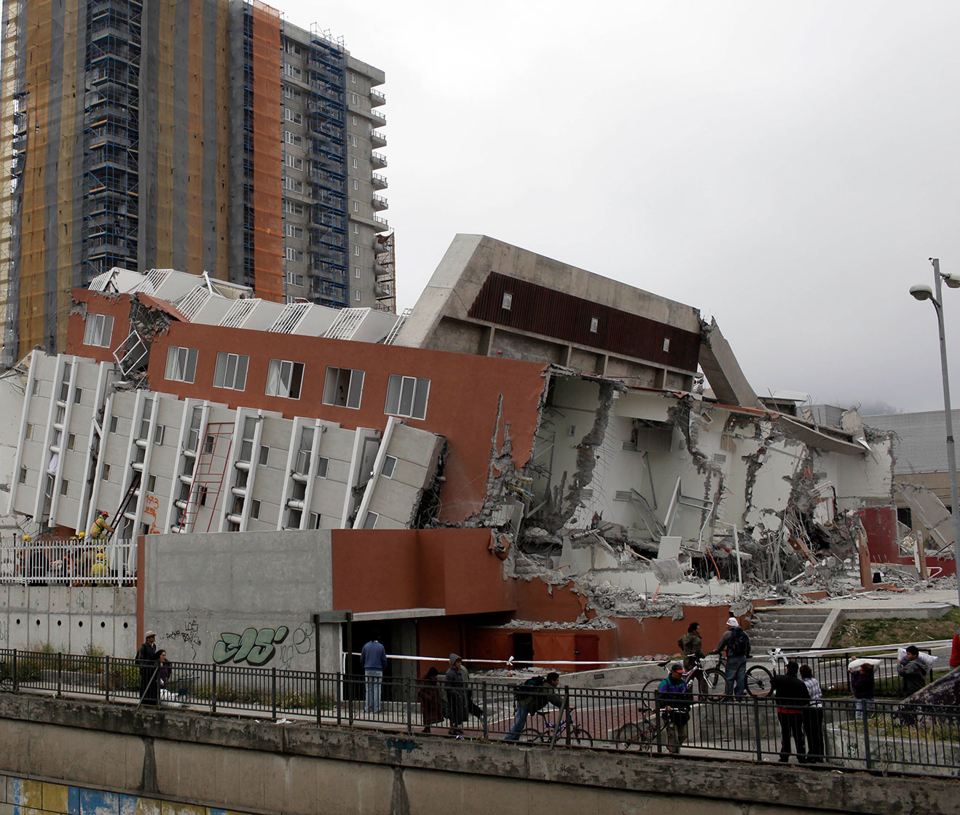
¿Quién está sufriendo?
(Pisarenko, 2010)
Everyone in the area of the natural disaster will suffer in many ways. Earthquakes can have immediate and long-term impacts on health.
They can also damage health facilities and transportation, which can disrupt service delivery and access to care.
Lots of homes are destroyed which means many citizens won't have a home to live in until the government helps pay/rebuild all the homes.
Notes:
Morgan

Slide 11
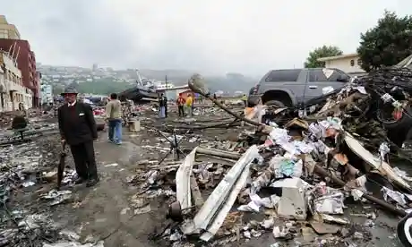
¿Qué pasa?
(Bernetti 2010)
Earthquakes can and have caused mass destruction in Chile; an example is the 2010 8.8 magnitude earthquake in Talcahuano. Same as 100,000 Hiroshima bombs.
As a result,
524 people died
25 disappeared
800,000 were affected by it
There were over $30 billion dollar's worth of damage such as:
1,500 km of roads
4,500 schools, two airports
53 ports
56 hospitals were damaged
220,000 houses were destroyed
Tsunami shortly followed after
This disaster has not been the only one to extremely damage Chile.
Imagine losing your home and life belongings.
Notes:
Cleon
Earthquakes can and have caused mass destruction in Chile; an example is the 2010 8.8 magnitude earthquake in Talcahuano. The energy of this earthquake was equivalent to 100,000 Hiroshima bombs.
As a result,
524 people died
25 disappeared
800,000 were affected by it
There were over $30 billion dollar's worth of damage such as:
1,500 km of roads
4,500 schools, two airports
53 ports
56 hospitals were damaged
220,000 houses were destroyed
Following this was even a tsunami, which further damaged the area. Though definitely on the larger scale, this disaster has not been the only one to extremely damage Chile.
Imagine losing your home and life belongings.

Slide 12
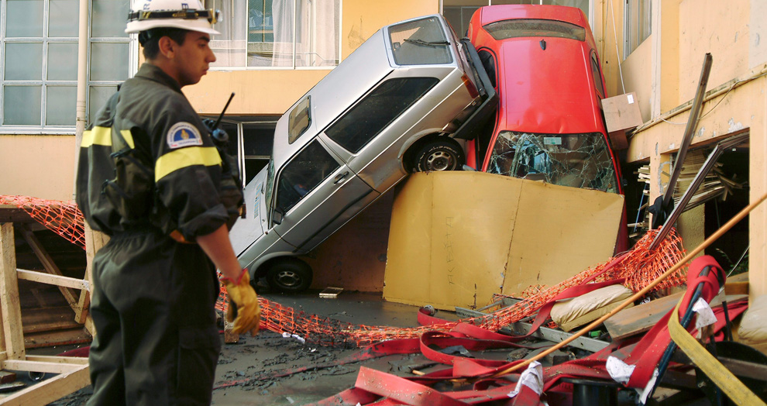
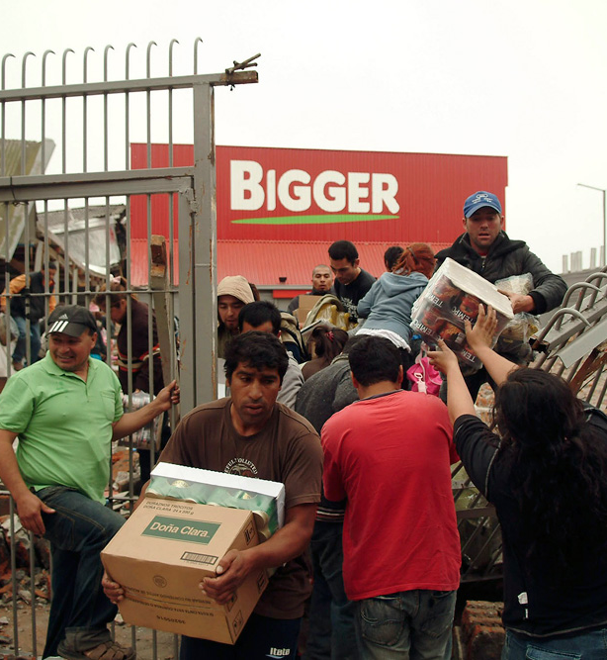
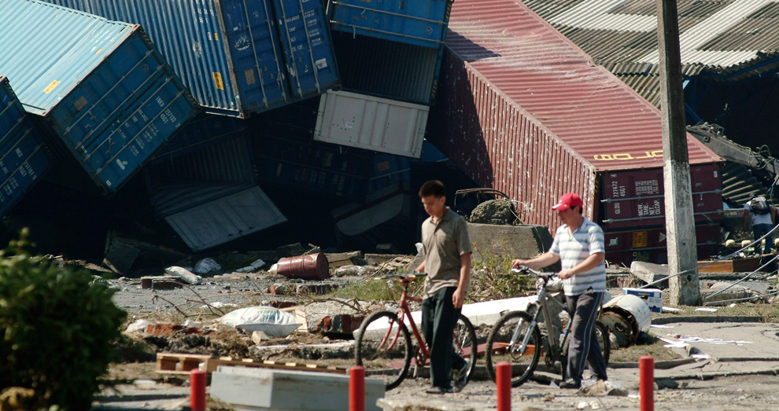
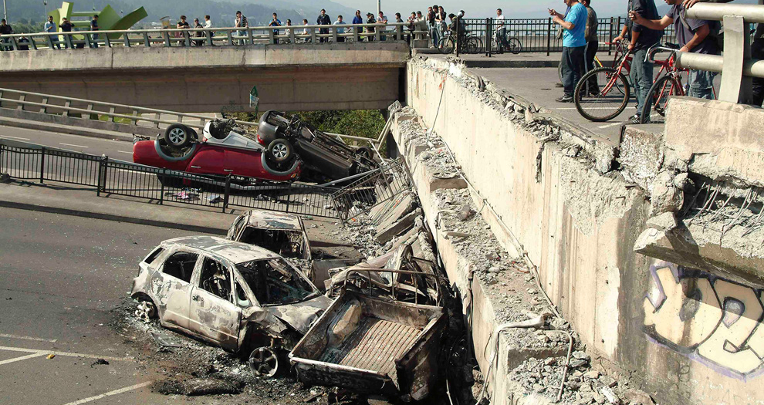
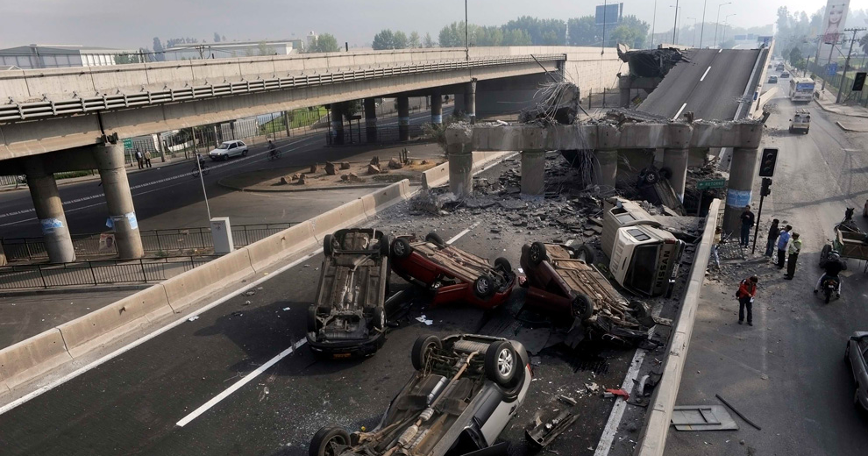
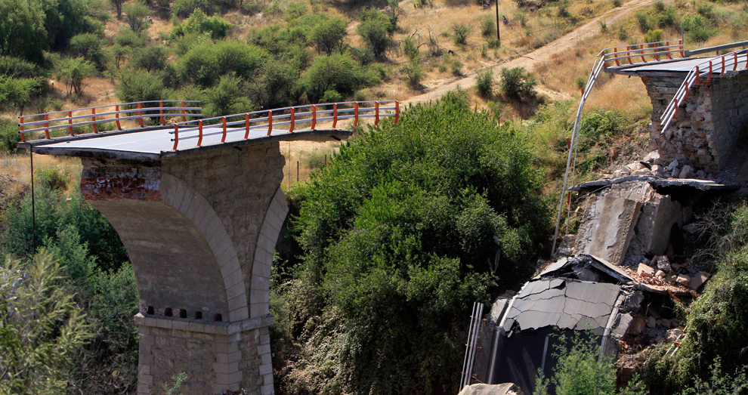
¿Qué pasa?
(Saavedra 2010)
(Saavedra, 2010)
(Saavedra 2010)
(Fredes 2010)
(Saavedra 2010)
Here are some more examples of the results and effects of devasting earthquakes in Chile
(Caballero 2010)
Notes:
Cleon
As you can see the effects of earthquakes looks like its out of a movie

Slide 13
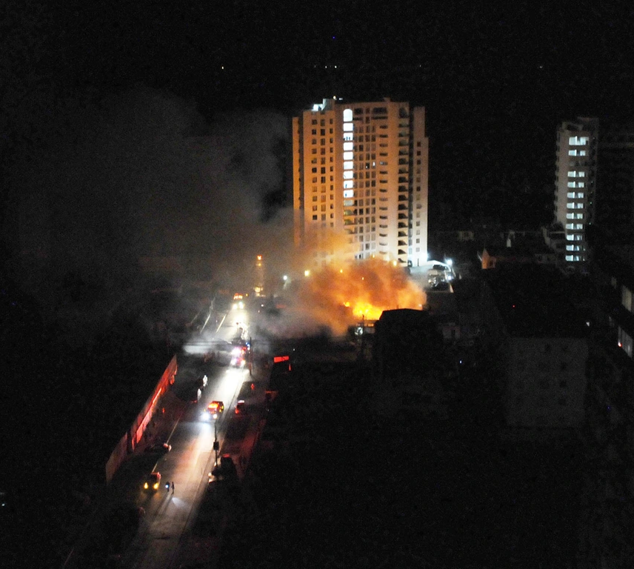
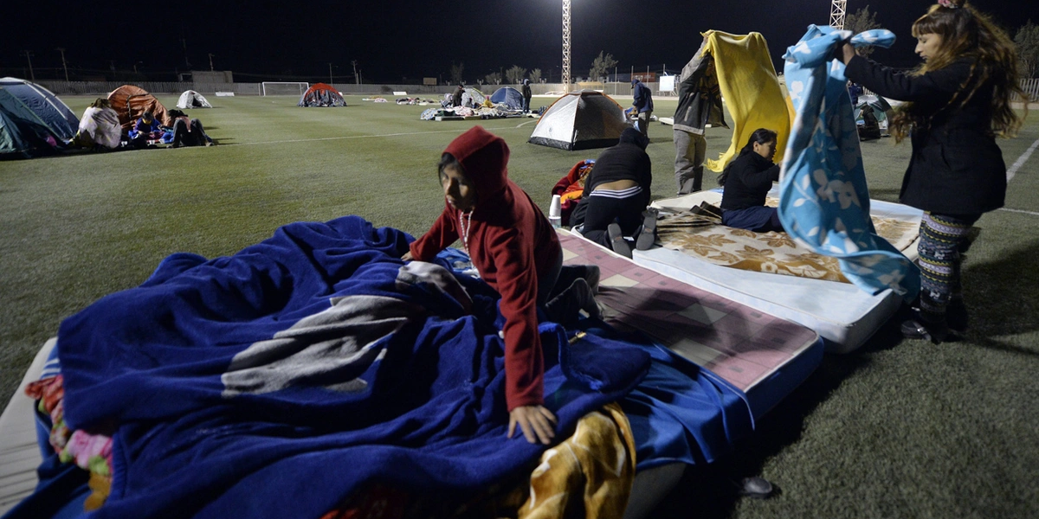
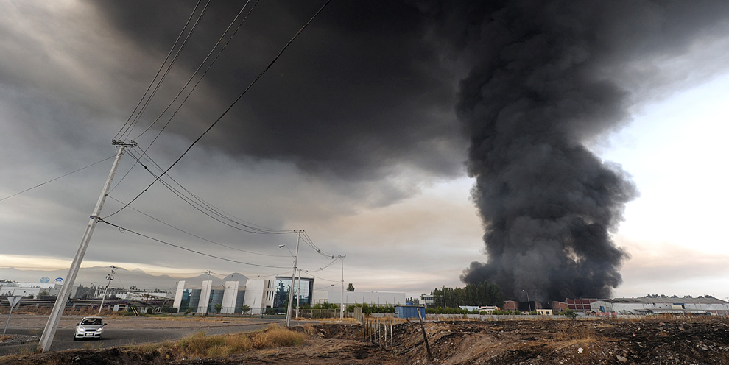
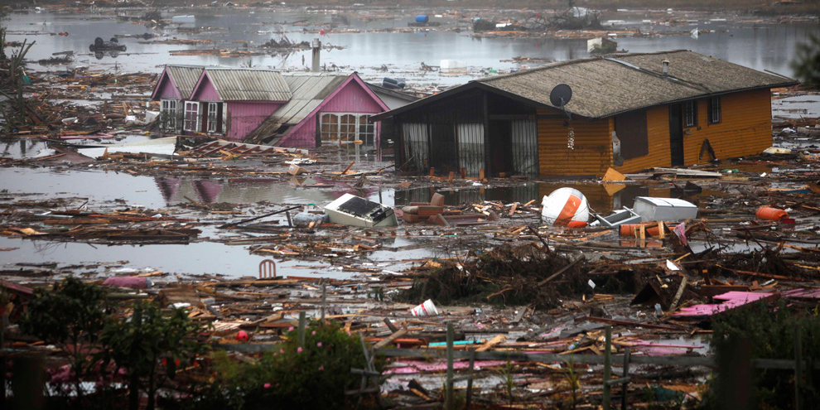
¿Que Pasa?
(Bouroncle, 2014)
Earthquakes not just destroy structures, it creates other problems, such as: floods, fires, tsunami's, etc.
It leaves many people homeless where they must sleep in tents or emergency homes
(Bernetti, 2010)
(Vivero, 2014)
(Candia, 2010)
Notes:
Cleon
Earthquakes not just destroy structures, it creates other problems, such as: floods, fires, tsunami's, etc.
It leaves many people homeless where they must sleep in tents or emergency homes

Slide 14
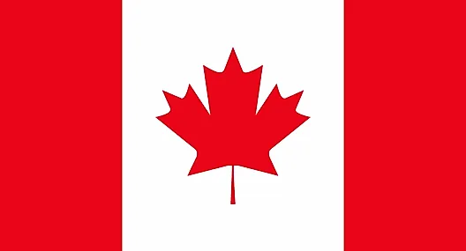
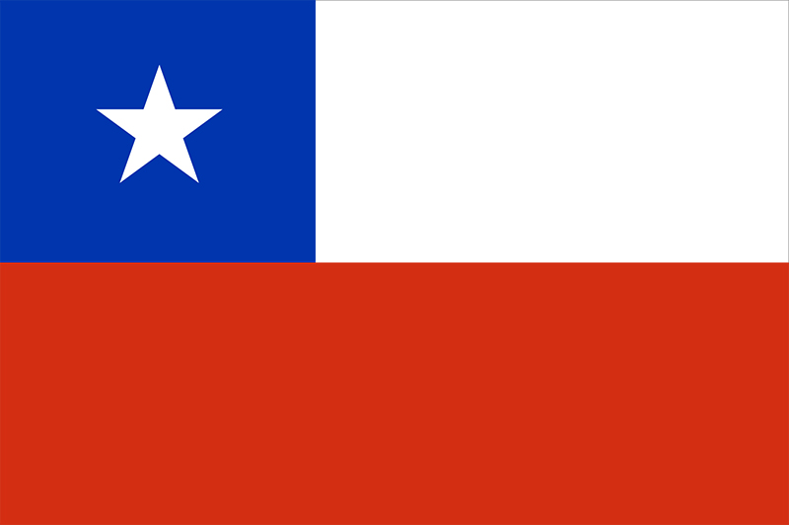
Para comparar Chile y Canada (Earthquakes)
Canada
Approximately 5,000 minor earthquakes across Canada each year
The last time there was a major earthquake was October 2012
Chile
2 million minor earthquakes happen per year
On average there are 8,000 minor earthquakes per day
18 major earthquakes each year
Notes:
Morgan

Slide 15
¿Hay una solución?
Unfortunately, natural disasters are hard to predict, however; anyone traveling should use caution and pay close attention to current news reports and government issued warnings.
The best plan is to understand protocols and proper actions to take during any of the cases.
Notes:
Emily

Slide 16
¿Que hacer en una emergencia?
Terremotos
Erupciones Volcánicas
“DROP, COVER AND HOLD ON”
Drop under heavy furniture such as a table, desk, bed or any solid furniture.
Cover your head and torso to prevent being hit by falling objects.
Hold on to the object that you are under so that you remain covered
Listen for emergency information and alerts.
Follow evacuation or shelter orders. If advised to evacuate, then do so early.
Avoid areas downstream of the eruption.
Protect yourself from falling ash.
Do not drive in heavy ash fall.
Notes:
Emily

Slide 17
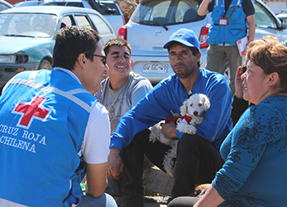
¿Quién está trabajando para eliminar el problema/ encontrar una solución?
Programs and organizations help and aid the effects of earthquakes
Chilean Red Cross aims to respond and support to disaster struck areas like first aid, food, water, tools, hygiene kits etc
The Larra Chile Program is meant to increase preparation capacity in vulnerable communities prone to natural disasters
This program seeks to reduce the number of deaths, injuries, and socio-economic impacts from the natural disasters
(Chilean Red Cross, Unknown)
Notes:
Can't really prevent the problem of earthquakes and natural disasters happening, however, there are programs and organizations that help and aid the effects of it
Chilean Red Cross is a national society aimed to respond and give support to disaster prone areas such as first aid, food, water, tools, hygiene kits etc
The Larra Chile Program employed with the Chilean Red Cross is a program to increase preparation capacity in vulnerable communities prone to natural disasters, which basically prepares a community whether it is supplies or instructions of safety, incase of any natural disaster happening
This program seeks to reduce the number of deaths, injuries, and socio-economic impacts from the natural disasters

Slide 18
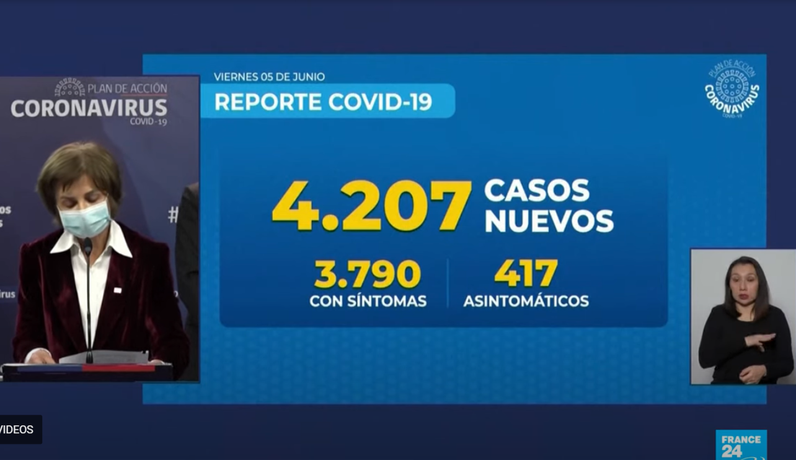
¿Qué es el impacto de COVID en este momento?
-Years of growth for the middle-class have been reversed.
-As of June of 2020, it was even reported as having the highest confirmed cases-to-population ratio in the entirety of Latin America (NEWS WIRES).
-As of January 17th of 2021, 669,832 cases have been reported and confirmed in Chile (U.S. Mission Chile).
(NEWS WIRES, 2020)
Notes:
Samuel
-COVID has heavily hurt the Chile populace, especially middle-class-wise.
-Years of growth for the middle-class have been reversed, and some are even ignoring COVID-isolation laws so they can work and provide for their family (Worldbank).
-As of June of 2020, it was even reported as having the highest confirmed cases-to-population ratio in the entirety of Latin America (NEWS WIRES).
-As of January 17th of 2021, 669,832 cases have been reported and confirmed in Chile, with at least more than 17,000 deaths (U.S. Mission Chile).

Slide 19
Works Cited
Bernetti, Martin. “Chile and Earthquake Reconstruction | Catalina May.” The Guardian, Guardian News and Media, 28 Feb. 2011, www.theguardian.com/commentisfree/cifamerica/2011/feb/28/chile-natural-disasters.
Cavallo, Eduardo. “Fuerza Chile.” Ideas Matter, IBD Improving Lives, 21 Sept. 2015, https://blogs.iadb.org/ideas-matter/en/fuerza-chile/
Chile Travel. “Chile Travel.” Chile Travel, Ministerio De Economica, Fomento y Turismo, 14 Aug. 2020, https://chile.travel/en/chile-country-of-volcanoes-a-passion-for-these-giants-photography
Chilean Red Cross, Communications Direction. “Chilean Red Cross Responds to Earthquake.” IFRC, 15 Sept. 2015, www.ifrc.org/fr/nouvelles/nouvelles/americas/chile/chilean-red-cross-responds-to-earthquake-69399/.
“Chile - Traveler View.” Centers for Disease Control and Prevention, Centers for Disease Control and Prevention, https://wwwnc.cdc.gov/travel/destinations/traveler/none/chile
Dabda, Charles. “The Greatest Canadian Flag Debate .” McGill, 10 Apr. 2018, blogs.mcgill.ca/hist203momentsthatmatter/2018/04/10/the-great-canadian-flag-debate/.
Earthquakes world health organization, https://www.who.int/health-topics/earthquakes#tab=tab_1
Fredes, Marco. “Earthquake in Santiago.” Boston.Com, 27 Feb. 2010, http://archive.boston.com/bigpicture/2010/02/earthquake_in_chile.html
Garro, Jonathan. “Chile Earthquake Recovery.” Chile Earthquake Recovery · NGO Aid Map, 31 Mar. 2016, www.ngoaidmap.org/projects/17979.
Guzman, Daniela. “After Earthquakes and Volcanoes, Chile Is Threatened by New Natural Disaster.” Bloomberg.com, Bloomberg, 5 Feb. 2019, www.bloomberg.com/news/articles/2019-02-25/land-of-earthquakes-and-volcanoes-threatened-by-a-new-scourge.
Hispanic Countries, Wikipedia. “Hispanic Term .” RBIRD, 16 Apr. 2007, https://rbird.com/movabletype/askmarivi/archives/hispanic-term-update.php

Slide 20
Works Cited
Lang, Gideon. “Dramatic Volcanic Eruption in Chile.” BBC News, BBC, 3 Mar. 2015, www.bbc.com/news/av/world-latin-america-31721795.
Litner , Andy. “Compare Canada to Chile .” Compare Canada To Chile, 2021, www.ifitweremyhome.com/compare/CA/CL.
Main, Diego. Calbuco Volcano in Southern Chile. 22 April, https://www.pri.org/stories/chiles-calbuco-volcano-eruption-absolutely-spectacular-photos
“Map-Hispanic Countries.” Wikipedia, https://en.wikipedia.org/wiki/File:Map-Hispanic_countries.png
Messer, A'ndrea Elyse. “Study of Chilean Quake Shows Potential for Future Earthquake.” Penn State News, 13 Aug. 2014, https://news.psu.edu/st/322766/2014/08/13/research/study-chilean-quake-shows-potential-future-earthquake
Pisarenko, Natacha. “Chile Earthquake of 2010.” Britannica , Richard Pallardy , 2 Mar. 2010, www.britannica.com/event/Chile-earthquake-of-2010.
Pizarro, Alejandro. “2015 Coquimbo Earthquake.” CBS News, Coquimbo, Chile, 17 Sept. 2015, www.cbsnews.com/news/death-toll-from-chile-earthquake-rises-1-
Smith , Whitney. “Flag of Chile .” Britannica , 2 Feb. 2001, www.britannica.com/topic/flag-of-Chile/additional-info#history.
Sylvester, Phil. “Natural Disasters and Other Hazards in Chile.” World Nomads, World Nomads, 17 July 2018, www.worldnomads.com/travel-safety/south-america/chile/chile-natural-disasters-and-other-concerns.
Taylor, Alan. “The Aftermath of Chile's Earthquake.” The Atlantic, Atlantic Media Company, 3 Apr. 2014, www.theatlantic.com/photo/2014/04/the-aftermath-of-chiles-earthquake/100709/.
USGS Earthquake Hazards Program, https://earthquake.usgs.gov/earthquakes/eventpage/us7000d18q/executive
U.S. Mission Chile. “COVID-19 in Chile: Information for American Citizens.” Usembassy, 6 Jan. 2021, cl.usembassy.gov/covid-19-information/.
“Volcanoes.” Volcanoes | Ready.gov, 11 Oct. 2020, www.ready.gov/volcanoes.

