Slide 1
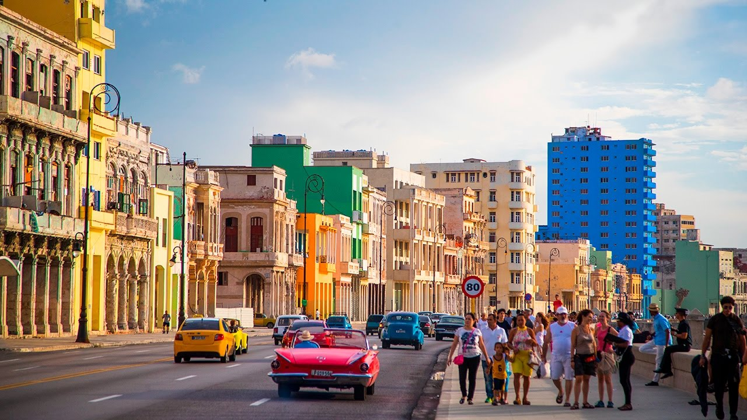
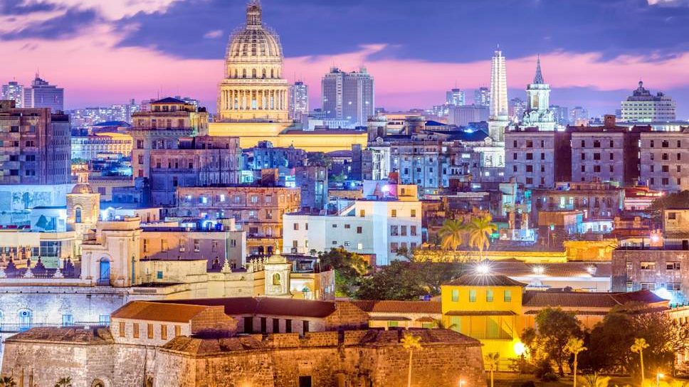
Cuba
BY: cLEON

Slide 2
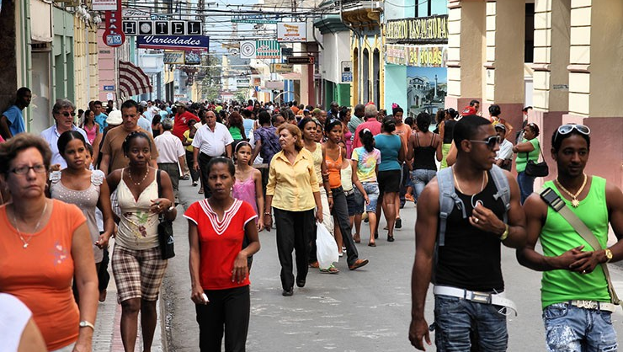
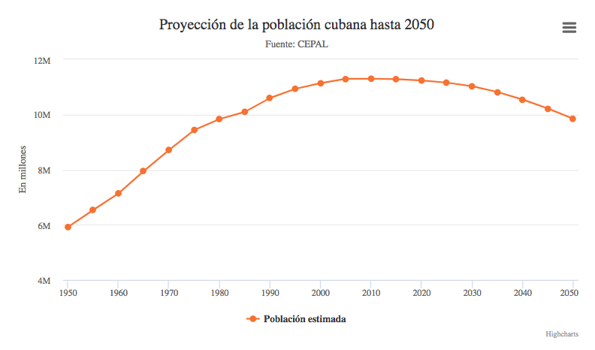
La Población Population
The population in Cuba is 11.48 million as of 2018
And the estimated growth of the population in further years will slowly decrease

Slide 3
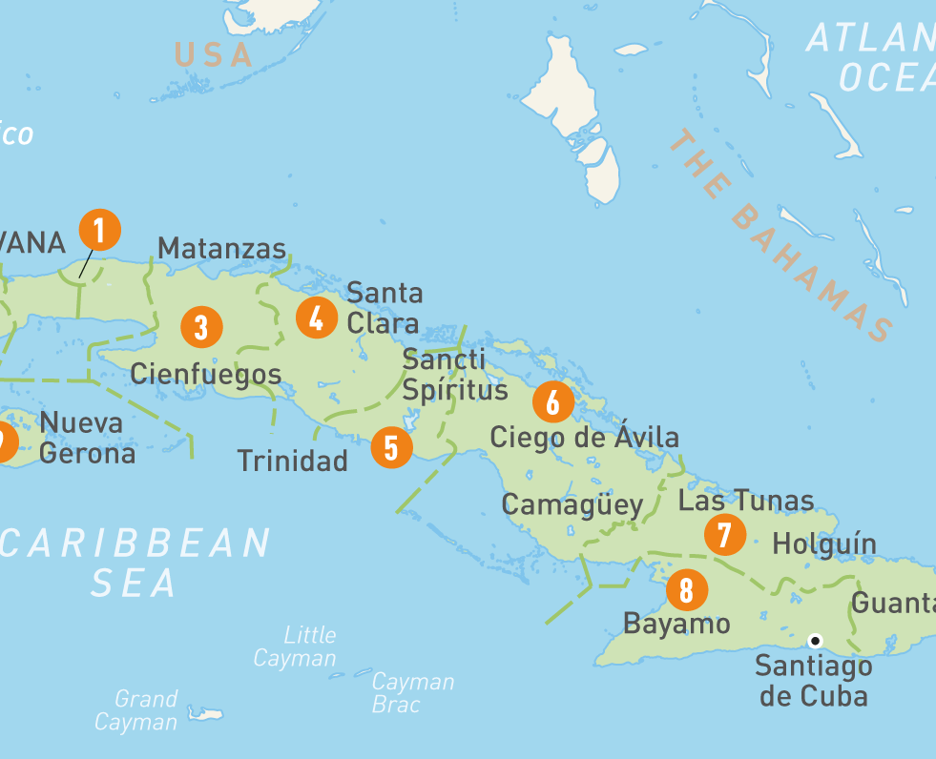
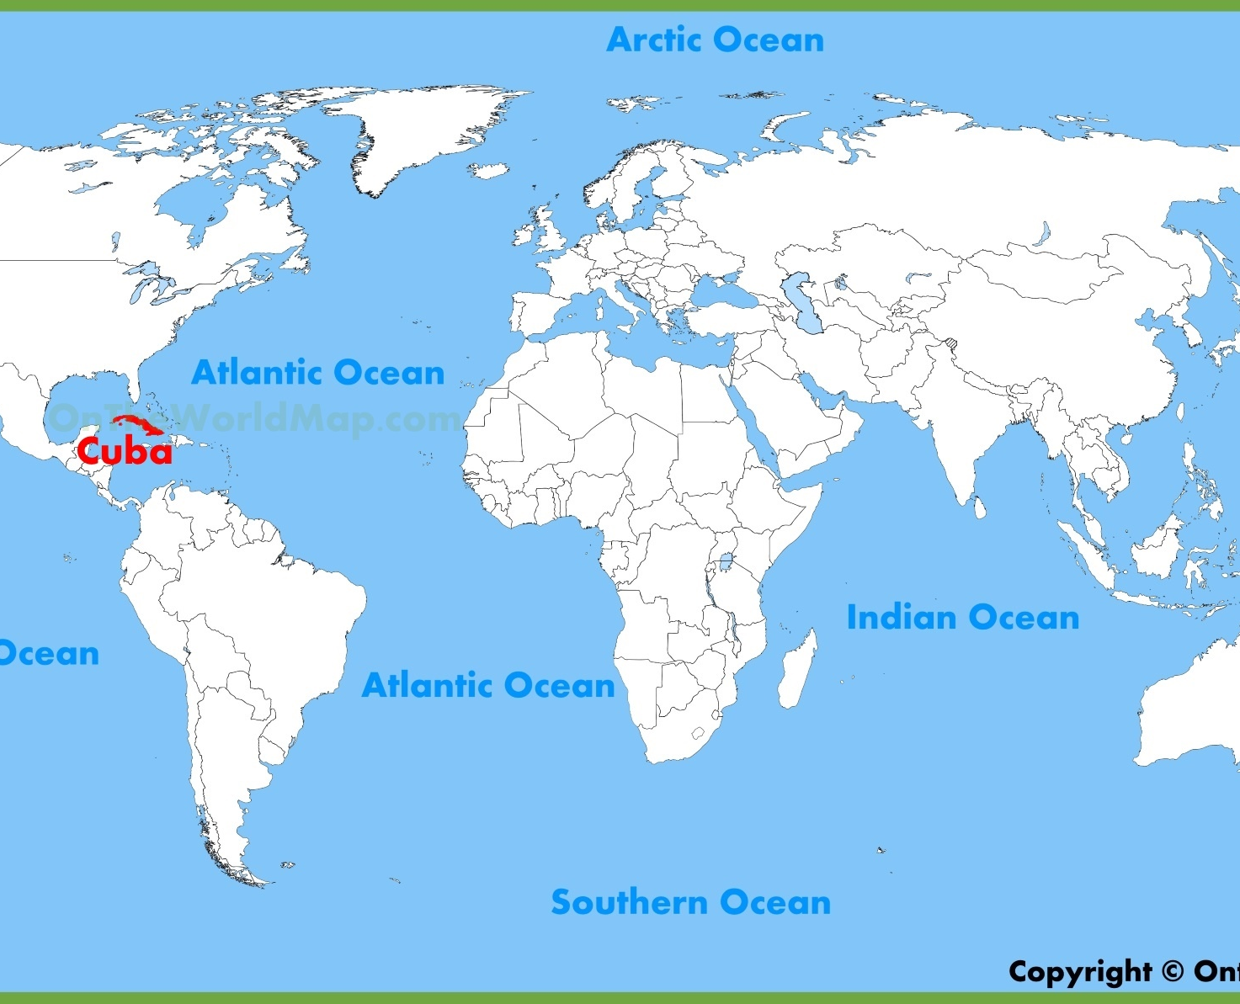
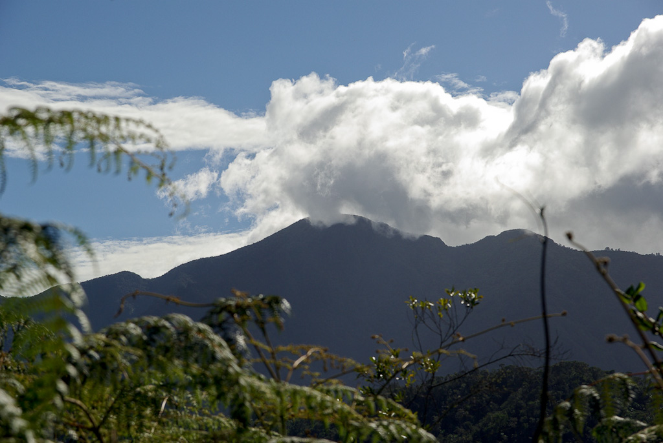
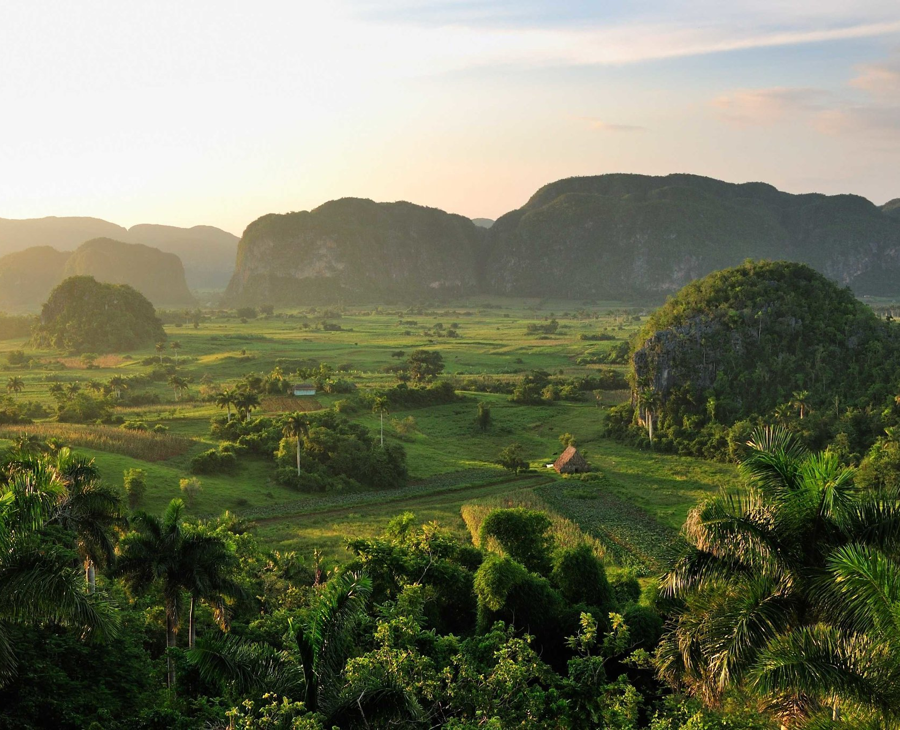
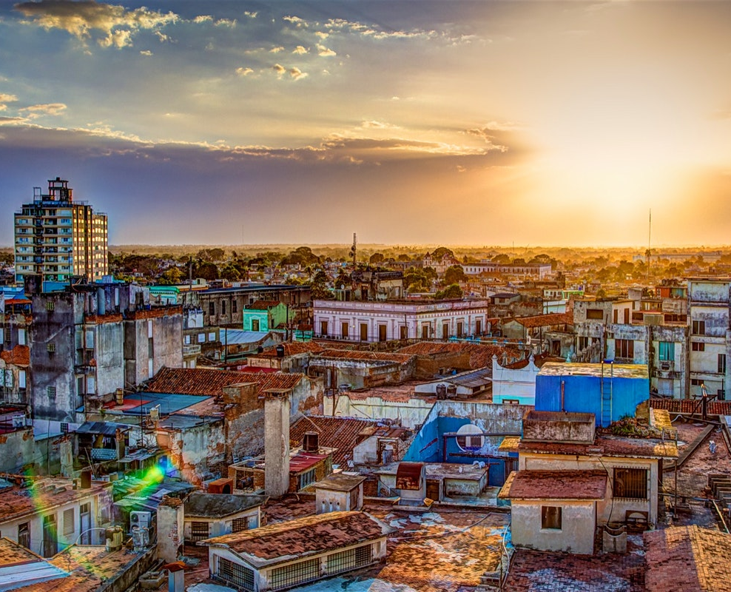
La Geografía Geography
The pictures on the right is a geographic picture of Cuba and where Cuba is on the world map.
The pictures on the right is the landscape of Cuba and on the very right is what the cities looks like.
The terrain is mostly flat with rolling plains , with rugged hills and mountains in the Southeast.
Fact: The lowest point in Cuba is the Caribbean Sea at 0 m (sea level) and the highest point in Cuba is Pico Turquino

Slide 4
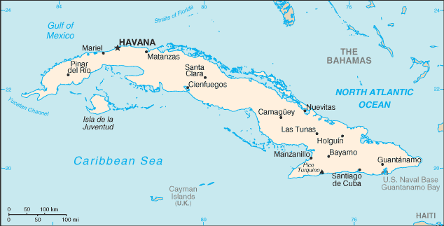
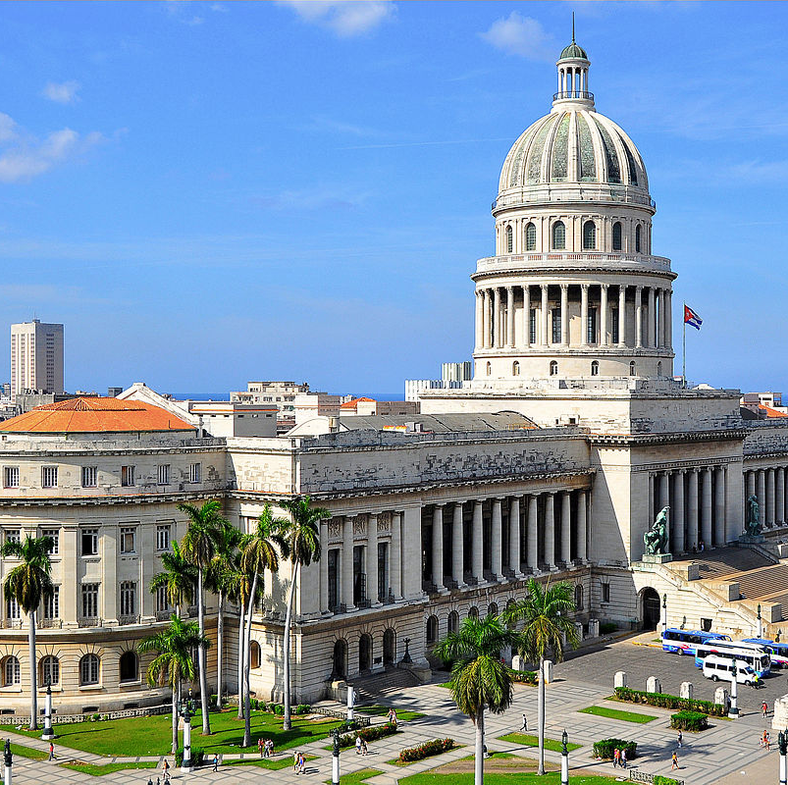
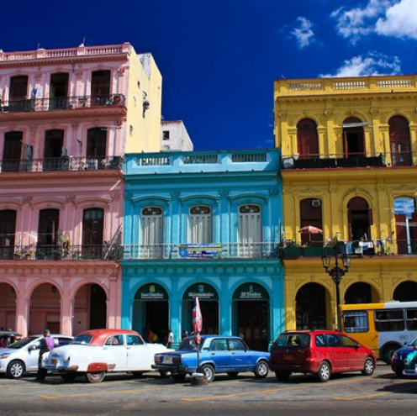
La Capital Capital City
The capital city of Cuba is Havana
In Havana, colourful buildings first appeared in the 16th and 17th centuries and the city still remains incredibly beautiful
The building on the right is called El Capitolio which was where the president stayed. You are allowed to enter the building and have a tour around the place.

Slide 5
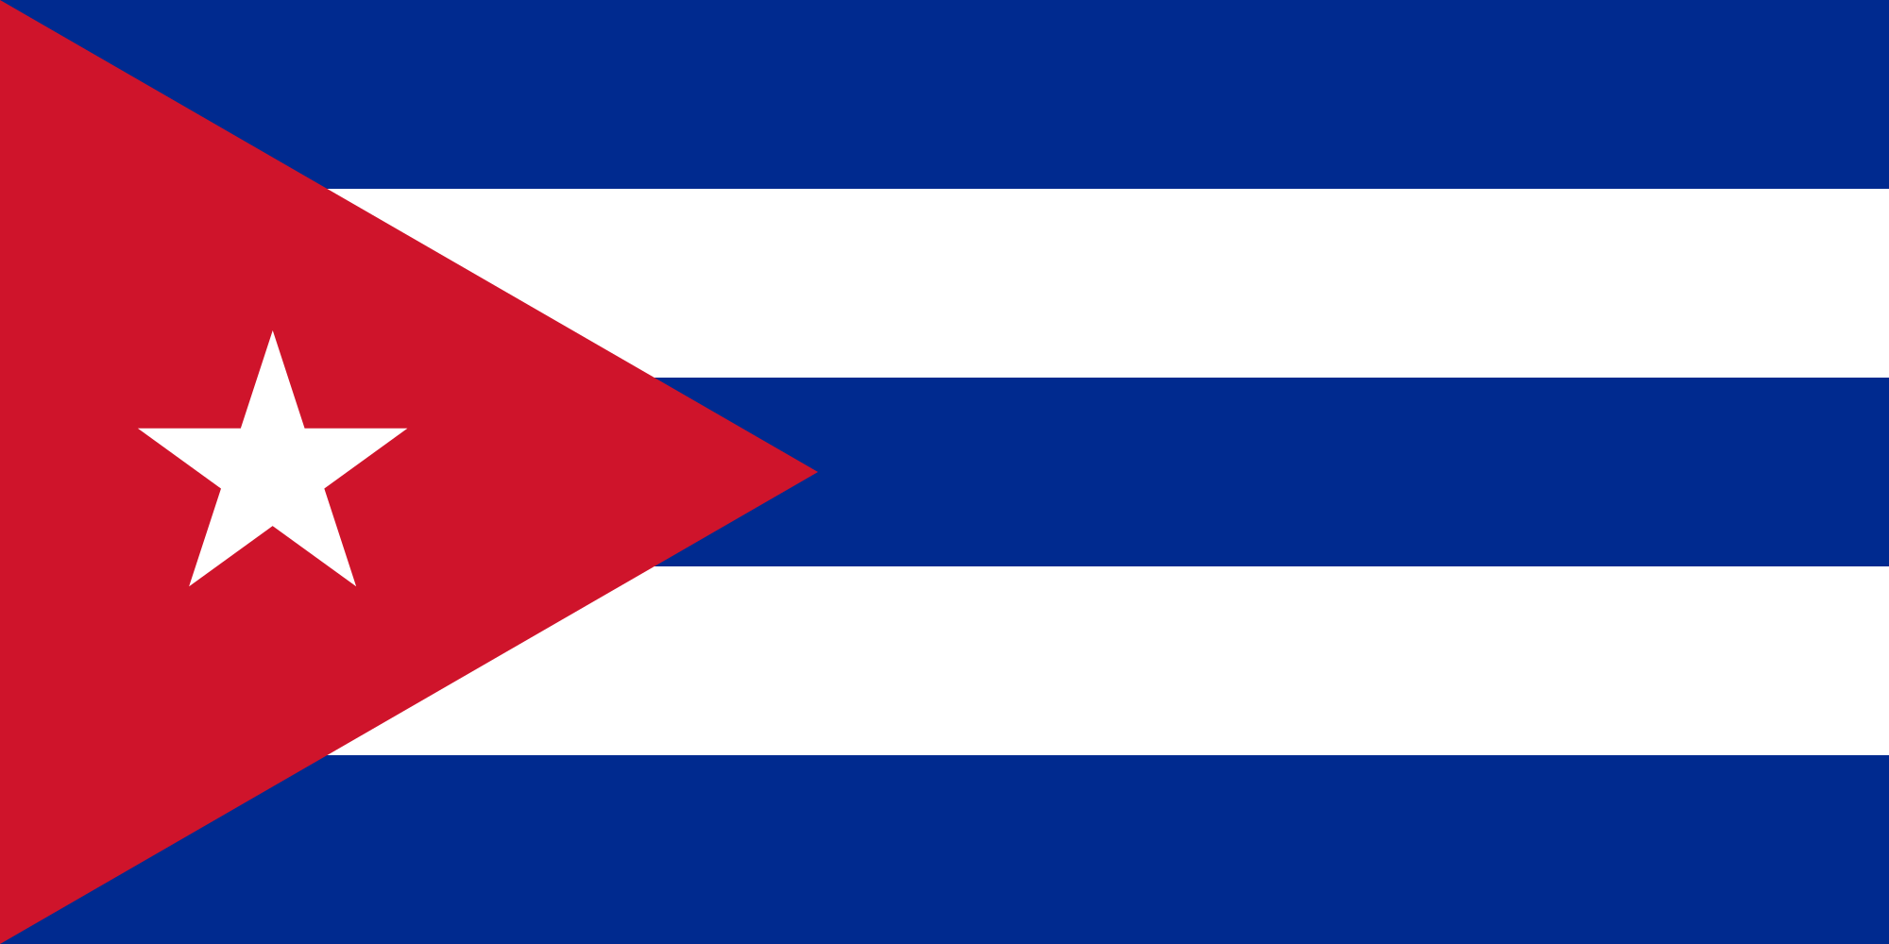
La Bandera Flag
The flag was created by Narciso Lopez in 1849 but not officially adopted until May 30, 1902
The 3 blue stripes represents the three districts in which Cuba was divided that time. The white strips represents the purity and justices of the patriotic liberators motives. The red triangle is a masonic symbol that represents the unity and equality of the people upon the blood spilled by their revolutionary heroes, and the white star stands for independence.

Slide 6
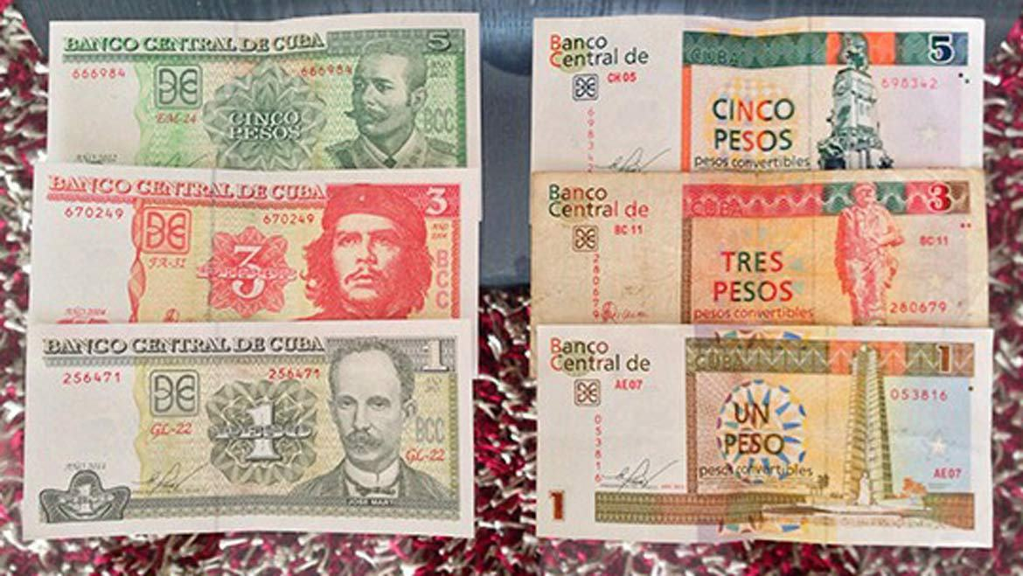
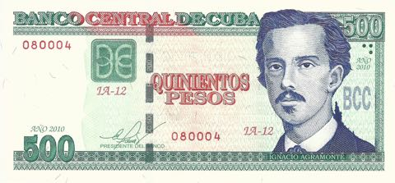
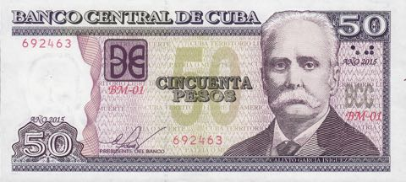
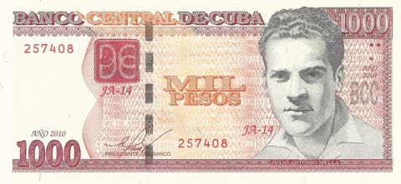
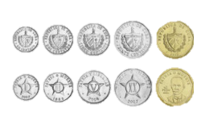
La Moneda Currency/Money
Cuba does not use US currency but uses their own currency called Cuban Peso
1 Cuban Peso equals to 1.31 Canadian dollars.
1 Canadian Dollar equals to 0.76 Cuban Peso’s

Slide 7
3 Tradiciones Traditions-detail
Fire Festival in Santiago de Cuba (early July)
Carnivals in Cuban provinces (late June and throughout July)
Cubadisco Festival (mid-May)

Slide 8
Fire Festival in Santiago de Cuba
This festival is one of the most anticipated festivities in July attended by locals and tourists. The Caribbean festival, as know as “La fiesta del fuego”. This traditions started in 1981 to pay tribute to the music, food, dances and traditions of this Caribbean town. The party last around 8 days and is celebrated in Santiago de Cuba, know for being cultural capital on the island. It has dance presentations, fireworks shows, theatrical performances, local crafts, workshops of poetry and acting, cinema series and much more. Other people from Brazil, Dominican Republic, Jamaica, Curacao Island and others will attend.

Slide 9
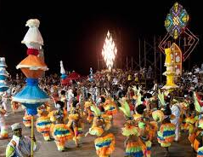
Carnivals in Cuban provinces
During late June and through out July, Cuban carnivals are held in regions such as Havana, Santiago de Cuba, Pinar del Rio, Las Tunas, Holguin, Matanzas, and Villa Clara. The festivals consist of Parade with floats, typical music such as the conga santaiguera, street food offering, typical Cubam meals, Fancy dress parades, and live music. There is no set date for the celebration of these carnivals.

Slide 10
Cubadisco Festival
In mid May, this international fair brings together singers, composers and artists. It includes awards and celebrations. Live music by different Caribbean music artists is what makes this event so special. The exhibitions, concerts and awards gathers locals and foreigners together to enjoy the event. Cubadisco is similar to the Grammy music awards for Cuban musicians.

Slide 11
La comida típica Typical Food
A national and common dish in Cuba is called Ropa Vieja. This dish is made of crushed beef tomato paste, red peppers, onions, and garlic. Rice is also part of the recipe, rice is almost in every dish in Cuba. You can order white rice, but Cubans prefer to eat it flavored. So brown rice and congri is very common. Boiled potatoes and fried plantains can also also be a complement of the Ropa Vieja recipe

Slide 12
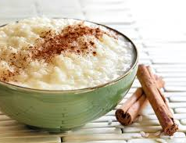
Dessert Arroz con leche
The rice pudding or arroz con leche was introduced by the Spanish and its found in many Latin American countries. It is created with boiling rice, evaporated and condensed milk, cinnamon sticks, and lemon. It is sweet, simple and delicious

Slide 13
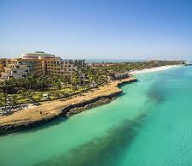
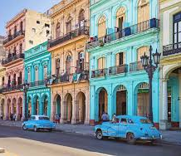
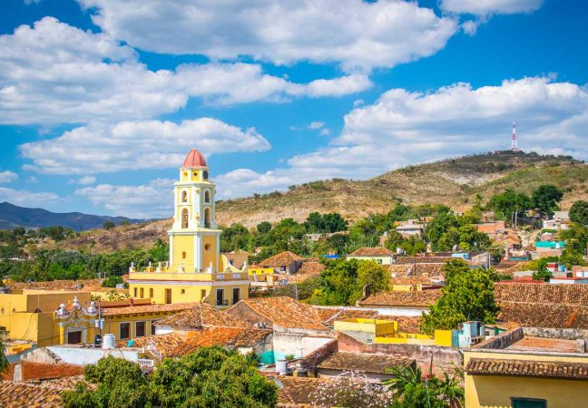
Las 3 mejores lugares a vistar 3 best place to visit
Havana
Varadero
Trinidad

Slide 14
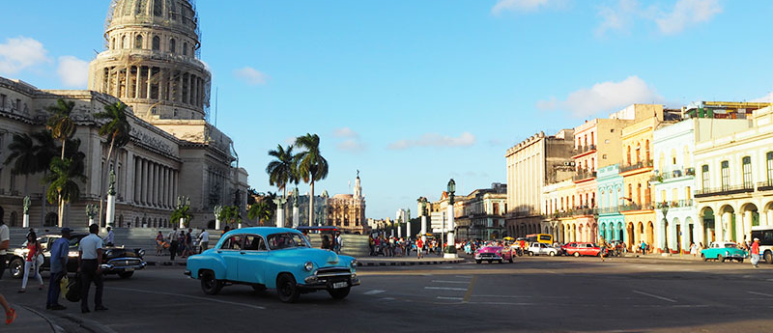
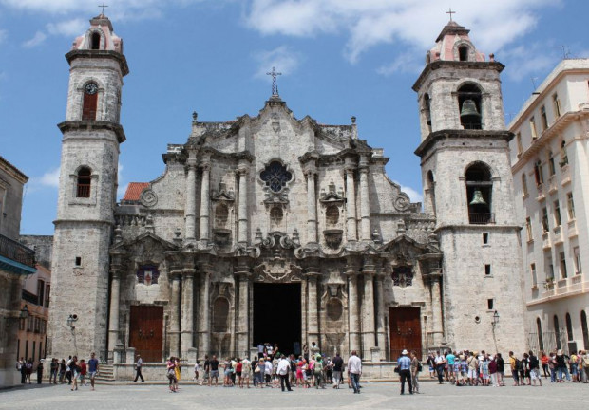
Havana, Cuba
Havana is a place full of wonder and one of the best things to do in Cuba. Things ranging from crumbling buildings to narrow streets full with life and ingenuity, Havana is Cuba’s capital for a reason.
Things you can see in Havana, Cuba:
El Capitolio – National Capitol Building
Rooftop bar of Hotel Ambos Mundos
The Malecon – esplanade and see wall
Almacenes San Jose market
The Catherdral Havana ----------------------→
Castillo el Morro

Slide 15
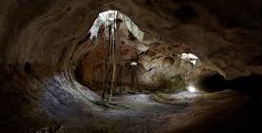
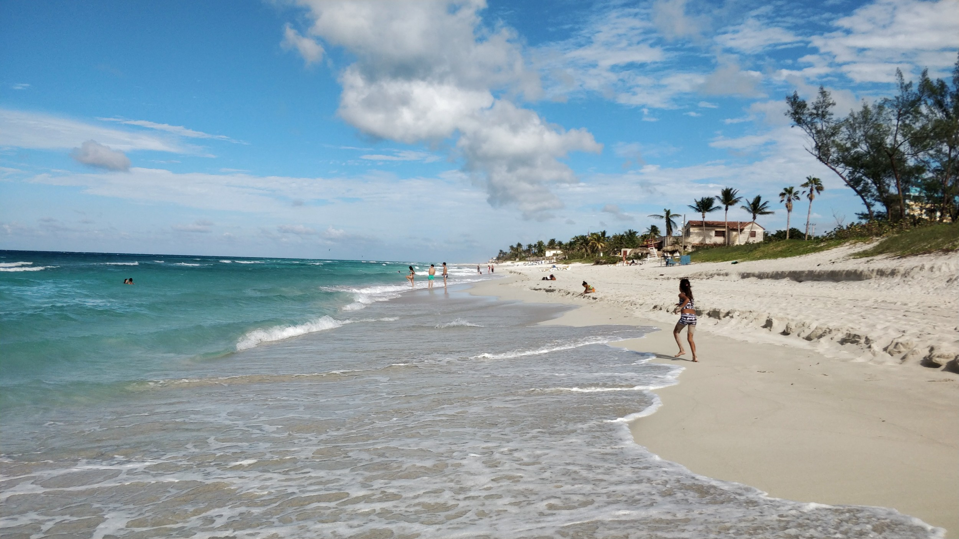
Varadero
Varadero is one of Cuba’s most famous beach destinations, and home to one of the best beaches in the Ccaribbean. It is along the Peninsula de hicacos, which goes into the sea off the north coast where a drawbridge connects in to the mainland. This magnificent white sand beach's includes Parque Natural Punta Hicacos, a nature reserve with a pretty beach, and the two caves, Cueva de Ambrosio and Cueva de Musulmanes.

Slide 16
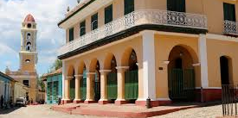
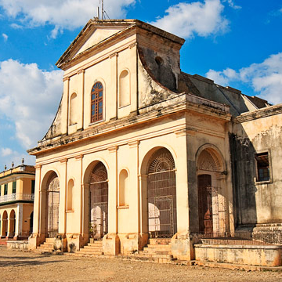
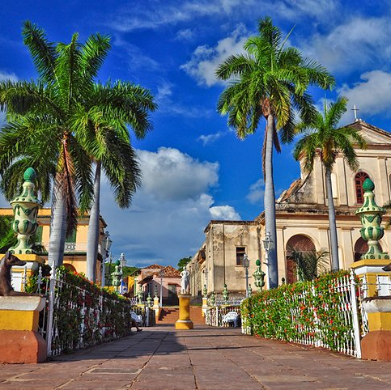
Trinidad
Trinidad is a UNESCO world Heritage site, and is like going back in time. The beautifully restored buildings and cobblestone streets in the city create a colonial feel. The architecture dates from the 17th to the 19th centuries. Some buildings you could visits are the cobble Plaza Mayor, Neoclassical Church of the Holy Trinity, Church and Monastery of Saint Francis, the Museum of Colonial Architecture, the art gallery at the Casa de Aldeman Ortiz, and the Palacio Brunet.

Slide 17
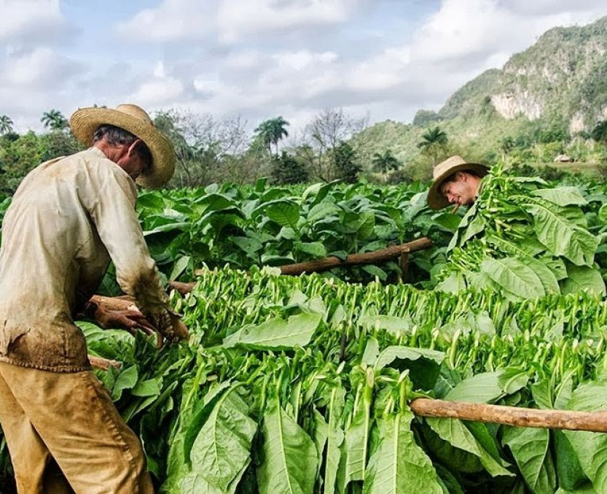
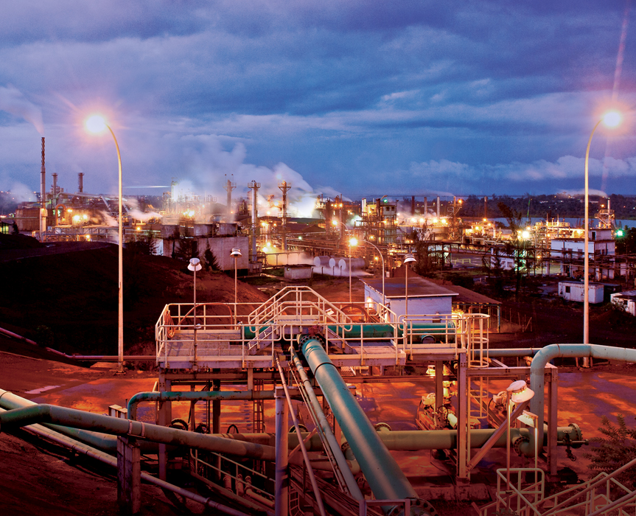
What are the important products of your country?
Sugar, sugar confectionery: US$556.4 million (29.7% of total exports)
Tobacco, manufactured substitutes: $24.3 million (13%)
Nickel: $140.8 million (7.5%)

