Slide 1
Fishie ville
By: Claire Bajaj

Slide 2
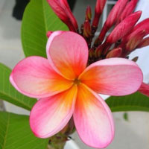
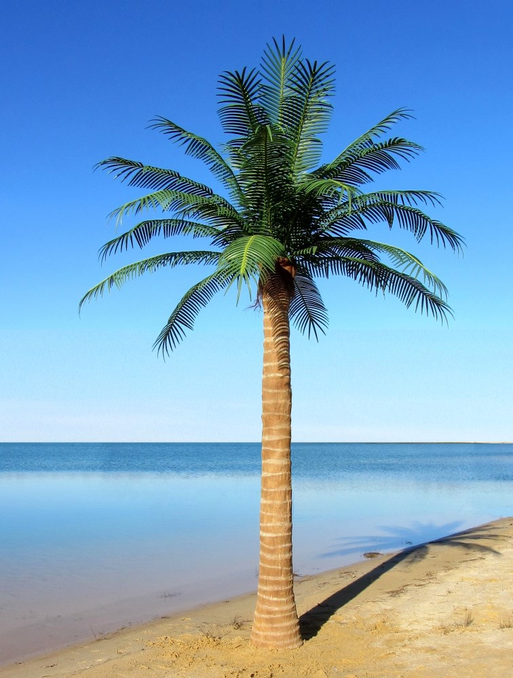
Iconography
National flag
National animal
National flower
National tree
Rainbow fish
Pink salmon flower
National fish tree

Slide 3
Fishie Villes flag
The blue circle represents the island and the white surrounding it represents the glass community. The fish around the archer inside the blue dot shows the community of fishie ville.

Slide 4
Charter bill of rights:
On behalf of Fishie Ville we declare our government philosophy to be an anarchy. Meaning there is no rules or laws. Those who choose to follow actions may do so without any limitation’s or restrictions. Regarding decisions within the country we will also include some influences of a technocracy.
Rights
- All those who are citizens in the country will have the right as much freedom as desired.
- Everyone is welcome to come and go from the country as they please.
- Everyone is entitled to their own race, sexuality, gender financial standpoint etc.
- Since there is no limitations everyone is entitled to follow any career path they choose.
- All visitors to the country are entitled to all rights and freedoms provided by the government
- Visitors may vote in the generators at the end of each month with the civilians but
Fundamental Freedoms
- Freedom of belief and religion
- Freedom of personal expression and creativity
- Freedom to entitlement of respect
Anarchy and Technocracy
In Fishie Ville we believe that everyone is entitled to following any desires they choose. Meaning we will allow anything and everything, To make political decisions regarding anything that involves the lifestyle or physical and social enviorment there will be a generator in each city that will be used to gather opinions form citizens. Each citizen will step into the generator at the end of each month to gather their general feeling of their life and how it can be improved. The generator will do so by collecting energy rays from the citizens brains. Reading their minds to get their unbiased opinion. Once the generator collects the information; it will be sent to the head of government office where they will be forced to meet with the citizens wants and needs with no questions asked. The generators are the leaders of the country, They gather and collect information to be condensed for their requests to be met. The head of the government office is a major server where all the information from the city generators are collected and actions are taken to meet the requests. There is no human species in charge it is just the generators leading the way to success.

Slide 5
Geography
Fishie ville is located where the islands of the Bahamas pre existed. Fishie ville has extended into the Caribbean waters to create a under water glass village where civilians can choose to either live above on the island or in the glass community. Fishie ville is located where it is because it has good access to natural marine resources.
Since Fishie ville has access to the marine resources we mainly base our trading systems through boat. Our main resource is fish hence our name.

Slide 6
Capital city
Our capital city, Salmonia is located partially on the south side of the island and the north side of the glass community. Salmonia is a busy metropolis city that has one of the largest populations in Fishie Ville. The city plan of Salmonia is an organic plan because Fishie ville is an island. Since there isn’t much room to spread the necessities of the country since it is mainly based on an island.
salmonia

Slide 7
Salmonia

Slide 8
Demography
Population pyramid
The population pyramid is an expanding pyramid. There is a high birth rate and death rate because people feel they can whatever they want whenever therefore causing many different events.

Slide 9
Population density
The population increases in the red area because there is a more city like section. Since the city areas are more populated there is more attractions and employment opportunities in that area

Slide 10
Industries and resources
Industries
resources
Primary industries- Fish and marine life- since Fishie Ville is surrounded by water it’s main resource is fish and marine life.
Secondary industry Another main industry is food and entertainment, many civilians of Fishie Ville enjoy the night life and attractions of the cities
Tertiary industry- a major industry in Fishie Ville is tourism. There is many places to go and visit while in town
A resource in Fishie Ville is trees and wood. Since there is great access to water.
Marine and sea life.

Slide 11
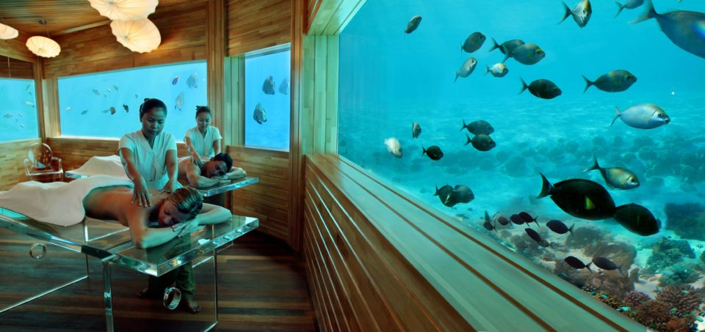
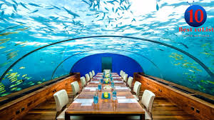
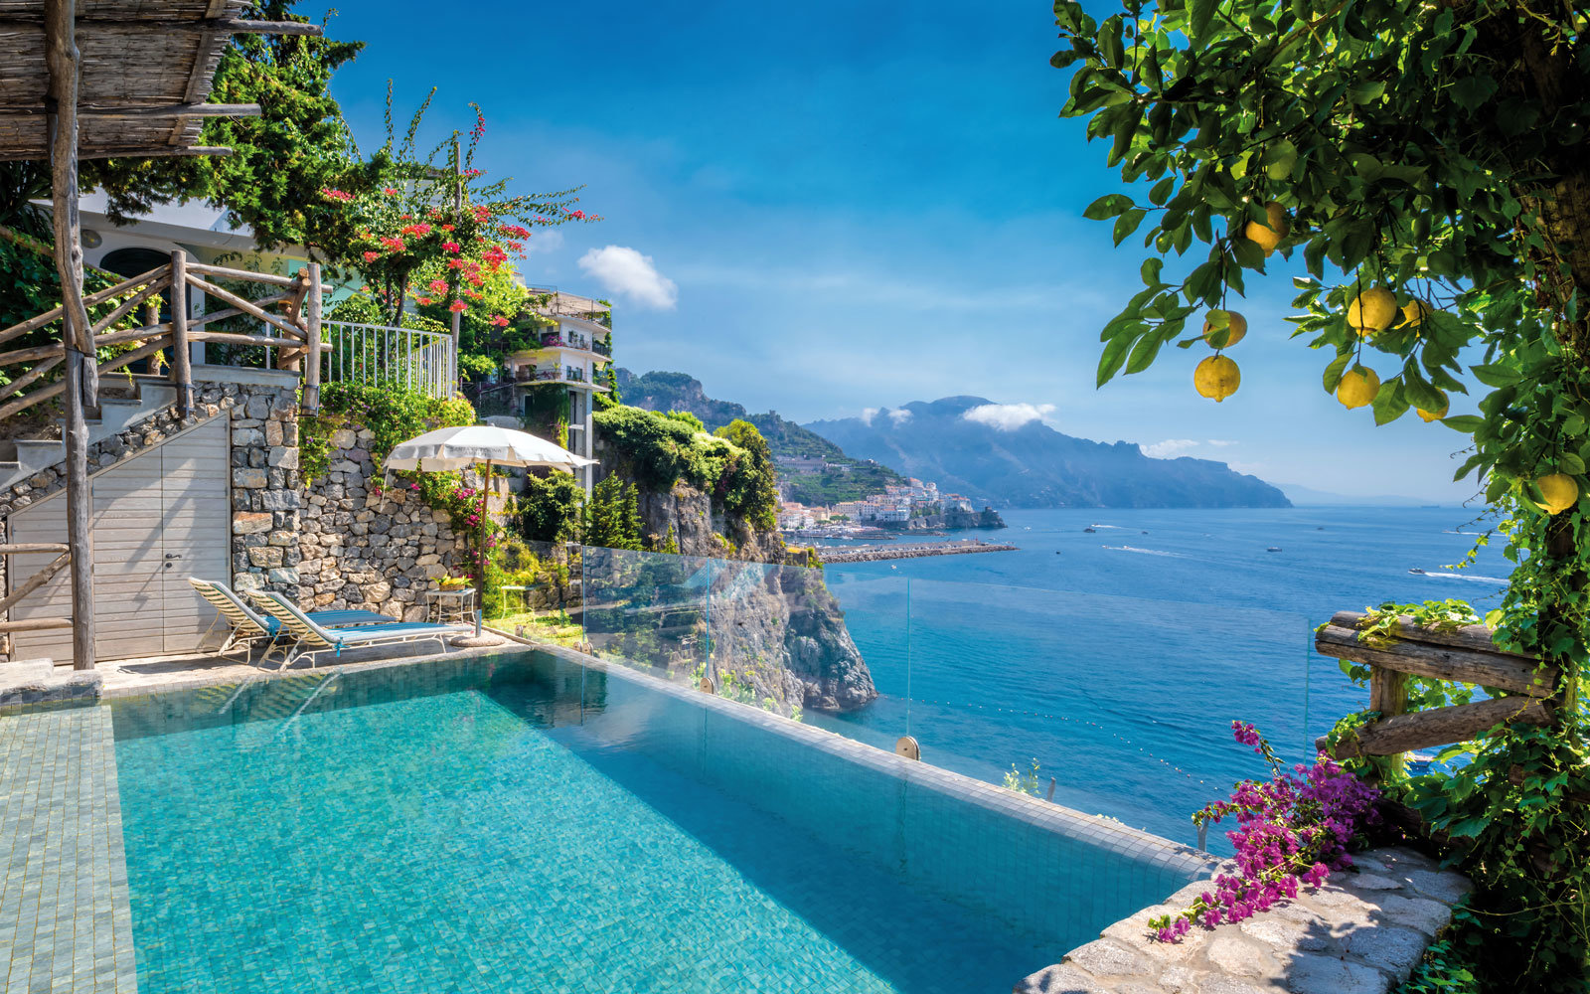
Tourism package
Hospitality/ hotel options

Slide 12
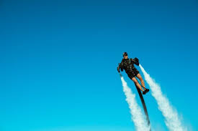
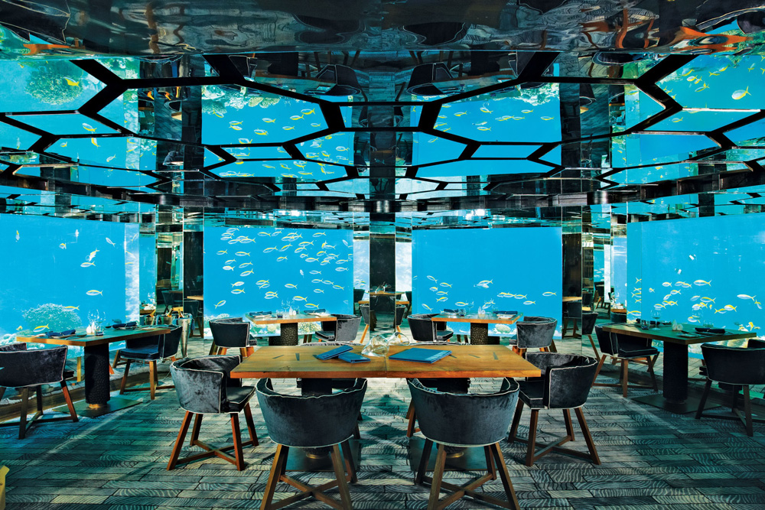
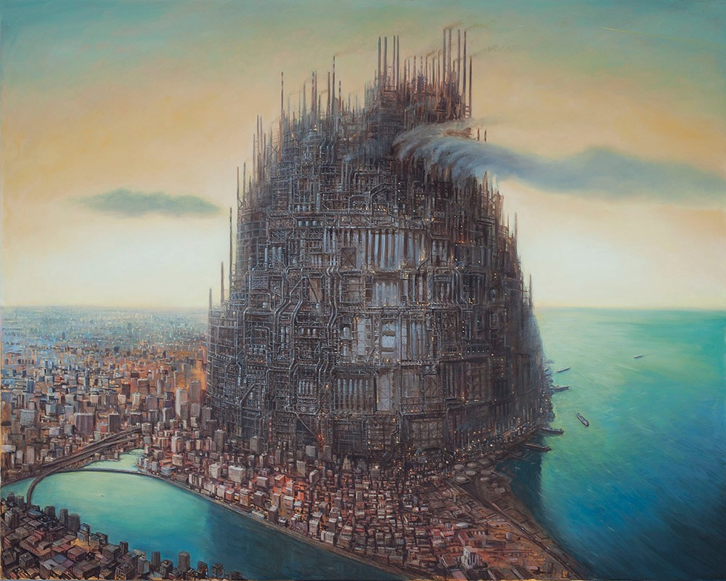
Entertainment
Underwater restaurants
Underwater showings and premiers
Anything you can dream of is possible
Dreams will always come true

Slide 13
Why should you go to Fishie ville
Fishie ville offers a variety of entertainment below and above the beautiful fish filled sea
Fishie ville provides the opportunity of an anarchy enviorment where those who choose to do anything are eligible to do so. The sea is the limit! Your fish is our command!!

Slide 14
Transportation in Fishie ville
There are many transportation options in Fishie ville. In Fishie ville public transportation is absolutely everywhere. To get to the glass underwater community there is a simple submarine transport which arrives every 5 minutes,. The public transportations within fishie ville is frequent and is commonly see looking like a bullet.
How can you get to Fishie ville? To get to Fishie ville you can easily transport by boat or plane.

Slide 15
Currency?
In Fishie Ville the currency is an original fish dollar called Goldie’s.

Slide 16
What makes Fishie ville different from the rest
Fishie ville provides people with the opportunities to do as they please and whatever they wish for will come true from the city generators.
The iconography of Fishie ville is different from the rest because it demonstrates qualities that can be changed regularly due to ones command.

Slide 17
Slogan
The slogan of Fishie Ville is “there’s bigger fish in the sea” we choose this slogan because it inspires citizens to dream big.

Slide 18
What you will need:
The weather in Fishie ville is rather warm although you will never need to bring anything because your wish is our command
There are no government entry requirements because we are an anarchy.

