Slide 1
Canada throughout the 20th Century
By Chakayla Graff

Slide 2
1900-1909
At the beginning of the century, Canada’s business expansion meant the wealth of Canadians increased. Raw materials became cheaper; this resulted in the most flourishing businesses of the time, the oil, steel, and railroad. In 1905 Alberta and Saskatchewan just newly became provinces on July 20. Furthermore The most iconic piece of literature was published in 1908, Anne of Green Gables.

Slide 3
Anne of Green Gables

Slide 4
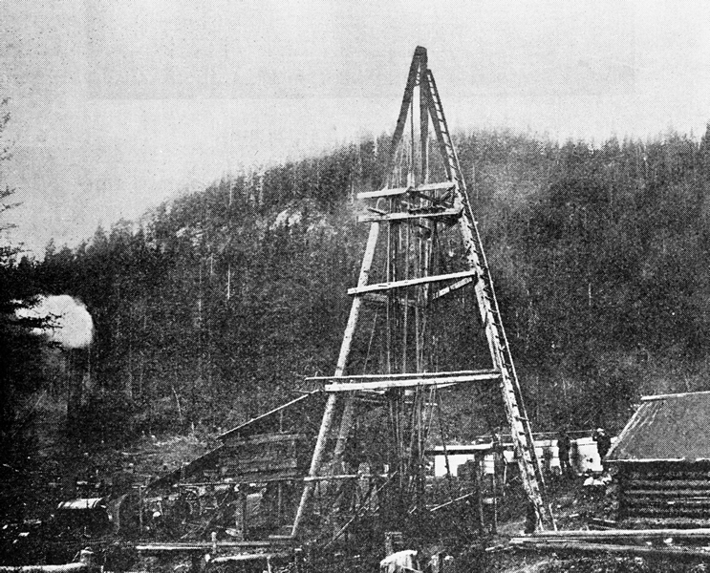
Oil tower

Slide 5
1910-1919
During the course of the 1910s Canada was wrapped up the First World War. The war began in 1914 and effected the lives of Canadians by taking over 60, 000 lives; essentially the war impacted every Canadian in some way. Seeing that woman could be of use in the war, led to woman being allowed the right to vote in federal elections under the Wartime Elections Act. In 1919 the Winnipeg general strike resulted from workers being unsatisfied with wages, working conditions, and hours, this united Canada’s working class.

Slide 7
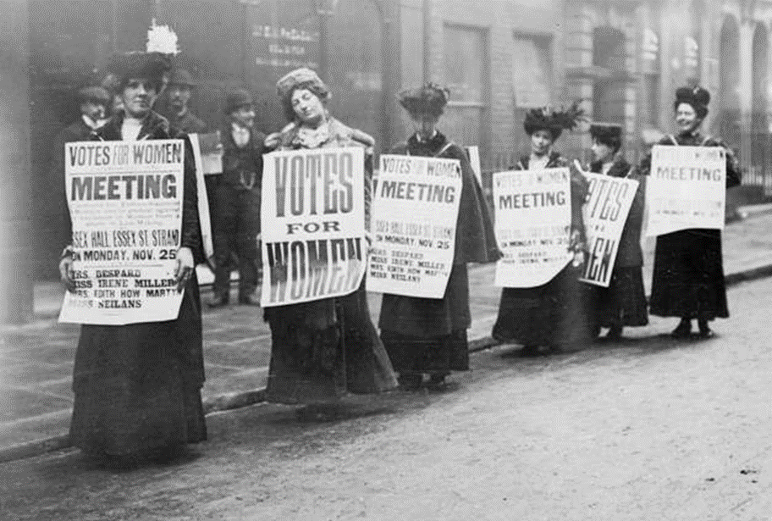

Slide 8
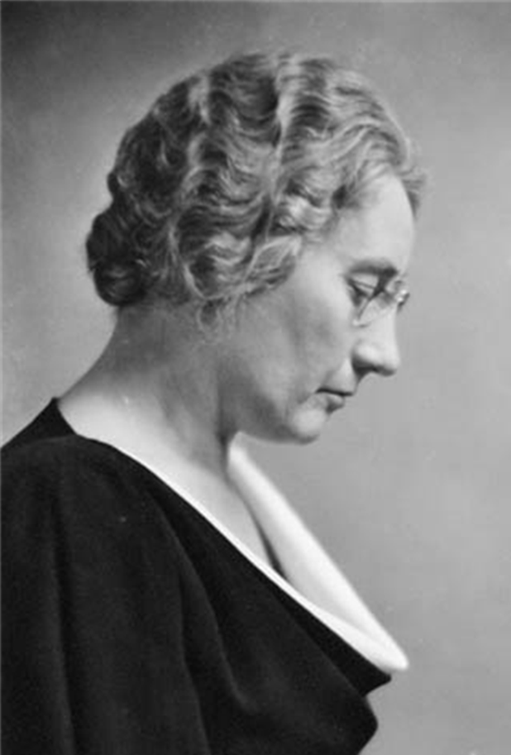
1920-1929
This age of the 1920s was filled with many prosperities, it was also known as the jazz age, which was filled with economic prosperity and carefree living for many. In 1921, Agnes Macphail became the first woman to be elected into the House of Commons; which later resulted in bill 1951. In the Roaring Twenties, a roaring economy created a period of mass consumerism, this meant people were partying and splurging. There came a crash to the prosperity this became known as the stock market crash of 1929. Leading to the “dirty thirties”.

Slide 11
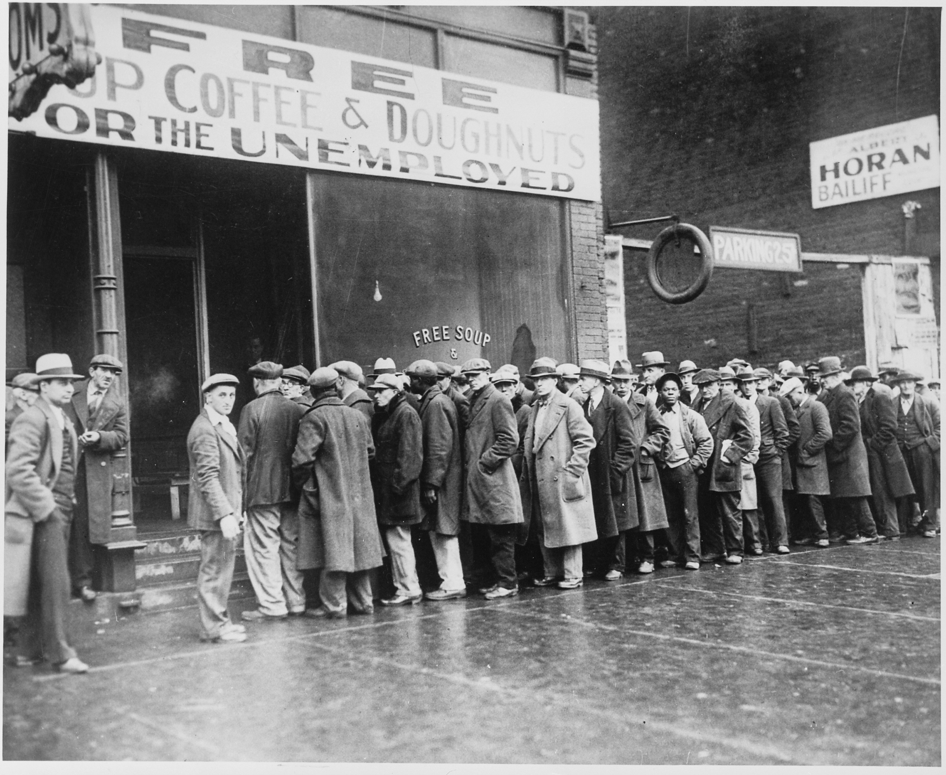
1930-1939
The 1930s began with the stock market crash in 1929, this led a decade of despair. The Great Depression had a tremendous negative effect on the economy and the income of many Canadians; men were seen lining up assistance. On September 10 Canada declared war on Germany, sending many young soldiers to fight. 900 Jew’s abord the St. Louis were fleeing, in fear Nazis were denied entry into Canada; this created a large social impact among the public.

Slide 12
St. Louis Refugee Ship

Slide 13
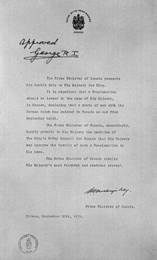
Canada declares war on Germany

Slide 14
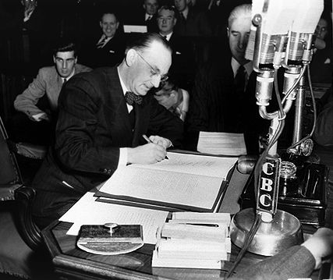
1940-1949
The 1940s in Canada were largely influenced by the second World War, Canada also gained a new Province. Newfoundland Became the 10th Province through the Act of Westminster. The economy in this time was good since soldiers and women returned to serving in the military or working in factories. the second World War ended in the 1940s, because Hitler killed himself and Germany surrendered. The Allied forces, Canada among them made their way headed for Germany, along the way liberating concentration camps. The Dutch are enterally grateful towards Canadians for helping liberate the Netherlands after the war.

Slide 15
Celebration of the ending of WWII
Canadians celebrating the ending of WWII

Slide 17
1950-1959
Following World War II the 1950s grew a strong post-war Economy for Canada. There was a major baby boom after the War felt mostly during the 1950s; Couples had held off having children due to the war. Now there were many immigrants and newborns increasing the population tremendously. In 1950, the pipeline was just completed, this linked Alberta's gas fields with the markets of central Canada which benefitted the economy of Canada greatly. Pearson's Peace Plan was established, which gave Canada the title of a peacekeeping nation reputation and Pearson received a Nobel Peace Prize.

Slide 18
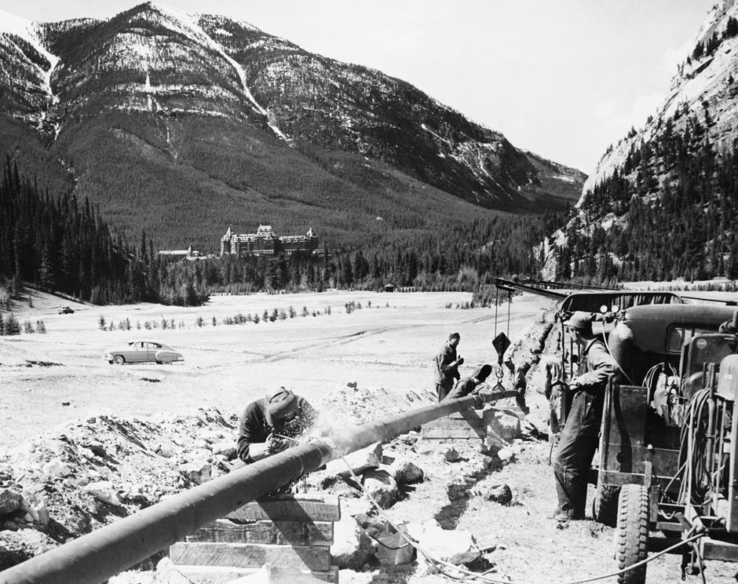
Pipeline across Canada was completed

Slide 19
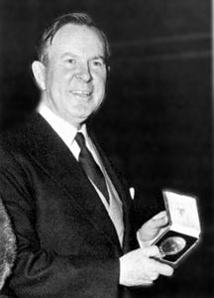
Lester Pearson

Slide 20
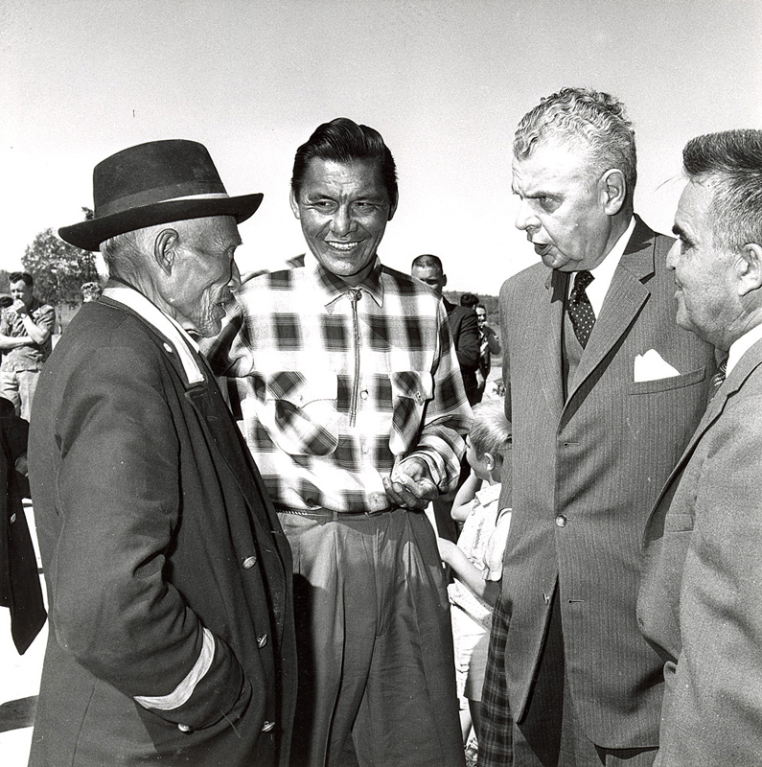
1960-1969
The 60s was a decade that concentrated mainly on social change, such as women's liberation, civil rights, and the work force was in the process of changing. In 1960 Diefenbaker's Bill of Rights was approved by the House of Commons; this pledged civil rights and freedoms to all Canadians guaranteed by the Canadian federal government . Indigenous peoples received the right to vote, previously never having the right; many people were pleased with the government doing such. By the 1960s, several workers had more well-paying jobs, but wages had not yet risen equally to both genders.

Slide 21
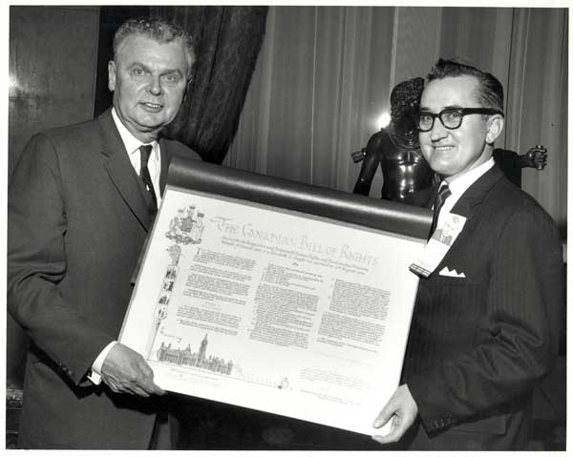
Bill of Rights

Slide 22
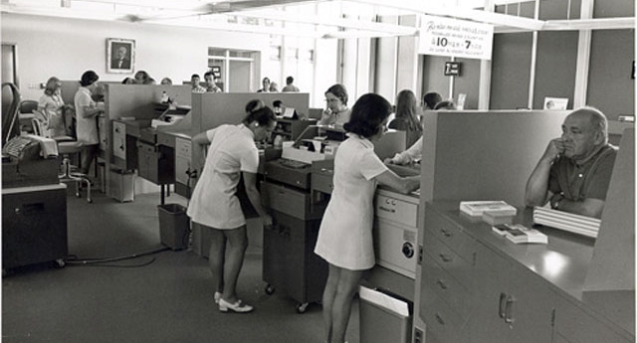

Slide 23
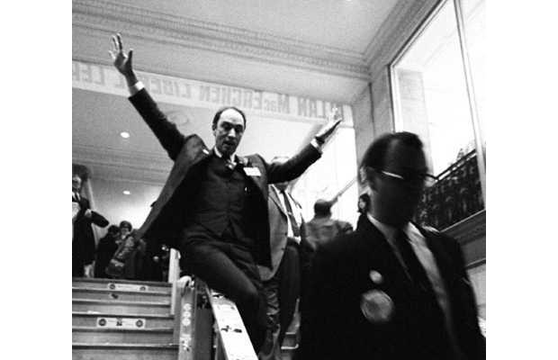
1970-1979
The 70s where a time for experimenting, although a little economic bump may have been created. Through the 60s and into the 70s the hippie movement was popular among youth; the new social norm became experimentation and new social values. A new leader Pierre Elliot Trudeau became the Prime Minister everyone could relate to became Canadas most beloved politician. He managed to deeply connect with younger generation's and touch their conscious. Price inflation during the 70s was becoming a real challenge , oil prices, unemployment, and the Canadian dollar became less valuable to the us during this time; all contributing to high inflation.

Slide 26
1980-1989
During the 80s the Free Trade agreement was established with the US and Mexico this benefitted the economy greatly by eliminating trade taxes. The Quebec referendum was held. Quebec wanted sovereignty association, the “No” side won by 60 percent support. Terry Fox started the marathon of hope, which brought together Canadians.

Slide 29
1990-1999
In 1996 the Canadian Government closed the last residential school. The demands for compensation and recognition for the treatment of indigenous children were long overdue. The government finally formally apologizes for the former maltreatment of indigenous peoples. The economy had taken damage, by 1990 inflation was 4 times as high as 1970. The last decade of the century was capped off with a fence-mending attitude.

Slide 31
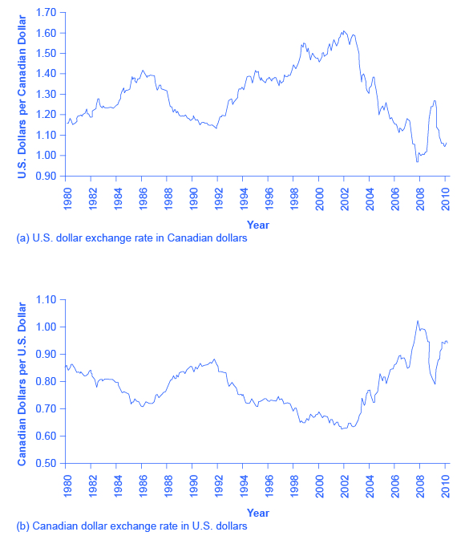

Slide 32
Citations:
Dickieson , Brenton. “Lm Montgomery Anne of Green Gables First Edition.” A Pilgrim in Narnia, 26 July 2017, https://apilgriminnarnia.com/2017/07/26/montgomery/lm-montgomery-anne-of-green-gables-first-edition/.
Valdez, David. “Canada and NAFTA.” The Canadian Encyclopedia, https://www.thecanadianencyclopedia.ca/en/article/north-american-free-trade-agreement-nafta.
“Farewell Blues.” YouTube, YouTube, 20 Apr. 2006, https://www.youtube.com/watch?v=eXMX7_hnt-A.
Karsh, Yousuf. “Agnes Macphail.” Wikipedia, Wikimedia Foundation, 1934, https://en.wikipedia.org/wiki/Agnes_Macphail.
Kelly, Tim. “A Canadian Crisis: Conscription Crisis of 1917 Divides English and French Canada.” YorkRegion.com, 23 Mar. 2017, https://www.yorkregion.com/community-story/7035697-a-canadian-crisis-conscription-crisis-of-1917-divides-english-and-french-canada/.
Kelly, Tim. “Canada 150: Great Crash of October 1929 Led to Great Depression of 1930-39.” Toronto.com, 17 Apr. 2017, https://www.toronto.com/community-story/7039843-canada-150-great-crash-of-october-1929-led-to-great-depression-of-1930-39/.
National Archives “The Roaring 20s.” PBS, Public Broadcasting Service, 1926, https://www.pbs.org/wgbh/americanexperience/features/crash-roaring-20s/.
King, Mackenzie. “Declaration of War by Canada.” Wikipedia , Http://Www.collectionscanada.gc.ca/Primeministers/h4-2013-E.html National Archives of Canada, C-140955, 10 Sept. 1939, https://commons.wikimedia.org/wiki/File:GeoVICan.jpg.
Learning, Lumen. “Macroeconomics [Deprecated].” Lumen, https://courses.lumenlearning.com/macroeconomics/chapter/reading-strengthening-and-weakening-currency-2/.
“Mission Statement and History.” The Terry Fox Foundation, 28 Jan. 2017, https://terryfox.org/our-role-and-research/mission-statement-and-history/.
“Moment in Time: Canada Declared War on This Day in 1939.” Moment in Time: Canada Declared War on This Day in 1939, RENATA D'ALIESIO, 10 Sept. 2013, https://www.theglobeandmail.com/community/sept-10-1939-canada-declares-war/article14213144/
Motkaluk, Jenny, and National Post. “Let's Not Romanticize the 1919 Winnipeg General Strike.” National Post, 26 June 2019, https://nationalpost.com/opinion/lets-not-romanticize-the-1919-winnipeg-general-strike.
Musée québécois de culture populaire. “Women Storm the Labour Market - The Beginning of a New Era.” Women Storm the Labour Market - The Beginning of a New Era, Musée Québécois De Culture Populaire, http://larevolutiontranquille.ca/en/women-to-conquer-the-world-of-work.php
Parren, Bonnie, et al. “13 Iconic Dutch Liberation Day Photos.” Stuff Dutch People Like, 5 May 2019, https://stuffdutchpeoplelike.com/2015/05/04/13-iconic-dutch-liberation-photos/.
“Quebec Referendum.” CBCnews, CBC/Radio Canada, https://www.cbc.ca/player/play/2157759965.

Slide 33
Citations:
Shelley, Service national du Récit de l’univers social. “The Prairies in 1905, a Plain to Settle on!” Societies and Territories, 12 Sept. 2014, https://hosted.learnquebec.ca/societies/societies/the-prairies-around-1905/the-prairies-in-1905-a-plain-to-settle-on/.
The Editors of Encyclopaedia Britannica. “Hippie.” Encyclopædia Britannica, Encyclopædia Britannica, Inc., 26 Dec. 2019, https://www.britannica.com/topic/hippie.
Unknown, Unknown “1950s Baby Boom The Baby Boom Was a Time between 1964 and 1964 Where There Were the Population Was Expanded. During Th...: Baby Boom, American Baby, Birth Rate.” Pinterest, https://www.pinterest.ca/pin/752382681472129682/.
Unknown, Unknown “The Canadian Bill of Rights.” The Canadian Bill of Rights - Diefenbaker Canada Centre - University of Saskatchewan, https://diefenbaker.usask.ca/virtual-exhibits/bill-rights.php.
Unknown, Unknown “Why Was Pierre Trudeau Considered Such a Good Prime Minister?” History Blogs, 10 June 2014, https://mohammad1011blogs.wordpress.com/unit-4/why-was-pierre-trudeau-considered-such-a-good-prime-ministerse/.
Unknown , Unknown. “Topic 7.” Inflation, https://www.economics.utoronto.ca/jfloyd/modules/infl.html.
Unknown, Unknown “Gordon's Residential School.” The Eugenics Archives, http://eugenicsarchive.ca/discover/institutions/residential/540f176905f79bb354000005.
Unknown, Unknown “Great Depression.” Inside The Mind Of Gabi, http://www.blog44.ca/gabrieller/category/great-depression/.
Unknown, Unknown “Newfoundland and Labrador and Confederation.” The Canadian Encyclopedia, https://www.thecanadianencyclopedia.ca/en/article/newfoundland-and-labrador-and-confederation.
Unknown, Unknown “TransCanada Pipeline.” TransCanada Pipeline - Natural Gas - Alberta's Energy Heritage, http://history.alberta.ca/energyheritage/gas/transformation/pipelines/transcanada-pipeline.aspx.
Unknown, Unknown “The Enfranchisement of the Aboriginal Peoples of Canada.” The Enfranchisement of the Aboriginal Peoples of Canada - Diefenbaker Canada Centre - University of Saskatchewan, https://diefenbaker.usask.ca/virtual-exhibits/aboriginal-enfranchisement.php.
Unknown, Unknown “Toronto, Ontario, Canada. VE Day Aug. 1945 Celebration. WWII Ends. Allies. The Greatest Generation.: Toronto, Canada Images, Vintage Photos.” Pinterest, https://www.pinterest.ca/pin/165366617545768771/
Unknown, Unknown “A Long-Awaited Apology for Residential Schools - CBC Archives.” CBCnews, CBC/Radio Canada, https://www.cbc.ca/archives/entry/a-long-awaited-apology-for-residential-schools.
Valdez, David. “Canada and NAFTA.” The Canadian Encyclopedia, https://www.thecanadianencyclopedia.ca/en/article/north-american-free-trade-agreement-nafta.
Wbur. “Remembering Refugees Turned Away From The U.S. In 1939.” Remembering Refugees Turned Away From The U.S. In 1939 | Here & Now, WBUR, 30 Jan. 2017, https://www.wbur.org/hereandnow/2017/01/30/1939-refugees-st-louis-manifest.
“Waterton: 1900-1910s.” Waterton: 1900-1910s - Conventional Oil - Alberta's Energy Heritage, http://history.alberta.ca/energyheritage/oil/the-waterton-and-the-turner-valley-eras-1890s-1946/waterton-1900-1910s/default.aspx.

