Slide 1
Catriona’s Career Path
How to become a Mechanical Engineer

Slide 2
My Career Goal
I want to become a Mechanical Engineer by 2034.
To get there, I will need to:
Graduate high school by June 2023
Get accepted into a University
Succeed in getting my Bachelors Degree
Succeed by also getting my Masters
3-4 years of supervised work experience
Work full time as a Mechanical Engineer

Slide 3
My Career Goal Statement
By 2030, I want to become a Mechanical Engineer by getting accepted into a University, succeed in getting my Bachelors degree, also succeeding by getting my Masters, doing 3 to 4 years of supervised work experience and then working as a Mechanical Engineer full time as my career.

Slide 4
What is a Mechanical Engineer?
Mechanical Engineers design, build, develop and test many products which can be as different as new batteries to medical devices. They design power-producing machines like internal combustion engines while also designing other machines that could be in buildings like elevator and much more.
Mechanical Engineers will regularly design engines, turbines, power producing products and power using products like air conditioners

Slide 5
About my future career
Mechanical Engineers usually work in offices and visit job sites.
The salary range in BC is $42, 661 – $119,995
The job will be about 8-9 hours a day or 45-50 per week but, that will change on how long you have been working their, and what you are working on which will usually result in working more in certain weeks and times.

Slide 6
My job has a 1.1% chance of becoming automated
I don’t think my job will become automated because:
Computers lack the creativity to be a mechanical engineer
Mechanical engineers are the one who fix and build the machines not the other way around

Slide 7
My compatibility
Based on the myBlueprint quiz, I am 79% compatible with this job.
The skills this job requires are:
Creativity
Listening skills
Math skills
Mechanical skills
Problem-solving skills

Slide 8
Mechanical Engineering would be great for me because…
I already have:
Problem-solving skills
Creativity

Slide 9
I am not quite ready for this career, but I will get there!
Skills that I still need to develop:
Math Skills
Listening skills
Mechanical skills
How I will get these necessary skills:
By taking the appropriate classes to learn them
To work on communicating more with others and working in groups
By taking the appropriate classes to learn them

Slide 10
Job Outlook
In BC, the job outlook is 2 of 3 stars.
Here are 2 reasons why:
Employment growth is leading into moderate about of new positions
Not many new positions due to people not retiring

Slide 11
Safety in the Workplace
In this career, I need to:
Have personal protection equipment on when needed
Being aware of companies/ schools safety resources and where to find them
Ask for assistance when needed
Get the appropriate training to complete tasks or use machinery if not already known

Slide 12
This is what appeals to me with this career…
Constant learning because there are always more things being learned and won’t always be the same and consistent.
The ability to go to different areas in engineering because you can have a mechanical engineering degree but, you can work more like an aerospace engineer or a civil engineer with certain projects.

Slide 13
These are some things I find less appealing about this career…
How long I have to be in school because that is time away from opportunities but, with the extra schooling it will improve my future in this career.
The field is very male dominating still so I will need to cope with that part of it and find a good network of support.

Slide 14
Potential obstacles to getting this career
The possible obstacles:
Getting into university to get my degrees
Not having the right network to find potential jobs
Not being able to get a job when I am in school even after getting my bachelor’s
My plan to overcome them:
Working hard in school for my grades to meet qualifications
Work to expand my network to get those opportunities
Continue to expand my resume and target jobs that interest me and that I am fully qualified for

Slide 15
Potential obstacles to being successful within this career
The possible obstacles:
Being a female in a male dominated profession
Being overlooked and not taking chances
My plan to overcome them:
Work hard on what I am doing and let my work show for myself
Make myself known for the right reasons and not being afraid to take some risks

Slide 16
The training/education required for my career is:
A Dogwood diploma
A Bachelor’s degree in Mechanical Engineering
An engineering licence by provincial or territorial associations to practise as a Professional Engineer (P.Eng)
Possible Masters and Doctorate
3 to 4 years of supervised work experience
Passing a professional practice exam

Slide 17
2 options for acquiring this training/education:
Option #1
Option #2
Mechanical Engineering, Bachelor’s of science degree
University of Calgary- main campus
English 12, Chemistry 12, Pre-calculus 12
4 year program length
Credential level of a degree
Campus in Calgary
Program starts in the fall the deadline in March
Mechanical Engineering, Bachelor’s of science degree
University of Alberta- Saint-Jean campus
English 12, Chemistry 12, Pre-calculus 12
5 year program length
Credential level of a degree
Campus in Edmonton
Program starts in the fall and the deadline is July

Slide 18
I intend to go to University of Calgary for that career
The University is in Calgary, Alberta, Canada
I would take a Bachelor’s and a Masters of Mechanical engineering
The Bachelor’s is 4 years and the Masters is 2 years
I would earn a Bachelor’s and Masters degree in Mechanical engineering

Slide 19
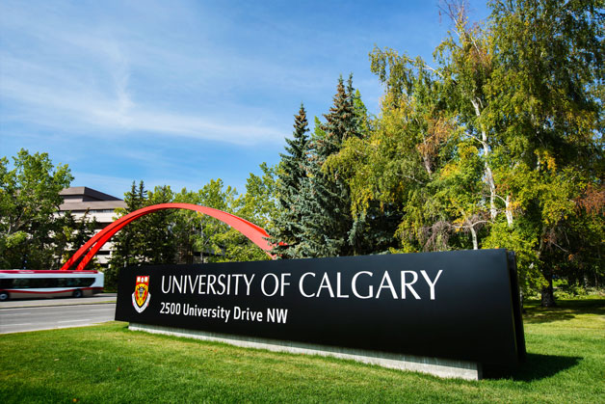

Slide 20
High school courses required
Grade 11 courses:
Pre-Calculus 11
English/English First Peoples 11
Chemistry 11
Physics 11
French 11
Grade 12 courses:
Pre-Calculus 12
Calculus 12
English/English First Peoples 12
Chemistry 12
Physics 12
Socials Studies 12

Slide 21
Scholarships/Bursaries/Grants
University of Calgary: Schulich School of Engineering Scholarship, $5,000. Undergraduate, citizenship, 1st year entry, Engineering Faculty
University of Calgary: Schulich School of Engineering Dean’s Entrance Scholarship, $7,150. Undergraduate, Citizenship, 1st year entry, Engineering Faculty, Indigenous student

Slide 22
University of Calgary is known for being one of the Canada’s top 10 research institutions and stands out for how much it actively engages students in leadership development in all areas
The main reason I chose this institution is the program that they offer Mechanical Engineering: Bachelor’s of Science degree

Slide 23
Financial Plan - Tuition
Bachelor’s degree total fees, tuition, meal plan, housing: total program costs $85,444.96
Master’s degree total fees, tuition: total program costs $21,806
I am going to pay for my program:
I can get some scholarship and or bursaries. Like if I get Schulich School of Engineering Scholarship and the Schulich School of Engineering Dean’s Entrance Scholarship then I would have paid for over half of my first year costs. Then in the following years get more scholarships and or bursaries.
I will also get assistance from my family to pay for my schooling
Then I will have savings from my part time job paying for it

Slide 24
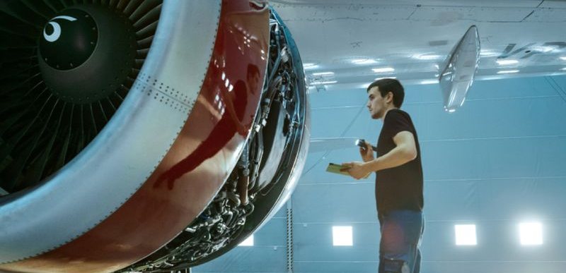
Some related occupations:
Aerospace engineering
Biomechanics

Slide 25
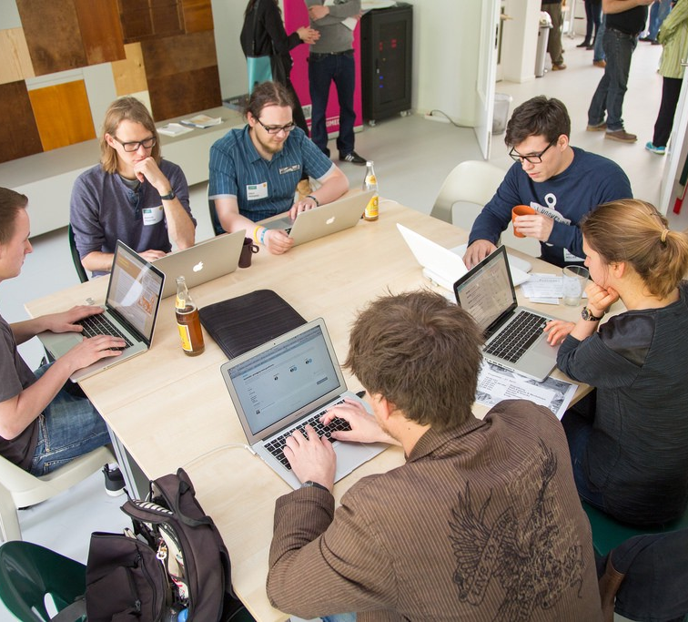
Mechanical Engineers are awesome!!!
Things I’m excited for in this career:
Being able to build and create new things
Constantly learning more because the knowledge is constantly growing
The ability to be involved in other branches of engineering and collaborate with others

